Slide 1
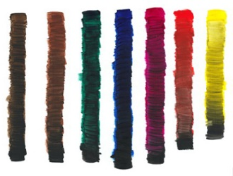
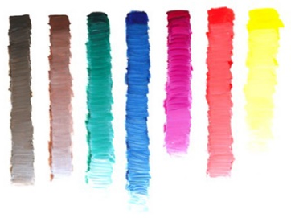
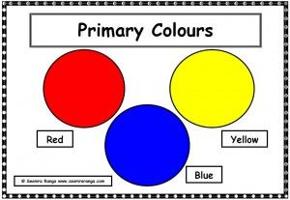
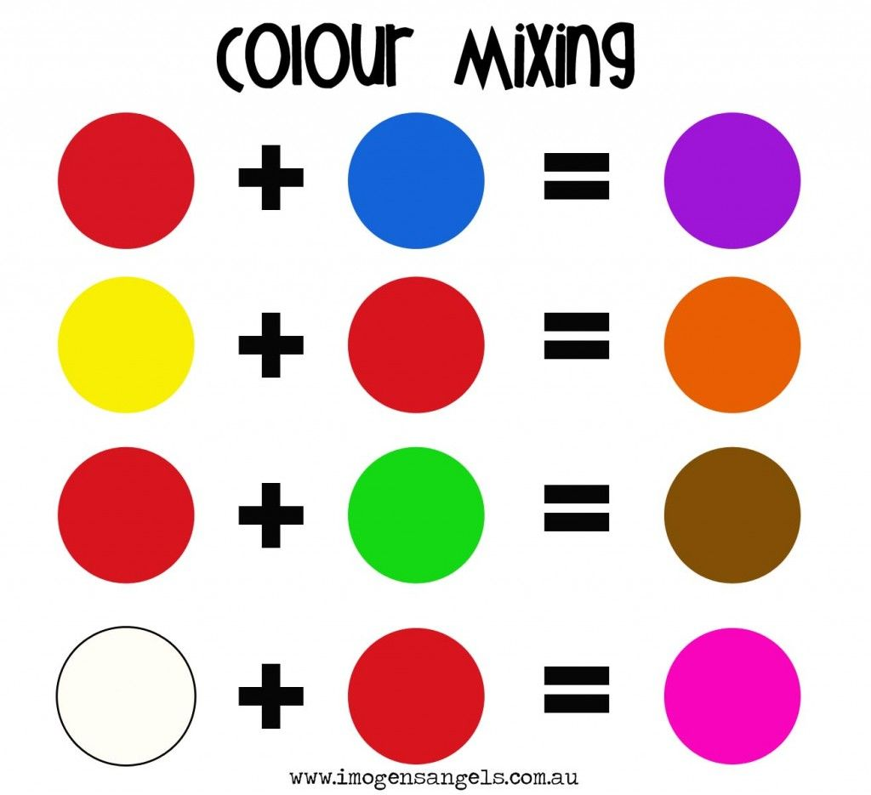
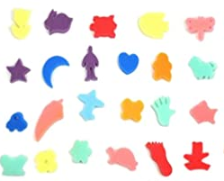
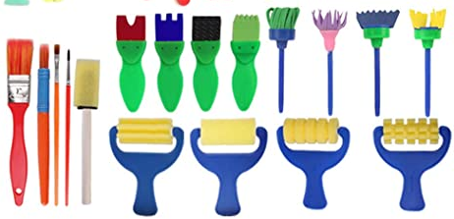
Sherdley Primary School: Art Knowledge Organiser.
Colour: KS1
Cool colour vocabulary!
tools | An object which helps us to complete a task.
mixing colours | Adding two or more colours to make a new one.
describe | Observing what something looks like and discussing this.
primary colour | Colours which cannot be produced by mixing other colours.
darken | Creating a new colour by adding a darker shade such as black.
lighten | Creating a new colour by adding a light shade such as white.
collections | A group of objects often with similar characteristics.
Year 1
Year 2
Name all of the colours used in their work.
Mix colours to create new ones.
Find collections of colours – colour wheel (DO not make, just discuss)
Apply colour using different tools.
Begin to describe colours in different objects.
Name all primary colours.
Darken colours with black.
Lighten colours with white.
Pretty primary colours!
Terrific tools!
Darkening with black
&
lightening with white!
Cool colour mixing!

Slide 2

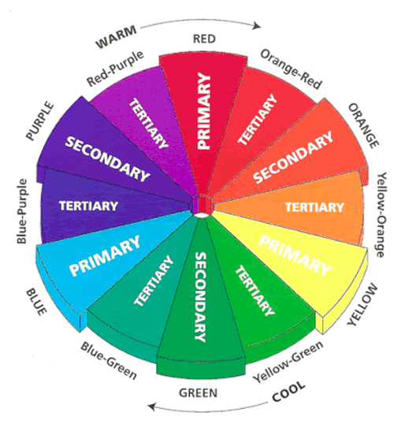
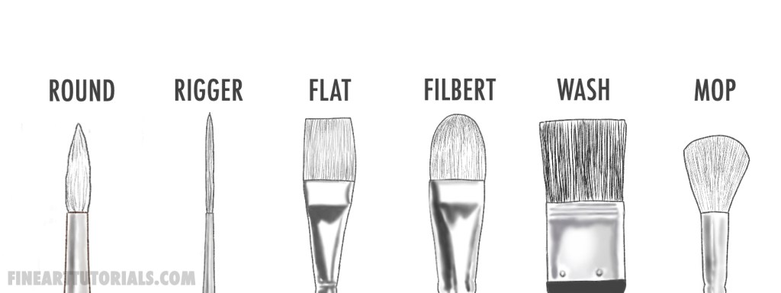
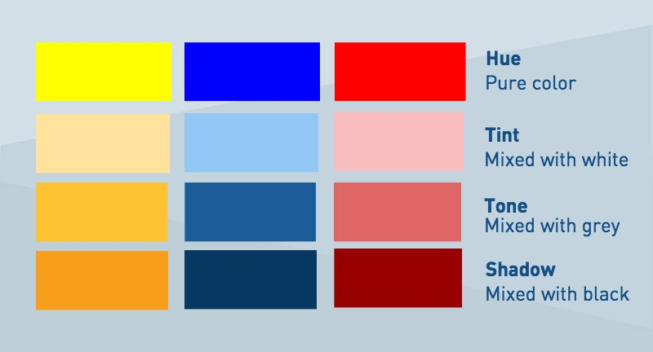
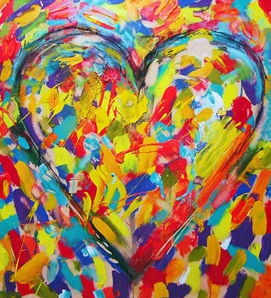
Cool colour vocabulary!
Sherdley Primary School: Art Knowledge Organiser.
Colour: LKS2
shade/shadow | A mixture of colour with black which increases darkness.
tint | A mixture of colour with white which reduces darkness
tone | The amount and effect of dark and light colours in a piece of artwork.
technique | The manner in which an artist employs his/her skills to complete a piece of artwork.
mood & emotion | The feeling or atmosphere that a work of art generates i.e. fear, tranquillity.
secondary colour | A colour produced by mixing 2 primary colours.
tertiary colour | A colour produced with mixing a primary and a secondary colour.
Year 3
Year 4
Mix various shades of colour to create effect.
Create an accurate colour wheel and name all primary/secondary/tertiary colours.
Introduce and use different types of paintbrushes.
Use a variety of techniques to develop the use of colour such as dotting, scratching and splashing.
Colour mix and match to develop the knowledge of tint, tone and shade.
Observe the use of colour in famous artists’ work.
Choose suitable materials for a range of colour mixing opportunities.
Observe the use of colour when signifying mood and emotion.
Colours to express emotion & mood!
Tint, tone & shade!
Paintbrush types!
Colour wheel!

Slide 3
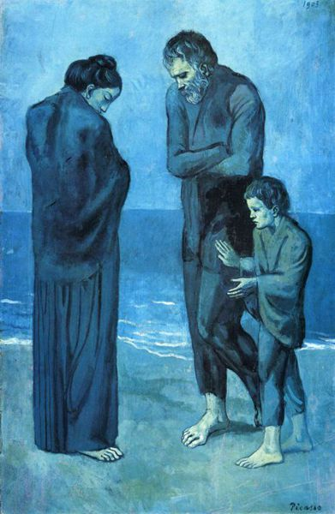
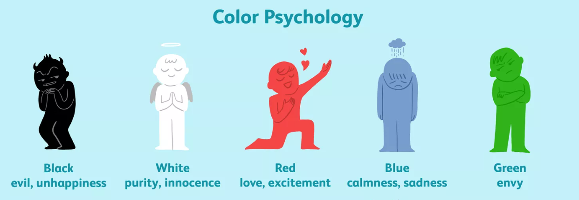

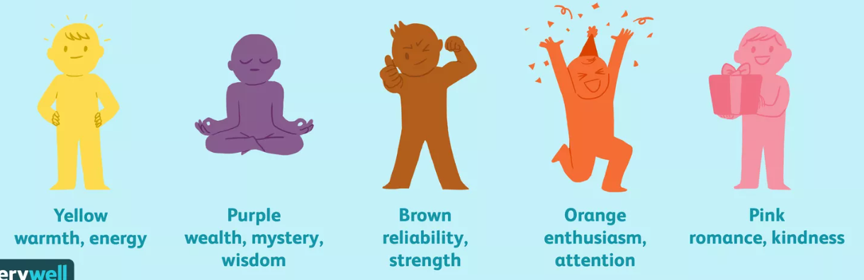
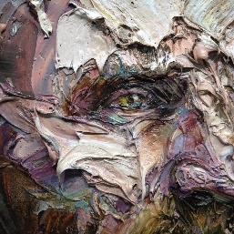
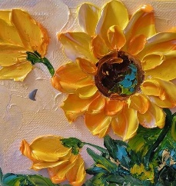
Sherdley Primary School: Art Knowledge Organiser.
Colour: UKS2
Cool colour vocabulary!
hue | A way of describing one solid colour. It can describe a colour and a shade of a colour such as red and pink – which is a tint of red.
tone | The amount and effect of dark and light colours in a piece of artwork.
tint | A mixture of colour with white which reduces darkness
shade/shadow | A mixture of colour with black which increases darkness.
mood & emotion | The feeling or atmosphere that a work of art generates i.e. fear, tranquillity.
texture | The feel and appearance of a surface.
inspiration | A feeling of enthusiasm on a subject/object/person/piece of music etc. This prompts a piece of artwork.
Year 5
Year 6
Experiment with hue, tone, tint shade and mood using a variety of colours.
Explore the use of texture in colour.
Explore the use of colour for different purposes.
Create work with different uses of hue, tint, tone, shades and mood. Using inspiration from other artists for their own work.
Explore the use of texture in colour and how they are used for different purposes.
Create pieces of artwork which express feeling and mood.
Hue, tint, tone & shade!
Pablo Picasso
– The Tragedy.
Colour to impact mood and feelings! Discussion topic!
Texture

