Slide 1

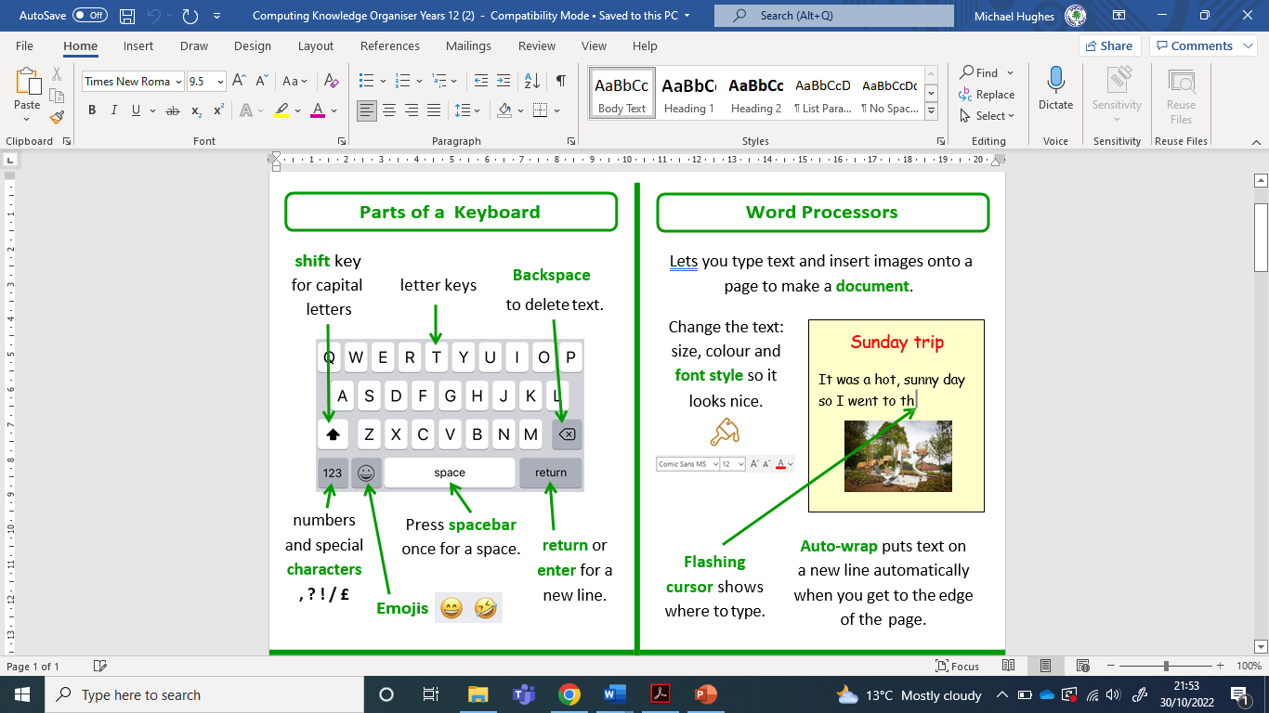
Sherdley Primary School Computing Knowledge Organiser
Year 1: Information Technology
Handy vocabulary
IT1.1 | Can produce text, adding and making basic edits to text in appropriate software or app.
IT1.2 | Be able to explore a range of simple tools within a digital art package, to create and alter the appearance of an image.
IT1.3 | Be able to use simple video or animation software.
IT1.4 | Can use a sound recorder to store information as sound, and create sounds or music by arranging sound markers.
IT1.5 | Be able to use suitable on-screen graphing software to represent information using pictographs.
Information Technology
Image - A digital picture that is viewed or stored on a digital device. Text - A collection of digital letters or words. Video - A moving image that can be viewed, created, stored and edited using a digital device. Space bar - A long key on a computer keyboard, used for making space between words. Pictogram - A chart that uses pictures to represent data. Record - To make a digital copy of sound or film.

Slide 2
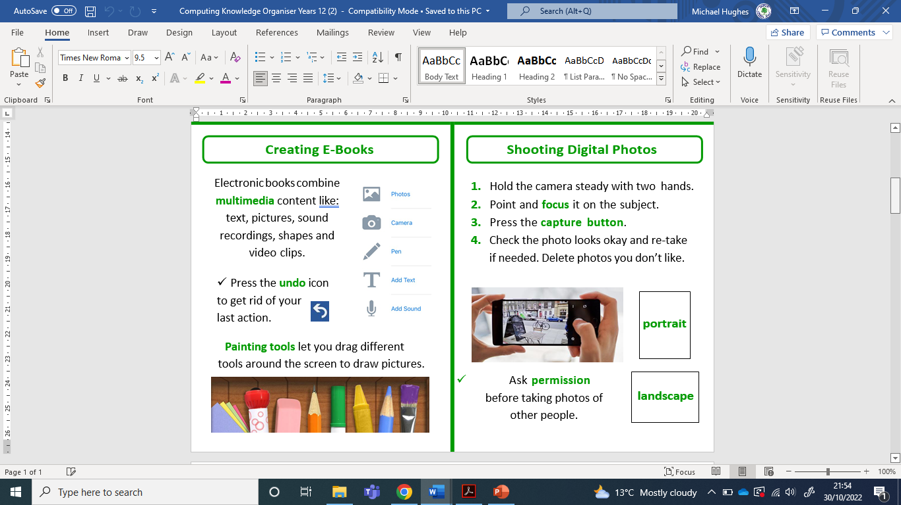
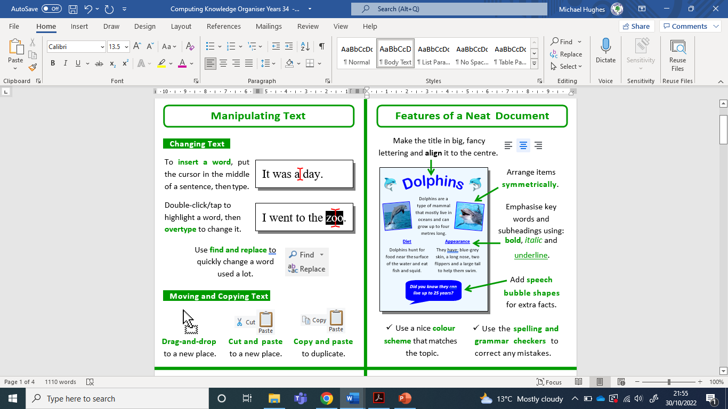
Sherdley Primary School Computing Knowledge Organiser
Year 2: Information Technology
Handy vocabulary
IT2.1 | When producing text, can add and edit text, considering style, colour, layout and font.
IT2.2 | Be able to use simple tools within age-appropriate software to create digital art or alter an image, using tools such as crop, resize, and flip, and exploring effects such as symmetry.
IT2.3 | Be able to sequence and arrange images and text for a purpose.
IT2.4 | Be able to select and record musical phrases, sound-effects or voice-overs to enhance multimedia work.
IT2.5 | Can make use of different types of graphs (pictographs and bar charts) to represent data collected.
Information Technology
File - An object on a computer that stores information, identified by a filename. Document - A file created by software on a digital device. Chart - Information that is displayed as a diagram or graph. eBook - A digital representation of a book which may contain text, images, sound and video. Font - The style of text as displayed on a digital device or print-out.

Slide 3
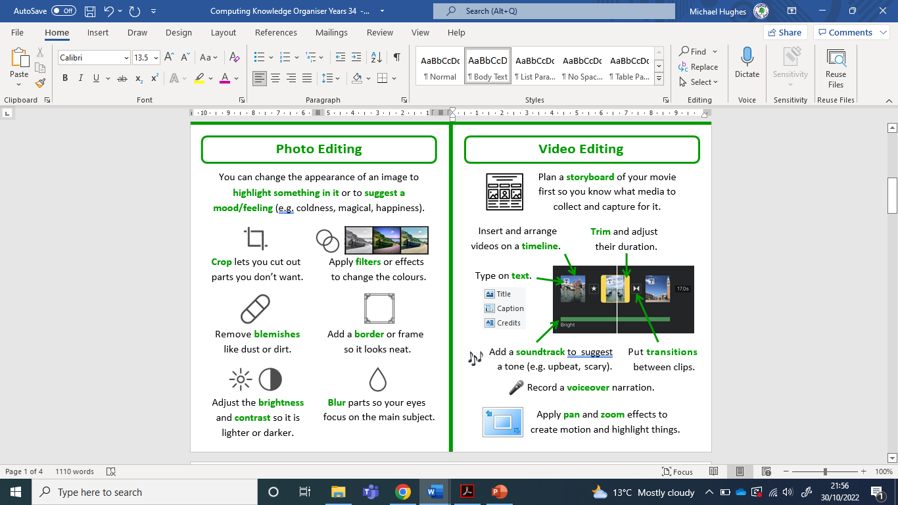
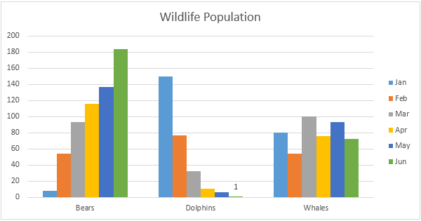
Sherdley Primary School Computing Knowledge Organiser
Year 3: Information Technology
Handy vocabulary
IT3.1 | Be able to format the text to indicate relative importance, including bold, italic, underline and strikethrough.
IT3.2 | Be able to select and use appropriate editing tools in an image-editing package for a specific purpose.
IT3.3 | Be able to sequence still images, video, audio clips and text to create a video presentation.
IT34 | Can locate, record, save and retrieve sounds in multimedia software.
IT3.5 | Be able to use data loggers to collect snapshot information and use information from a given source.
IT3.6 | Be able to enter data into a graphing package and use it to create a range of graphs.
Information Technology
Animation – Moving images on a digital device. Copy / Paste – A computer function that allows us to copy information from one location and paste it to another. Edit - Making changes or corrections. Import / Export – The process of moving data or information into or out of software, applications or devices. Multimedia - a mixed media presentation, combining text, images, audio etc.
An example of a bar chart in Microsoft Excel

Slide 4
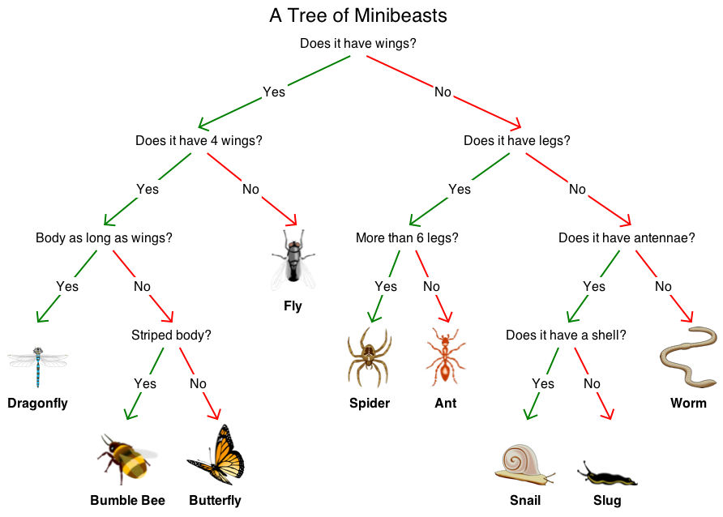
Sherdley Primary School Computing Knowledge Organiser
Year 4: Information Technology
Handy vocabulary
IT4.1 | Can use a range of features of layout and design such as text boxes, columns and borders, to control the layout and presentation of a document.
IT4.2 | Be able to make use of a range of visual effects such as filters, hues, saturation, contrast and combining images to give different effects.
IT4.3 | Be able to create and add text, video, sound and other graphic effects to a video presentation for an audience, using editing techniques such as crop and trim.
IT4.4 | Layer sounds using music composition software.
IT4.5 | Collect snapshot data from data loggers, selecting the appropriate tool to generate graphs or charts.
IT4.6 | Be able to create a branching database to sort and identify objects.
Information Technology
Data - Information that can be displayed in a spreadsheet, table, graph, diagram or chart. Spreadsheet – An electronic document that organises data into cells, rows and columns. It can be used to organise information. Filter - A software routine that applies a set of changes to an image that alters the pixels in a given manner. Branching database – A way of classifying a group of objects using yes or no questions (sometimes called a binary tree).
Branching database

Slide 5
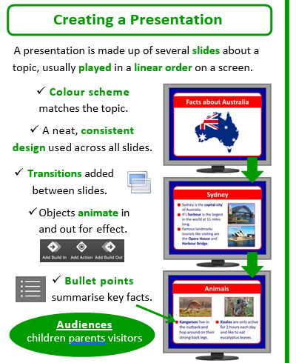
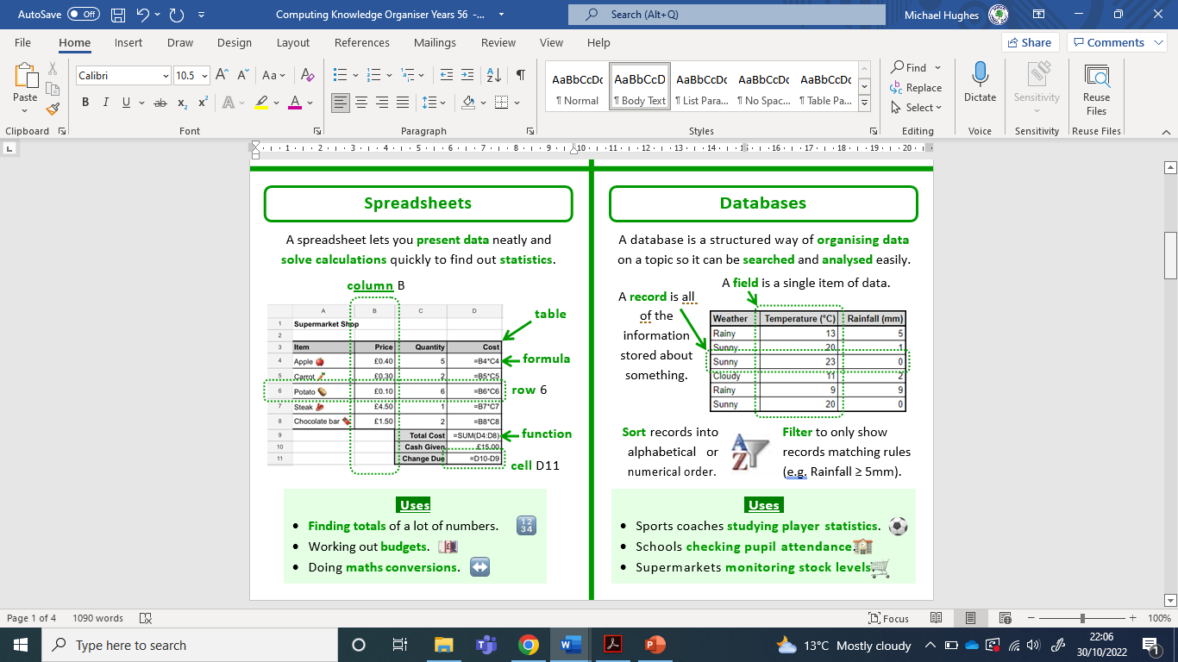
Sherdley Primary School Computing Knowledge Organiser
Year 5: Information Technology
Handy vocabulary
IT5.1 | Can independently plan and structure the layout of multimedia presentations, drawing on a range of different techniques and styles as appropriate for the task.
IT5.2 | When using digital art software, be able to select and change options within the creation tools to alter the effect or transform an image e.g. line width, opacity, blur, iterations, etc.
IT5.3 | Include a range of media in documents or presentations, including images, video and sound, embedded media and hyperlinks.
IT5.4 | To be able to layer and edit sounds in appropriate sound editing software.
IT5.5 | With support, be able to organise data by designing fields and entering records in a database, checking for accuracy.
IT5.6 | Query a database using keywords and filters to search a large database, for example using 'greater than', 'equal to' and 'contains'.
IT5.7 | Understand that spreadsheets perform calculations. Explore the effect of changing the cell values in a pre-prepared spreadsheet.
Information Technology
Database - A collection of data stored in a computer program, organised into tables, records and fields. Audience - The intended viewers of a presentation or other digital creation. Structure - The layout of a presentation. Format - The way text or a document is laid out on a page. This may include font, size, colour, alignment and indentation. Snapshot Data - Data that is collected at a given point in time.

Slide 6
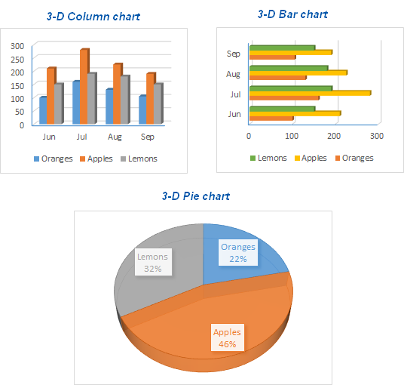
Sherdley Primary School Computing Knowledge Organiser
Year 6: Information Technology
Handy vocabulary
IT6.1 | Be able to make appropriate use of text and hyperlinks to produce a non-linear presentation or document.
IT6.2 | Be able to use layers within a digital art package to allow more detailed creation, refining the use of tools to create increasingly purposeful digital artworks.
IT6.3 | Be able to create videos that include greenscreen or animated footage. Edit footage with different effects such as slow-motion, cutaway, picture in picture.
IT6.4 | Be able to import sounds into audio editing software, layering and editing to refine their work.
IT6.5 | Can export and analyse continuous data from data logging and present in graph form.
IT6.6 | Can add simple formulae to their own spreadsheets, such as SUM, MAX, MIN and AVERAGE. Enter data and use filters to sort information.
IT6.7 | Can use a spreadsheet to produce bar and pie charts.
Information Technology
Hyperlink - An icon, graphic, or text that links to another file or object e.g. on the web or within a document. Formula - An equation that makes calculations based on data in a spreadsheet Data Validation - A feature in spreadsheet software (e.g. Excel) used to control what a user can enter into a cell. HTML (HyperText Markup Language) - The code used to create and layout web pages. Collaboration - The process of connecting users digitally to communicate and work together in an online space. Discrete Data - Data that can only have certain values e.g. colour or shoe size. Continuous Data – Data that can have any value e.g. time, height or length.
Some examples of different graphs

