Slide 1

Welcome to EYFS at St Johns!
Wednesday 11th June 2025

Slide 2
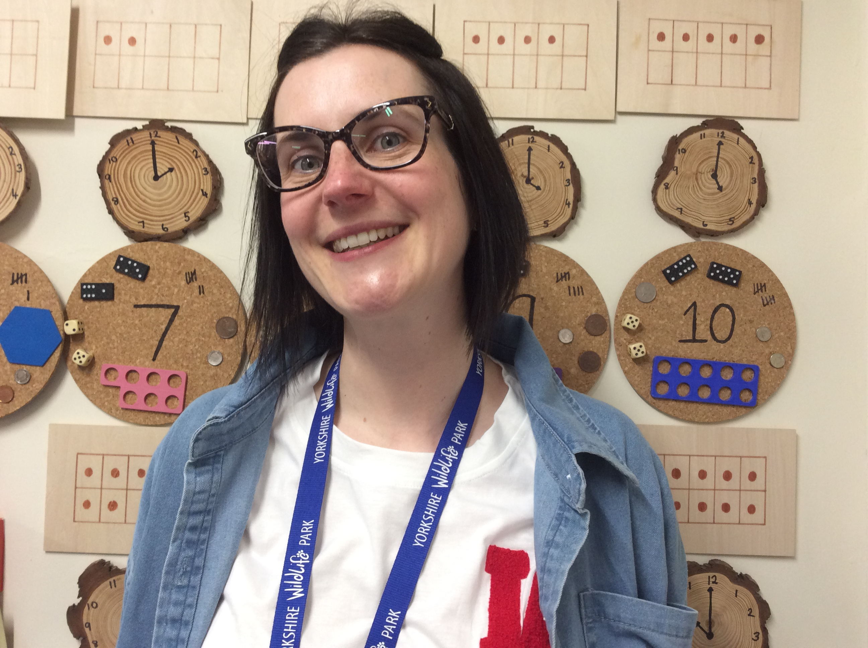
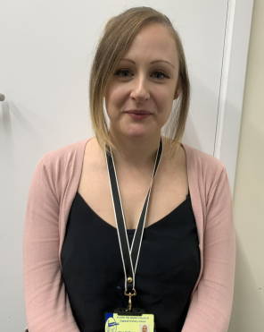
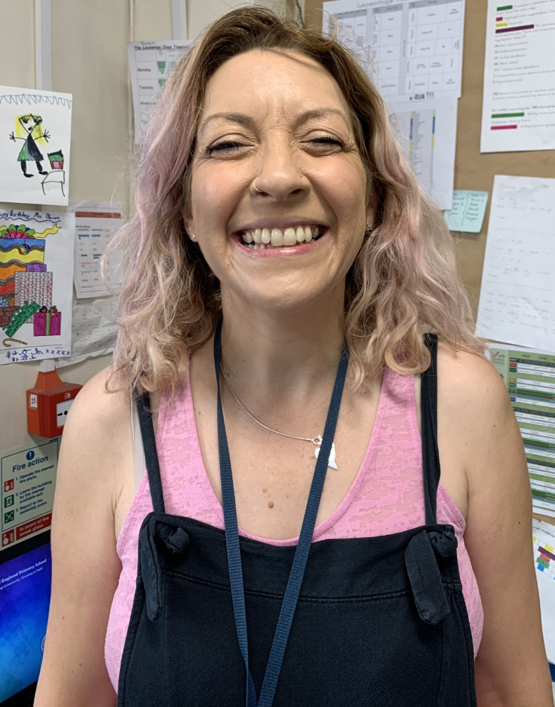
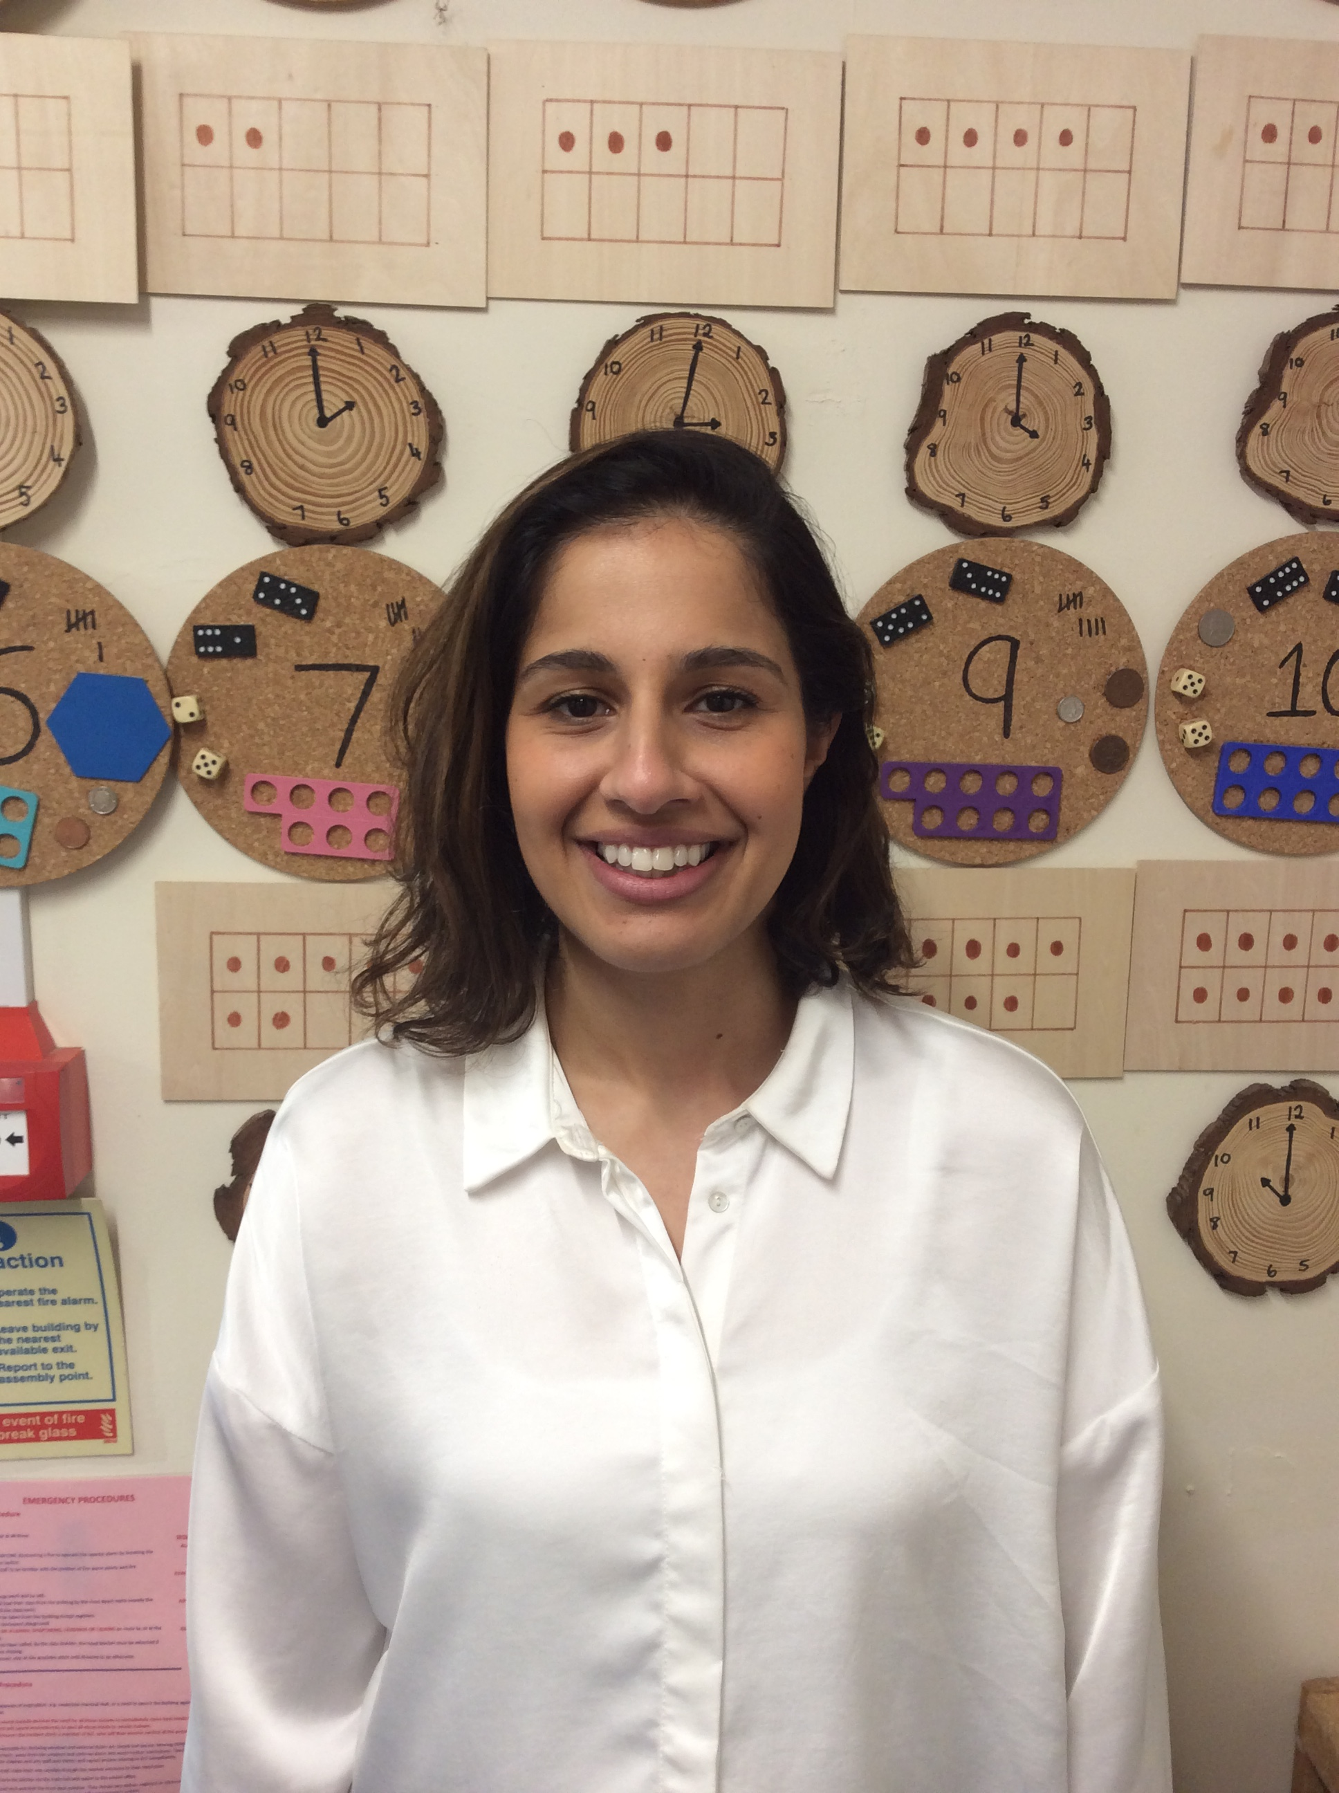
Meet the Teachers!
Miss Higgs
The Owl Babies class teacher (Mon - Weds) and EYFS Lead.
Miss McManus
The Owl Babies class teacher (Thurs - Fri) and EYFS Lead.
Miss Bannister The Rainbow Fish class teacher.
Mrs Issa
The Hungry Caterpillars class teacher.

Slide 3




What will my child learn?

Slide 4
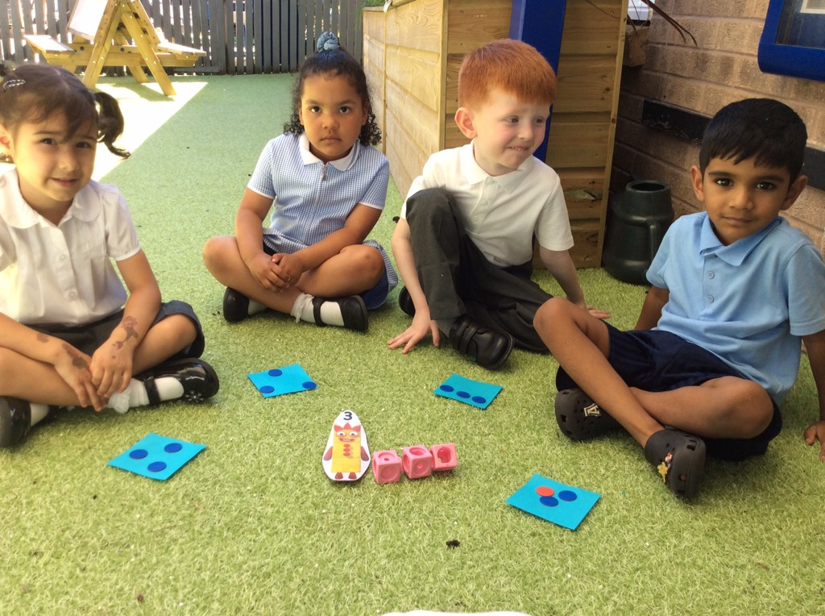
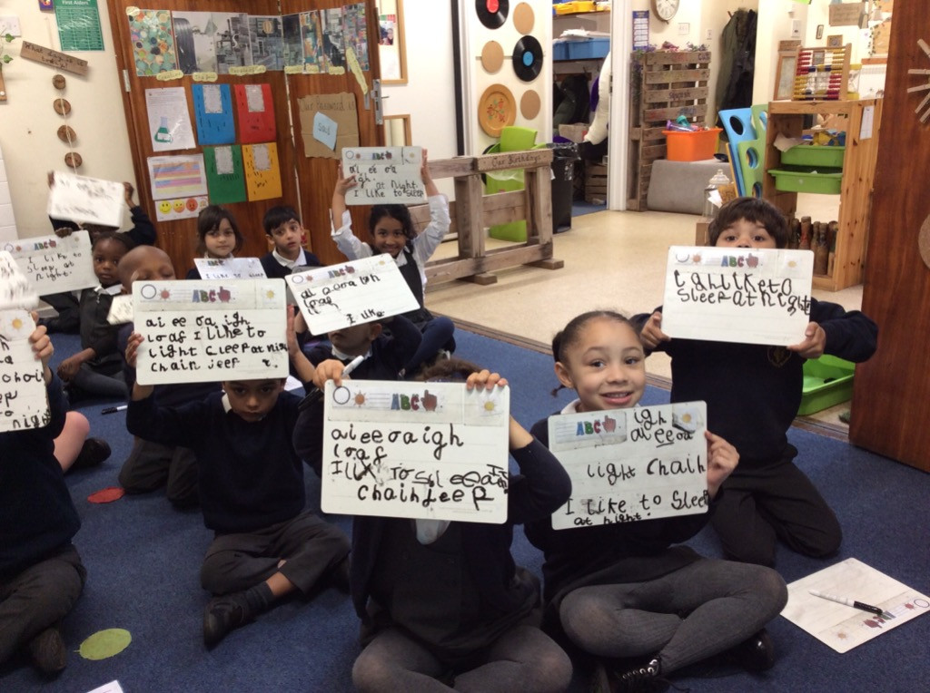
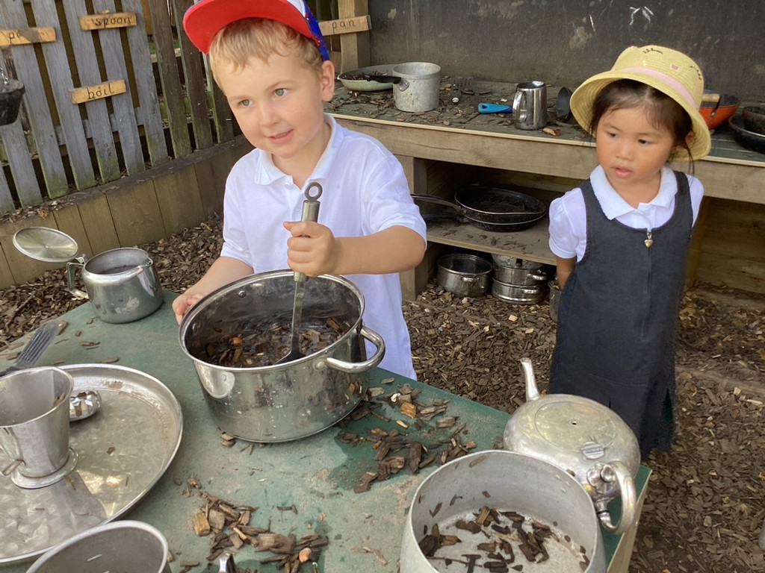
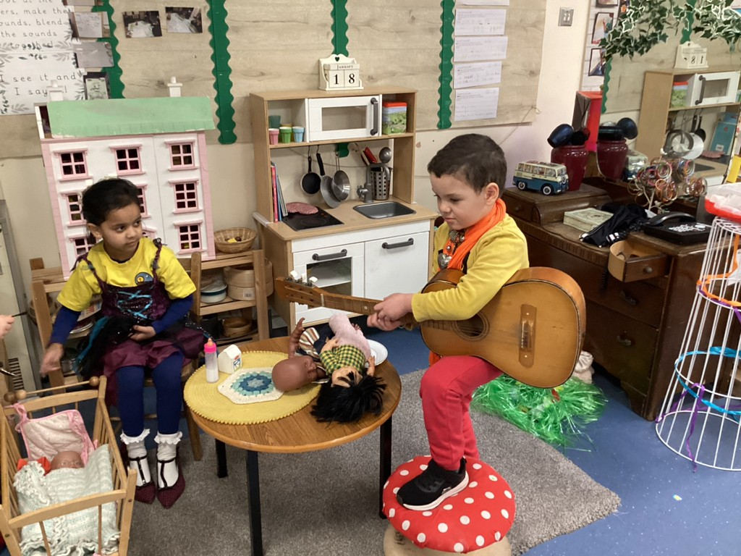
How will they learn?
Adult led carpet times and small groups – Formal lessons are taught to the whole class on the carpet. These last around 10 minutes at the start of the year and gradually build up to around half an hour. The children then complete activities in small groups with their teacher or ta.
Continuous provision and child led activities – Each of the areas of learning have a special dedicated area in the classroom. The children have free access to these areas and can choose what they want to play with. We ensure that each area is well organised and inviting, and full of authentic and interesting resources that challenge the children and encourage them to play in an open ended way. The children also have free flow access to our outdoor area.

Slide 5
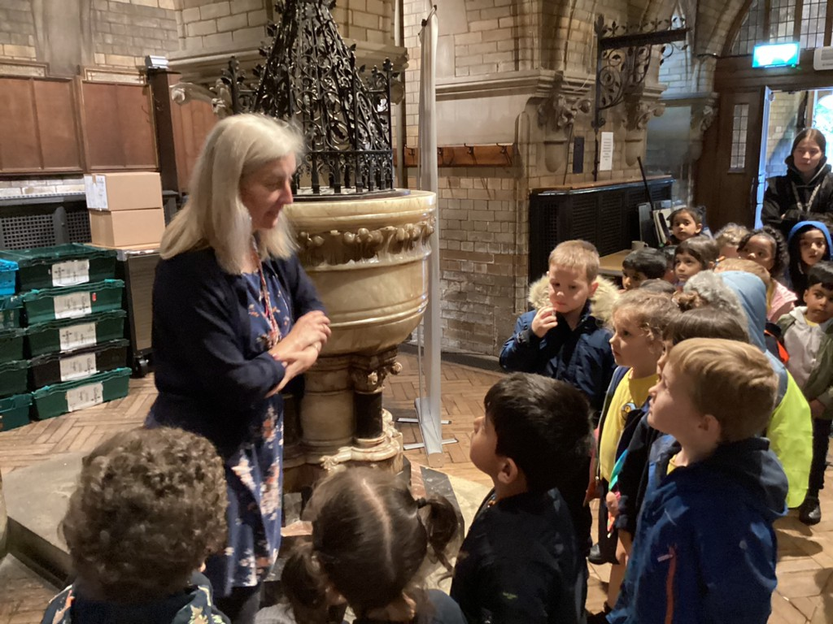
St Johns Church
We have a close relationship with the Church. We visit around once a half term to celebrate events in the Christian calendar. Members of the church often come in to school to deliver assemblies. We also have a reflection area in each classroom and the children have the opportunity to take part in collective worship everyday – either through assemblies or class prayers. For those children who would rather not pray, we invite them to take this time as an opportunity for quiet reflection.

Slide 6


Slide 7
Timings of the day
8:30 EYFS Gate (East Avenue) will be opened. Please wait with your children and ensure they refrain from playing on the outdoor equipment during this time.
8:45 Class doors will open – your teacher will greet your child and help them to put their belongings away independently.
8:55 Class doors will be closed.
9:00 The gate will be locked – if you arrive after this time, please take your child to the school office to be marked as late.
10:00 Fruit and Milk
10:10-10:25 Break time
11:45-12:45 Lunch time
2:00-2:20 Break time
3:00 EYFS Gate will be opened.
3:15 Home time – please call the office and let us know if you are running late or if a different adult will be collecting your child – we will not release your child to an unfamiliar adult without confirmation from you.

Slide 8
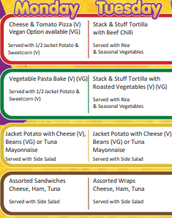
Eating and Drinking
Fruit and Milk
At 10am, the children are offered fruit and milk. Fruit is provided for all children. Milk is free for all children until they are five. We ask that you do not send your own snacks in to school.
School dinners
All children in Reception are entitled to free school dinners. These are served in the hall, and the children eat together at tables. The children are also given water and a pudding.
Children are welcome to bring their own packed lunch if they prefer.
Water
Please send your child to school with a bottle of water everyday. Please make sure that your child’s bottle is named. They will have access to this throughout the day.

Slide 9
Illness and Absence
We understand that children are sometimes not well enough to attend school. If your child is unwell, please contact the school office in the morning to let them know.
If your child has vomited, please do not send your child to school for 48 hours, to ensure that the illness is not passed on to other children and staff.
If your child is unexpectedly absent and we have not heard from you, the office will give you a ring to make sure everything is okay.
Absences for other reasons will need to be authorised via the school office.
School office - 0116 270 9932

Slide 10
Accidents at school
We have several members of staff who are first aid trained. If your child hurts themselves, we will treat their injuries and write an accident form for them to take home at the end of day.
If they receive a facial or head injury, we will phone you just to let you know.
If your child receives a more serious injury, has an upset tummy or seems generally unwell, we will phone and ask you to pick them up. Please make sure that you provide us with suitable telephone numbers where we will be able to reach you at any time during the school day

Slide 11
Going to the toilet
All children starting school should be able to use the toilet independently unless there is a medical reason why they can’t. If your child is still wearing nappies or pull ups please let us know as soon as possible.
We know that all young children will still have toileting accidents from time to time. We recommend that your child keeps a bag of spare clothes on their peg in case of any accidents. If they have a toileting accident at school we will help them to clean themselves. If you have any concerns about this, please speak to your child’s class teacher.

Slide 12

Uniform
Uniform – Grey/black trousers, skirt or pinafore dress, white polo t-shirt, navy St Johns jumper/cardigan, black shoes (Velcro is best!).
PE kit – Navy shorts or joggers, navy jumper/hoody, yellow St Johns t-shirt, black trainers. Please send your child to school wearing their PE kit on their PE day.
Uniform and PE kit are available from Gascoigne Clothing in Oadby PASSWORD: SJTB
https://www.gascoigneclothing.com/st-john-the-baptist
Preloved uniform is also available from the school office.
Please make sure that all uniform is named!

Slide 13
Homework and Reading
Homework – Each half term you will be sent a homework grid. Each week you must choose an activity from the homework grid to complete. Please submit photographs of your child’s homework on Tapestry. We also send 'Rocket Words' (HFW) home termly for children to practice reading and writing.
Reading books – Each week your child will bring two books home. The first is a phonics book, and this is explicitly matched to the sounds that your children are learning in phonics. This is for your child to read. There will also be a share-at-home book, which is for you to enjoy reading to your child. You will also be given a reading record. Please record each time you read with your child – this should be at least three times a week. Reading at home regularly with your children really does make a difference. You will also be able to access e-books via Bug Club.
Library books – We also regularly visit Knighton Library, where your child will be able to take out a book. Please fill in the library card form in your pack and return to your child’s class teacher.

Slide 14
Breakfast Club
Breakfast Club is run in the music and drama studio, and is managed by Dawn Southwell and Helen Whitmore.
Breakfast Club is open from 7:30 and you can drop your children off at any time after that. Staff from Breakfast Club will take your children down to their classes ready for the school day to start.
When the children first arrive there are activities set out for them. Breakfast is served from 8am and is optional. The children can have healthy cereal and toast with jam, marmite or honey. They are also offered juice.
To join please fill out a form from the office. Places are offered on a first come first served basis.

Slide 15
After School Club
Afterschool Club is situated within the school building and run by the managers Elli Kenning and Amanda Joyce.
The club is open term time only, Monday – Friday, from the end of the school day until 5.45pm.
If you wish for your child to attend the club, please email us at stjohnafterschoolclub@gmail.com. Please provide us with the days you require and the full name of your child/ren. Please note, places are very limited and are allocated on a first come, first served basis.
We look forward to hopefully welcoming some new faces here at Afterschool Club.
Thank you,
Elli, Amanda and the ASC Team

Slide 16
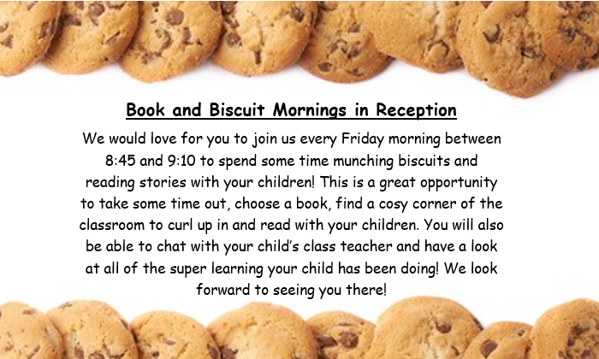

Slide 17
Preparing your child for the first day
Chat about starting school regularly and show them the pictures of their classroom and teachers in the transition booklet. You might want to walk past school a few times or practise your route to school so that it is less scary on the first day!
Help them to practise putting their coats/shoes on and off independently.
Practise wearing their school uniform – school shoes can take a little getting used to for little feet!
Practise using a knife and fork/eating their packed lunch independently.
Toileting! Please make this a priority over the summer to ensure that your child can use the toilet independently.

Slide 18


Communication
Communication will be mainly through Weduc and Tapestry. It is essential that you are engaging with these platforms as there will be regular messages about non-school uniform days, events in school and your child’s learning. If you download the apps, the calendars will sync with your phone.
Please complete the registration forms in your pack and return to your child's class teacher on transition day.

Slide 19
What happens next?
Tuesday 8th July 2025– Transition Day – Your child is invited for either the morning or afternoon session. Please note that parents do not stay for this session. You’re allocated session is in your information pack. Please bring all of your permission and getting to know you forms to this session.
Tuesday 26th August, Wednesday 27th August and Thursday 28th August – Home visits – We will be visiting you at home for around 20 minutes to get to know you a little better! You have been given a date and time slot in your information pack.
Friday 29th August 2026 – First Day of School!

Slide 20
School website
You can find more information about EYFS at St Johns at:
https://www.st-john.leicester.sch.uk
Key Information
EYFS at St Johns

Slide 21
Class Reps
If you are interested, please speak to your child’s class teacher!

