Slide 1
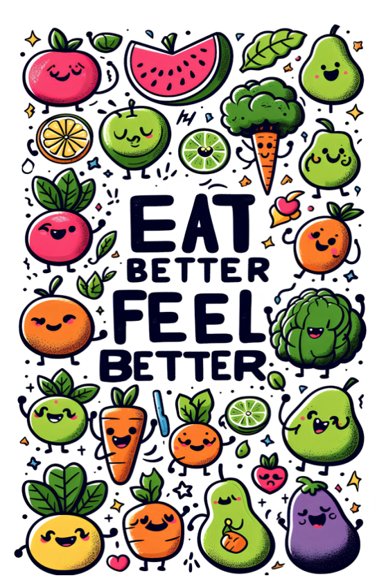


Slide 2
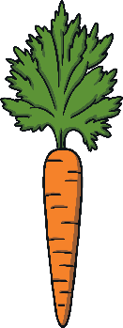
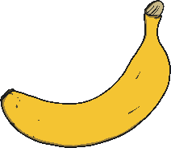

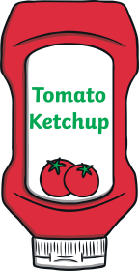

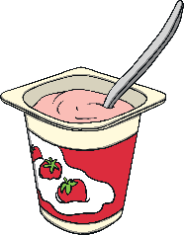

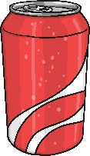
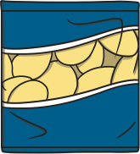
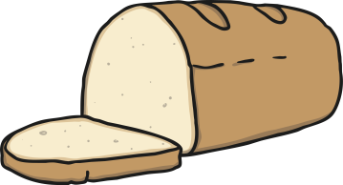
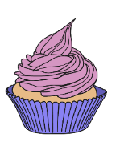
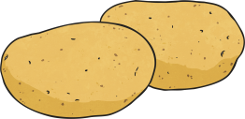

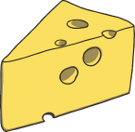

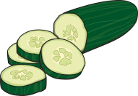
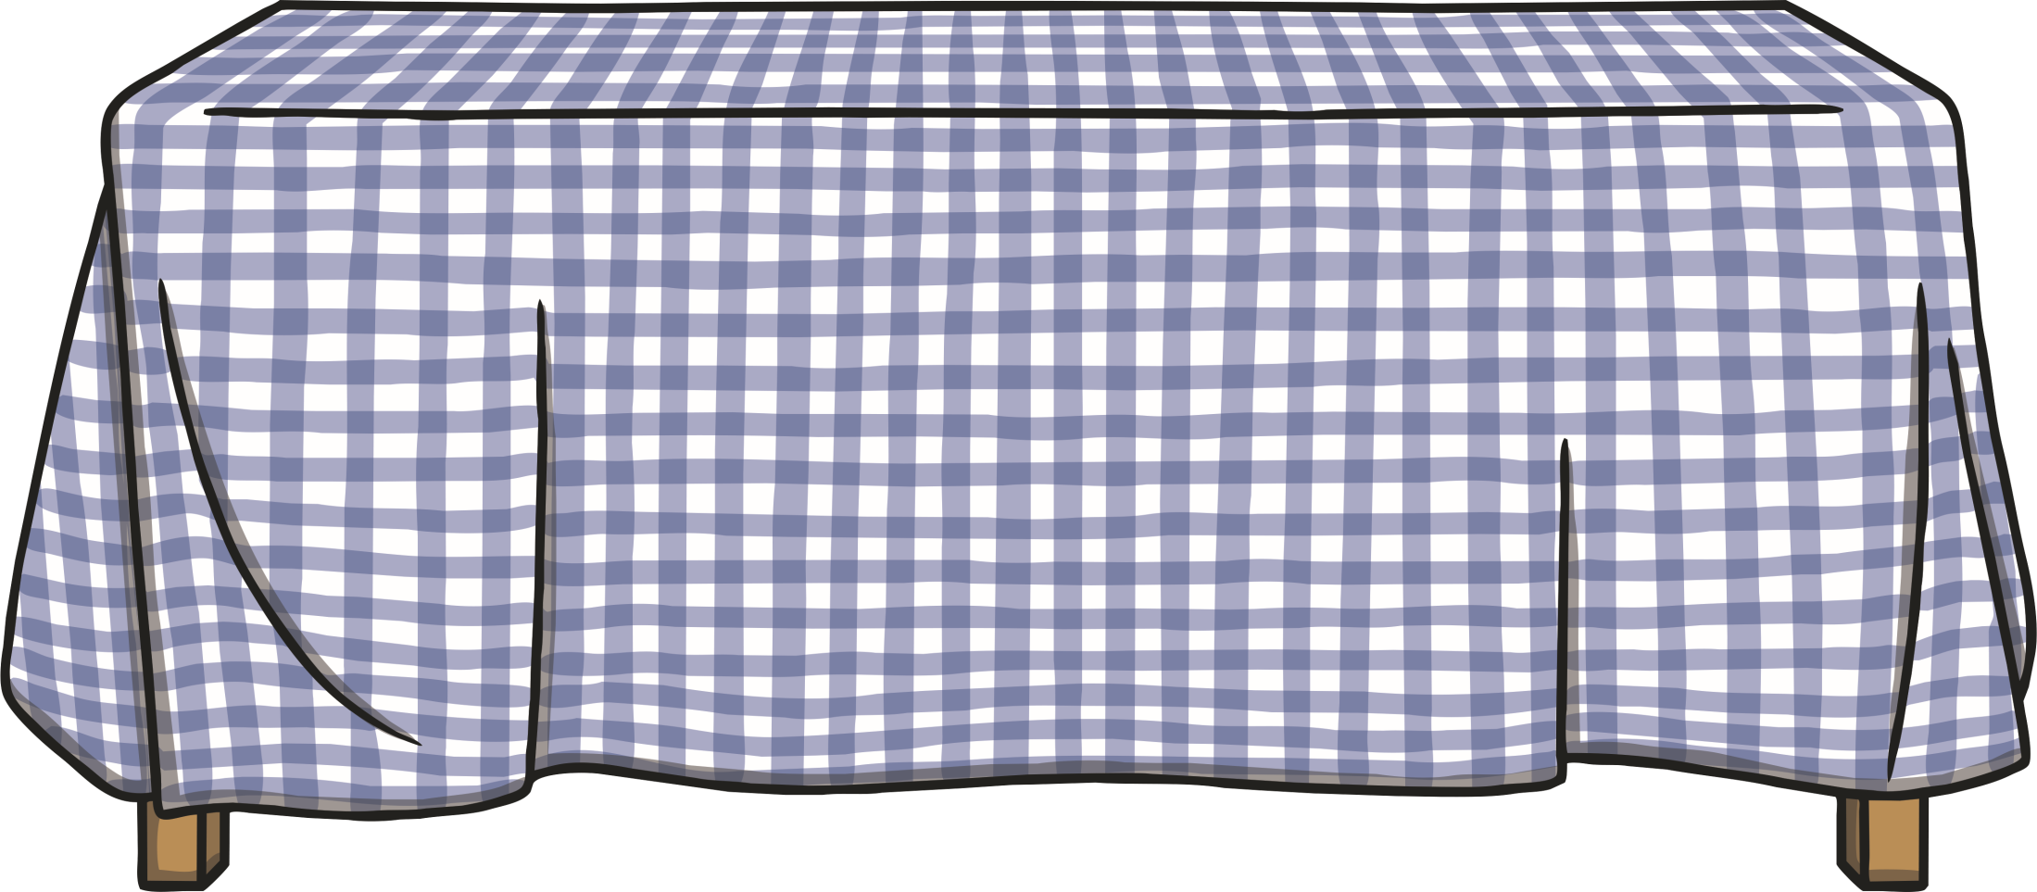
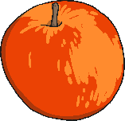

To help our bodies and minds stay healthy and well, we can eat a balance of lots of different types of foods. It is very important to keep our body hydrated with lots of water as well. Which of these foods should only be eaten in small amounts?

Slide 3


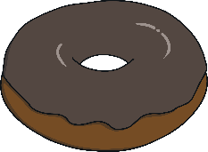
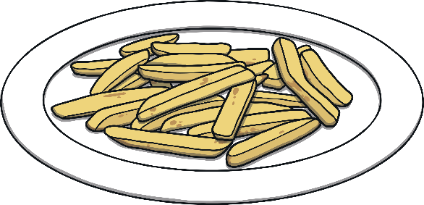
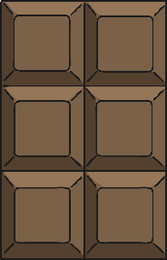
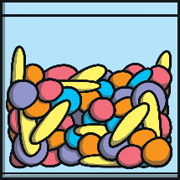
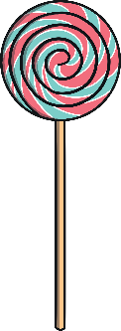
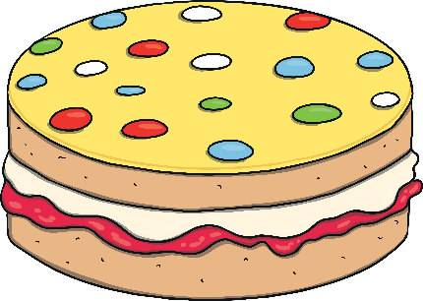
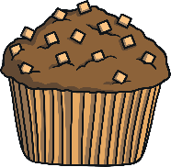
Healthy Eating
Some foods are not needed in a healthy diet so should only be eaten in small amounts.
chocolate
chips
Foods High in Fat, Salt and Sugars
sweets
cake

Slide 4
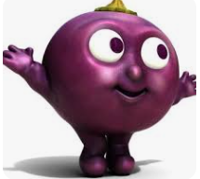
Eating good food is good for your mood! Did you know it can make a difference to your mental wellbeing? Your mental well being is about how you feel and how well you cope with daily life.
Our mental wellbeing can change from moment to moment and if we don’t get the right fuel in our bodies then our mood can be affected.
A healthy diet can give us energy, improve our mood and help us to think clearly. By eating the right things we can stop ourselves feeling tired, frustrated and cranky.

Slide 5
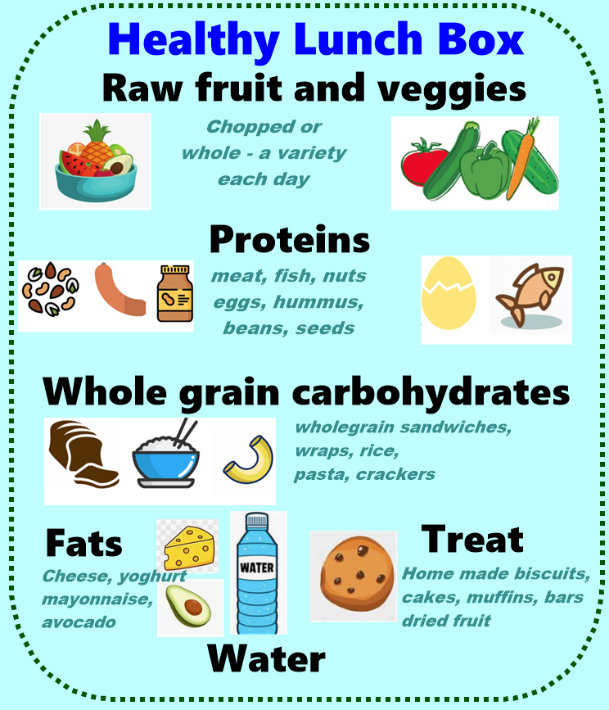
Eat more of these things…

Slide 6
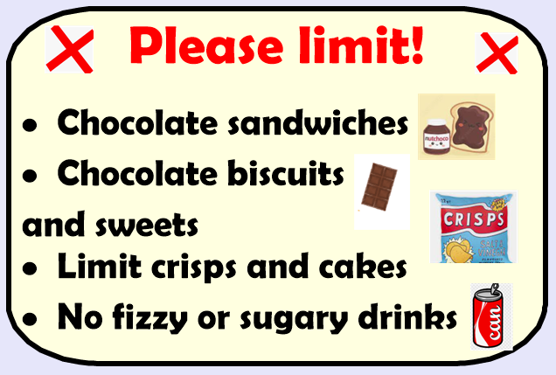
Make the right choices in your lunch box!

