Slide 1


Slide 2

Y4 MULTIPLICATION TABLES CHECK
WHAT YOU NEED TO KNOW AS A PARENT/ CARER

Slide 3
THE MULTIPLICATION TABLES CHECK
The purpose of the MTC is to determine whether pupils can recall their times tables fluently, which is essential for future success in mathematics. It will help schools to identify pupils who have not yet mastered their times tables, so that additional support can be provided.
Schools must administer the MTC to all eligible year 4 pupils between Monday 3 June and Friday 14 June 2024.
Schools can use the following week to administer the check to any pupils who were absent during the first 2 weeks or in case of any delays to the administration of the check due to technical difficulties.

Slide 4

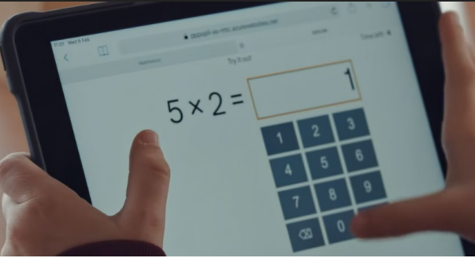
WHAT WILL THE CHECK INCLUDE?
The MTC will include 25 timed multiplication calculations, each worth one mark.
It will be presented as shown below:

Slide 5

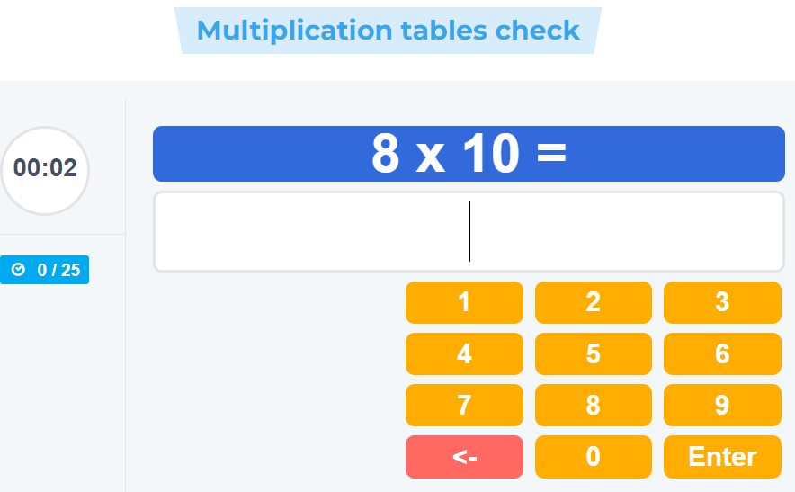
WHAT WILL IT LOOK LIKE?
The MTC is an online test.
The children will complete the MTC on a tablet or laptop.
The multiplication questions are randomly generated, so no test will be the same.
All questions will be in the same format.
The test will last no longer than 5 minutes.
This is what the test will look like:

Slide 6
WHAT ARE WE DOING TO SUPPORT YOUR CHILD IN SCHOOL?
Strong focus as always on multiplication tables.
Daily work on multiplication facts.
Tables will become an embedded feature in their maths work.
Children will have ample opportunities to practise their tables.
The children will be trained to use the TTRS soundcheck, and they have every opportunity to practise their tables using the online system.
Dedicated sessions in their weekly timetable to practice.

Slide 7
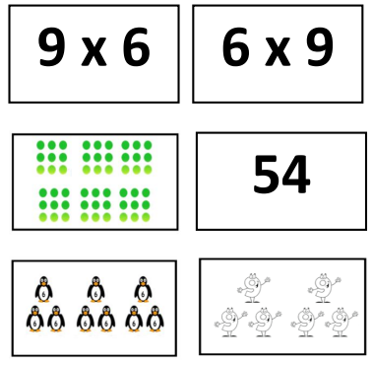
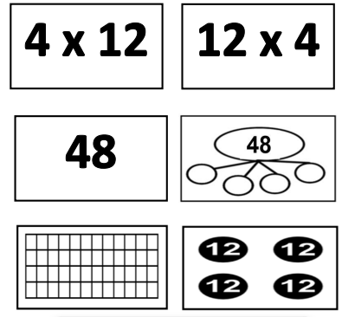
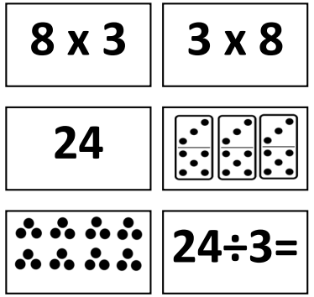
Concept cards

Slide 8
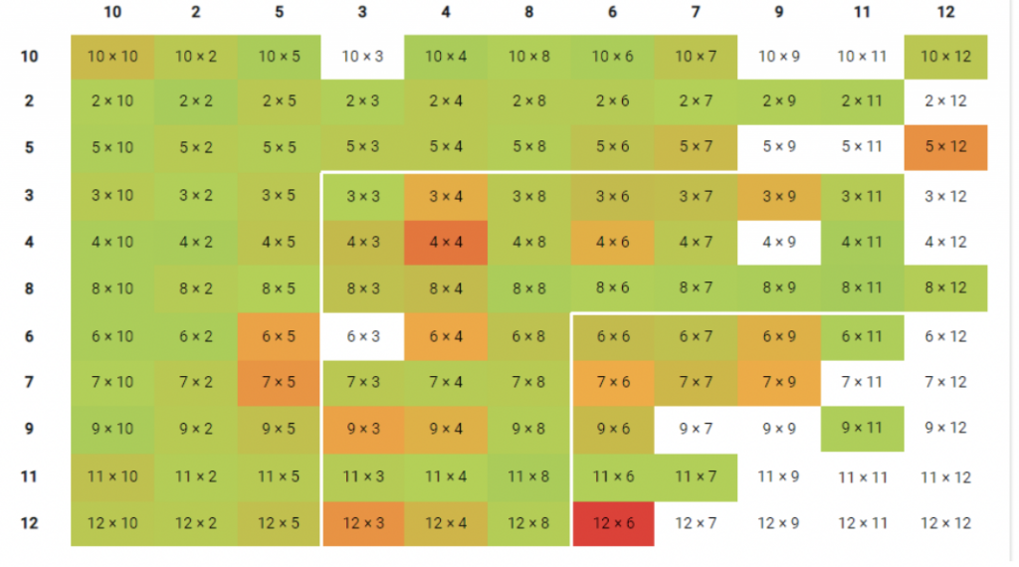
Heat Maps

Slide 9
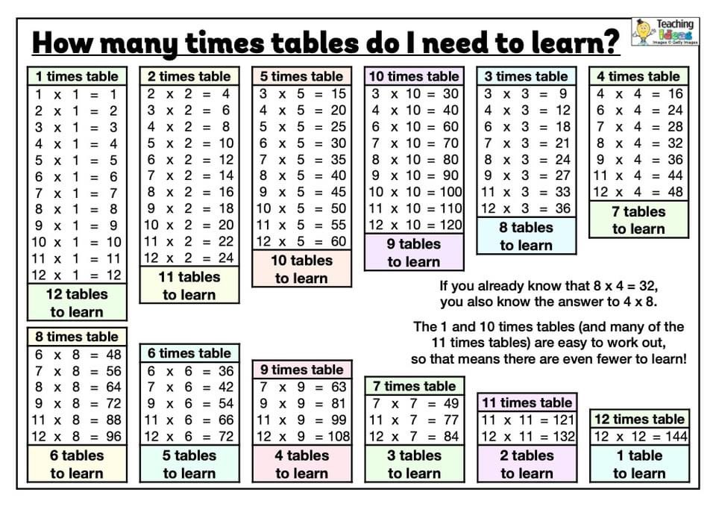

Slide 10
WHAT CAN YOU DO AT HOME?
Practise tables by rote.
Learn chants and songs that may help.
Make use of TTRS at home – the Soundcheck option on here is in line with the MTC.
Allow them to access websites to practise their tables recall on a weekly basis.
E.g. timestables.co.uk / hit the button
Ask multiplication questions out of order as the test questions on the day will be random.
Check TTRS heat map and practice times tables that aren’t green
Ensure they've completed their times tables homework each week.

Slide 11
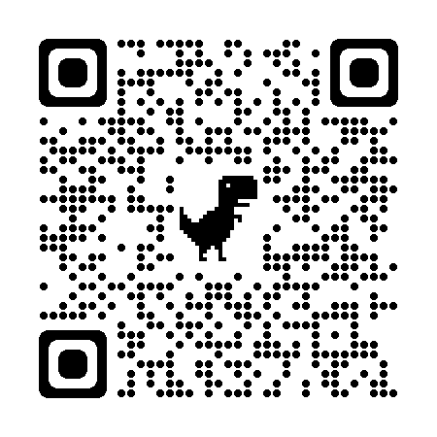
THANK YOU
Any questions?

Slide 12


