Slide 1
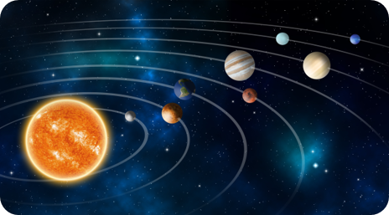
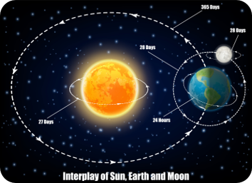



Key Vocabulary
Key Word | Definition
Earth | The planet in which we live. 3rd in order from the Sun.
Sun | The Sun is a 4.5 billion-year-old yellow dwarf star – a hot glowing ball of hydrogen and helium – at the centre of our solar system.
Moon | A moon is an object that orbits a planet or something else that is not a star.
Planets in our Solar System | Mercury, Jupiter, Saturn, Venus, Marsa, Uranus, Neptune
Solar System | The Sun together with the eight planets, their moons, and all other bodies that orbit it, including dwarf planets, asteroids, comets, meteoroids, and Kuiper belt objects.
Spherical | Having the form of a sphere
Rotates | the circular motion of an object around its centre
Star | a natural luminous body visible in the sky especially at night
orbit | a regular, repeating path that one object in space takes around another one.
Year 5 Science
Earth and Space
Learning Sequence
Our Solar System
What is in our solar system? What are the planets?
Lesson
1
Where is the sun in our solar system?
Lesson
2
How do the Earth and Moon move in space?
Lesson
3
How can you explain how we get day and night?
Lesson
4
Working Scientifically Skills
How would you describe the characteristics of a newly discovered planet in our solar system or beyond?
Lesson
5
Science Enquiry
Investigate and record the formation of craters
Lesson
6
Notes:
Add more visuals as prompts eg thermometer, spring etc

Slide 2
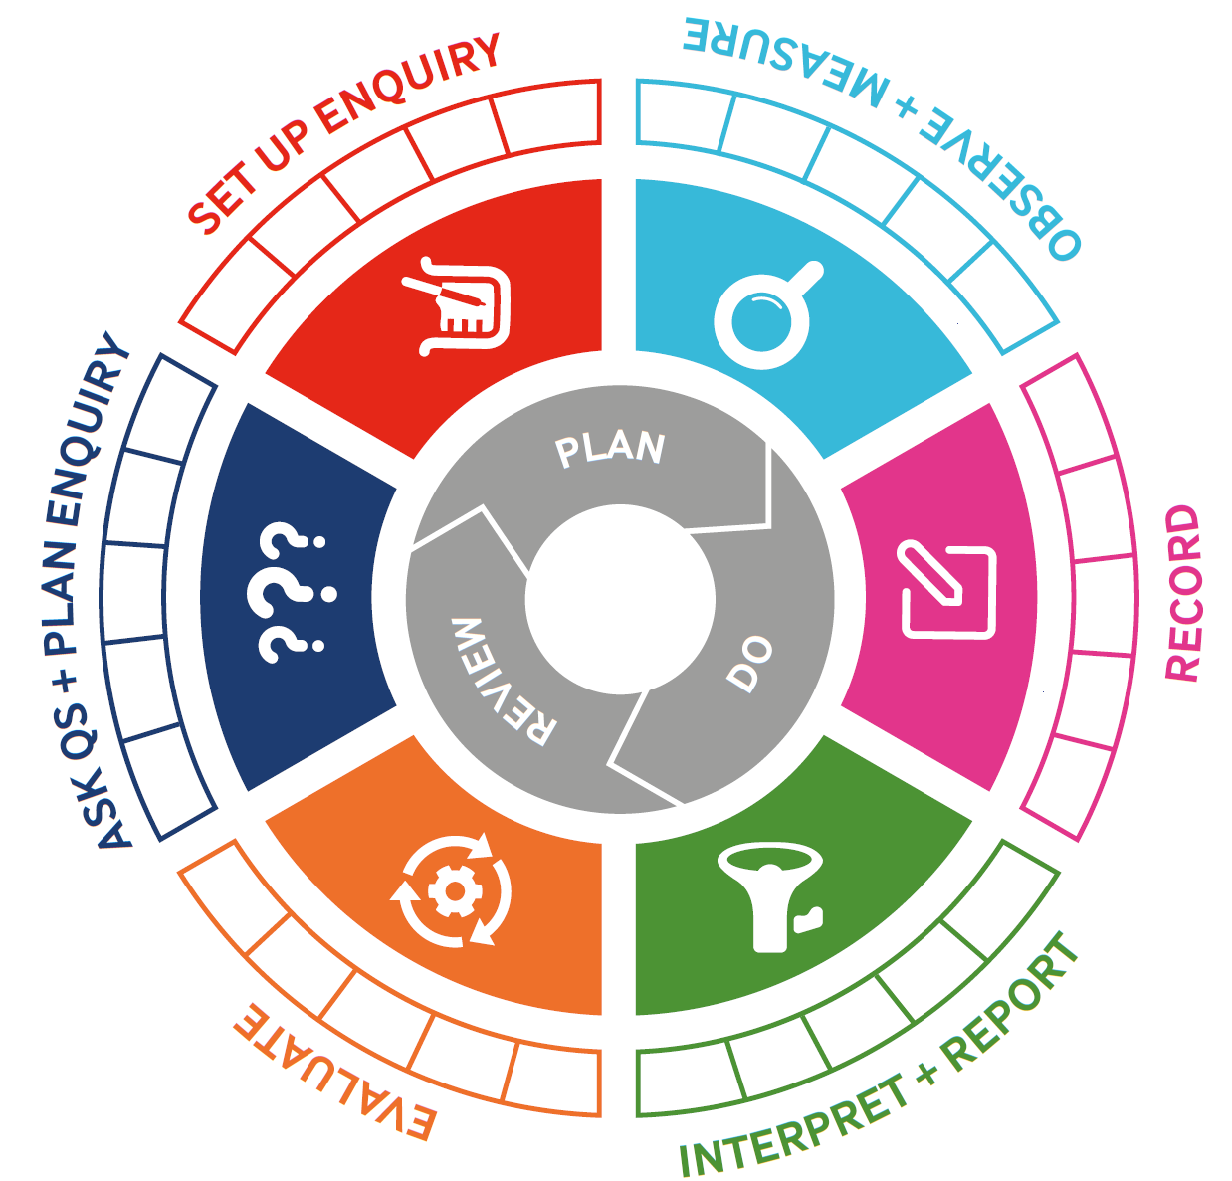
Today, we are focusing on:

Slide 3
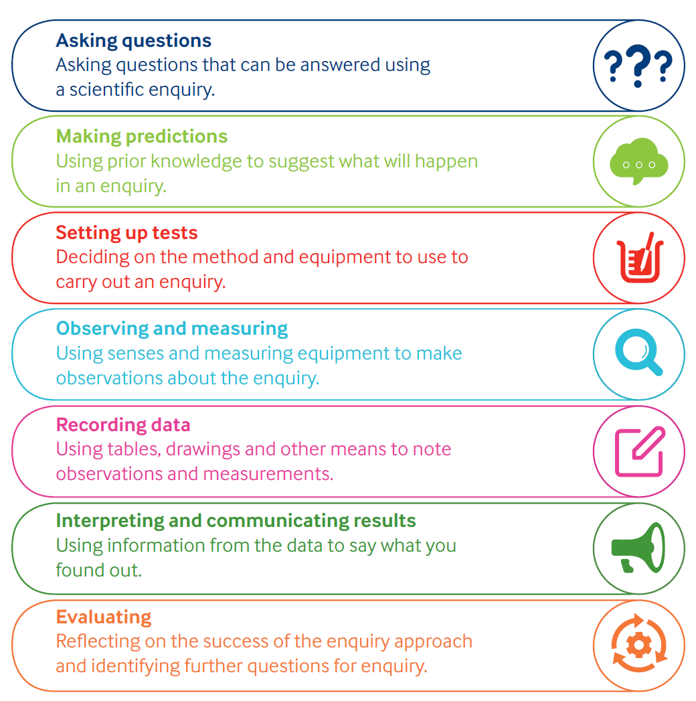
Working Scientifically

Slide 4
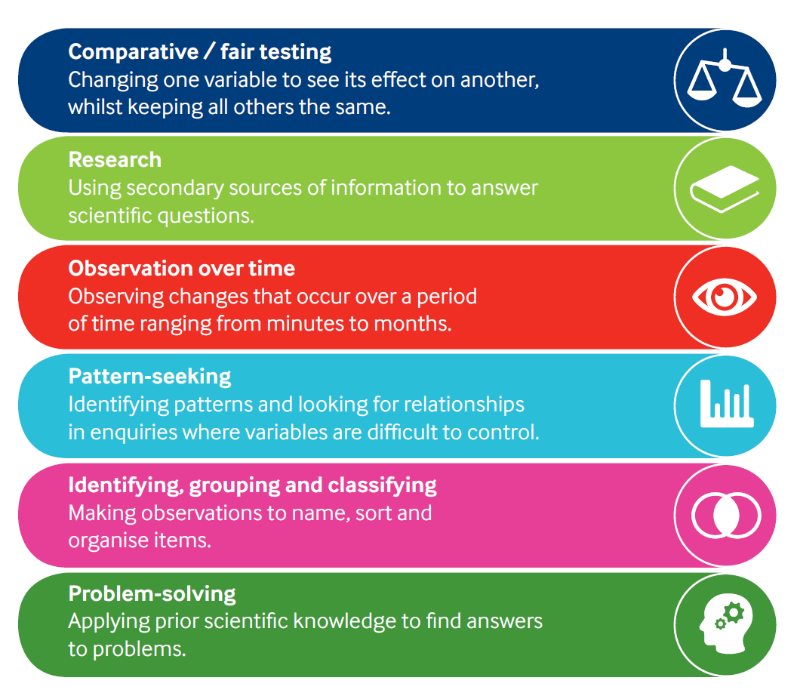
Types of Enquiry

