Slide 1

Year 6
Notes:
Change to your year group

Slide 2
What to bring to school?
Their reading book
A bottle filled with water
A healthy snack for break
A coat (preferably with a hood)
Notes:
Add info:
Coats
Water bottles- filled with water not juice
Snacks- please push healthy snacks
Bookbags/ reading books
PE kits- if kept in school

Slide 3
PE- days/ kit arrangement
PE days are Wednesday and Thursday
Kit consists of; black bottoms, white top and trainers
Notes:
Add in info about your pe days- when?
Arrangements for PE kit- where its kept?
What kit: white t-shirt, dark coloured shorts, jogging bottoms/ dark coloured tracksuit (for winter), trainers

Slide 4
Reading
Children are expected to read for at least 20 minutes a day
Children are expected to read at home daily
Your child can quiz on books you have read at home
Please read to your children as well as listening to them read
Ask your children questions about what they've read
Notes:
Expectation for reading- at least 15 minutes of reading at home daily
Most children should be quizzing once a week (change depending on your year group)
Parents can levels of children’s books at home- AR book finder
Discuss types of reading with children- listening to them (fluency), reading to them (developing love of reading) and reading/ asking questions (developing comprehension)

Slide 5
Sparx
Sparx homework is set every Friday at 4pm
It is due in by 3pm the following Friday
It is an expectation that it is completed at home
If it is not done at home, it will be completed during lunchtimes at school
Notes:
Sparx weekly times table home work- set Friday 4pm and due following Friday 3pm
If homework is not completed at home, the children will complete this during their own time at school.
Please add info about spellings applicable to your year group

Slide 6
Events throughout the year
KCC open mornings (26.9.24/11.10.24)
Grenville House – WC 10.2.25
SATS – WC 12.5.25
Bikeability – WC 2.6.25
Open classrooms
KCC transitions
Leavers play
Notes:
Add in any memorable experiences- trips/ residentials (dates if known)
Open classrooms- mention these and that dates will follow- keep an eye on the newsletter

Slide 7
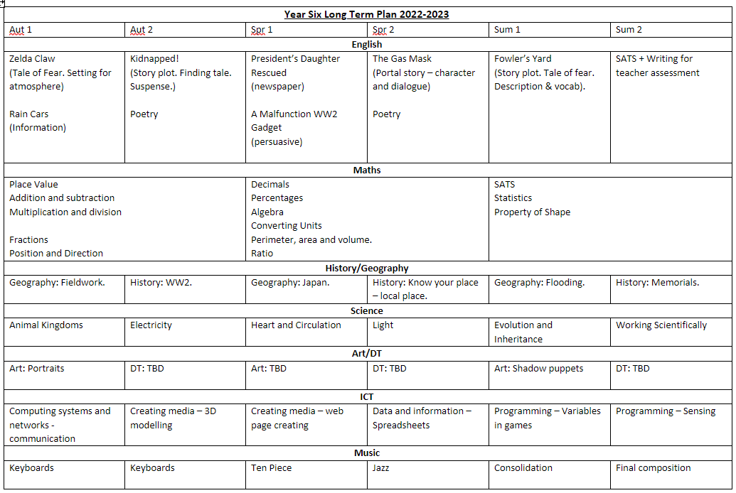
Long-Term Plan- year 6
Notes:
Add in LTP for year group

Slide 8
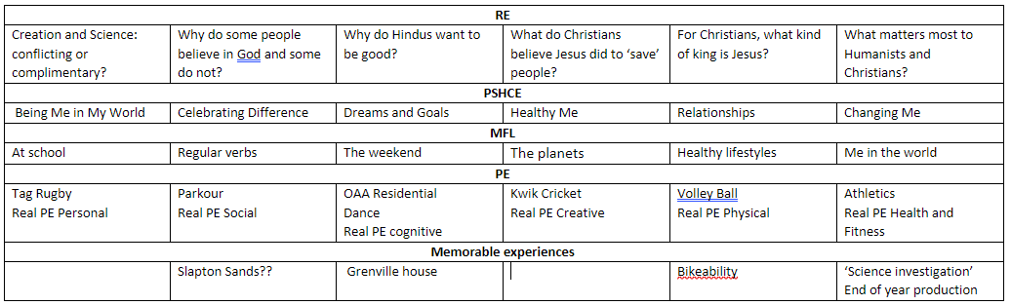
Long-Term Plan- year 6
Notes:
Add in LTP for year group

Slide 9
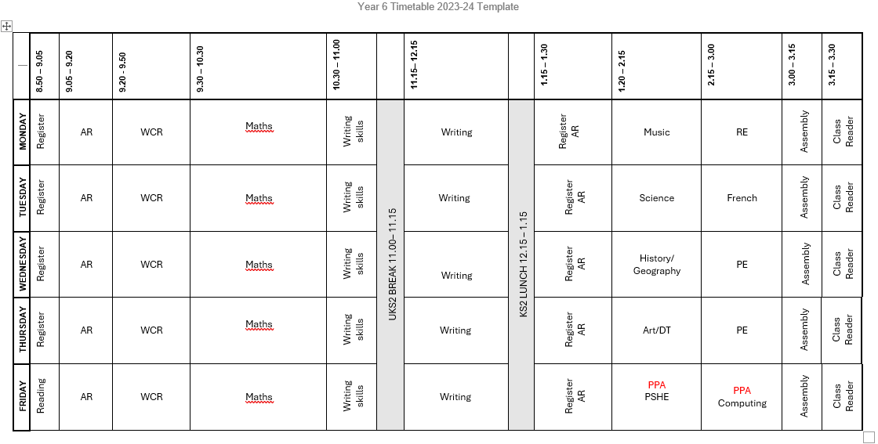
Weekly timetable
Notes:
Add in LTP for year group

Slide 10
Any questions?
Rebecca.thom@kingsbridgeprimary.org.uk
Ellen.janman@kingsbridgeprimary.org.uk
Notes:
Add in your teacher email address if you want to. Parents can directly email the office and they will forward it to you.

