Slide 1

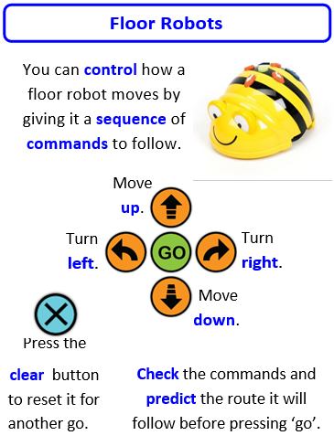
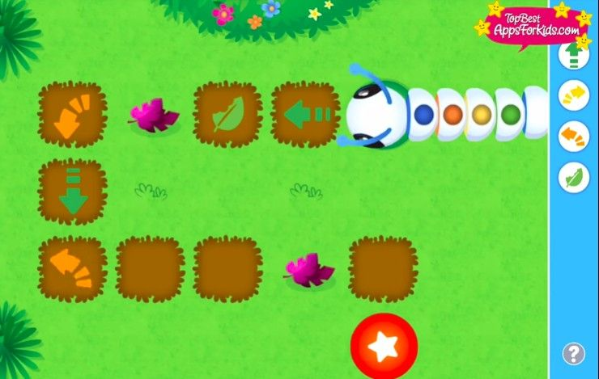
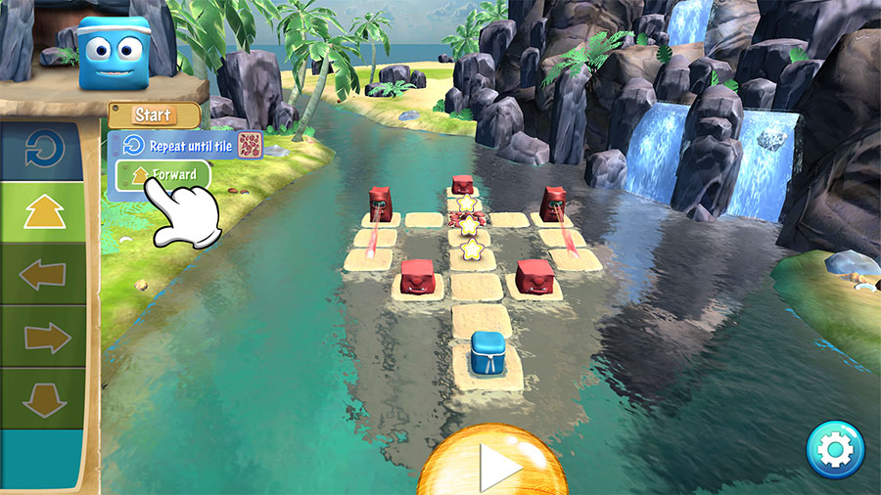
Sherdley Primary School Computing Knowledge Organiser
Year 1: Computer Science
Handy vocabulary
CS1.1 | Be able to say what an 'algorithm' is.
CS1.2 | Be able to use the appropriate keys or commands to make a virtual or floor robot go forward, backward, left and right.
CS1.3 | Be able to program a bot or sprite by giving simple sequences of commands with an immediate outcome.
CS1.4 | Can use basic symbols to record directional instruction and attempt to identify a bug in their code.
CS1.5 | Be able to use a developing range of language and styles of control e.g. tilt and turn/instructional to direct a robot.
Computer Science
Algorithm - A set of rules used to solve a problem. These rules need to be in order (e.g. a recipe). Command – An instruction for the computer. A set of commands together make up algorithms and computer programs. Program - A collection of instructions that a computer can perform (execute) to complete a specified task. Programming - A way of instructing a computer to perform various tasks. The process of creating a program. Sequencing - One of the three basic building blocks of computer programming. Sequencing is the process of putting instructions into the correct order.
Program using different apps
Code-a-Pillar
Box Island

Slide 2
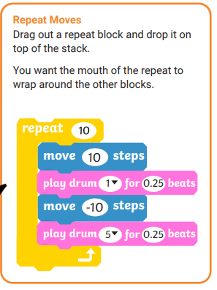
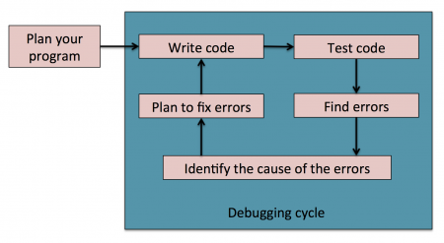
Sherdley Primary School Computing Knowledge Organiser
Year 2: Computer Science
Handy vocabulary
CS2.1 | Be able to give control devices instructions that contain numerical data (e.g. move 2 steps etc).
CS2.2 | Can use the repeat command (loops) to program more efficiently.
CS2.3 | Can use logical reasoning to predict the outcome of a sequence of instructions and test the sequence, amending if necessary.
CS2.4 | Is able to make use of simple events e.g. mouse clicks/tap on screen.
CS2.5 | Be able to find a bug in simple code and attempt to debug errors.
Computer Science
Bug - A software bug is an error, flaw or fault in a computer program that causes it to produce an incorrect or unexpected result, or to behave in unintended ways. Debugging - The process of finding and fixing defects or errors in a computer program. Loop - The second basic building block of programming. Also called Iteration. A sequence of instructions that is continually repeated until a certain condition is met. Repeat - Execute an instruction more than once. Event - An action that occurs as a result of the user or another source, such as a mouse click.
Use the debugging cycle to check your code.

Slide 3
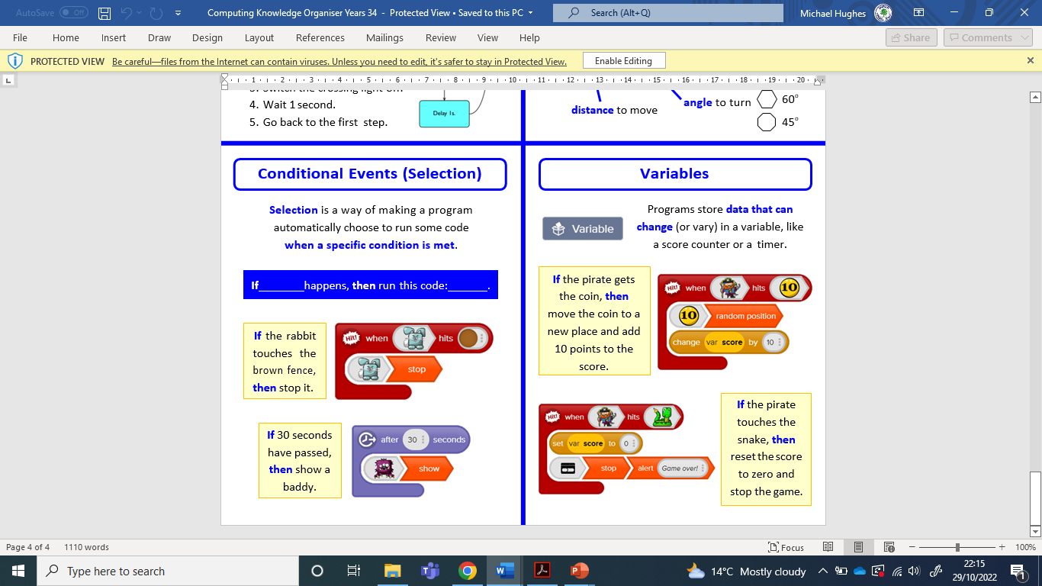
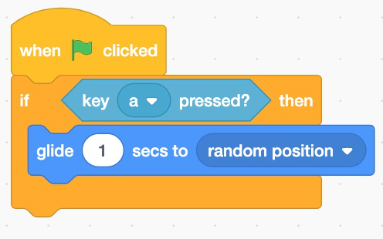
Sherdley Primary School Computing Knowledge Organiser
Year 3: Computer Science
Handy vocabulary
CS3.1 | To sequence a list of commands/ blocks to produce an output e.g. a light comes on or a robot follows a defined route.
CS3.2 | Is able to use 'repeat' and 'repeat until' loops when appropriate.
CS3.3 | Can use simple conditional statements (if and when commands) and understands the importance of time within a program (e.g. using wait), with support.
CS34 | Can make use of an input 'event' within a simple program e.g. when the start button is clicked.
CS3.5 | Be able to find errors in a simple program, and successfully debug to make the program work.
Computer Science
Broadcasts - Events which allow sprites to interact by sending messages that can be picked up by the other sprites. Code - Computer code or program code is the set of instructions forming a computer program which is executed by a computer. It is called code because the computer has to translate the code that humans can understand into ‘machine code’ that only the computer can understand easily before it is executed. Condition - Something that can be true or false. Selection or Conditionals - The third basic building block of programming. A statement that a program checks to see if a condition is true or false. If true, an action is taken. Otherwise, the action is ignored. Usually formatted in the form of IF <condition> THEN <do something> Sprite - A 2-dimensional image that can be programmed using code to perform actions.
Use the debugging cycle to check your code.

Slide 4
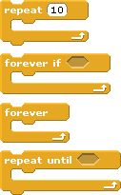
Sherdley Primary School Computing Knowledge Organiser
Year 4: Computer Science
Handy vocabulary
CS4.1 | Design, test and amend programs to achieve an intended objective, including controlling an external output.
CS4.2 | Be able to use nested loops to increase the efficiency of a program.
CS4.3 | Can use and change a pre-written function.
CS4.4 | Understands a wider range of 'events' such as sprite interactions and button presses, and can use them within programs.
CS4.5 | Be able to find errors in a program of their own design, and successfully debug to achieve a specific goal.
Computer Science
If / Else - An extension of a conditional or selection statement that allows for an alternative set of instructions to execute if a condition is false i.e. IF <condition> THEN <do something> ELSE <do something>. Nested Loop - When a loop is placed within the body of another loop, it becomes nested. The ‘inner’ loop will complete an entire cycle of repetition for each repeat of the ‘outer’ loop. Until Loop - A loop that tells the computer to repeat something only up to the point that a condition becomes true. Usually formatted like REPEAT <something> UNTIL <condition>. While Loop - A loop that continues to repeat while a condition is true. Usually formatted in the form of WHILE <condition> DO <something>.
Different loop blocks have different functions.
Use the debugging cycle to check your code.

Slide 5
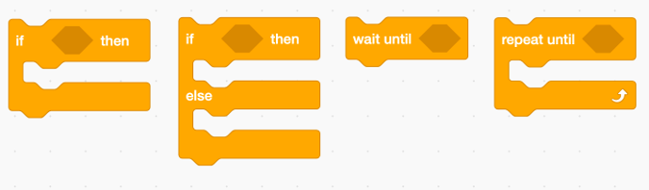
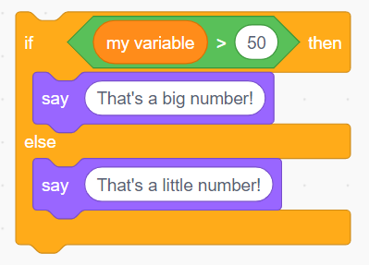
Sherdley Primary School Computing Knowledge Organiser
Year 5: Computer Science
Handy vocabulary
CS5.1 | Can use decomposition when solving problems (break the code/problem into smaller parts).
CS5.2 | Can explain what happens when a variable changes and can use this within a computer program to manipulate data.
CS5.3 | Show an understanding of when to use 'while', 'repeat until' and 'forever if' loops to make programs shorter and more efficient and can use them appropriately (understanding the differences between them).
CS5.4 | Can use and change a pre-written function as part of a longer program or sequence.
CS5.5 | Be able to use a greater range of conditionals (selection) including “whilst”, “if else”, “repeat until”.
Computer Science
Behaviour - A sequence of instructions that are triggered by an event. Decomposition - This is the breaking down of a complex problem into smaller problems that are more manageable and easier to understand. Each of these smaller problems can be solved and the solutions programmed, which then in turn solves the larger, more complex problem. Subroutine - Instructions can be grouped together into named, reusable sections of code. This improves readability and efficiency of the code. Function - Functions are a type of subroutine where a value is returned back to the main program. Procedure - A procedure is a type of subroutine that performs one or more tasks without returning a value back to the main program. Input – Data provided to a computer system, such as via a keyboard, mouse, microphone, camera or physical sensors. Output – The information produced by a computer system for its user, typically on a screen, through speakers or on a printer, but possibly through the control of motors in physical systems.
Can you use variables and a greater range of conditional blocks?

Slide 6
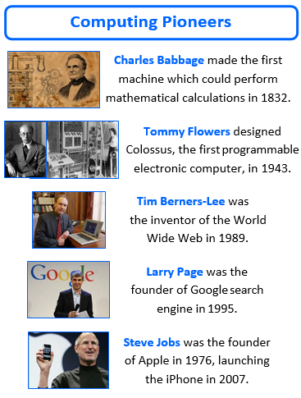
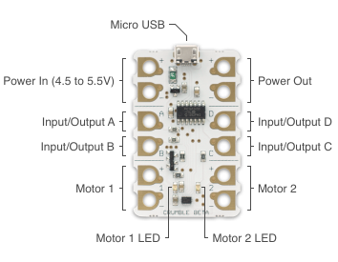
Sherdley Primary School Computing Knowledge Organiser
Year 6: Computer Science
Handy vocabulary
CS6.1 | Be able to use logical operations (not, or, and) to alter and control the outcome of a series of commands.
CS6.2 | Can use variables efficiently. Be able to create their own variable and use this within a computer program to manipulate data.
CS6.3 | Can demonstrate an understanding of what subroutines (e.g. functions and procedures) are, and be able to create them within a computer program to store and retrieve data.
CS6.4 | Be able to use a wider range of events (such as broadcasts) and use them efficiently within programs to start and stop scripts.
CS6.5 | When debugging, can use abstraction to filter out extraneous detail and debug the program.
Computer Science
Abstraction - Abstraction is the process of simplifying problems to only see the relevant information. This is used when designing programs - removing the extraneous information allows the programmer to more easily design a solution. Constant - A store for data within computer memory which is given a label, but which cannot be changed once set. For Loop - A type of loop that uses a counter to define how many times the loop should repeat. This can either be a numerical counter, where the value of the iteration is stored in a variable, or a list of items that the loop works through. Sometimes a ‘step value’ is defined, so the counter moves up (or down) that number of steps (instead of just 1). While Loop - A type of loop which uses a condition to determine if it should repeat. e.g. WHILE <condition> DO <sequence of instructions>. When the condition is evaluated as False the loop stops repeating. Models and Simulations - A program which replicates or mimics key features of a real world event in order to investigate its behaviour without the cost, time, or danger of running an experiment in real life. Variable - A store for data within computer memory, which is given a label (name) and can be changed or manipulated.
Programming using crumble controllers

