Slide 1
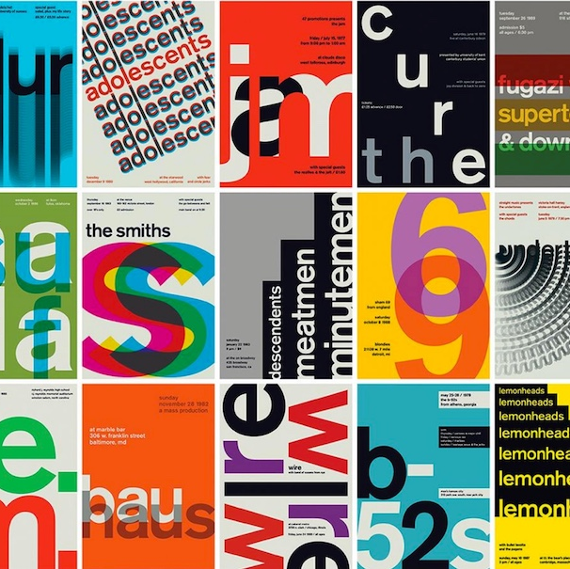
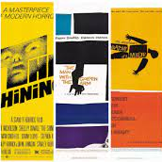

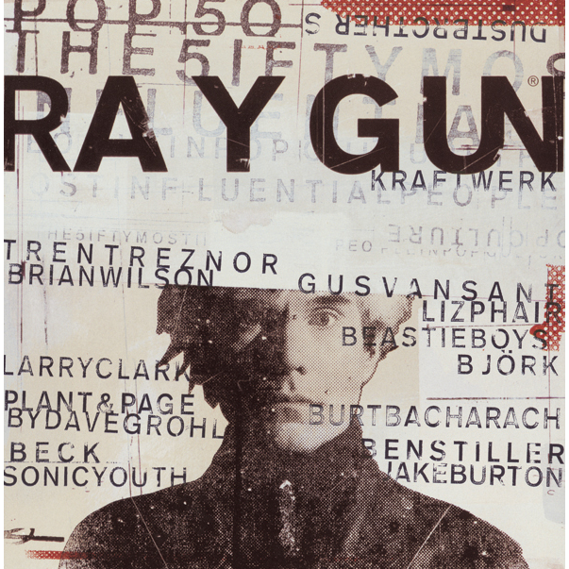



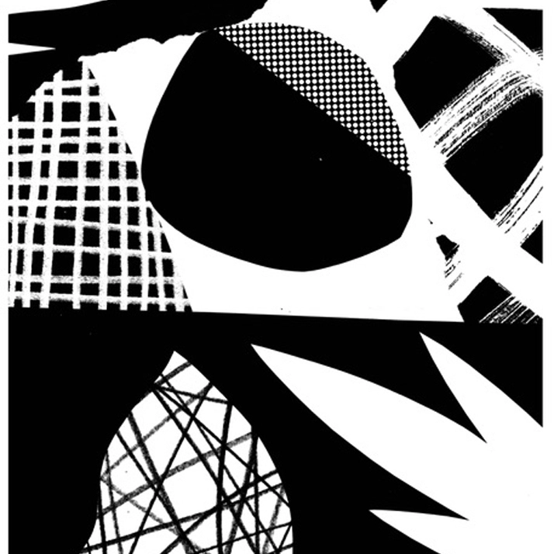
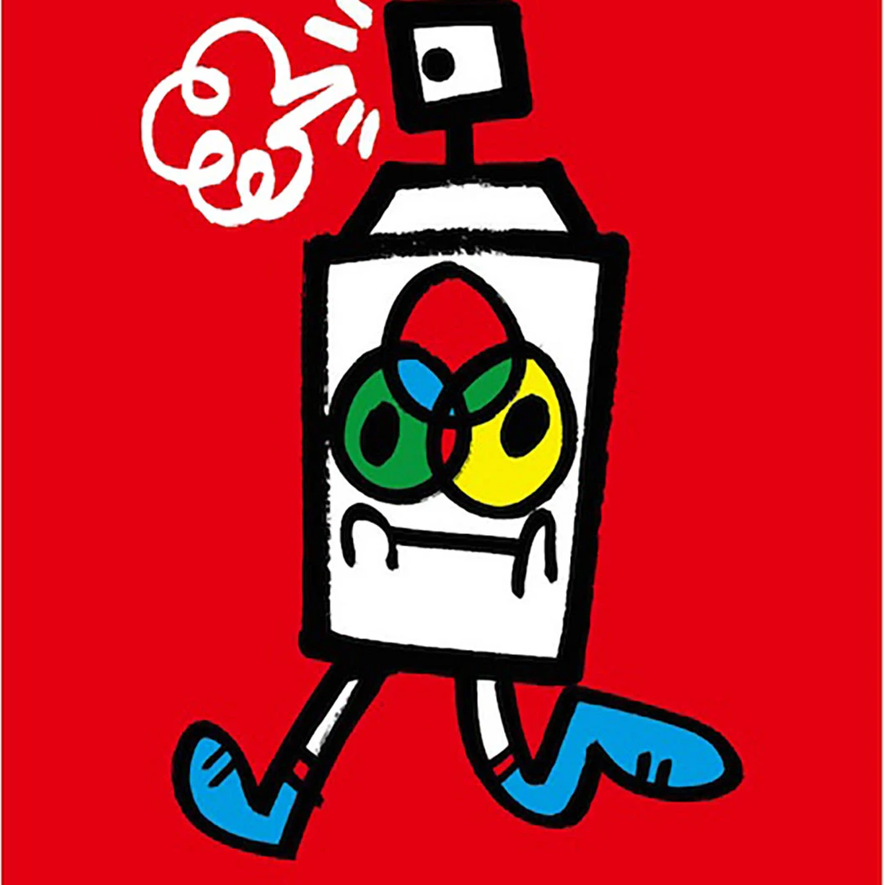
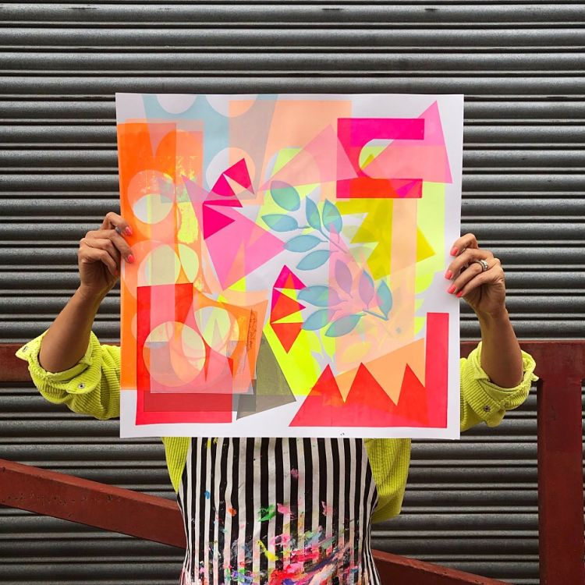
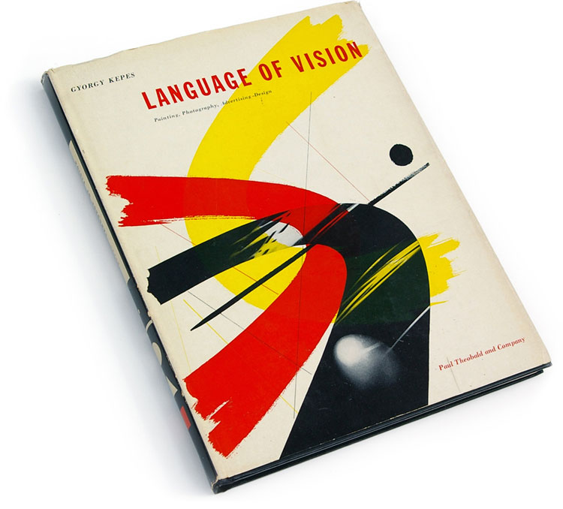

YR 12 GRAPHICS
FINAL RESPONSE
EXPERIMENT
Create a meaningful and original outcome
Explore a range of techniques & processes
YR 13
AO4
AO3
AO2
AO1
RECORD
CRITICAL STUDIES
CYCLE 3
Imagery, ideas, plans and observations
Analytical Research
Design Elements Workshops – Characterisation – Typography – Branding - Design
SWISSTED
DAVID CARSON
Photographic Collage
Photographic Kaleidoscopes
Knowledge & Inspiration Overview
Q4
Q3
Q2
Q1
Learn how to apply and experiment with the Visual Elements through a variety of skills, techniques and processes
CYCLE 2
SAUL BASS
RAYGUN
Developing how to talk and write about your own and other’s work
Layering Visual Elements
Visual Element Adjustment
TOM ABBISS-SMITH
ZOE ANKER
Photoshop and Digital Art
How to create a Photographic Essay – Why do we document?
Learning how to create original artwork inspired by the work of others
Q1
Q2
Q3
Q4
CYCLE 1
Learning how to evaluate your own and others work
JON BURGERMAN
HISTORY OF GRAPHIC DESIGN
Introduction to Photoshop and editing skills
‘Ways of Seeing’ – The Rules of Composition – How to be a better Photographer

