Slide 1



Alternative Academic Qualification (AAQ)
Health & Social Care
Introduction to Sixth Form
Name: ______________________

Slide 2

Contents
What | Page No:
What will I be studying | 3
Recommended Netflix programmes | 4
Other recommended viewing | 5
Recommended reading | 6
Recommended social media | 7
Written report task related to viewing/reading | 8
Learning Log | 9
Information leaflet task | 10
Checklist for September | 11

Slide 3
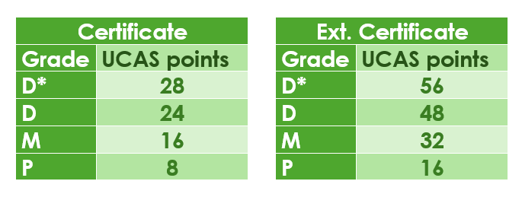
What will I be studying?
Health and social care is a subject that has many topic areas and is a good foundation subject for a wide range of careers.
In general, it’s about people, their health, individual circumstances and what affect individuals.
Your learning will explore what healthcare and social care services are and how different job roles support people to meet their individual needs.
First year – Certificate
One exam assessed unit – Principles of health and Social Care
Two mandatory supervised assignments called NEA’s (non-examined assessment)
FO92 - Person-centred care and
FO93- Supporting people with mental health conditions
You will have an opportunity to resit your exam and there will be a chance to improve and resubmit some of your assignment work
Second year – Extended Certificate
One exam assessed unit – Anatomy & Physiology for health and social care
Two supervised assignments called NEA’s (non-examined assessment) likely to be:
FO94 - Supporting people with long term physiological conditions
FO96 - Supporting people in relation to sexual health, pregnancy and postnatal health
Your teachers will deliver the course content using a wide range of teaching methods.
Checklists will be provided for each unit and you can monitor your own learning by ticking off the content as you go along .
You may be considering a career which requires a university degree and are thinking about UCAS points for the AAQ.

Slide 4













What the Health
Louis Theroux: Extreme love, Dementia
Babies
Five Feet Apart
Theory of Everything
Humans;
Body Systems
Three identical strangers
Brain on Fire
The Game Changer (2018)
Girl, interrupted
Call the Midwife
13 Reasons Why
Recommended Watching for Health & Social

Slide 5


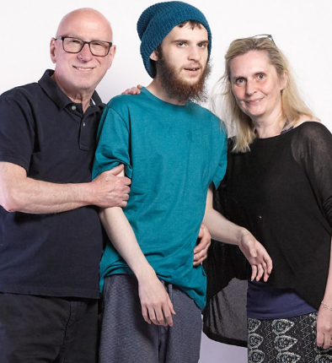


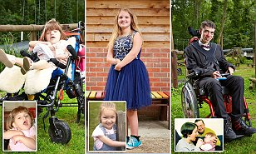
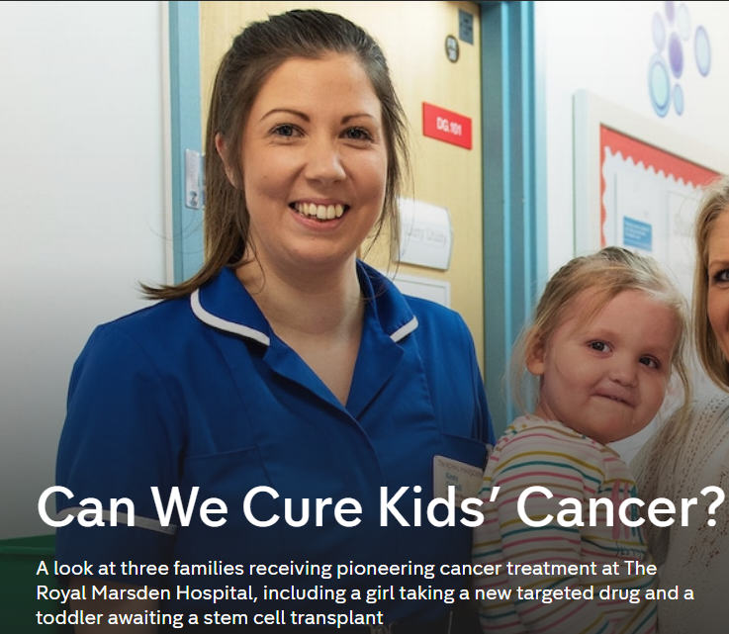





Not
Rhod Gilbert's Work Experience
Katie Price; Harvey and Me
Inside our Minds
Stacey Dooley 9-5 Care Home
BBC iPlayer
24 hours in A&E
Born to be different
The Royal Marsden
Losing it: Our mental health
All 4
Beyond weight loss
The Upside
ALLELUJAH
Miss you Already
Amazon Prime
No Netflix paid account

Slide 6
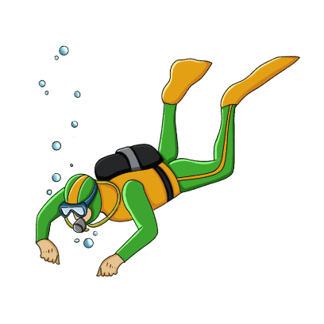




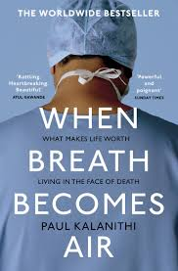








Dive into a book
Pig Heart Boy by Malorie Blackman
The Illustrated Mum Jacqueline Wilson
This is Going to Hurt by Adam Kay
When Breathe becomes Air by Paul Kalanithi
Further Reading
The Hate U Give by Angie Thomas
Me Before you by Jojo Moyes
The Fault in Our Stars by John Green
The Story of Baby P by Ray James
The Language of Kindness by Christie Watson
I am Malala by Malala Yousafzai
The Perks of Being a Wallflower Stephen Chbosky
Katie Price; Harvey
Recommended Reading for Health & Social Care
Yes, some of these are also films, if you prefer!

Slide 7


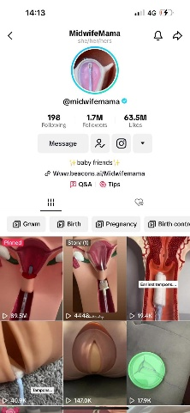
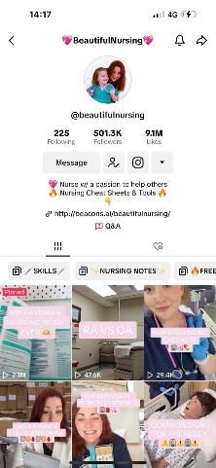
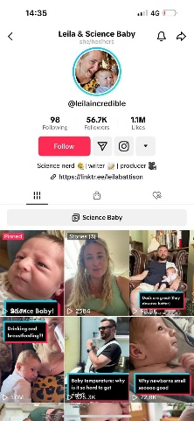
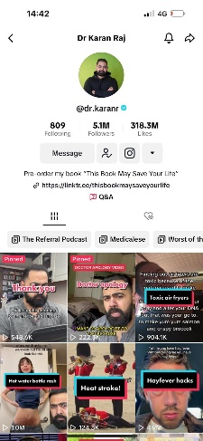
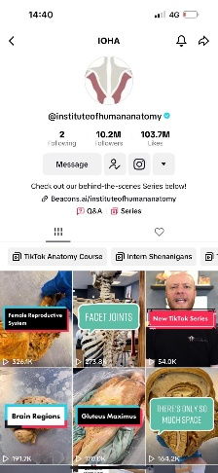
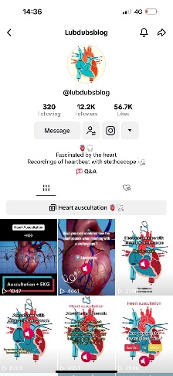
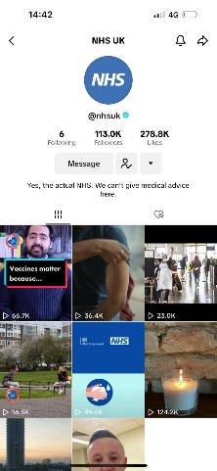
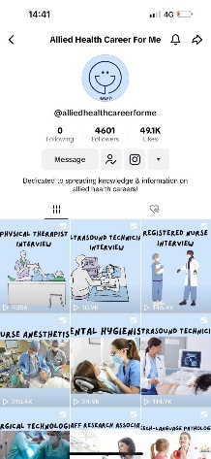

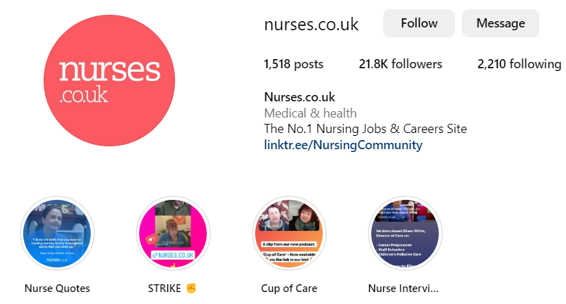

Social Media
Follow
Follow
@midwifemama
@beautifulnursing
@leilaincredible
@dr.karanr
@instituteofhumananatomy
@lubdubsblog
@nhsuk
@alliedhealthcareforme
Nurses.co.uk
@nursezara_uk
If you have any others, you think are good, let us know ☺

Slide 8


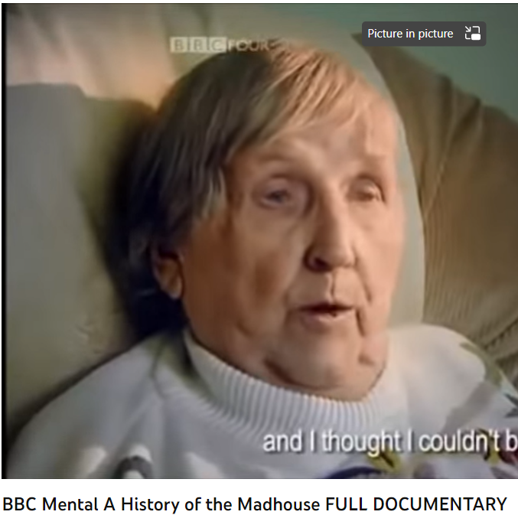
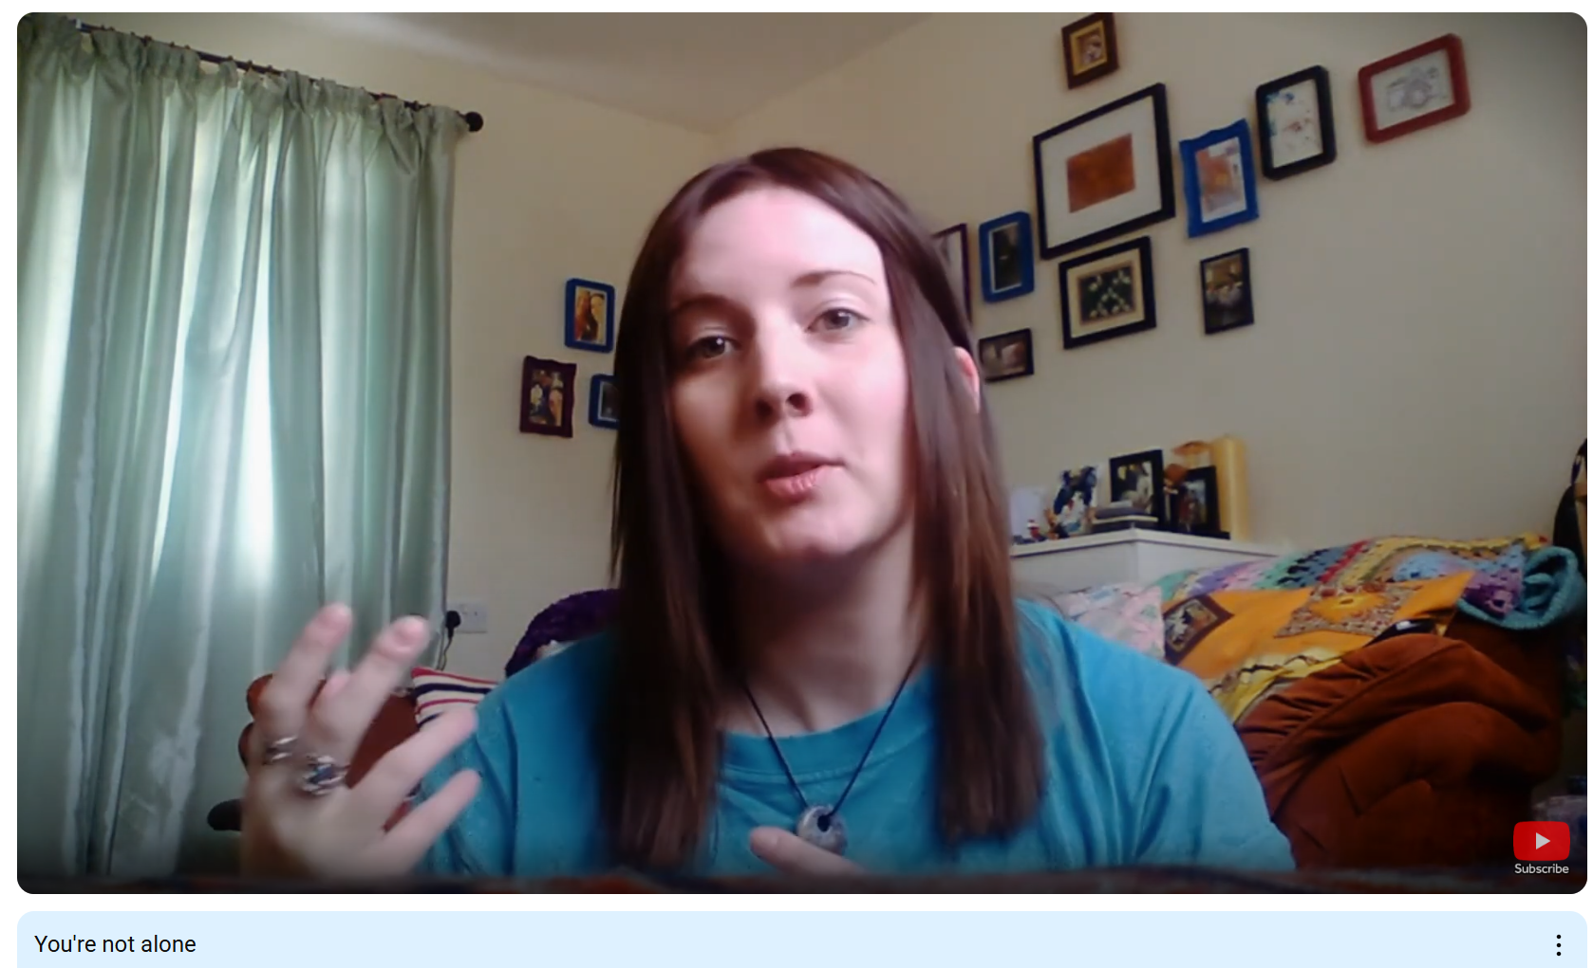
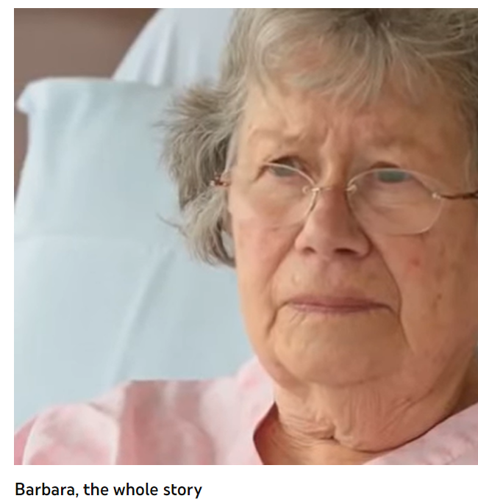
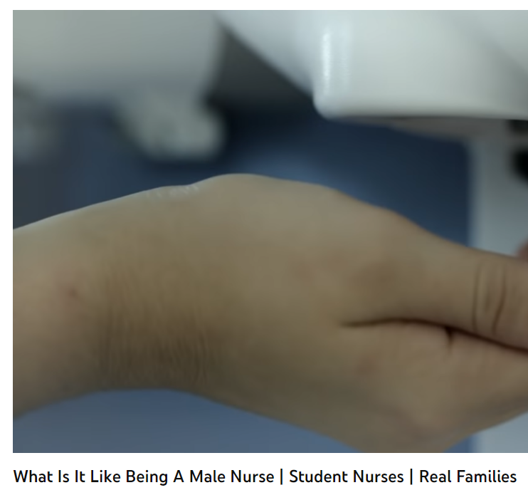
Health and Social Care in the Media
It is important to have a broad understanding of health care and social issues which affect services and professionals working for the NHS. One way of raising your awareness is to prepare you before your course starts with summer learning using different forms of media.
Your task is to pick…
➢ 2 Films
➢ 1 Book
➢ 2 Documentaries
You are then tasked with writing a report which is to be a minimum of half an A4 page with the following title: ‘Discuss the issues [in the film/book or documentary] and impact on health care provision’
You must watch or read using examples on the previous slides or another media resource relevant to your learning.
Consider the following:
What issues, if any, are being raised in the stimulus? E.g. dementia
How does the stimulus present health? E.g. care for people with dementia
Explain why the topic of the media source is relevant to your learning and whether you think it is helpful and why?
This list is NOT exhaustive there may be other questions/ideas you wish to consider as you watch or read – it would be lovely to share with us all.

Slide 9
Learning Log
Record here any additional reading/viewing you are undertaking in order to show what you have been completing in order to prepare you for the course. Use the reading list on the previous slides you have been given for guidance on what you could you watch/read/research
Date | Title | Summary of content | My thoughts

Slide 10
An information leaflet task
Choose one of the below
Research the government recommendations for the below lifestyle factors and produce and educational information leaflet;
Alcohol units
Exercise
Hydration
Nutritional diet
Sleep
Smoking
Prescription and illegal drugs
Research different techniques to manage stress, worries and anxieties and produce an educational leaflet;
Grounding
Breathing exercises
Me time and saying no
Meditation
Avoid unhealthy habits

Slide 11

Passport to Sixth Form
Check list
Use this list to make sure you have everything you need to hand in in September in order to start your AAQ Health & Social Care course.
Report/review on your chosen film, documentary and book in the media, page 8.
Complete at least a minimum of 5 sections of the learning log, page 9.
Information leaflet task, page 10
Have an A4 ring binder and dividers ready for learning materials
Pencil case with pens, high lighters, pencil and rubber.
A positive attitude, a lovely smile and be ready to be yourself ☺

