Slide 1


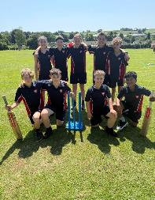
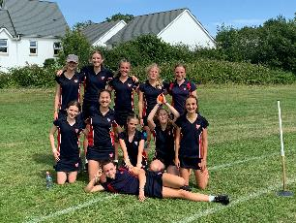

Summer Term Extra-Curricular Timetable
Starting 27th April
Time | Monday | Tuesday | Wednesday | Thursday
Lunchtime (13.40 - 14.15) | Fitness Suite All year groups Gym Mr Styler | Super League - Rounders Year 7 Grids Mrs Meatyard and Miss Booton | Fitness Suite All year groups Gym Miss Thomas | Super League - Rounders Year 8 (Fri A Thurs B) Grids Mr Meatyard and Mr Wood
After School (3.30-4.30) | Year 7 -10 Athletics Astro Mr Styler Mr Wood | CNAT Power Hour - Week B PE1 Mr Styler Year 7 and 8 Rounders Grids Miss Booton & Mrs Meatyard Year 7 – 10 Tennis Tennis Courts Mr Meatyard | Dance Power Hour - Week B EN8 Miss Thomas PE Studies Power Hour - Week B PE1 Mr Chisholm Year 9 and 10 Cricket Astro Mr Trumper Year 9 and 10 Rounders Grids Miss Thomas | Year 7 and 8 Cricket Astro Mr Furness-brown, Mr Wood & Miss Booton Year 7 – 10 Flag Football Grids Mr Meatyard & Mr Styler
Teamwork Resilience Respect Leadership Confidence Effort Communication

