Slide 1

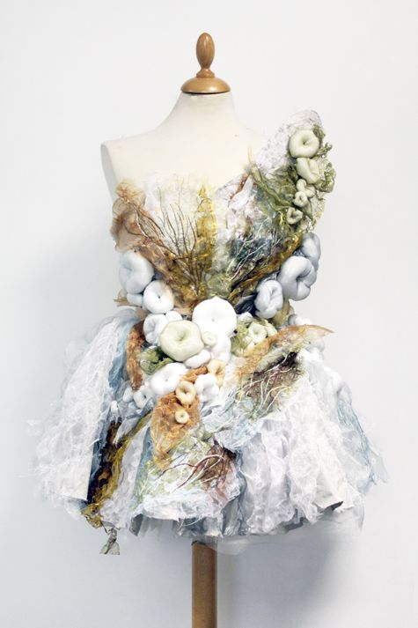
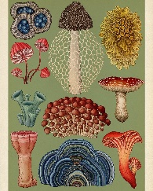
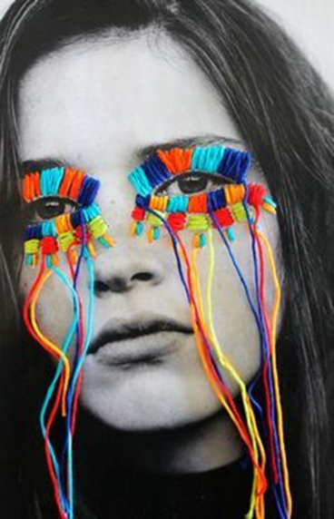


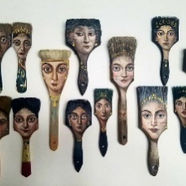

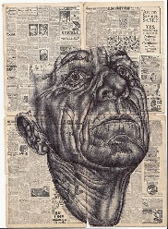
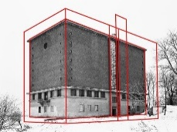
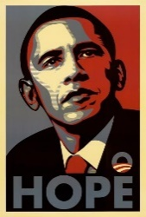
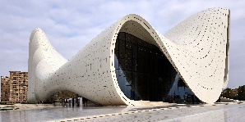
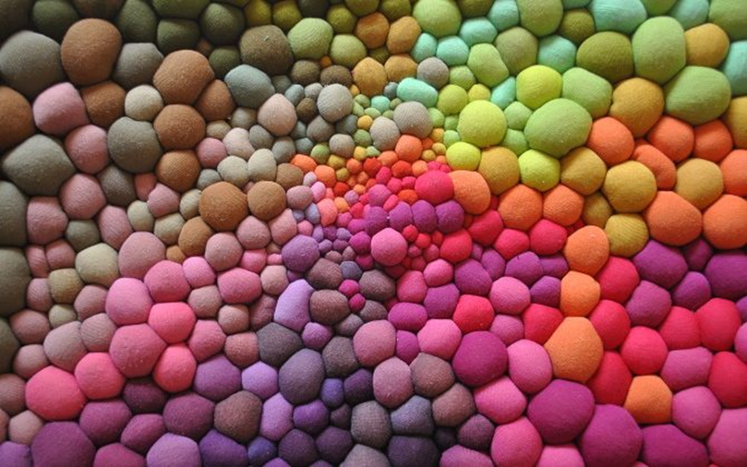

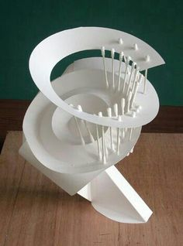
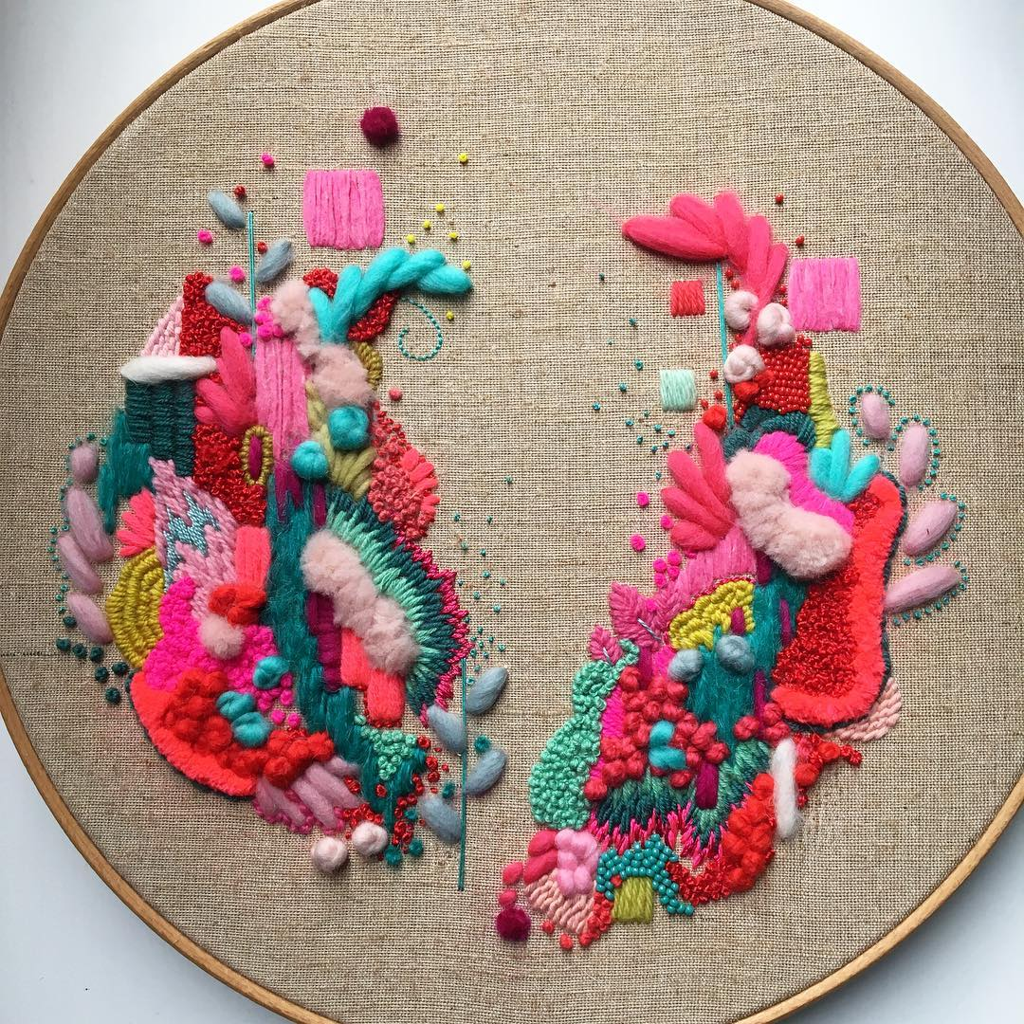

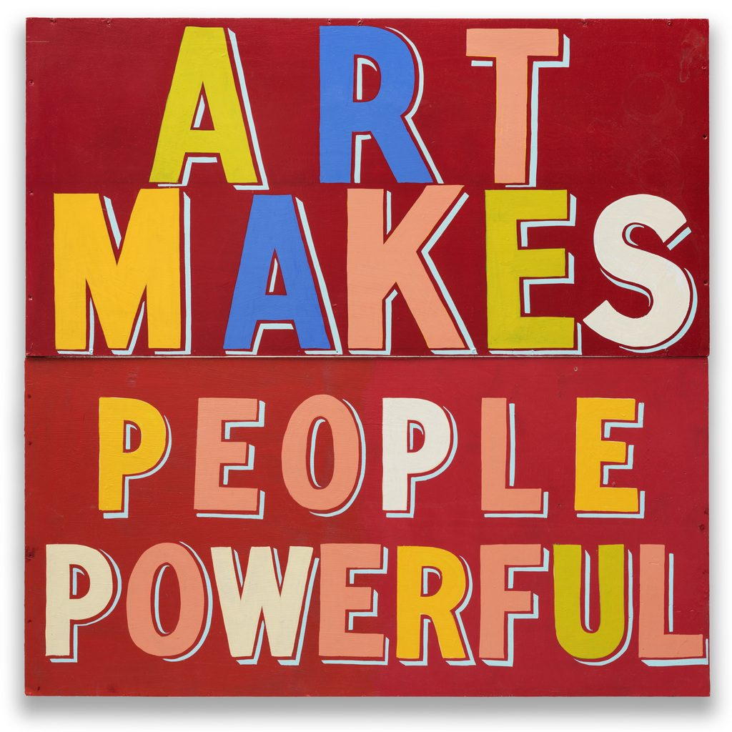
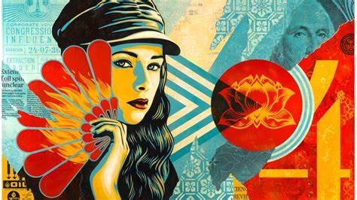
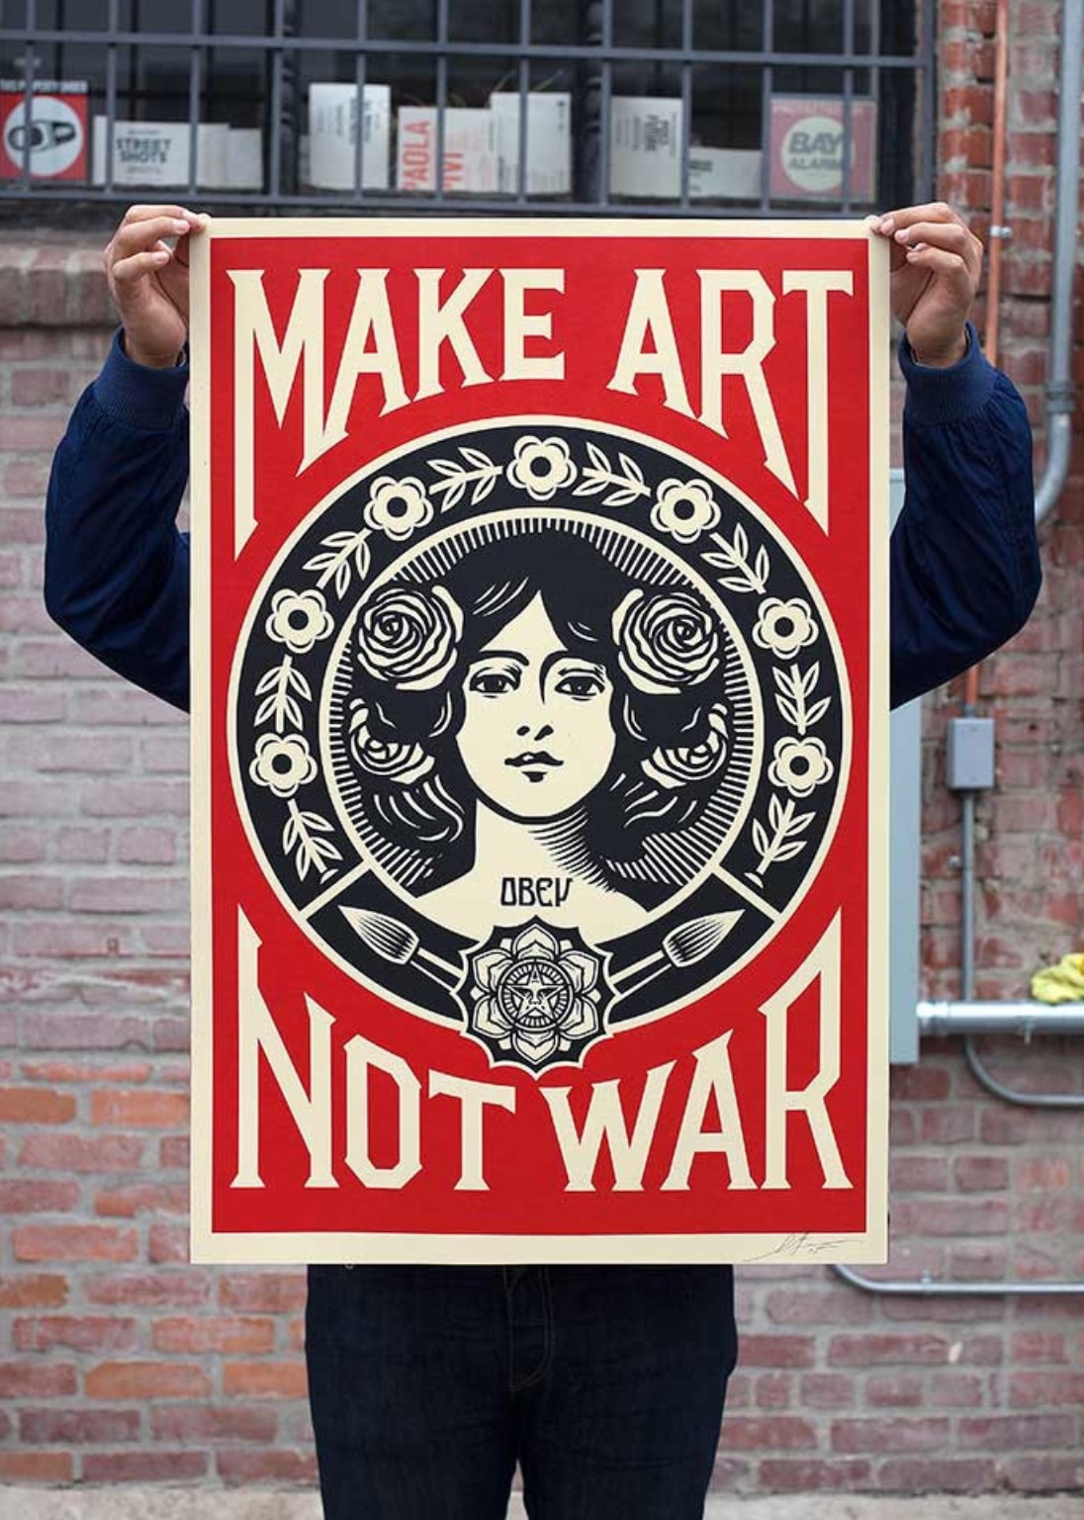
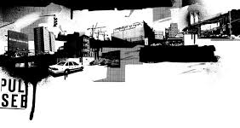
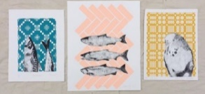
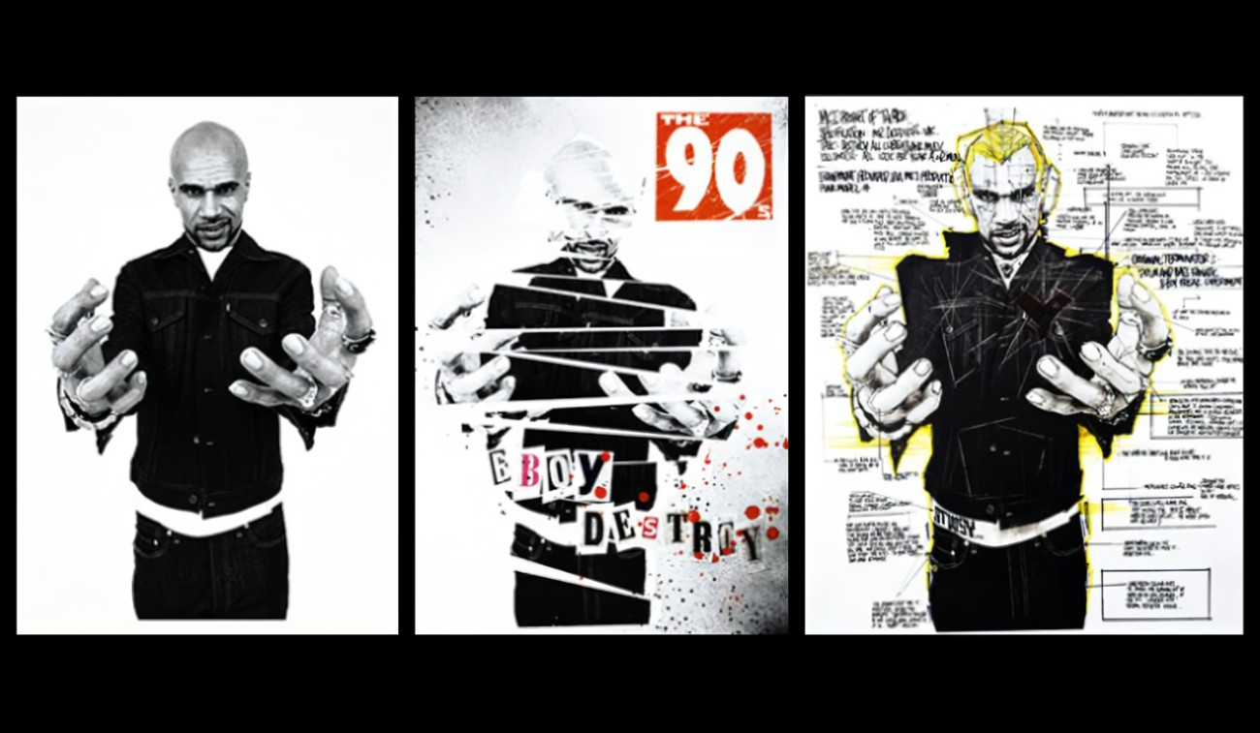
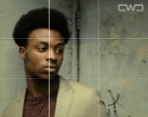

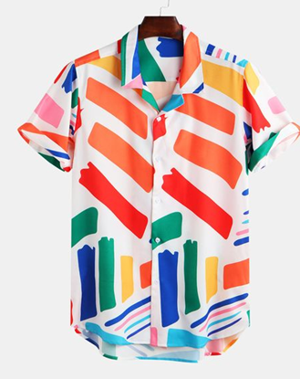
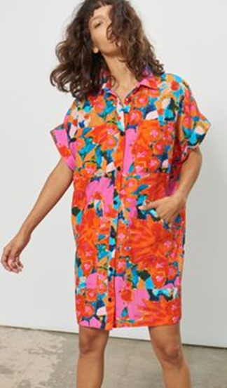

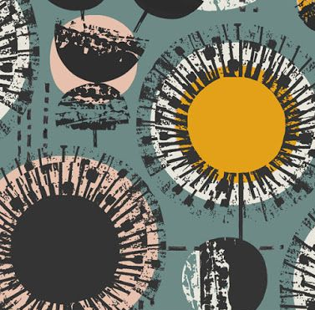

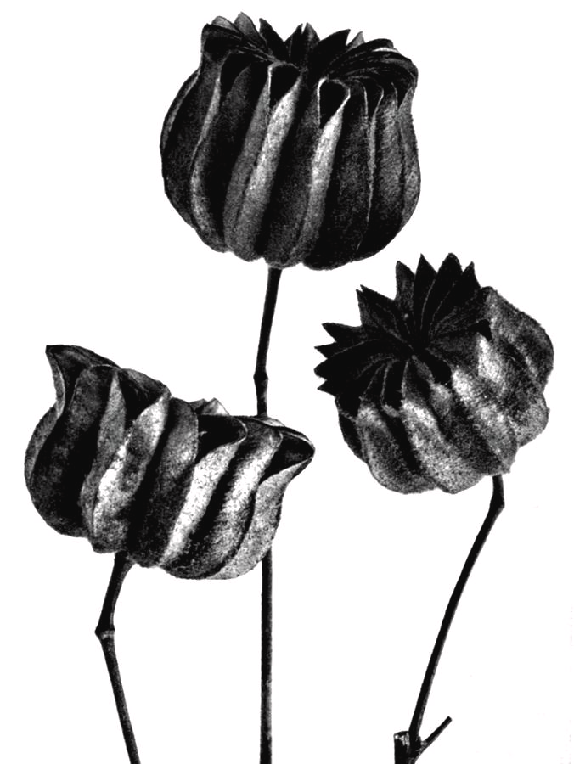
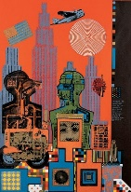
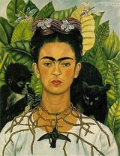
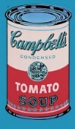
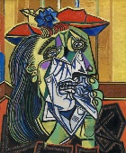
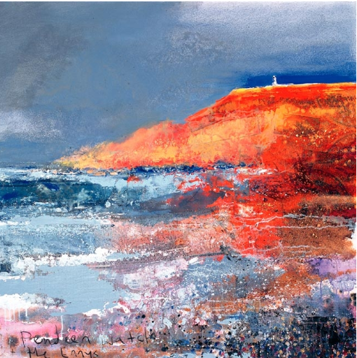


The Five Year Curriculum: Creative Arts
Pupils’ Learning Journey
Katie Scott
Jean Paul Gaultier
10-hour practical exam based upon a theme provided by the exam board
How will your journey continue?
A-Level Art, Craft & Design
A-Level Textiles
A-Level Graphics
A-Level Photography
Externally Set Assignment 40% of GCSE
EXTERNALLY SET ASSIGNMENT
Waldemar Strempler
YEAR 11 GCSE
Your final year of GCSE will allow you to explore and experiment with all of your skills, understanding and previous knowledge in your chosen subject specialist area. You will be expected to show evidence of all four assessment objectives in your Portfolio and Externally Set Assignment.
Portfolio 60% of GCSE
Victoria Villasana
Natalia Santos
YEAR 11
Further learning how to evaluate your own and others work at a higher level
PORTFOLIO
Year 11
Developing how to talk and write about your own and other’s work using key vocab, terminology and expressing your own opinions
Alexandra Dillon
By choosing a Creative Arts subject at GCSE you get the opportunity to explore a variety of skills and techniques in Art & Design, Photography, Textiles and 3D Design building upon all of your previous knowledge and experience
AO 1 – EXPLORE and be INSPIRED. Learn how to research, analyse, write and discuss ideas and themes in your own work and the work of others.
YEAR 10 GCSE
AO 2 – PLAY and be CREATIVE. Learn how to experiment with a range of media and processes, developing and linking ideas to a theme.
SKILLS
Alexey Bogolepov
AO 3 – RECORD and be INVENTIVE. Learn how to observe and record in a variety of media. How to develop ideas, plans and designs linking to artists work and themes.
Learn how to apply and experiment with the Visual Elements through a variety of skills, techniques and processes
AO 4 – CREATE and be ORIGINAL. Learn how to create original and meaningful outcomes that show relevant links to ideas and a theme.
Mark Powell
PORTFOLIO
Shephard Fairey
Learning how to create original artwork inspired by the work of others
How will your journey continue?
GCSE Art & Design
GCSE Photography
GCSE Textiles
GCSE 3D Design
Zaha Hadid
Serena Garcia Dalla Venezia
Heatherwick Studios
Wild Floss Embroidery
Bob & Roberta Smith
Shepard Fairey
YEAR 10
ART ACTIVISM
Miles Donovan
TC#9 Artists and designers use text & images
to create
work with personal, political or social messages
YEAR 9 CREATIVE CHOICES?
Developing how to talk and write about your own and other’s work using key vocab, terminology and expressing your own opinions
Learning how to create a variety of original artworks and outcomes inspired by the work of others
The Yr 9 Curriculum Creative Arts allows you to develop your skills further in Art & Design, Photography, Textiles and 3D Design by exploring the Visual Elements in greater detail. This pathway will help you in your decisions of which Creative GCSE option to choose
TC#7 Creatives produce original work on their own and in collaboration. Art inspires design and vice versa
TC#8 Artists use self expression and symbols to convey identity & ideas
CREATIVITY & CAREERS
SELF EXPRESSION & SYMBOLISM
Marian Haf - printmaking
YEAR 9
Learn how to apply and experiment with the Visual Elements through a variety of skills, techniques and processes
Further learning how to evaluate your own and others work at a higher level
Year 9
Composition – Rule of Thirds
Fashion Textiles
Rankin – Destroy Project
Learning how to create original artwork inspired by the work of others
TC#6 Artists, architects & designers use perspective to represent & distort space to shape the built environment
TC#5 Artists use traditional craft techniques to create work with different forms & functions
NEW PERSPECTIVES
Rachel Jaques
Learning how to evaluate your own and others work
ART & CRAFT
Alexander Rodchenko
Learning how to apply the Visual Elements through
collage techniques
Karl Blossfeldt
Developing how to talk and write about your own and other’s work
Learning how to create original artwork inspired by the work of others
Developing how to talk and write about your own and other’s work
Eduardo Paolozzi
Learn how to apply the Visual Elements through design and print
TC#3 Art & culture go hand in hand. Art is the creative expression of culture, reflecting its customs, beliefs and values
Learning how to create original artwork inspired by the work of others
YEAR 8
TRADITION & INNOVATION
Learning about genres of artwork and how to identify the Visual Elements
ART & CULTURE
Year 8
Frida Kahlo
TC#4 Artists use traditional methods to create art. They also rebel against the ‘rules’ to create new ideas
Pablo Picasso
Sugar Skulls & The Day
of the Dead Festival
TC#2
Artists connect our senses & express ideas & emotions.
Artists experiment & take risks
Andy Warhol
Learning how to evaluate your own and others work
Learning how to create original artwork inspired by the work of others
Learning how to draw a portrait
Kurt Jackson
MAKING SENSE
Luke Dixon
YEAR 7
MARK-MAKING
Year 7
Learning about colour theory and how it is used in Art
Learn how to talk and write about your own and other’s work
Learning how to evaluate your own and others work
TC#1 Artists observe, make marks and respond to the world around them
Discovering the Visual Elements through drawing

