Slide 1



Maths Calculations Year 4
Methods for teaching the four calculations at St. David’s.

Slide 2
Year 4 National Curriculum objectives.
Year 4:
Pupils should be taught to:
add and subtract numbers with up to 4 digits using the formal written methods of columnar addition and subtraction where appropriate
estimate and use inverse operations to check answers to a calculation
solve addition and subtraction two-step problems in contexts, deciding which operations and methods to use and why.
recall multiplication and division facts for multiplication tables up to 12 × 12
use place value, known and derived facts to multiply and divide mentally, including: multiplying by 0 and 1; dividing by 1; multiplying together three numbers
recognise and use factor pairs and commutativity in mental calculations
multiply two-digit and three-digit numbers by a one-digit number using formal written layout
solve problems involving multiplying and adding, including using the distributive law to multiply two digit numbers by one digit, integer scaling problems and harder correspondence problems such as n objects are connected to m objects.

Slide 3
Vocabulary related to the four calculations for Year EYFS – Year 6
EYFS/Year 1
more (than) less (than) total
fewer (than) equal (to) most
least
sum difference between total
first
plus add(ition) subtract(ion)
minus ones tens column(s) multiples
Year 2
multiple commutative
>as ‘greater than’
< as ‘less than’ partition
place holder
place value estimate
estimation
inverse
array
calculate
multiplication division
times tables
Year 3
multiple(s) inverse operations integer(s) decimal(s) remainder
Year 4
round rounding
negative
operation
Factor
factor pairs distributive associative derive remainder
odd even double halve pair
how much how many larger smaller estimate compare together
Year 5
power(s) prime complement
composite prime factor square(d)2 cube(d)3 equivalence
Year 6
long division Multi-step common factors common multiple

Slide 4
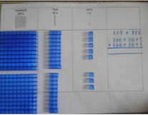
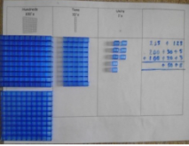
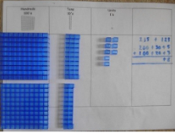
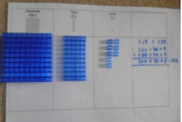
Addition
Expanded horizontal method, leading to columnar addition:
The concept of exchange is reinforced through continued use of manipulatives.
Teachers model:
Step 3: add the tens together write this total below.
Step 1: Partition the numbers into hundred, tens and ones.
Step 4: add the hundreds together write this total below.
Step 5: add all totals together.
Step 2: add the ones together write this total below.

Slide 5
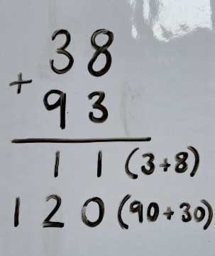
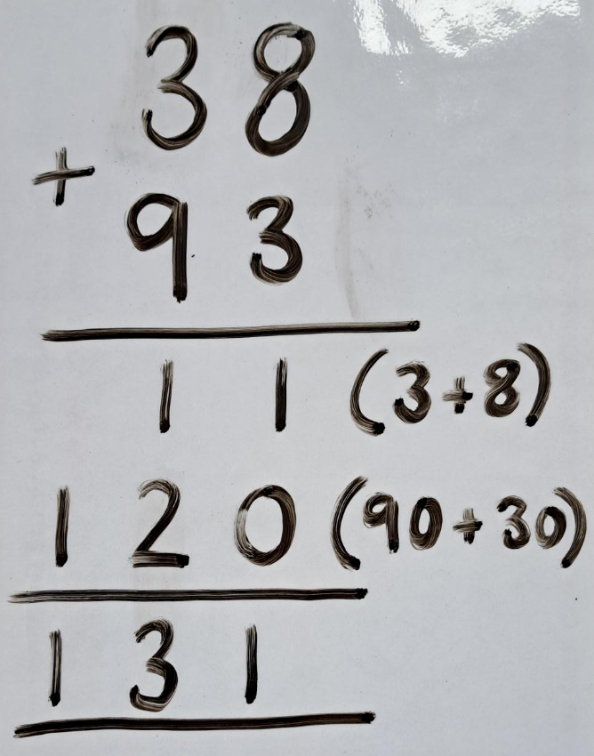
Addition continued…
Children then advance to model the addition of two 3-digit numbers through method as shown.
Add the ones first
Then add the tens
Then add to reach the total.

Slide 6

Need to be able to:
•Add in columns.
•Have place value awareness.
•Organisation (layout)
•Ability to estimate.
•Can check answers for reasonableness

Slide 7
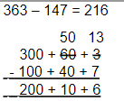
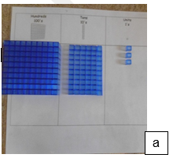
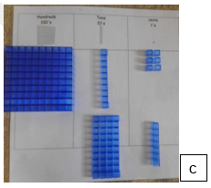
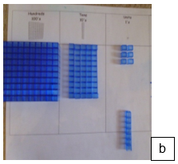
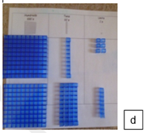
subtraction
Expanded horizontal method, leading to columnar subtraction:
The concept of exchange is reinforced through continued use of manipulatives.
Teachers model:
Step 3: subtract the tens write the answer below.
Step 1: Partition the numbers into hundred, tens and ones.
Step 2: subtract the ones write the answer below. We need to exchange a ten for 10 ones.
Step 4: subtract the hundreds write the answer below.

Slide 8

Subtraction continued…
Finding the difference:
Finding the difference is used when two numbers are close together – using a number line on a strip of paper.

Slide 9
Need to be able to:
•Subtract Ones from Ones; Ones from Tens and Ones
•Have place value awareness.
•Organisation (layout).
•Knows to work from right to left.
•Understands conservation of number.
•Knows larger number goes “on top”.
•Knows you can only exchange one ten , hundred,
thousand etc.
•Ability to estimate.
•Can check answer for reasonableness

Slide 10
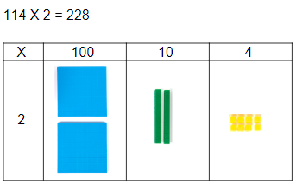
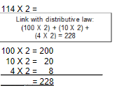
multiplication
Expanded horizontal method, leading to columnar multiplication:
The concept of exchange is reinforced through continued use of manipulatives.
Teachers model:
Step 1: Partition the numbers into hundreds, tens and ones.
Multiply each column by the multiplier.
Then add the hundreds, tens and ones to find the total.
u
Step 2: we now move to vertical layout but continue to partition into hundreds, tens and ones.

Slide 11
Need to be able to:
•Knows times tables
•Have place value awareness.
•Procedural fluency.
•Organisation (layout)
•Ability to estimate
•Can check for errors.

Slide 12
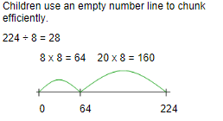

division
Expanded horizontal method, leading to columnar division: Dividing a 3 or 2-digit by 1-digit number, representing this efficiently on a number line, also in relation to long division:
The concept of exchange is reinforced through continued use of manipulatives.
Teachers model:
Step 1: Using known multiplication facts subtract these amounts from the larger number. Continue until you have reached 0 or the remainder is smaller than the divisor. Now count the number of chunks e.g. 20 + 8 = 28
u
Step 2: we now move to vertical layout but continue to subtract chunks using known multiplication facts.

Slide 13
Need to be able to:
•Know times tables
•Understand the effect of x ÷ by 10 and 100.
•Have place value awareness.
•Can subtract HTO from HTO.
•Organisation (layout)
•Ability to estimate
•Can check for errors

