Slide 1
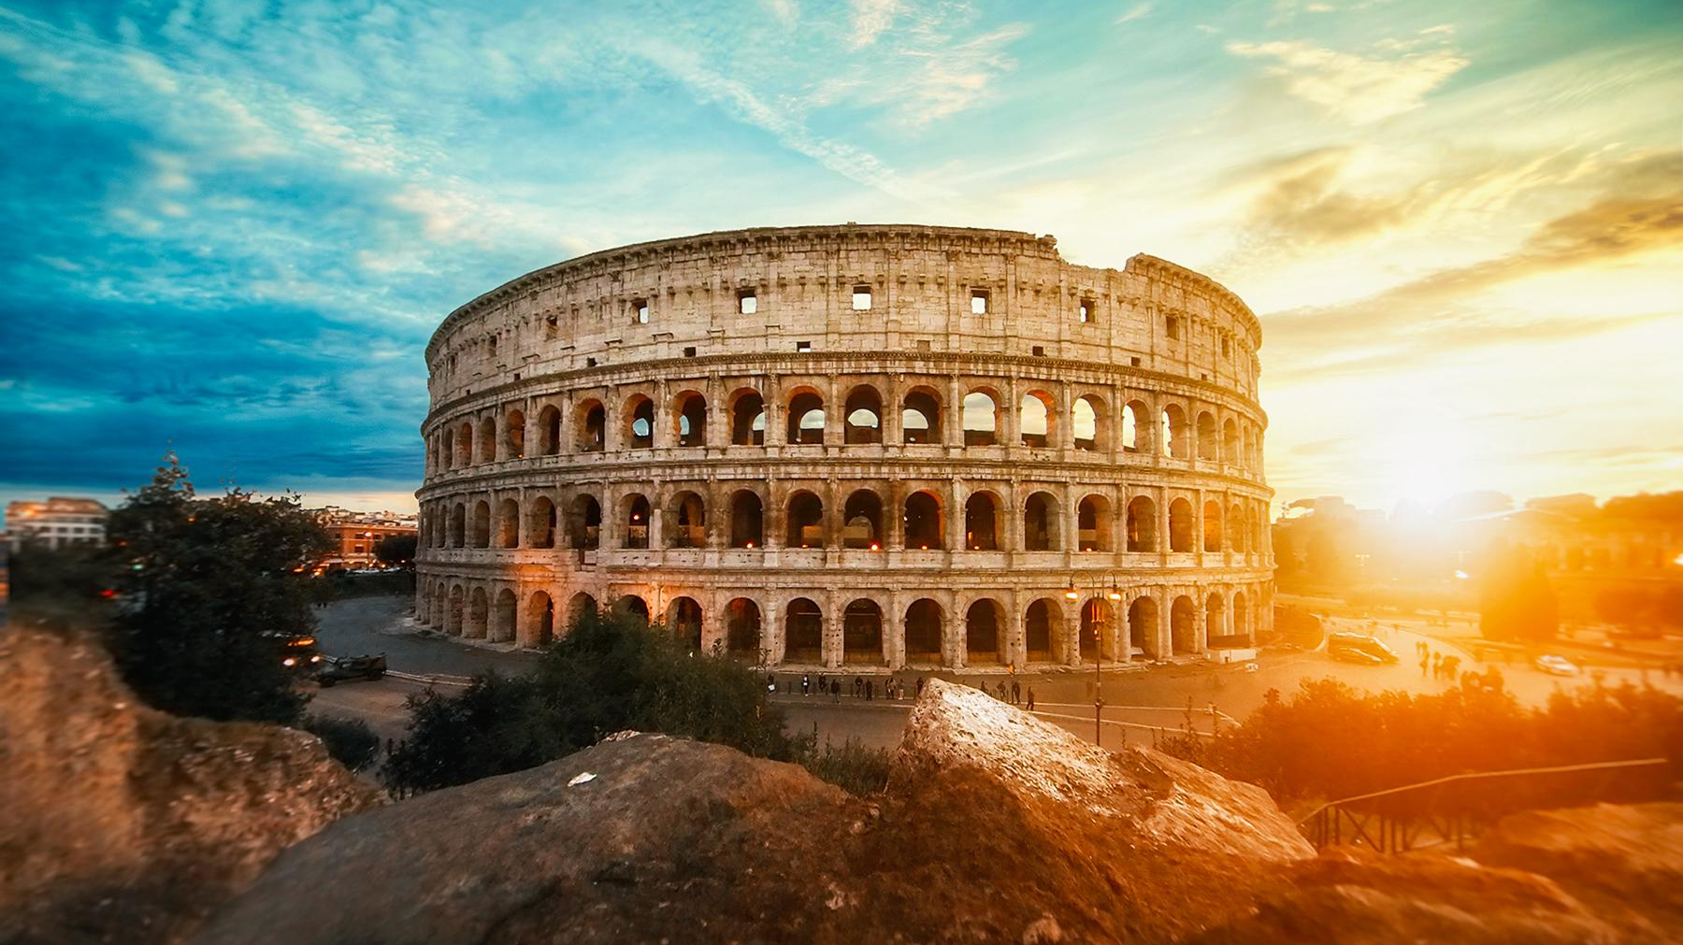
Ancient History:
Transition Work
Rome

Slide 2
Task 1: An Introduction - Note-taking
Read the 'Introduction to the Romans' pages.
Make notes on the 'Rome and the Romans' section.
Use the 'Roman Government' section to create a timeline with notes on the three major phases in the political history of Rome (Kingdom; Republic; Empire).
Use the 'Roman Society' section to create a diagram for the different classes in Roman Society. Include notes/annotations.

Slide 3
Task 2: The Olympian Gods - Sources
Read and make notes on Chapter 1: The Olympian Gods.
Complete the sources activities on the next slides -
Source 1.1: Vulcan's forge
Source 1.2: Venus' beauty
Source 1.3: A mosaic of Minerva
Source 1.4: Do gods look like humans?

Slide 4
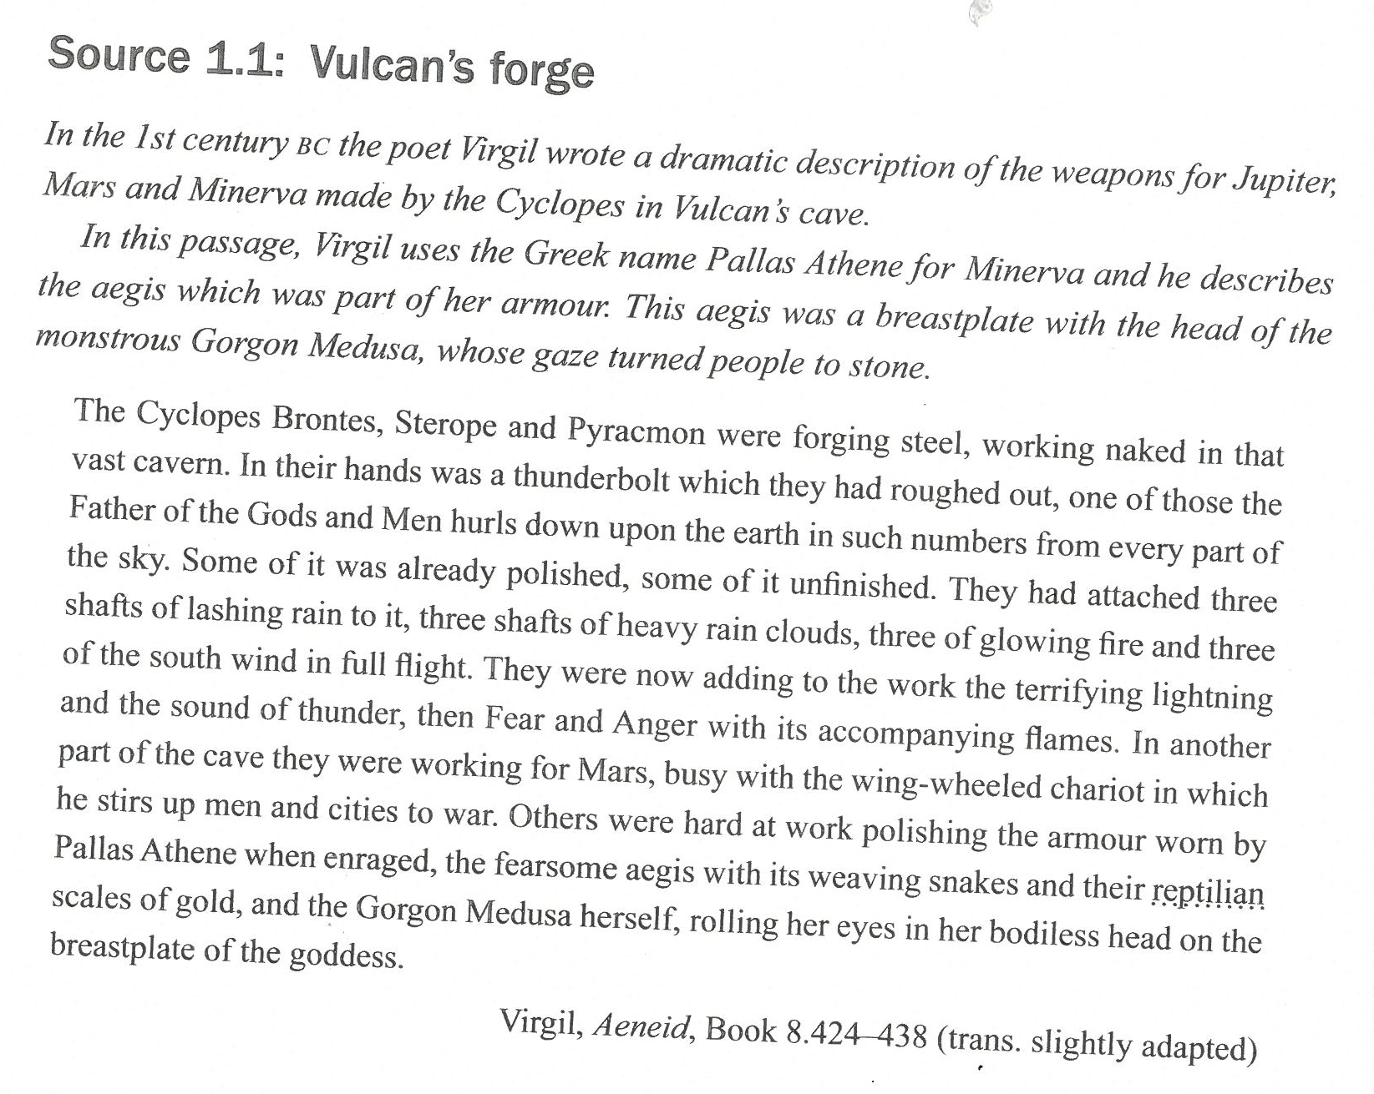
Questions
1. How many Cyclopes are described in the cave, and what are their names? What might the naming of individuals suggest about their role?
2. Which god is the thunderbolt being made for, and what does this suggest about his power and authority?
3. How does Virgil build a sense of fear and power in his description of the thunderbolt?
4. What are the Cyclopes making for Mars, and how does this reflect Roman ideas about war and Mars’ character?
5. Examine the description of Minerva’s armour. What imagery does Virgil use, and what does it suggest about her nature and powers?
6. Which deity is presented as the most powerful or intimidating in this passage? Support your answer with precise evidence from the text.
Notes:
Source 1.1: Vulcan's Forge
In the 1st century BC, the poet Virgil wrote a dramatic description of the weapons made for Jupiter, Mars, and Minerva by the Cyclopes in Vulcan's cave. In this passage, Virgil uses the Greek name Pallas Athene for Minerva, and he describes the aegis, which was part of her armour. This aegis was a breastplate featuring the head of the monstrous Gorgon Medusa, whose gaze turned people to stone.
The Cyclopes Brontes, Steropes, and Pyracmon were forging steel, working naked in that vast cavern. In their hands was a thunderbolt which they had roughed out—one of those the Father of the Gods and Men hurls down upon the earth in such numbers from every part of the sky. Some of it was already polished, while some of it was unfinished. They had attached three shafts of lashing rain to it, three shafts of heavy rain clouds, three of glowing fire, and three of the south wind in full flight. They were now adding to the work the terrifying lightning and the sound of thunder, then Fear and Anger with their accompanying flames. In another part of the cave, they were working for Mars, busy with the winged chariot in which he stirs up men and cities to war. Others were hard at work polishing the armour worn by Pallas Athene when enraged: the fearsome aegis with its writhing snakes and their reptilian scales of gold, and the Gorgon Medusa herself, rolling her eyes in her bodiless head on the breastplate of the goddess.
Virgil, Aeneid, Book 8.424–438 (translation slightly adapted)

Slide 5
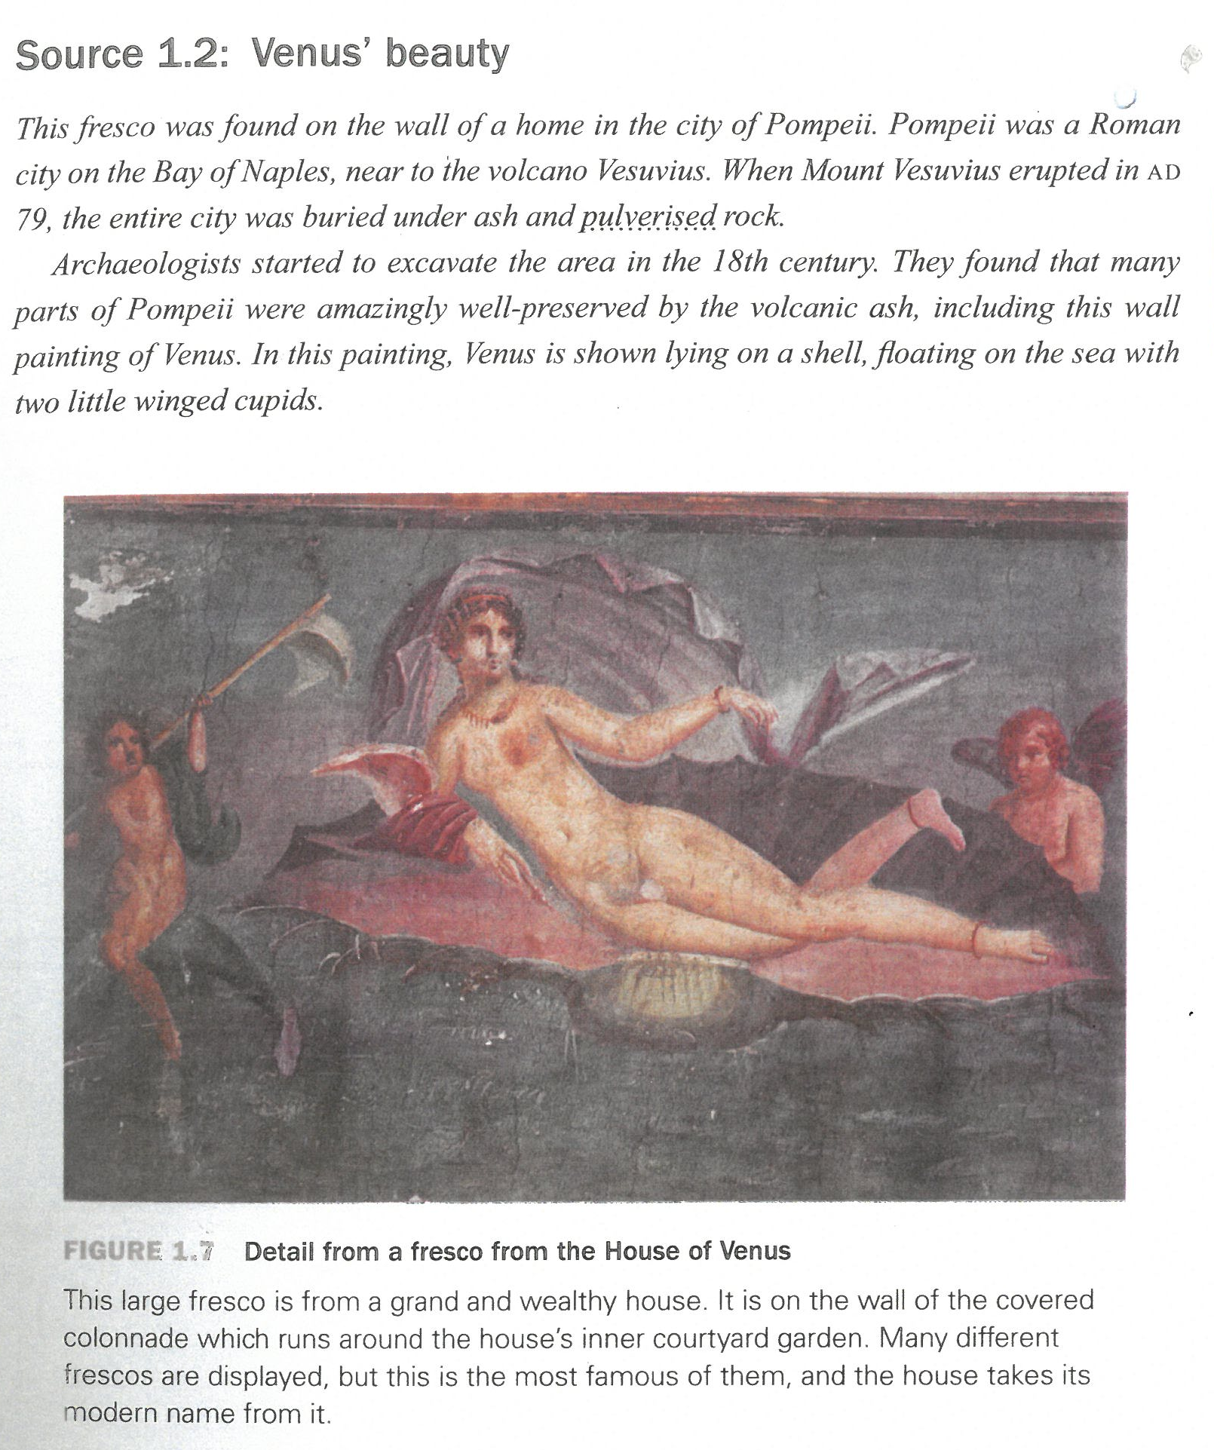
Questions
1. What has the painter done to Venus’ appearance to show that she is the goddess of love?
2. What characteristics does this image suggest belong to Venus?
3. Why do you think the Romans might have wanted paintings of the gods on display in their homes?
Notes:
Source 1.2: Venus’ Beauty
This fresco was found on the wall of a home in the city of Pompeii. Pompeii was a Roman city on the Bay of Naples, near the volcano Vesuvius. When Mount Vesuvius erupted in AD 79, the entire city was buried under ash and pulverised rock.
Archaeologists started to excavate the area in the 18th century. They found that many parts of Pompeii were amazingly well preserved by the volcanic ash, including this wall painting of Venus. In this painting, Venus is shown lying on a shell, floating on the sea with two little winged cupids.
Figure 1.7: Detail from a fresco from the House of Venus
This large fresco is from a grand and wealthy house. It is on the wall of the covered colonnade which runs around the house’s inner courtyard garden. Many different frescos are displayed, but this is the most famous of them, and the house takes its modern name from it.

Slide 6
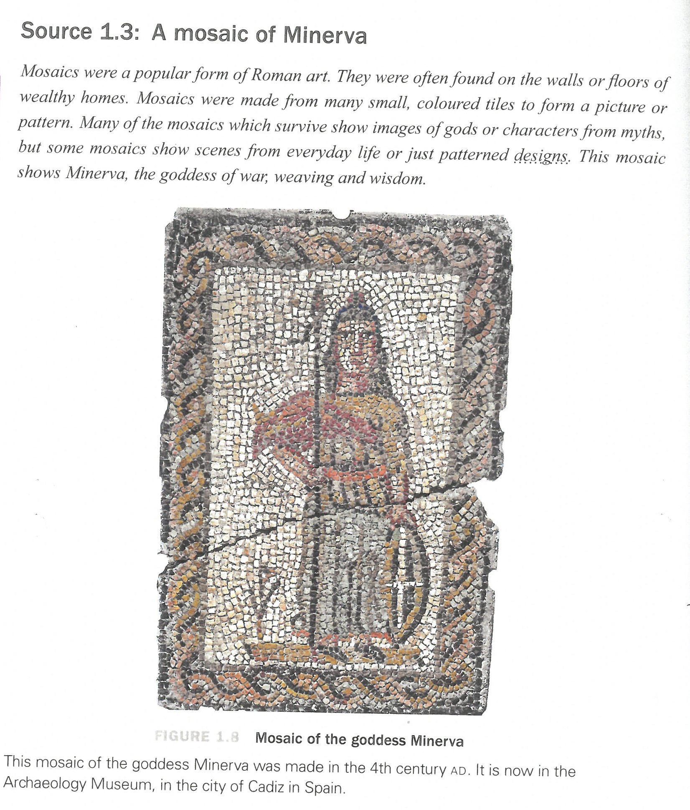
Questions
1. How can you identify the figure in the mosaic as the goddess Minerva? Give at least two pieces of visual evidence.
2. What does the mosaic suggest about Minerva’s character or role? Use details from the image to support your answer.
3. Why did this mosaic require a high level of skill to create? Explain your answer with reference to the use of small tiles (tesserae) and the level of detail.
4. What does this suggest about the significance of the gods for the Romans?
Notes:
Source 1.3: A mosaic of Minerva
Mosaics were a popular form of Roman art. They were often found on the walls or floors of wealthy homes. Mosaics were made from many small, coloured tiles to form a picture or
pattern. Many of the mosaics which survive show images of gods or characters from myths but some mosaics show scenes from everyday life or just patterned designs. This mosaic
shows Minerva, the goddess of war, weaving and wisdom.
FIGURE 1.8 Mosaic of the goddess Minerva
This mosaic of the goddess Minerva was made in the 4th century AD. It is now in the Archaeology Museum, in the city of Cadiz in Spain

Slide 7
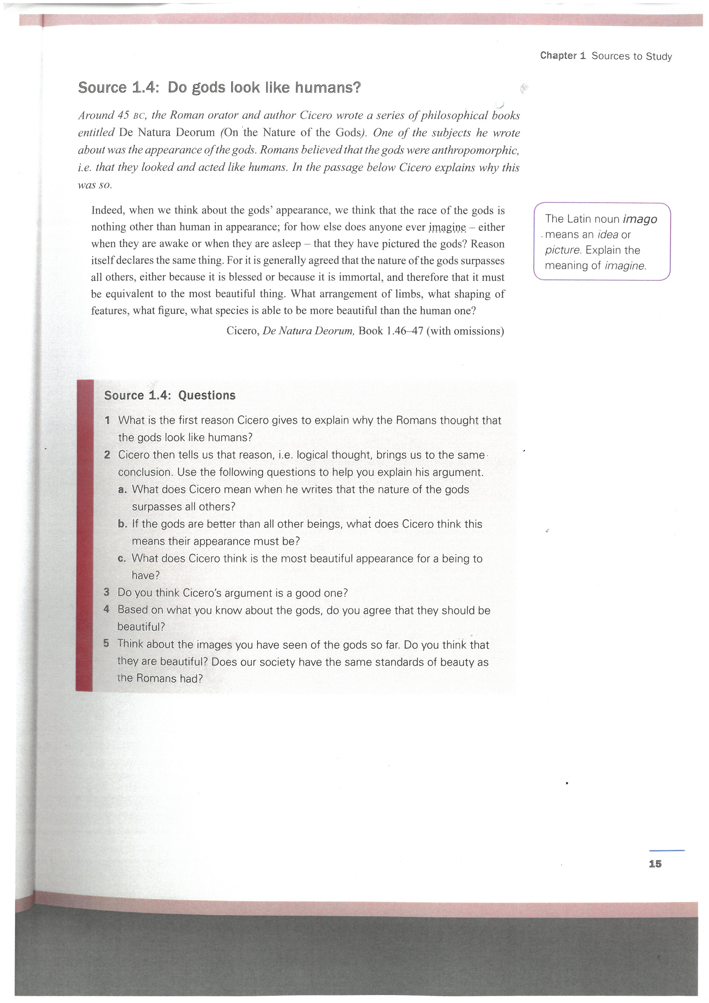
Questions
1. What reasons does Cicero give to explain why Romans believed the gods looked like humans?
2. How convincing do you find Cicero’s reasons? Use evidence from the source to support your view.
3. What does this source suggest about Roman beliefs about the nature of the gods?
Notes:
Source 1.4: Do gods look like humans?
Around 45 BC, the Roman orator and author Cicero wrote a series of philosophical books entitled 'De Natura Deorum' (On 'the Nature of the Gods). One of the subjects he wrote about was the appearance of the gods. Romans believed that the gods were anthropomorphic. i.e. that they looked and acted like humans. In the passage below Cicero explains why this was so.
Indeed, when we think about the gods' appearance. we think that the race of the gods is nothing other than human in appearance; for how else does anyone ever imagine - either when they are awake or when they are asleep -that they have pictured the gods? Reason itself declares the same thing. For it is generally agreed that the nature of the gods surpasses all others, either because it is blessed or because it is immortal, and therefore that it must be equivalent to the most beautiful thing. What arrangement of limbs, what shaping of features, what figure, what species is able to be more beautiful than the human one?
Cicero, De Natura Deorum, Book 1.46-47 (with omissions)

Slide 8
Conclusions
Why do Roman myths often show gods behaving badly? Use the sources to support your answer.
Based on the sources, which god or goddess might Romans have considered most important to worship? Why?
What do these sources suggest about Roman values and attitudes towards the gods?

Slide 9
Task 3: Roman Heroes – Further Research
Read and make notes on Chapter 2: Roman Heroes.
Conduct further research on one of the following Roman heroes...
  Hercules
  Aeneas
  Romulus
Produce a 1–2 page summary (or detailed notes) addressing the following:
Myth and Story:
  Outline the key events of your chosen hero’s story
  Identify any involvement of the gods
Character and Values:
  What qualities does this hero represent?
  How do these reflect Roman values (e.g. duty, leadership, strength)?
Importance to the Romans:
  Why was this hero important in Roman culture?
  How might Romans have used this figure to explain or justify their world?
To what extent is your chosen figure a “typical” Roman hero? Support your view with evidence from your research.

