Slide 1

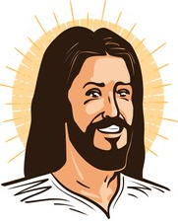

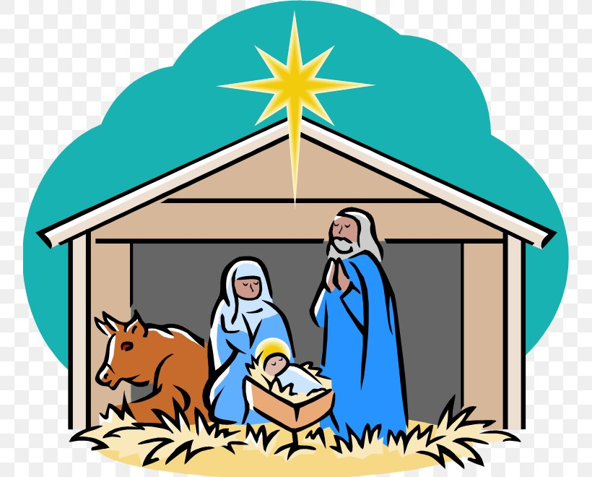

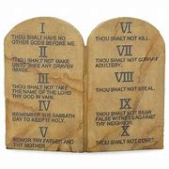


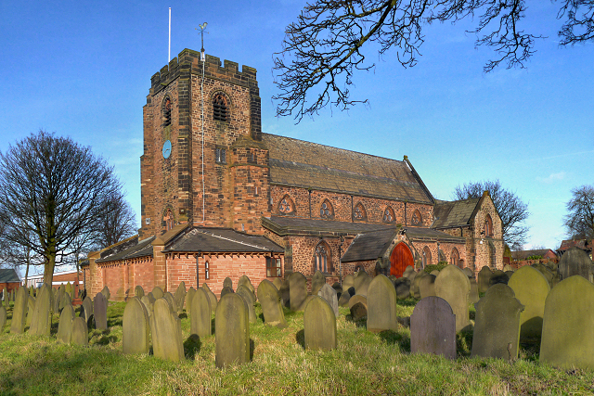

Vocabulary
Bible – Holy Book of Christianity
Charity – An organisation that helps people by raising money.
Church – Christian place of worship.
Crucifixion – A form of Roman punishment used on Jesus. It involves putting someone on a cross to die.
Disciple – A loyal servant and friend to Jesus
Holy Spirit – This is God’s power in action. Christians believe the Holy Spirit is with us at all times.
Parable – stories Jesus told
Prophet – Is a person who God has spoken to
Sacrifice – To think of somebody else before yourself
Testament – There is an old Testament and a new Testament they are parts of the Bible.
Christianity Y3/4
Where Christianity Began: Israel in the Middle East
How Christianity Began
Jesus Christ is the founder of Christianity.
Jesus Christ is the Son of God. He came to earth to teach about love and fellowship.
Jesus was a Jew who was born just over 2000 years ago in Bethlehem. Jesus lived for 33 years before being crucified by the Romans. After he died his teachings were firstly spread by his disciples and eventually Christianity spread around the world.
Christianity is the largest of the six main world religions.
The cross is the symbol of Christianity as Jesus died on the cross.
Discipleship
Jesus had 12 disciples who were very loyal to him. They trusted and believed in him.
After Jesus died they spread the word about God as Jesus had taught them to.
Prophets from the Bible:
Noah
God told Noah to build an ark to save the animals of the world and his family.
Abraham
God spoke to Abraham about getting people to trust God.
Moses
Moses freed the slaves from the Egyptians when God asked him to. God also gave Moses the Ten Commandments.
Parables are stories that Jesus told that have a moral to them which are usually to do with treating people equally or showing love to others.
Examples of parables:
The Good Samaritan
The Unforgiving Servant
Festivals/Special Times
Christmas is the celebration of Jesus’s birthday and is the 25th December.
Easter is the time when Jesus died to save the people.
Lent is linked to the story of ‘Jesus in the Wilderness’.
Pentecost
This is the celebration of the descent of the Holy Spirit onto the disciples.
Charities
Charities are important to Christians as they are helping people in need.
Some Christian Charities:
Cafod
Christian Aid
Main Beliefs
Christians believe that Jesus Christ was the Son of God and that
God sent his Son to earth to save people from doing bad things. He taught people how to live a good life and help others.
Jesus sacrificed himself to be crucified on cross by the Romans.
Jesus rose from the dead on the third day after his Crucifixion (the Resurrection)
Christians believe that there is only one God, but that this one God consists of 3 "persons"
  God the Father
  God the Son
  The Holy Spirit
Christians believe that God made the world.
The Bible
The Bible is the holy book of Christianity.
It is actually made up of 66 books put to together by different people over many years.
Testaments
The Bible is mainly split into two testaments.
The Old Testament contains everything about God and various prophets before Jesus came. Parts of the writing contained in the Old Testament are also sacred to Jewish and Muslim people.
The New Testament – Mostly about things that happened during Jesus’s life.
Statements by Jesus that have inspired people to show incredible passion for others
“Love the Lord your God with all your heart and with all your soul and with all your mind”
“Love your neighbour as yourself” (Christian love is known as agape – a selfless love of others.
Special People – Heroes
Mother Teresa – spent her whole life helping the poor people.
Oscar Romero – known as hero of the poor.
Gifts of the Holy Spirit
There are 7 gifts which are really qualities that can develop through the Holy Spirit.
They are Love, joy, peace, patience, kindness, goodness, faithfulness, gentleness and self-control.
Places of Worship:
The Church, Chapel or Cathedral
St. Nicholas’s Church, Sutton, St.Helens
The dove is the symbol of the Holy Spirit and peace.

