Slide 1
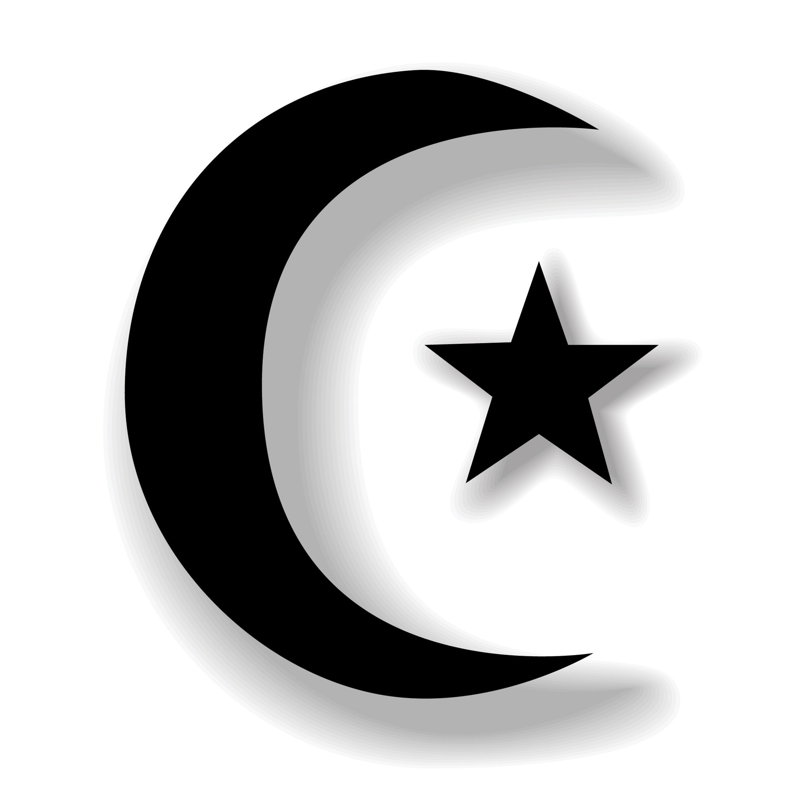
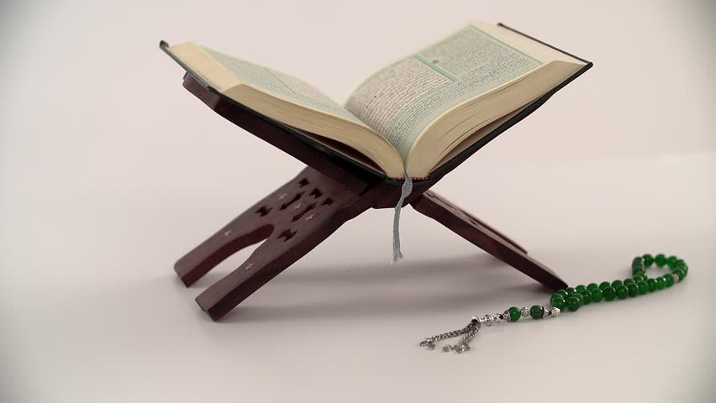
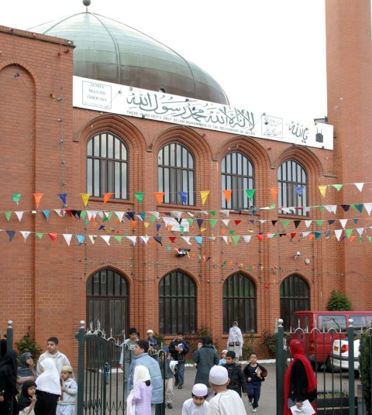
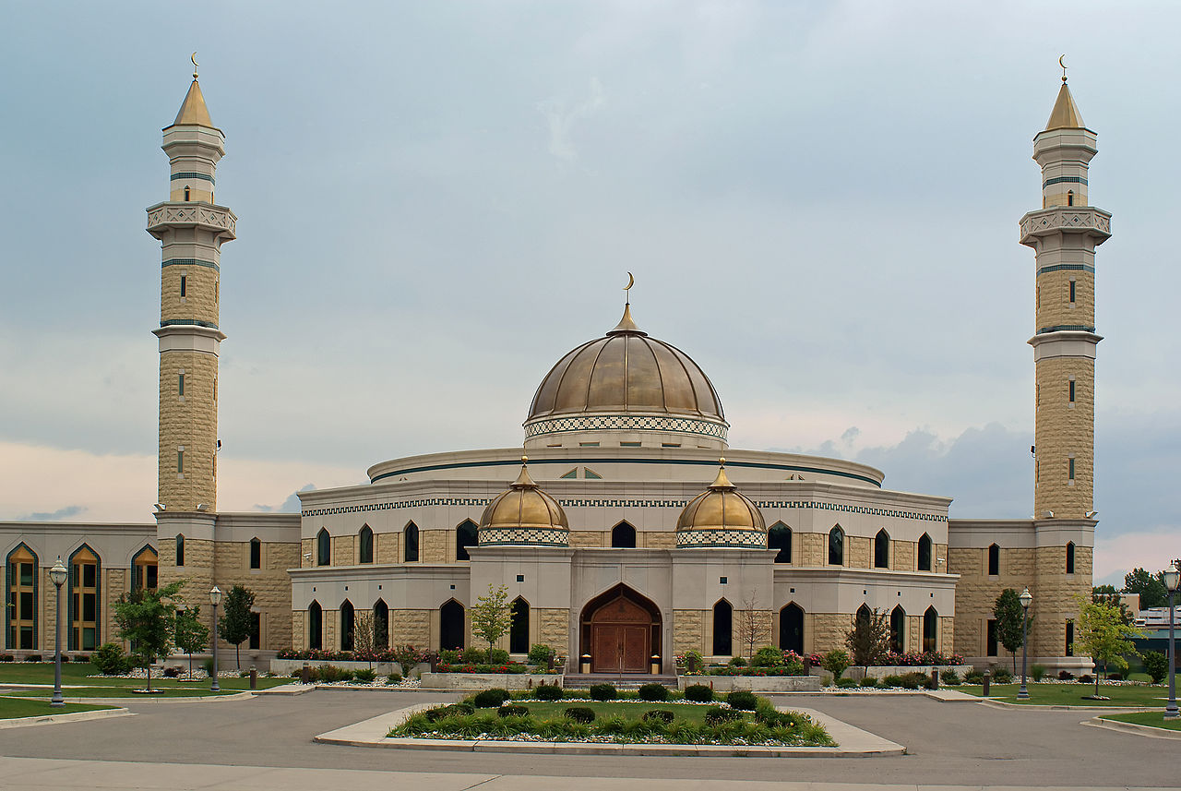
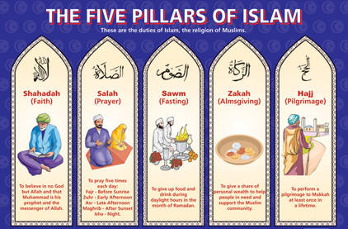
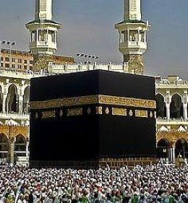
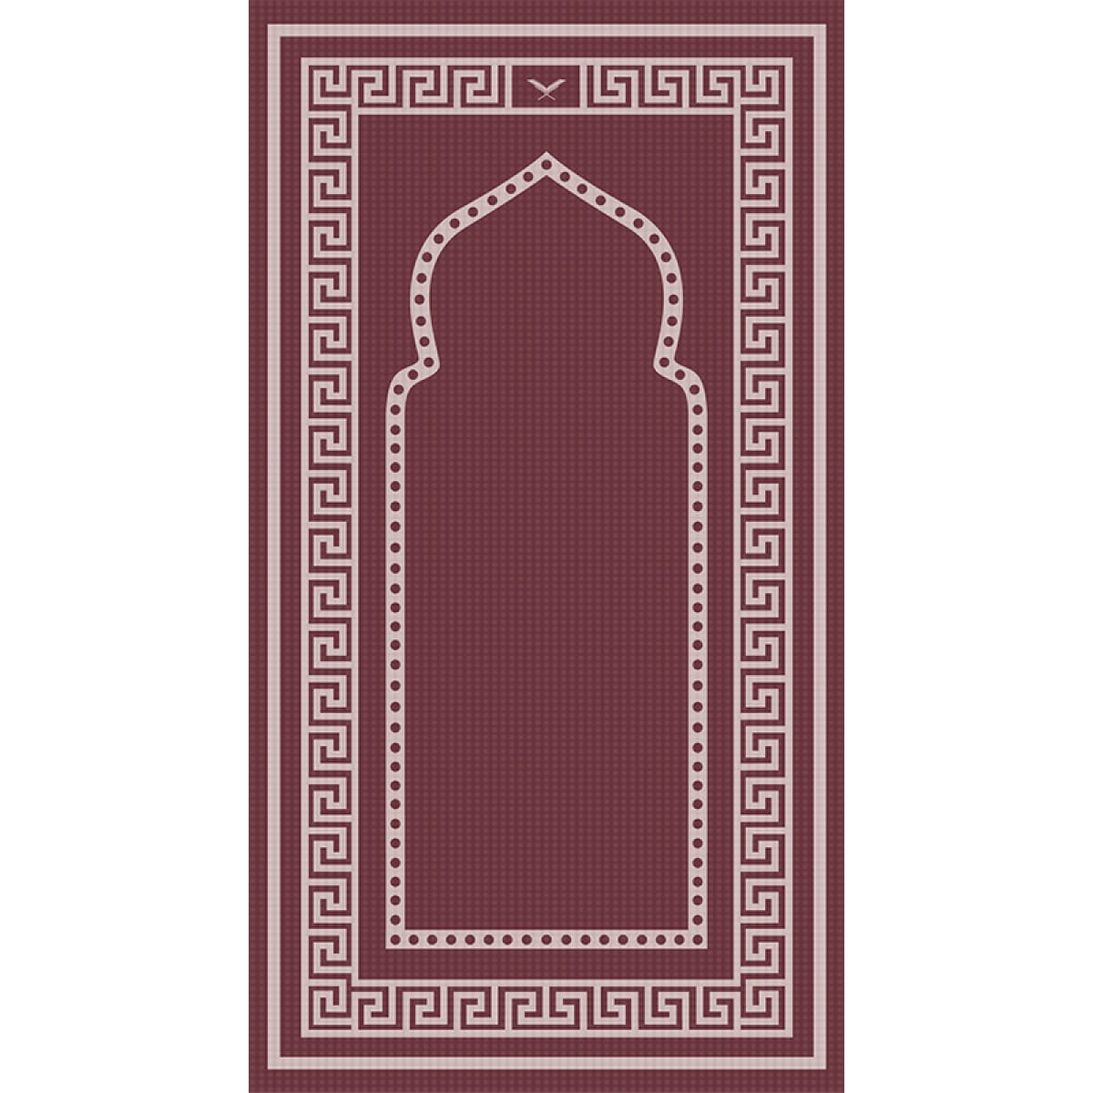
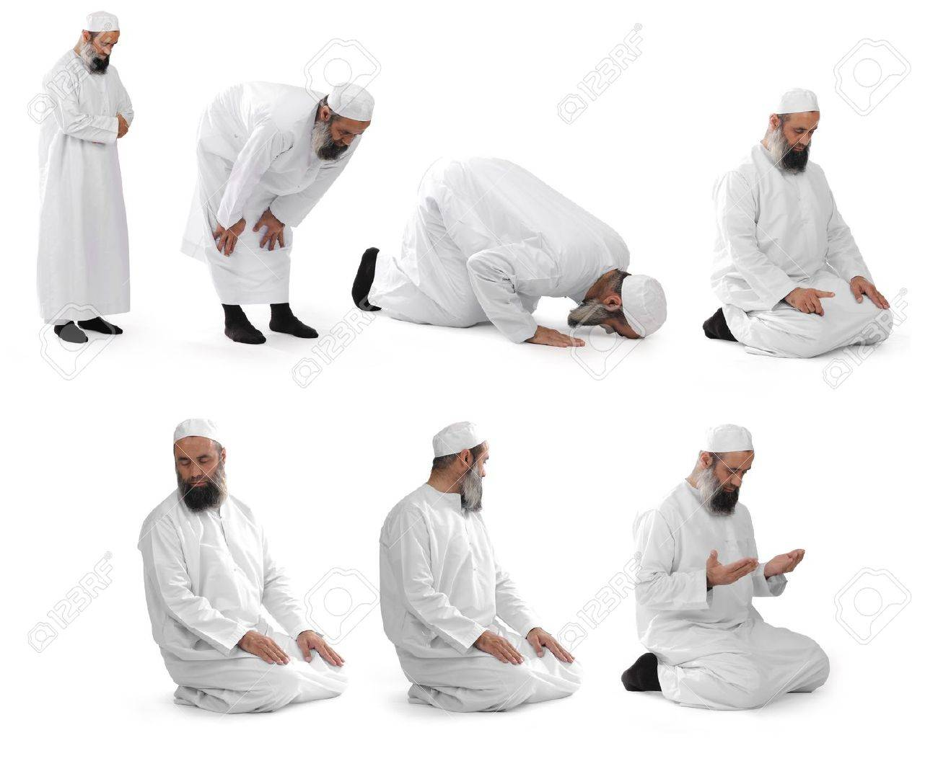
Vocabulary
Muslim – a person who practices the religion of Islam
Qur’an – the sacred text.
Mosque – place of worship.
Five Pillars – rules that hold up the religion.
Kaaba – sacred building in Mecca visited by Muslims as a pilgrimage known as The Hajj.
Mecca – City in Saudi Arabia where Islam began.
Prophet – messenger of God.
Ramadan – month of fasting
Fasting – Not eating.
Hajj – pilgrimage to Mecca
Pilgrimage – a holy journey to a sacred place.
Islam Y3/4
Where Islam Began: Mecca, Saudi Arabia
Moon and star is the symbol of Islam.
Sacred Text: The Qur’an which is written in Arabic. Muslims believe it is the actual word of God.
God and Mohammad his messenger
Islam began with Mohammad who was an ordinary man who was born in 570 AD in Mecca. He became a prophet who was given lot of messages by the angel Jibreel that came from God.
The messages were about how God wanted people to live a good life. All the messages were put into the holy book called the Qur’an.
Mohammad became the founder of Islam.
Muslims think so highly of Muhammad that they say ‘Peace be upon him’ whenever they say his name. So you may see the initials pbuh after his name.
Main Festivals
Ramadan, Eid-Ul-Adha, Milad-Al-Nabi
Ramadan
This is a special month of fasting which means Muslims do not eat or drink during daylight hours but then can eat after dark which is known as Iftar.
It usually takes place in April/May time.
Children under 14, pregnant women and the elderly do not have to fast. Also people who are ill or travelling do not have to fast too.
At the end of the festival Muslims have a big celebration known as Eid al-Fitr.
Worship
How Muslims worship:
In the mosque they stand in long lines and all perform certain movements together which includes kneeling and putting their forehead on the ground (see picture below)
They have to face Mecca when they do this.
At home it is the same - but of course individually. They have a prayer mat to kneel on but they must still face Mecca.
Main Beliefs
Muslims believe in one God named Allah
Muhammad was the last prophet sent by God.
Muslims must follow the 5 Pillars of Islam.
An American mosque
An English Mosque
The Shahada
The Shahada is a phrase that Muslims say aloud every time they pray. They say ’there is no God but Allah and Muhammad was his messenger’.
Holy Day of the Week
Friday is the holy day when most Muslims go the Mosque.
The Kaaba in Mecca.
Visited by Muslims for the Hajj as a pilgrimage.
A prayer mat
Special prayer movements

