Slide 1
What does it mean for our school?

Slide 2
Maintained schools also have a duty to promote the spiritual, moral, cultural and mental (SMCM) and physical health of pupils. This is no longer included in the Prevent guidance but is still a requirement of the Education Act 2002 and Ofsted Inspection handbook 2023.

Slide 3
What should I do if I have a concern?
Follow our usual safeguarding procedures
Report to the DSL/DDSL – and we will decide whether to involve other agencies eg, First Response, the police, Channel (the government’s programme for identifying and supporting those at risk of being drawn into terrorism).

Slide 4
Contest
Counter terrorism strategy – overall aim is to reduce the risk of terrorism in the UK.
PREVENT remains one of the key pillars of CONTEST alongside the other ‘P’ strands
Prevent: to stop people becoming terrorists or supporting terrorism
Pursue: to stop terrorist attacks
Protect: to strengthen our protection against a terrorist attack
Prepare: to mitigate the impact of a terrorist attack

Slide 5
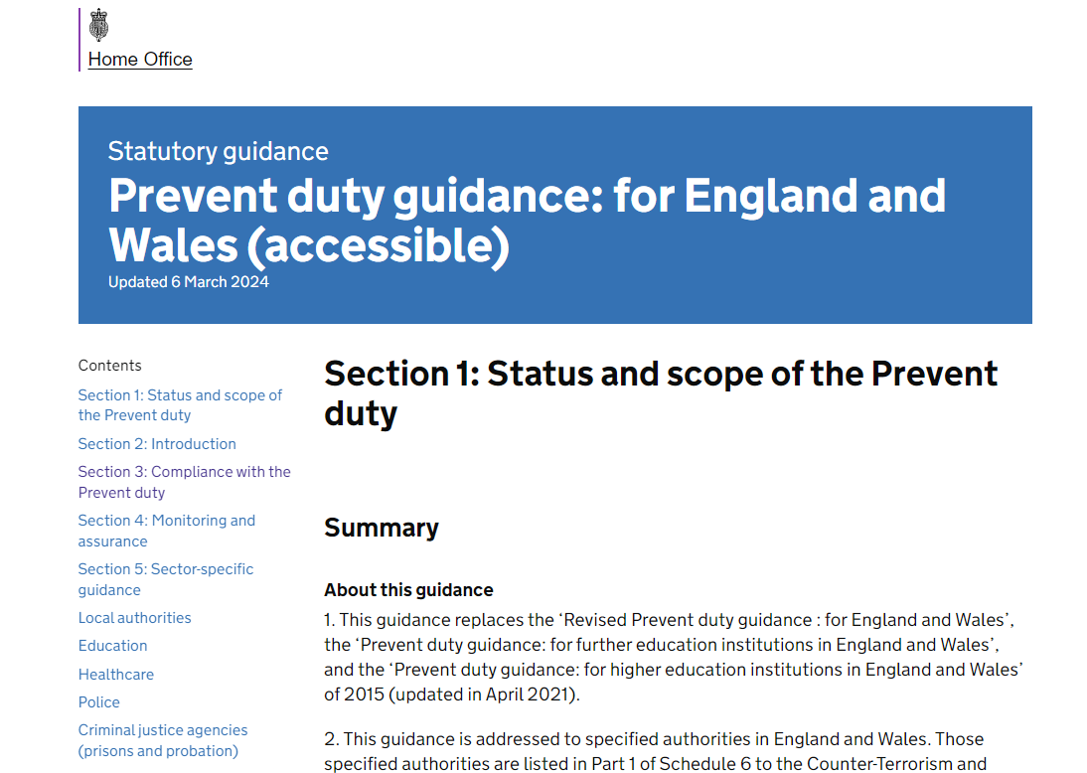
All SCHOOLS MUST comply with the prevent duty

Slide 6

The government updated its definition of extremism on 14th March 2024, but the DFE is NOT currently asking schools to adopt this definition or apply the principles. It will review existing guidance in due course.

Slide 7
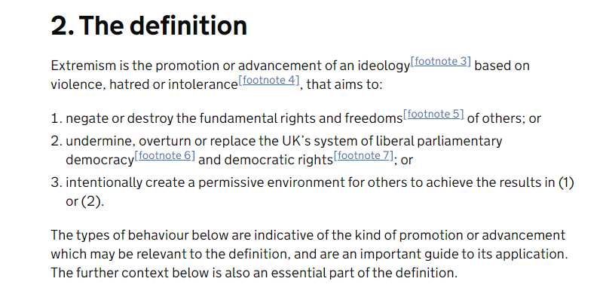

Slide 8
uPDATES
The changes in the full guidance provide greater clarity, practical advice and sign posting to best practice.
Prevent’s objectives - point 1 changed to ‘tackle the ideological causes of terrorism’. The guidance recommends education settings consider ideology when delivering all aspects of Prevent.
Designate a staff member to lead and oversee Prevent (part of the DSL/DDSL role already)
Data protection legislation doesn’t stop staff from sharing information to keep a child safe (as with safeguarding). Clarification that you don’t need consent to share information about a pupil who might be susceptible to radicalisation.
Clarity that staff should not only be alert to violent extremism but also non-violent extremism.
Terminology changes –
Old terminology - ‘vulnerable’ to extremist ideology and radicalisation #
New terminology - ‘Susceptible’ to extremist
ideology and radicalisation
Old terminology – children, young people and adult learners New terminology - learners

Slide 9
Refresher Awareness course 20-30 mins
https://www.support-people-susceptible-to-radicalisation.service.gov.uk/portal#refresher-awareness-course
Course overview
This course will give you a refresher of the Prevent duty, the forms of extremism and terrorism threatening the UK and develop your knowledge around the risks of radicalisation and your supportive role.
When you have completed this course, you will be able to:
know what Prevent is
understand why Prevent is important
understand how Prevent applies to your role
identify the emotions and behaviours that might make someone susceptible to radicalisation
understand how to apply the notice, check, share procedure

Slide 10
Awareness course 30 – 40 mins
https://www.support-people-susceptible-to-radicalisation.service.gov.uk/portal#awareness-course
Course overview
This course will give you an introduction to the Prevent duty, the forms of extremism and terrorism threatening the UK and develop your knowledge around the risks of radicalisation and your supportive role.
When you have completed this course, you will be able to:
know what Prevent is
understand why Prevent is important
understand how Prevent applies to your role
identify the emotions and behaviours that might make someone susceptible to radicalisation
understand how to apply the notice, check, share procedure

