Slide 1
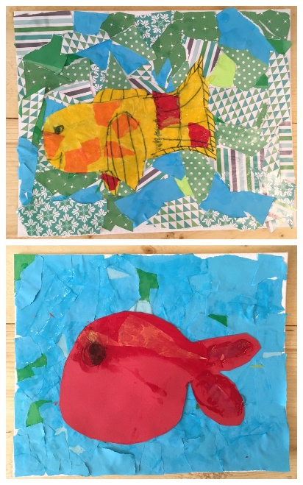
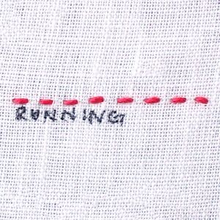
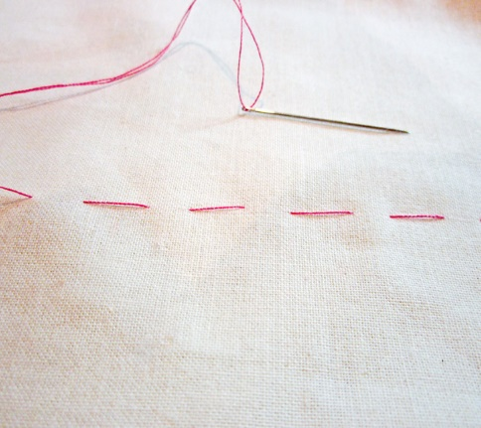
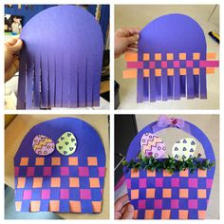
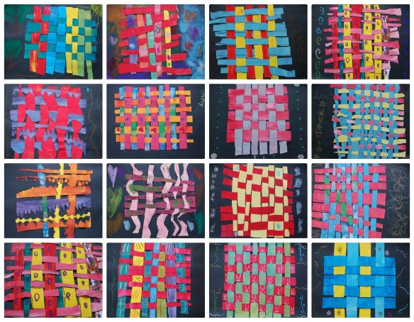
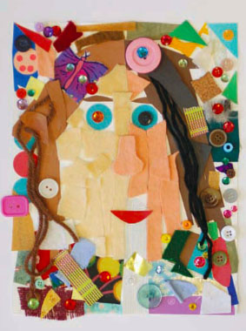
Research
Evaluate
Design
Make
Sherdley Primary School: DT Knowledge Organiser.
Texture: KS1
Terrific texture vocabulary!
C
Year 1
Year 2
weaving | A method in which two pieces of textile or material are interlaced at a right angle.
textiles | A type of cloth or woven fabric.
applique | Needlework where pieces of fabric are sewn or stuck onto larger pieces of fabric to form a picture or pattern.
collage | A piece of artwork made by sticking various different materials onto paper or fabric. This is often layered.
overlapping | Placing one or more artistic materials on top of one another.
Create simple weaving products and samples.
Create simple collages using a range of materials and textiles.
Sort materials according to their specific qualities.
Know and recognise how textiles create products.
Use overlapping and overlaying to create different effects in collage work.
Use large eyed needles to create a simple running stitch.
Begin to develop simple applique work.
Start to explore different stiches.
Weaving!
C
Collage!
C
C
C
Running stitch!
Baste stitch!

Slide 2
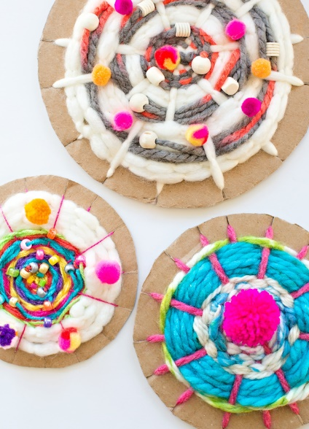
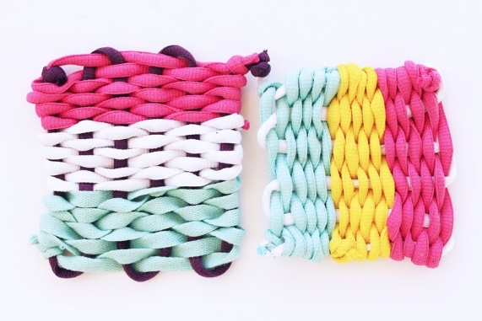
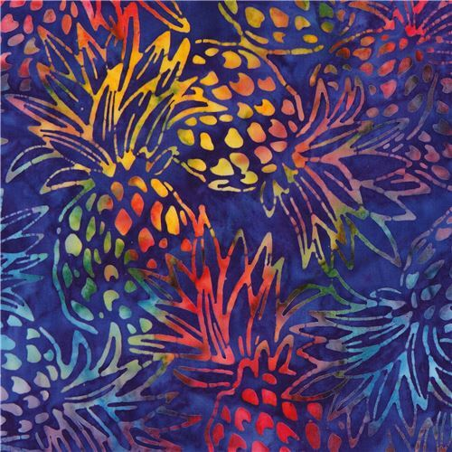
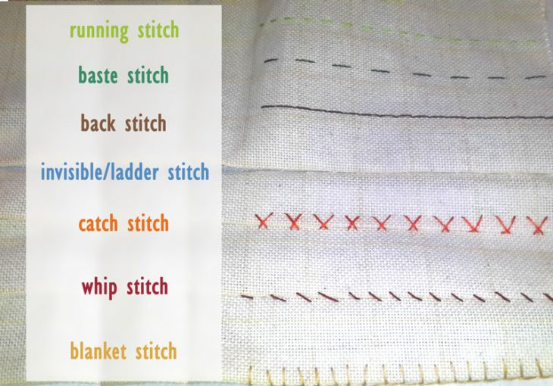
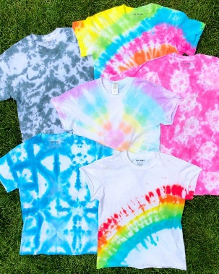
Research
Evaluate
Design
Make
Sherdley Primary School: DT Knowledge Organiser.
Texture: LKS2
Terrific texture vocabulary!
C
Year 3
Year 4
weaving | A method in which two pieces of textile or material are interlaced at a right angle.
tie dyeing | A method of dyeing to create pattern by tying different sections of cloth together so certain sections will not absorb the dye.
batik | A method for creating coloured designs where wax is applied to the areas where no dye is wanted.
textiles | A type of cloth or woven fabric.
overlapping | Placing one or more artistic materials on top of one another.
Create simple stitches using smaller eyed needles and finer thread.
Develop more complex weaving products using paper and fabric.
Create work using tie dying and batik.
Use a wider variety of stitches to create a pattern and join simple textiles.
Observe the design and imitate textural art.
Compare different fabrics and materials to discuss their appropriate uses.
Use a wider variety of stitches to create patterns and joins simple textiles.
Stitching!
C
Weaving products!
Batik and Tye Dye!

Slide 3
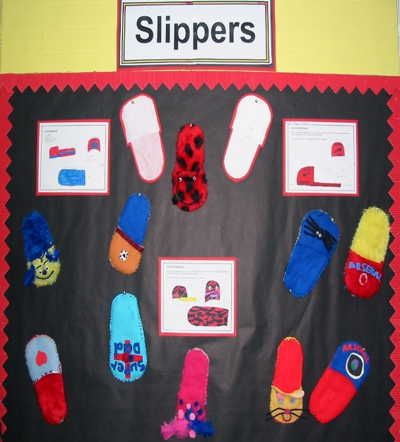
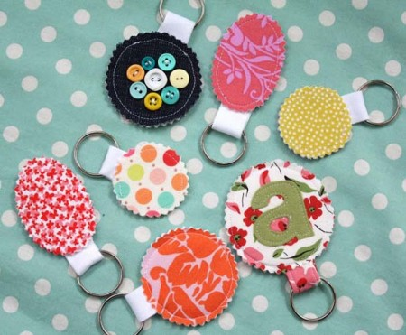
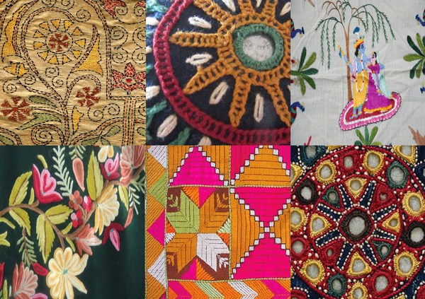
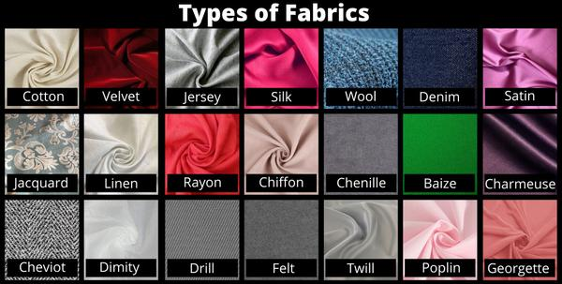
Research
Evaluate
Design
Make
Sherdley Primary School: DT Knowledge Organiser.
Texture: UKS2
Terrific texture vocabulary!
C
Year 5
Year 6
embellish | To make a product more visually attractive by adding decorative details.
collaboration | Working with one or more people to create a piece of work.
textural piece | This relates to either the surface or feel of a piece of art or the visual ‘feel’ of a piece i.e. what emotions it inspires.
textiles | A type of cloth or woven fabric.
product | An object or substance which serves a purpose. i.e. A pair of slippers for wearing in the home.
Use stories, music and poems for a range of textural pieces.
Select and use appropriate materials to embellish a range of work.
Create products using different textiles and fabrics.
Develop experience in embellishing fabrics and textiles.
Apply knowledge of different techniques to express feelings.
Work collaboratively on a larger scale to create effects.
Fabric types
Textile work!
Embellishing work!
C
C
C

