Slide 1
Welcome to our EYFS parent meeting! Please put your microphones on mute.
Please note that this meeting is being recorded. If you would prefer not to be part of the recording, please turn your camera off.
If the meeting runs over 40 minutes, please sign back in using the same code and password.

Slide 2
New Parent Meeting
Your guide to all things EYFS at St Johns!

Slide 3
Diary Dates
Tuesday 29th June – Transition day. You will be invited either for the morning or afternoon session. Please return all forms to your class teacher.
25th, 26th & 27th August – Individual Zoom Meetings
Tuesday 31st August – First day of school

Slide 4
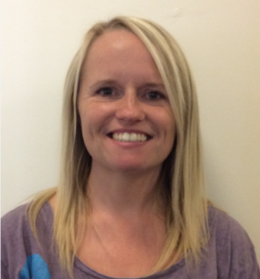
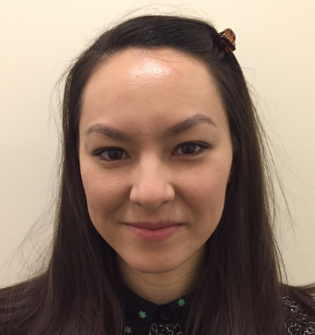
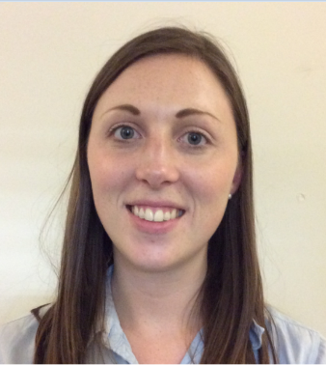
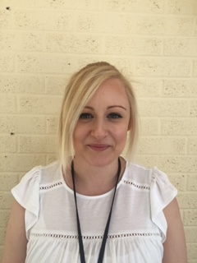
Meet the Team
Teachers
Miss McManus
Ladybirds Class Teacher and EYFS Lead.
Mrs Woodward Fireflies Class Teacher. (Monday – Wednesday)
Mrs Scarborough Fireflies Class Teacher. (Thursday-Friday)
Mrs Sharpe Crickets Class Teacher.

Slide 5
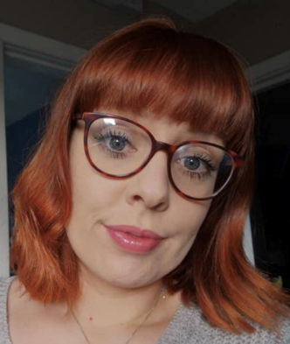
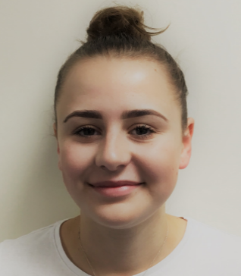
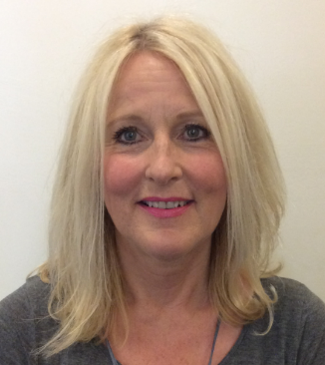
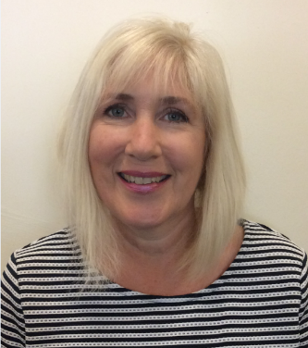
Meet the Team
Teaching Assistants
Miss Verity
Miss Hill
Mrs Whitmore
Mrs Richardson

Slide 6
What is EYFS?
Early Years Foundation Stage
Prime Areas – Communication and Language
- Physical Development
- Personal, Social, Emotional Development
Specific Areas – Literacy
- Maths
- Understanding the World
- Expressive Art and Design
Early Learning Goals

Slide 7
Communication & Language
Listening, attention and understanding: Listen attentively and respond to what they hear with relevant questions, comments and actions when being read to and during whole class discussions and small group interactions. Make comments about what they have heard and ask questions to clarify their understanding. Hold conversation when engaged in back and forth exchanges with their teacher and peers.
Speaking: Participate in small group, class and one-to-one discussions, offering their own ideas, using recently introduced vocabulary. Offer explanations for why things happen, making use of recently introduced vocabulary from stories, non-fiction, rhymes and poems when appropriate. Express their ideas and feelings about their experiences using full sentences, including use of past, present and future tenses and making use of conjunctions, with modelling and support from their teacher.

Slide 8
Physical Development
Gross Motor Skills: Negotiate space and obstacles safely, with consideration for themselves and others. Demonstrates strength, balance and coordination when playing. Move energetically, such as running, jumping, dancing, hopping, skipping and climbing.
Fine Motor Skills: Hold a pencil effectively in preparation for fluent writing – using the tripod grip in almost all cases. Use a range of small tools, including scissors, paint brushes and cutlery. Begin to show accuracy and care when drawing.

Slide 9
Personal, Social, Emotional Development
Self regulation: Show an understanding of their own feelings and those of others, and begin to regulate their behaviour accordingly. Set and work towards simple goals, being able to wait for what they want and control their immediate impulses when appropriate. Give focused attention to what the teacher says, responding appropriately even when engaged in activity, and show an ability to follow instructions involving several ideas and actions.
Managing Self: Be confident to try new activities and show independence, resilience, and perseverance in the face of challenge. Explain the reasons for rules, knows right from wrong and tries to behave accordingly. Manage their own basic hygiene and personal needs, including dressing, going to the toilet and understanding the importance of healthy food choices.
Building Relationships: Work and play cooperatively and take turns with others. Form positive attachments to adults and friendships with peers, Show sensitivity to their own and to others needs.

Slide 10
Literacy
Comprehension: Demonstrate understanding of what has been read to them by retelling stores and narratives using their own words and recently introduced vocabulary. Anticipate – where appropriate – key events in stories. Use and understand recently introduced vocabulary during discussions about stories, non fiction, rhymes and poems and during role-play.
Word Reading: Say a sound for each letter in the alphabet and at least 10 digraphs. Read words consistent with their phonic knowledge by sound-blending. Read aloud simple sentences and books that are consistent with their phonic knowledge, including some common exception words.
Writing: Write recognizable letters, most of which are correctly formed. Spell words by identifying sounds in them and representing the sounds with a letter or letters. Write simple sentences and phrases that can be read by others.

Slide 11
Mathematics
Number: Have a deep understanding of number to 10, including the composition of each number. Subitise (recognise quantities without counting) up to 5. Automatically recall (without reference to rhymes, counting or other aids) number bonds up to 5 (including subtraction facts) and some number bonds to 10, including double facts.
Numerical patterns: Verbally count beyond 20, recognising the pattern of the counting system. Compare quantities up to 10 in different contexts, recognising when one quantity is greater than, less than or the same as the other quantity. Explore and represent patterns within numbers up to 10, including evens and odds, double facts and how quantities can be distributed equally.

Slide 12
Understanding the World
Past and Present: Talk about the lives of the people around them and their roles in society. Know some similarities and differences between things in the past and now, drawing on their experiences and what has been read in class. Understand the past through settings, characters and events encountered in books read in class and storytelling.
People, Cultures and Communities: Describe their immediate environment using knowledge from observation, discussion, stories, non fiction texts and maps. Know some similarities and differences between different religious and cultural communities in this country, drawing on their experiences and what has been read in class. Explain some similarities and differences between life in this country and life in other countries, drawing on knowledge from stories, non fiction texts and – when appropriate – maps.
The Natural World: Explore the natural world around them, making observations and drawing pictures of animals and plants. Know some similarities and differences between the natural world around them and contrasting environments, drawing on their experience and what has been read in class. Understand some important processes and changes in the natural world around them, including the seasons and changing states of matter.

Slide 13
Expressive Arts and Design
Creating with materials: Safely use and explore a variety of materials, tools and techniques, experimenting with colour, design, texture, form and function. Share their creations, explaining the process they have used. Make use of props and materials when role playing characters in narratives and stories.
Being Imaginative and Expressive: Invent, adapt and recount narratives and stories with peers and their teacher. Sing a range of well-known nursery rhymes and songs. Perform songs, rhymes, poems and stories with others, and – when appropriate –try to move in time with music.

Slide 14
Characteristics of Effective Teaching and Learning
Playing and exploring: Children investigate and experience things and “have a go.”
Active Learning: Children concentrate and keep on trying if they encounter difficulties, and enjoy achievements.
Creating and thinking critically: Children have and develop their own ideas, make links between ideas and develop strategies for doing things.

Slide 15
Our Approach
We aim to provide our children with a broad and balanced curriculum that reflects the diversity of where we live. We tailor our curriculum to suit the needs and interests of the children, and provide them with a learning experience that is authentic and relevant to them.
We teach short whole class inputs on the carpet, and then work with small groups of children doing adult-led activities.
In EYFS we follow a Reggio Emilio style of teaching where the classroom is the “third teacher”.
Our indoor and outdoor provision promotes the children’s natural curiosity, encourages risk taking and develops their independence. As much as possible we use authentic and natural objects. We provide open ended activities and provocations that allow the children to take ownership of their own learning. We believe that play is the most effective way for young children to learn.

Slide 16
Baseline
During your child’s first six weeks at school, staff will be spending lots of time playing and getting to know them. This will enable staff to complete a baseline assessment of each child across all 17 areas of learning. This provides us with a starting point for each child and informs our planning.
We will also be completing a statutory baseline assessment covering language, communication and mathematics. This will be done 1:1 with a member of staff that is familiar to your child using age appropriate resources. Each assessment will take approximately 20 minutes and will be routed – so your child won’t be asked a series of questions that they find too tricky. We will not baseline any child until they have settled in and are comfortable in school.
Results of the baseline are stored electronically and are used to measure school performance when your child leaves Year Six.

Slide 17
RE
At St Johns we aim to provide each child with the opportunity to have a relationship with God. Each classroom has a reflection area – these are quiet spaces where children can look at religious books, pictures and artefacts. We do three daily prayers, have regular collective worship and teach an RE curriculum that celebrates all religions.
During prayer time or collective worship, all children are invited to reflect in their own way.
We also normally visit the church at least once a term, to learn about and celebrate events in the Christian calendar.

Slide 18
Lunches & snacktime
School dinners in Reception are free. Each day there will be a meat option and a vegetarian option. Please bear in mind that the meat option is not halal.
We will send home a school dinner menu and it would be really helpful if you could spend some time with your child each morning helping them to choose their lunch so that they are ready to tell us when they get in to school. We will complete a dinner register each morning and your child will be given a band or a dot to ensure that they get the correct meal.
EYFS staff will be on hand to help your children at lunchtimes – particularly during the first few weeks. It would be really helpful if your child could practice cutting up their own food before they start school.
If your child is having a packed lunch, it might be a good idea to help them practice opening their food and eating their packed lunch in the correct order.
All children will be given a piece of fruit for snack time – please do not send in your own. They will also be given free milk until they are five.

Slide 19




Behaviour
We have a positive behaviour management policy where children are praised for good behavior and their successes are celebrated:
House points
Behaviour charts
Stickers
Golden Book
Good Work Assemblies
Rainbow Raffle
Tapestry
Individual reward charts
Home-school communication books
Golden Time

Slide 20
Homework and Reading Books
Homework – Your child will receive a Learning Log and a home work grid. Each week you must choose an activity from the homework grid to complete. The Learning Log is there for you to use for any recording/writing that the children may do. Please keep Learning Logs at home, and submit photographs of your child’s homework on Tapestry.
Reading books – In the first half term, your child will receive three books:
PM Book
Wordless Book
Share at home book
After October half term, your child will start to bring home phonics books instead of wordless books. The phonics books will match the sounds that your child has learnt that week.

Slide 21

Other Useful Information
Start school
Break time
Lunch time
Home time
Timings
Uniform – Grey/black trousers or skirt, white polo t-shirt and navy St Johns jumper.
PE – Navy shorts, yellow St Johns t-shirt, plimsoles, navy St Johns bag.
Uniform and PE kit are available from the school office, PTFA and Gascoigne Clothing in Oadby PASSWORD: SJTB
Communication will be mainly through Weduc and Tapestry.
If your child will be absent, please let the school office know. For sickness or upset tummies, children should be kept at home for 48 hours.

Slide 22
Accidents happen!
We have several members of staff who are first aid trained. If your child hurts themselves, we will treat their injuries and write an accident form for them to take home at the end of day.
If they receive a facial or head injury, we will phone you just to let you know.
If your child receives a more serious injury, has an upset tummy or seems generally unwell, we will phone and ask you to pick them up. Please make sure that you provide us with suitable telephone numbers where we will be able to reach you at any time during the school day.
If your child has a toileting accident during the school day we will help them to clean themselves and get changed into their spare clothes. If you have any concerns about this, please speak to your child’s class teacher.

Slide 23
Preparing your child for the first day
Use your parent and child checklists in your pack to ensure that you are all prepared for your child starting school.
Regularly discuss starting school with your child, and explain how you will walk to school together and what will happen when mummy or daddy leaves – it is very important to prepare your child for this moment of separation.
We understand that the first day of school can also be an anxious time for parents too – please try to show your children how exciting this is. Try not to worry too much - we will look after your children and they will have a wonderful time playing, learning and making new friends!

Slide 24
PTFA
We are very lucky to have a very active PTFA at St John’s, who regularly hold events and competitions to raise money for the school.

Slide 25
Breakfast Club and After School Club
Afterschool Club is situated within the school building and run by the managers Elli Kenning and Amanda Joyce.
The club is open term time only, Monday – Friday, from the end of the school day until 5.45pm.
The club provides a wide range of activities, including arts/crafts, physical activities, forest schools and much more. Here at Afterschool Club, we create a fun, relaxed environment for all children and cater the sessions to follow individual interests.
We charge a flat rate fee of £8.25 for the first child and siblings at a discounted rate of £7.75.
If you wish for your child to attend the club, please email us at stjohnafterschoolclub@gmail.com. Please provide us with the days you require and the full name of your child/ren. Please note, places are very limited and are allocated on a first come, first served basis.
We look forward to hopefully welcoming some new faces here at Afterschool Club.
Thank you,
Elli, Amanda and the ASC Team

Slide 26
Questions

