Slide 1

Phase 3

Slide 2
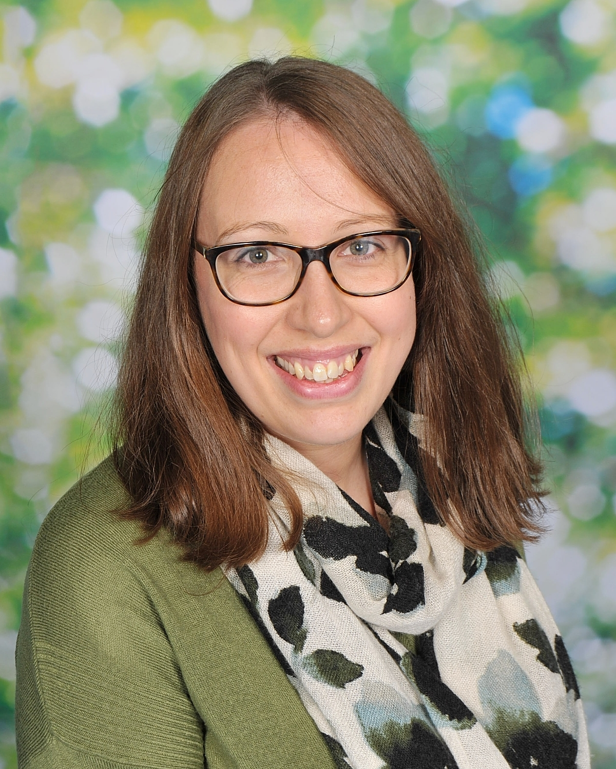
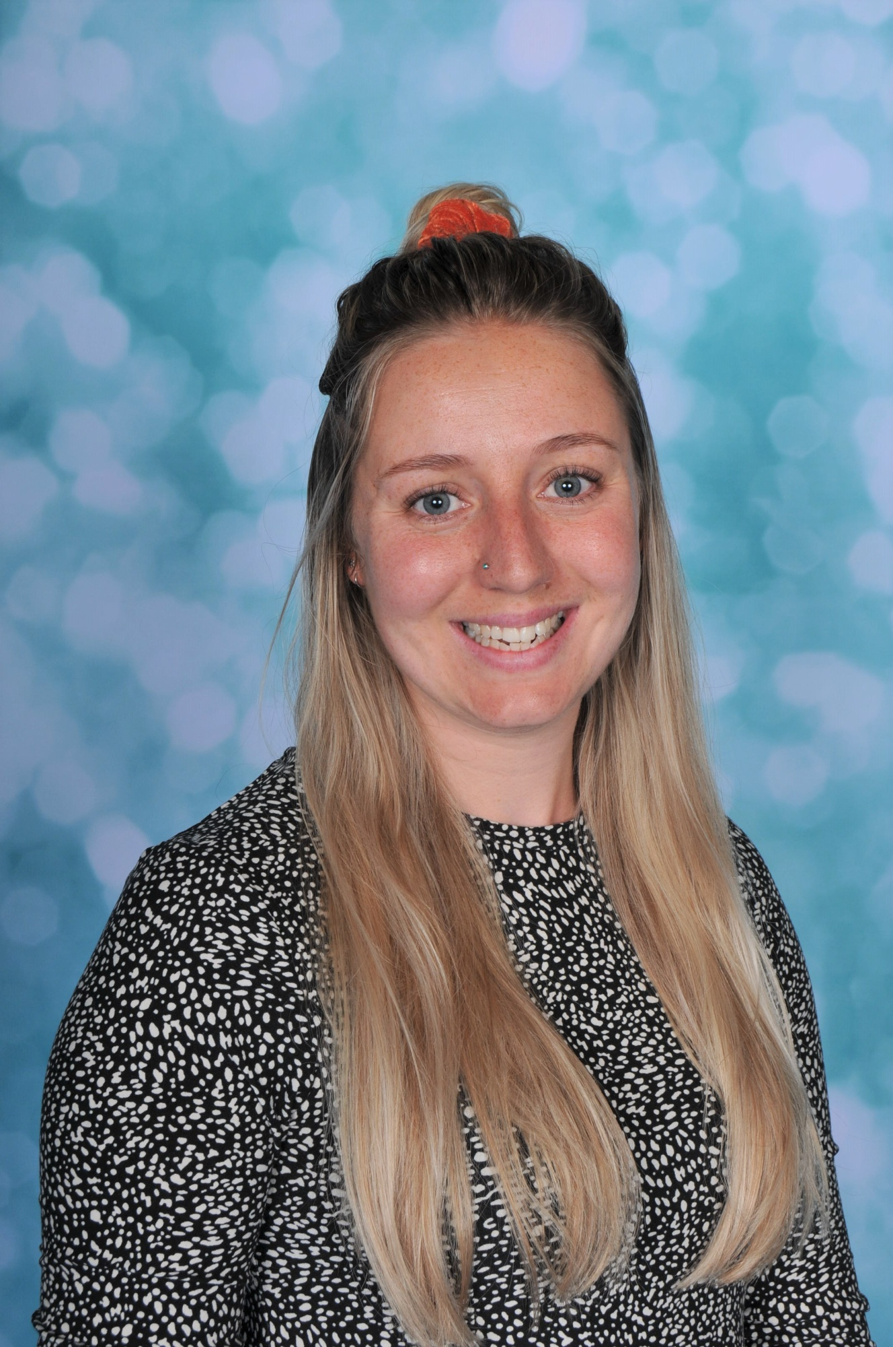
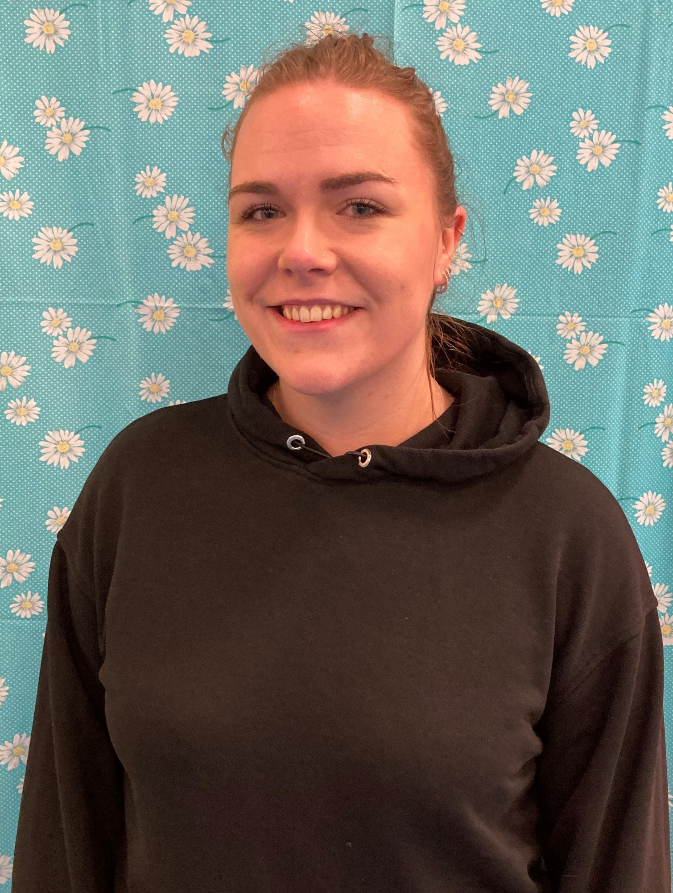
Staff structure
Head teacher- Mr Howells
Assistant head – Miss Martyn
SENDCO- Mrs Dudley
Phase leaders:
Phase 1: Miss Sullivan Phase 2: Miss Mott Phase 3: Miss Thom
Lead teacher for foundation and year 1
Lead teacher for year 2 and 3
Lead teacher for years 4, 5 and 6
Notes:
Introduce staff structure
Talk about our role/ experience in school
Who to contact- teachers, phase leader (if available), SLT
If you’d like our email please see the slide at the end

Slide 3

Tapestry and emailing
You may receive updates about your child’s learning and events within school via tapestry.
Please be aware that messages sent to your classes teacher can be viewed by any member of staff at school with a login to tapestry.
If you need to discuss a confidential or sensitive topic with your child’s class teacher, please email them or the admin team directly, who will pass the message onto your child’s teacher or alternatively talk to your child’s teacher in person.
If you cannot access tapestry or are unsure of an email, please contact the school admin team.
admin@kingsbridgeprimary.org.uk
Notes:
Discuss RWI/ Reading updates on tapestry
When emailing teacher’s, you may not receive a reply straight away as many teachers will reply within work hours (before or after school). As you can appreciate the school day is busy and we will often not reply during lunch/ break times.

Slide 4
Attendance
‘Attendance is the essential foundation to good outcomes’ Working together to improve school attendance DFE 2024
Registration in class opens at 8:50- 9:05
After 9:05 your child is registered as late
The register closes at 9:10. If your child arrives at school after this time, they must go to the office before going to their classroom.
If your child misses… | That equals at least… | Which is the same as around…. | And over 13 years of education that’s… | Or at least…
1 day a fortnight | 78 lessons per year | 4 whole school weeks per year | Nearly 1.5 whole years | 1014 lessons
1 day a week | 156 lessons per year | 8 whole school weeks per year | Over 2.5 whole years | 2028 lessons
2 days a week | 312 lessons per year | 16 whole school weeks per year | Over 5 whole years | 4056 lessons
3 days a week | 468 lessons per year | 23 whole school weeks per year | Nearly 8 whole years | 6084 lessons
Notes:
Understand that children are poorly/ medical needs
Touch upon missing day fortnightly

Slide 5
Reading
Your child should be reading, for at least 20 minutes, at home each day.
Reading to your child is just as valuable in year 6 as it is in their earlier years. Please continue to read out loud to your child.
Your child can quiz on the books you’ve read with them.
Notes:
Check levels of children’s books at home- AR book finder
Discuss types of reading with children- listening to them (fluency), reading to them (developing love of reading) and reading/ asking questions (developing comprehension)

Slide 6

sparx
Children are set weekly compulsory timestable homework on Sparx maths.
This is set on Fridays at 4pm and due the following Friday at 3pm.
The expectation is for the homework to be completed at home. If you have concerns around this, please contact your child’s teacher.
We celebrate Sparx achievements weekly in celebration assemblies.
Notes:
If homework is not completed at home, the children will complete this during their own time at school.

Slide 7
Phase 3 leader email
Rebecca.thom@kingsbridgeprimary.org.uk

