Slide 1


Computer Science/ICT

Slide 2

Welcome to Holte
ICT is changing the lives of everyone. Through teaching Computer Science and ICT we equip you to participate in a rapidly-changing world where work and leisure activities are increasingly transformed by technology. We enable you to find, explore, analyse, exchange and present information. We also focus on developing the skills necessary to be able to use information in a discriminating and effective way.
The aims of Computing is to enable you :
To develop valuable thinking and programming skills that are extremely attractive in the modern workplace.
To develop a deep understanding of computational thinking and how to apply it through a chosen programming language

Slide 3
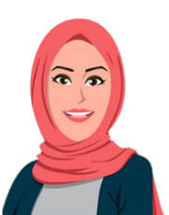
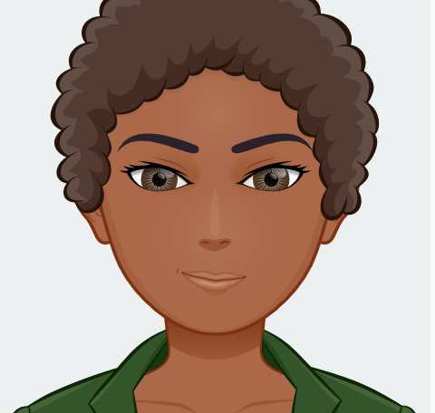
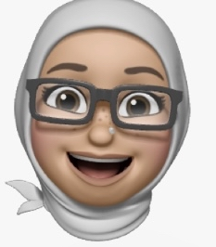
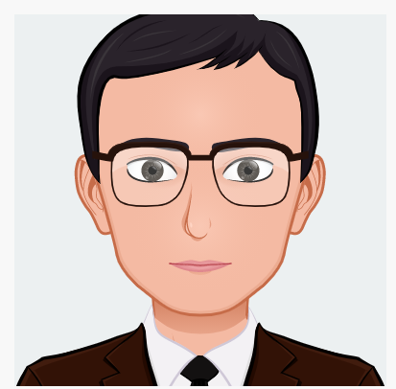
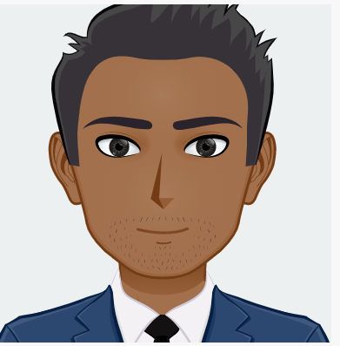
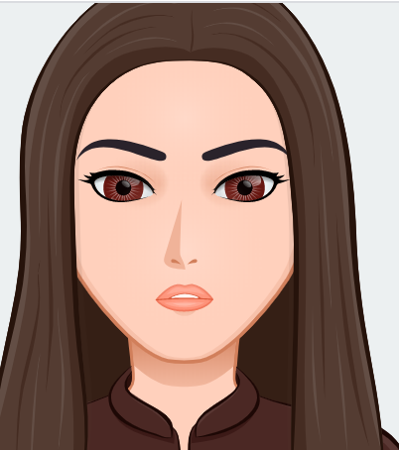
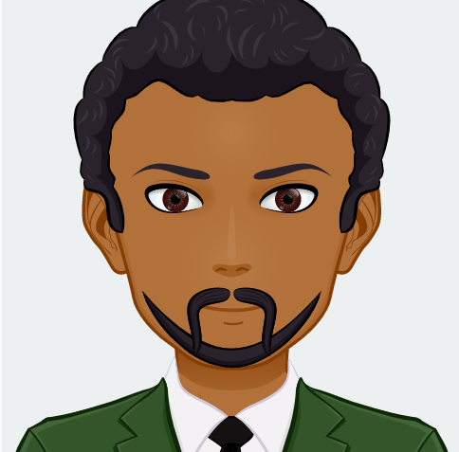
Meet The Department
Head of Faculty -Mrs Ali
Miss Seville
Mrs Jamila
Mr Zaheer
Miss Naseem
Mr Tarafdar
Mr Gakhal

Slide 4
What you will be learning in Year 7:
7.1 File Management &Email
7.2 E-safety
7.3 MS Office
7.4 Cash 4 Kids
7.5 Computer System- Binary Control
7.6 Kodu game Lab
Year Group | ½ Autumn | ½ Autumn | ½ Spring | ½ Spring | ½ Summer | ½ Summer
Year 7 | Unit 1 File Management & Email | Unit 2 E Safety | Unit 3- MS Office | Unit 4- Cash 4 Kids | Unit 5- Computer Systems-Binary Control | Unit 6- Kodu Game Lab

Slide 5

Were are we based :
We have 2 IT Suites in K cluster (K104 and K107)
We have 2 IT Suites s in N cluster (N104 and N107)
We have 1 IT Suite in Q Cluster (Q104)
We have 1 IT Suite in E Cluster (E006)

Slide 6
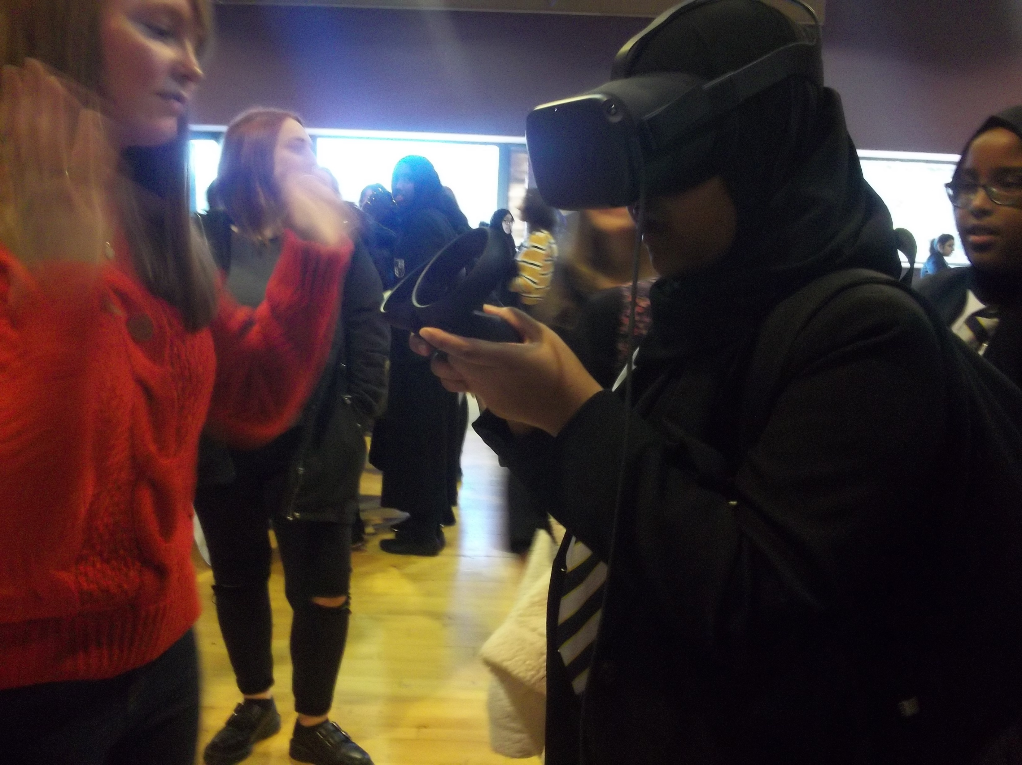
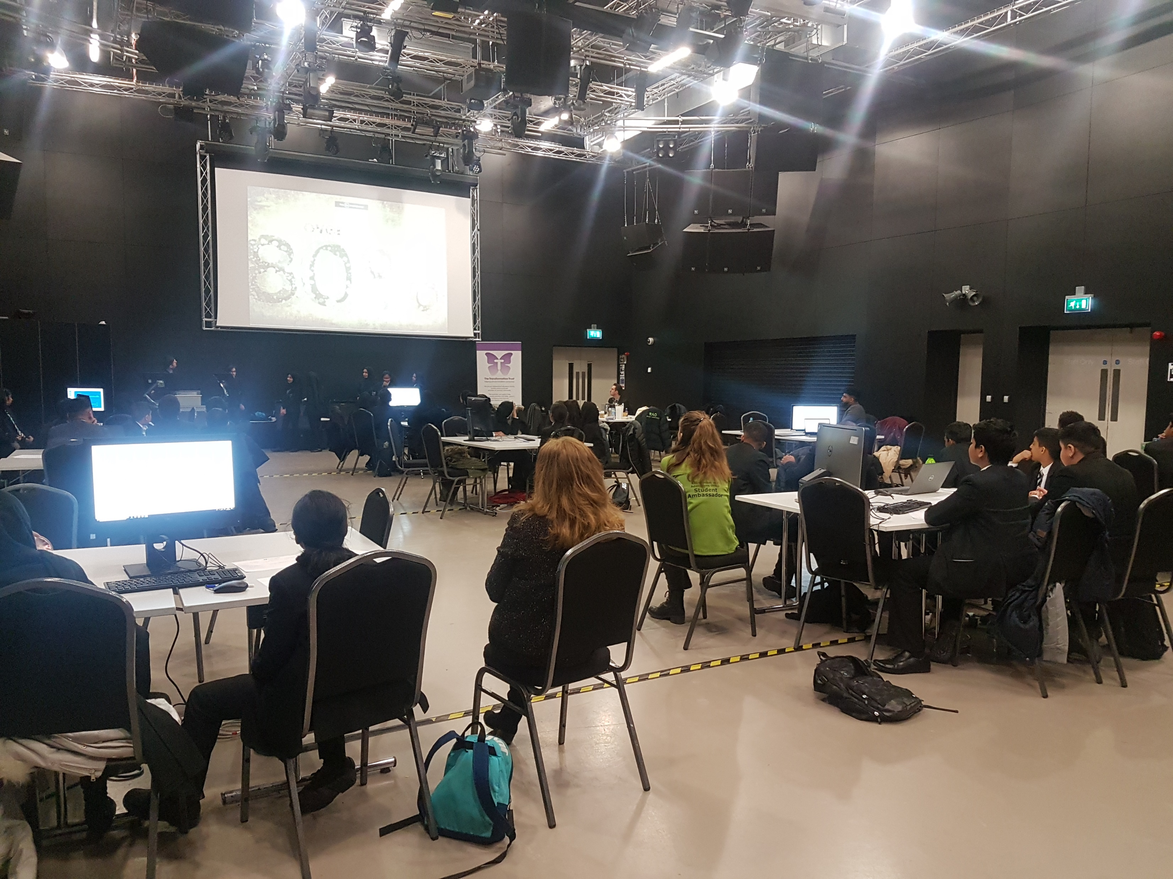
ICT Clubs
Digital leaders
Who Runs the world , Girls! (Girls Computing Club )
Teen Tech
Raspberry Pi Club
Bafta YGD (Young Gaming Designer Awards )

Slide 7
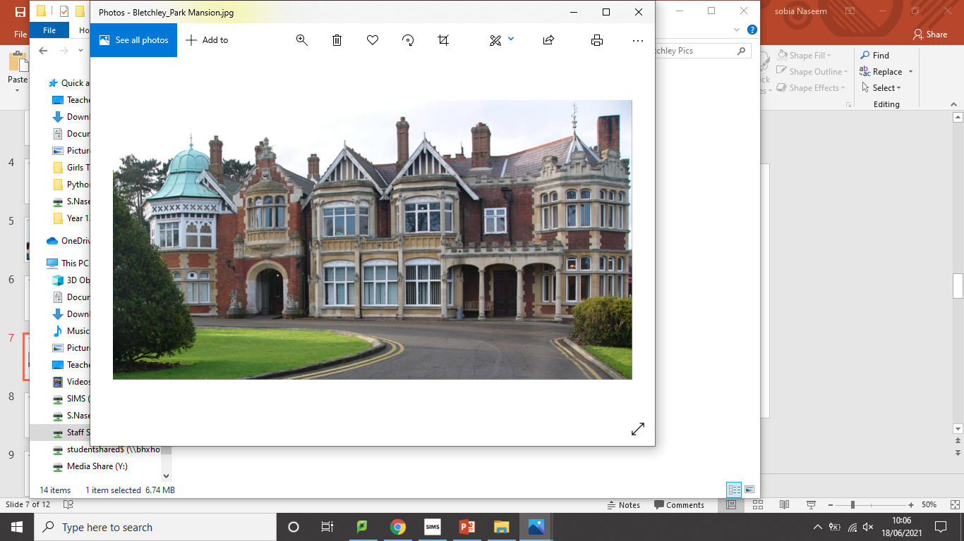
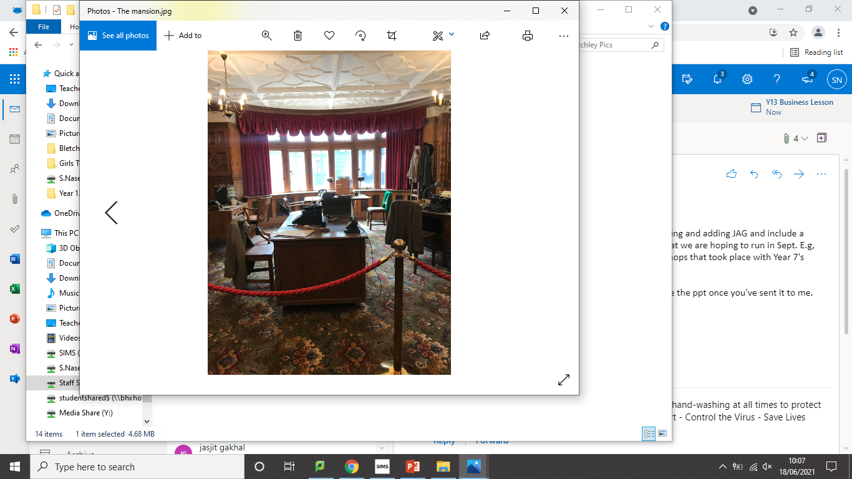
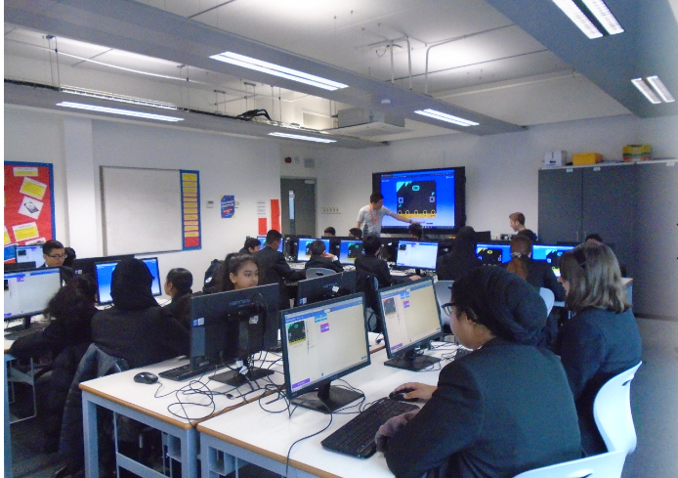
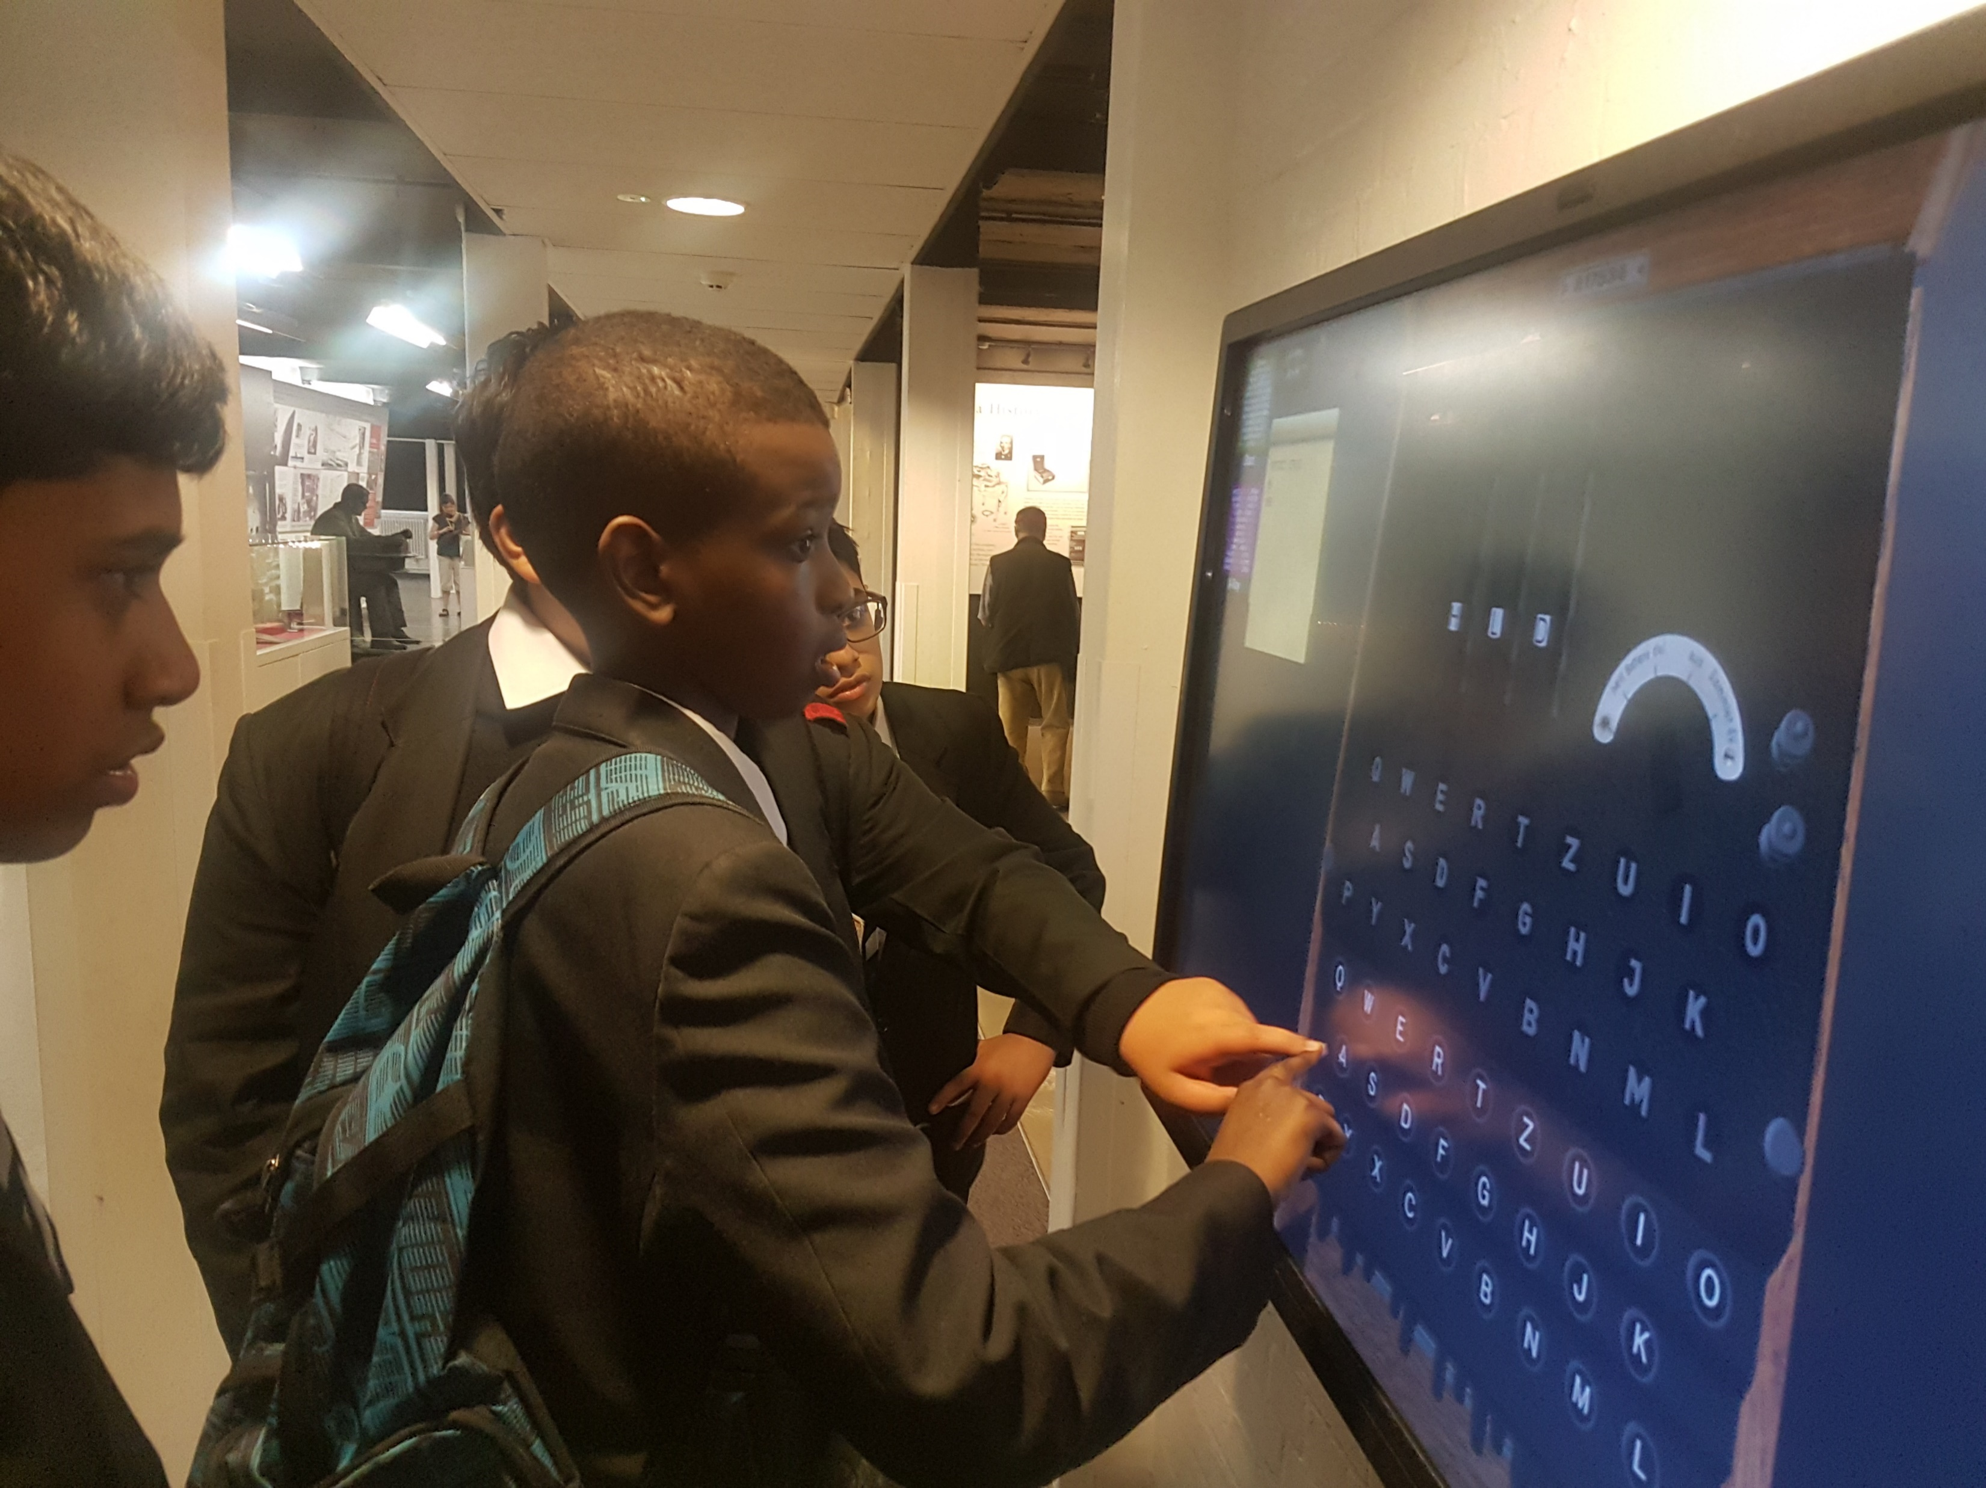
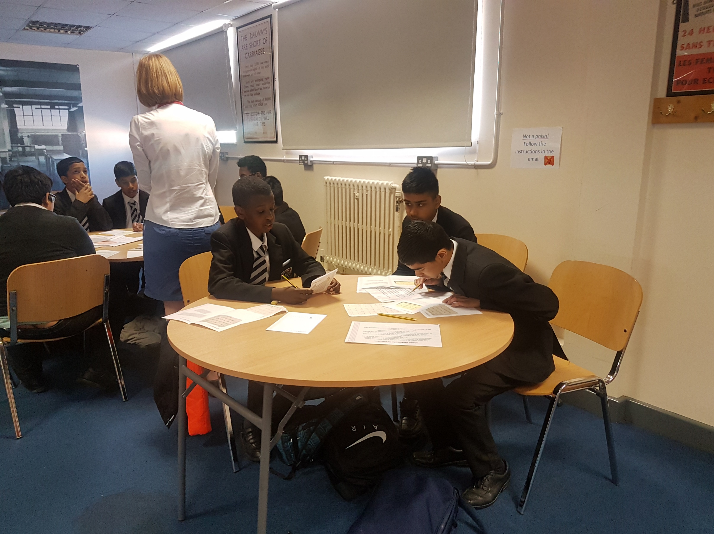
Ict Trips
Bletchley Park
Apple Store

Slide 8

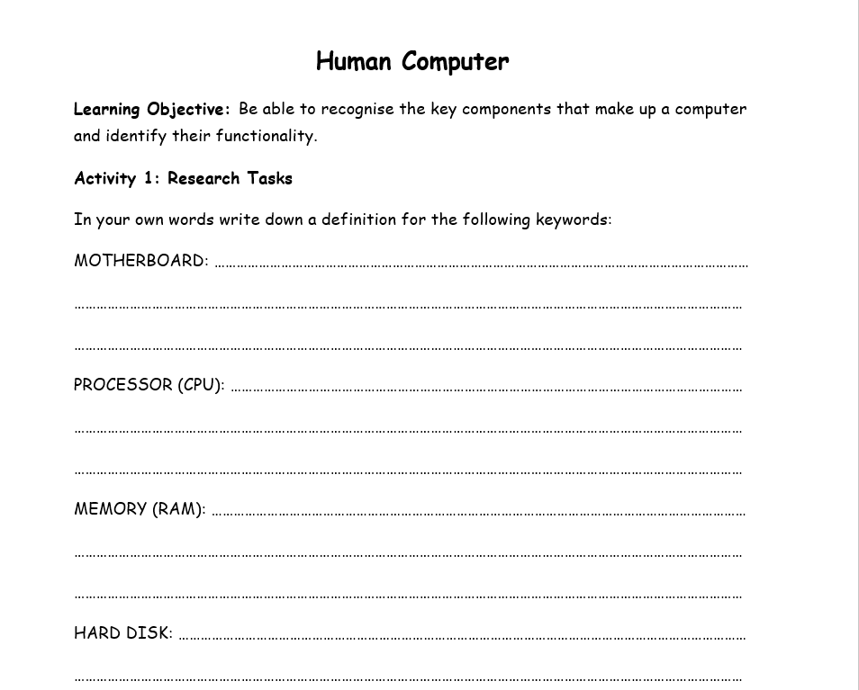
Tasks to complete:
The Computer Science department at Holte would like you to have a look at the following tasks and have a go . The best tasks will receive a Prize
Slide 8
Open up the word document
Once the document looks like this image
Uses the internet and research what each keyword means
Right down a definition for each keyword into the document

Slide 9
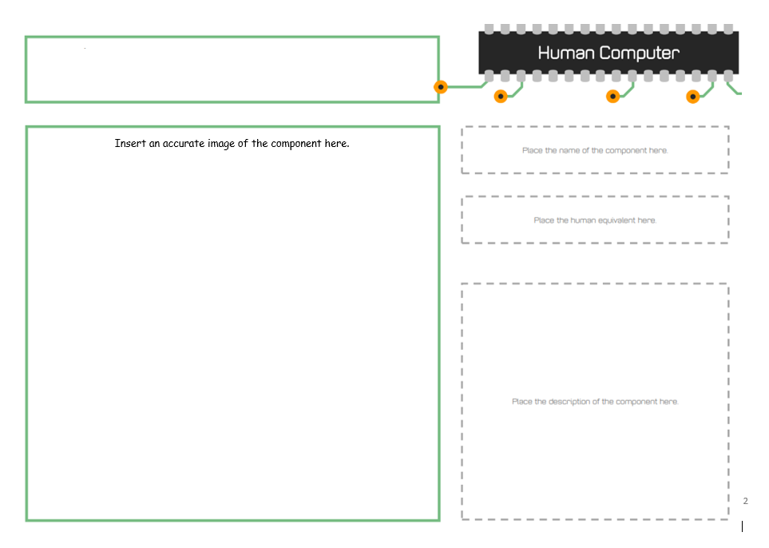
Tasks 2
Once , you have completed the first activity, scroll down and you will see the next one
Slide 8
Using the keywords from Activity 1 , search what they look like
Insert a image of what each keyword looks like
Then tell me the name of the image along with the human equivalent and a description

Slide 10

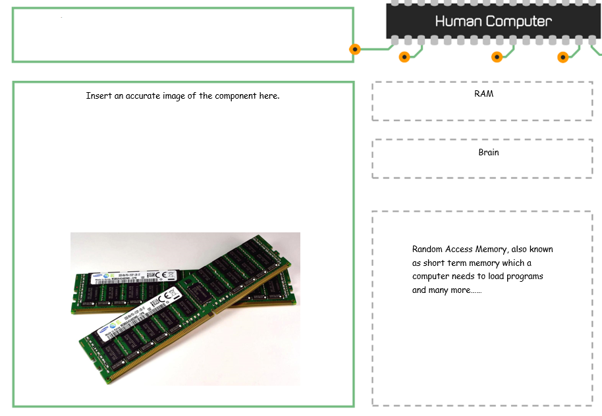
Help ! A example
This is an example of a simple solution

Slide 11
Other useful Links
You may have a lot of extra time, below are links that will help in you Computer Science lessons . Have a go at some activities :
https://hourofcode.com/uk/learn – a range of activities and exercises to introduce students to coding.
https://www.bbc.co.uk/bitesize/subjects/zvc9q6f – a good resource for revising Computer Science content and taking online quizzes.

Slide 12

We look forward to seeing you in September!

