Slide 1
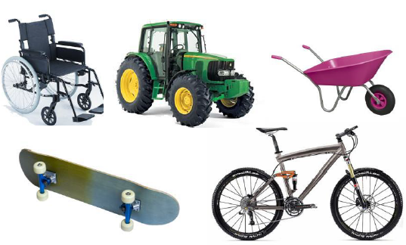
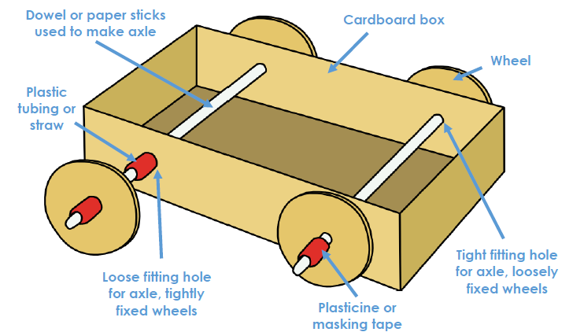
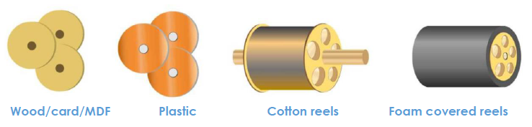
Key Vocabulary
Key Word | Definition
Axle | a rod on which one or more wheels can rotate, either freely or be fixed to and turn with the axle.
Axle holder | the component through which an axle fits and rotates.
Chassis | the frame or base on which a vehicle is built.
Friction | resistance which is encountered when two things rub together
Dowel | wooden rods used for making axles to hold wheels
Vehicle | a thing used for transporting people or goods
Assembling | fit together the separate component parts
Shaping | give a particular shape or form to
Fixed or Free | fastened securely in position Not fastened securely in position
Mechanism | A device used to create movement in a product
Functional | designed to be practical and useful, rather than attractive
Y2 Knowledge Organiser Autumn Term
Wheels and Axles
Learning Sequence
Look at products and how they work, with drawings and labels
1
Use a simple plan to create a wheel and axle mechanism.
2
Create ideas with labelled drawings.
3
Create a design criteria to make a product with wheels and axles.
4
Use a design criteria to make a product with wheels and axles
5
Evaluate my product, and suggest changes, independently.
6

