Slide 1
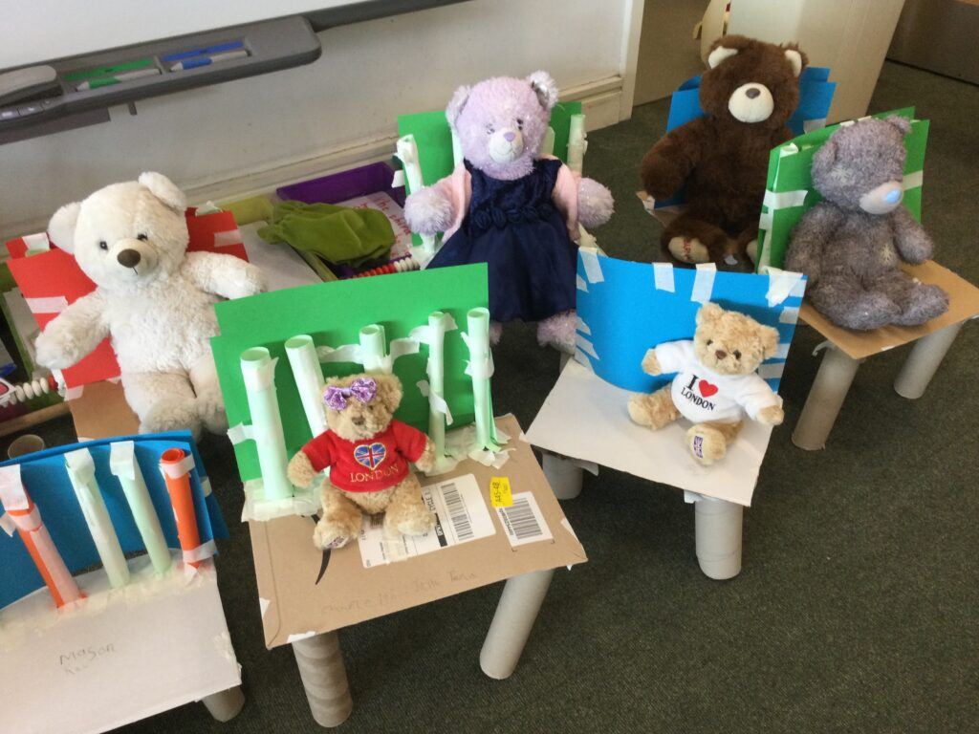
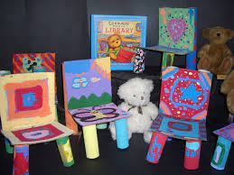
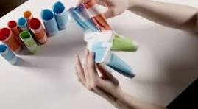
Year 2 Structures Summer Term
A Chair for Baby Bear (Evaluate)
Learning Sequence
Evaluate a range of existing products (chairs).
Key Vocabulary
Key Word | Definition
Natural | Materials found in nature.
Man-made | Materials made by humans.
Instructions | Tell you how to do something or how to make something.
Assembly | Putting parts together to make something.
Strong | It does not break easily.
Stable | A structure that is fixed and steady and will not fall over.
Test | To see if a product works.
1
Understand what makes structures strong and stable.
2
Evaluate a range of joins.
3
Design a product with a purpose for an intended user (make a chair)
4
Use design criteria to make a chair.
5
Evaluate my design and suggest changes.
6

