Slide 1



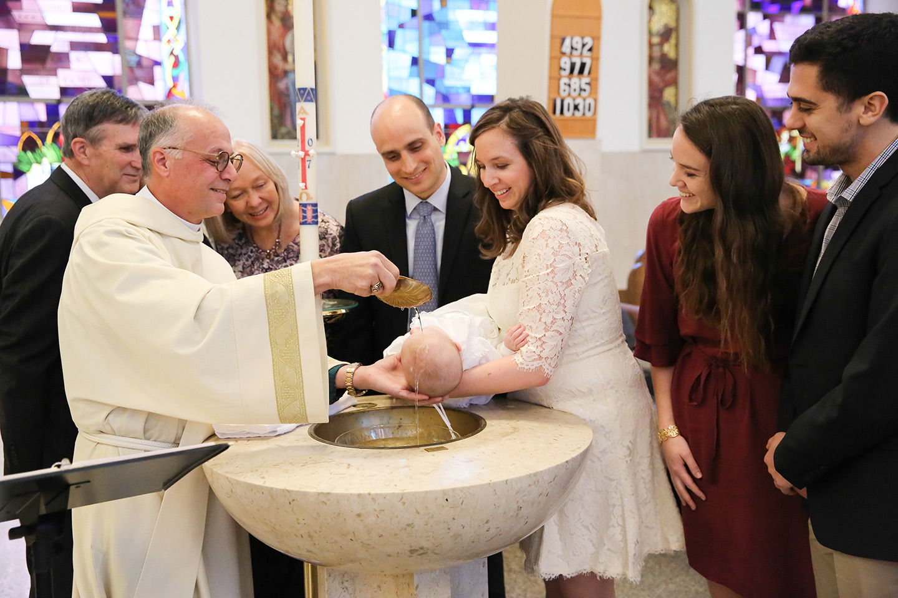
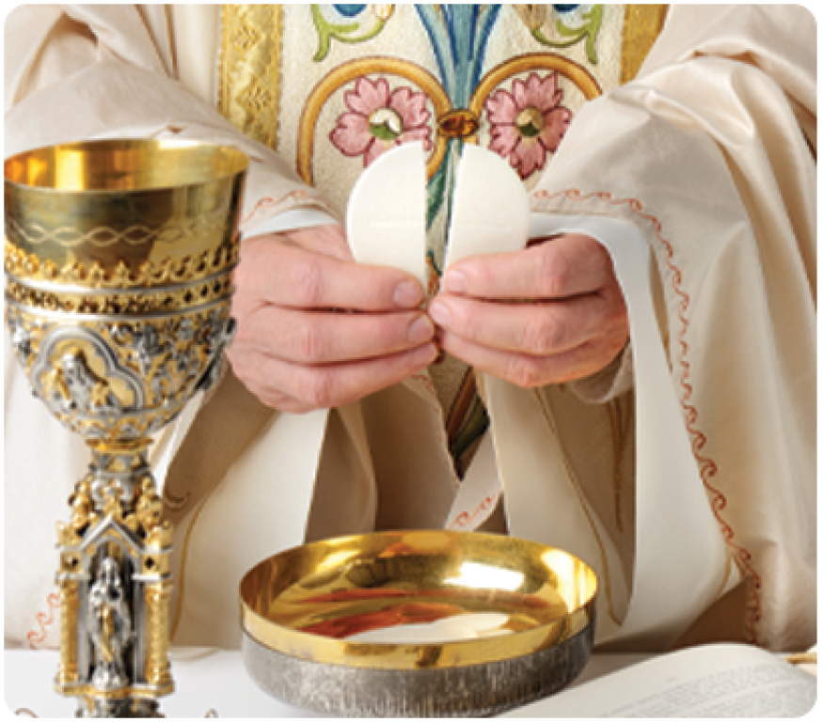
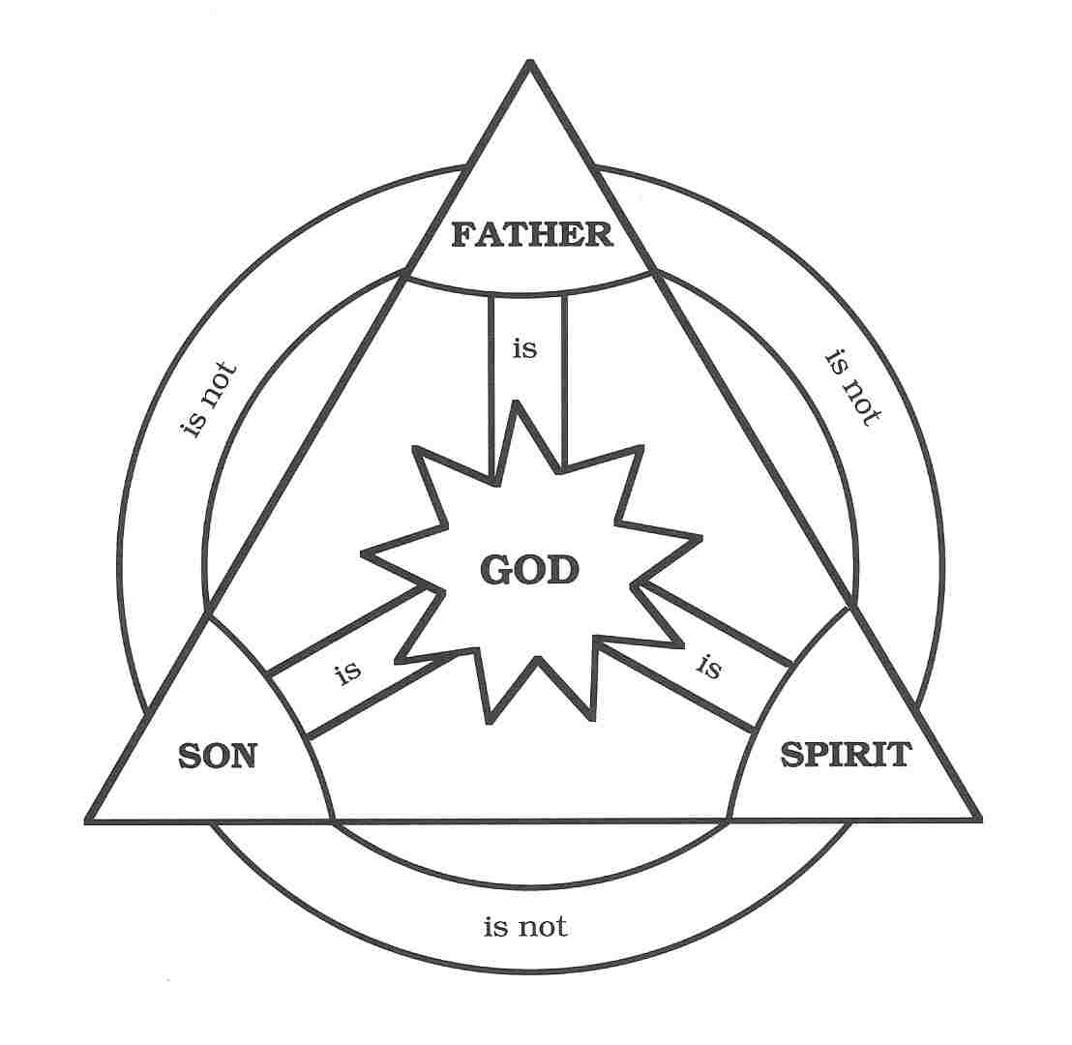
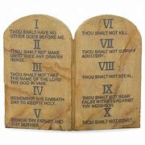
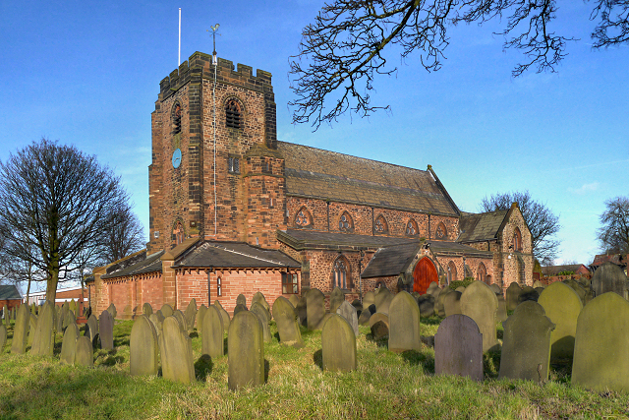
Vocabulary
Baptism – is a ceremony where a Christian is marked with Holy water to welcome them into the church.
Bible – Holy Book of Christianity.
Commandments – Ten rules given to Moses
Crucifixion – A form of Roman punishment used on Jesus. It involves putting someone on a cross to die.
Eucharist – ceremony of giving bread and wine.
Forgiveness – Forgiving someone for some wrong they have done.
Holy Spirit – This is God’s power in action. It is one part of the Trinity.
Resurrection – Jesus came back from the dead.
Temptation – When someone is tempted to do the wrong thing.
Testament – There is an old testament and a new testament they are parts of the Bible.
Trinity – Is made up of God as the father, son and holy spirit.
Christianity KS2
Festivals
Christmas is the celebration of Jesus’s birthday and is the 25th December.
Easter is the time when Jesus died to save the people from their sins and because he gave them new life it is often celebrated with eggs. The Easter week is known as Holy Week.
Holy Week begins with Palm Sunday, then the following Thursday is Maundy Thursday (the day of the Last Supper), then the day after is Good Friday (the day Jesus died). The next day is Holy Saturday when Lent ends and the next day is Easter Sunday when Jesus rose from the dead (the resurrection).
Christianity is the largest of the six main world religions.
Lent – is a religious observance that begins on Ash Wednesday and lasts for 6 weeks up to Holy Saturday. Christians often give up a luxury item for Lent eg Chocolate.
The cross is the symbol of Christianity as Jesus died on the cross.
Sacred Text: The Bible which consists of the Old Testament and the New Testament. Parts of the writing contained in the Old Testament are also sacred to Jewish and Muslim people.
Timeline of Christianity compared to other religions
The dove is the symbol of the Holy Spirit and peace.
How Christianity Began
Jesus Christ, who was crucified in Jerusalem, is the founder of Christianity.
Jesus Christ is the Son of God. He came to earth to teach about love, fellowship and forgiveness. He represents the person that all Christians must strive to be.
Jesus was a Jew who was born just over 2000 years ago in Bethlehem, Jerusalem which is in the Middle East. Jesus lived for 33 years before being crucified by the Romans. His disciples travelled around the world teaching people Jesus and God.
Hinduism Buddhism Islam
2000 BCE 590 BCE 0 610 CE
1500 BCE 33 CE 1500 CE
Judaism Christianity Sikhism
The Lord’s Prayer
Our Father, who art in heaven, hallowed be thy name; thy kingdom come; thy will be done on earth as it is in heaven. Give us this day our daily bread; and forgive us our trespasses as we forgive those who trespass against us; and lead us not into temptation, but deliver us from evil. Amen.
John the Baptist (Matthew 3:13-17
Jesus came to John the Baptist while he was baptising people in the River Jordan. John tried to make him change his mind, but Jesus answered, “In this way we will do all that God requires.” So John agreed. As soon as Jesus was baptised, he came up out of the water.
A Christening (Baptism) ceremony in a church. Adults can also be baptised and this can vary in different countries.
Holy Communion – The ceremony of giving the bread and wine.
Main Beliefs
Christians believe that Jesus Christ was the Son of God and that
God sent his Son to earth to save humanity from the consequences of its sins
Jesus was fully human, and experienced this world in the same way as other human beings of his time. Jesus was tortured and gave his life on the Cross (At the Crucifixion) to save people from their sins. Jesus rose from the dead on the third day after his Crucifixion which is known as the Resurrection. Because he came back to life Christians believe he was divine.
Christians believe that Jesus was the Messiah promised in the Old Testament.
Christians believe in the Apostles Creed.
Trinity
Christians believe that there is only one God, but that this one God consists of 3 "persons"
  God the Father
  God the Son
  The Holy Spirit
This is known as the Trinity.
Christians believe that God made the world as told in the Bible in the book of Genesis.
Christians believe that after a person dies they live on in heaven.
Other facts:
Christianity has many denominations. Here are just a few: Catholicism, Protestantism, Eastern Orthodoxy, Anglicanism, Oriental Orthodoxy and Assyrians.
Holy Ceremonies - Depending on the specific denomination of Christianity, holy ceremonies and practices may include Baptism, Eucharist (Holy Communion or the Lord's Supper), prayer (including the Lord's Prayer), confession, confirmation, burial rites, marriage rites.
Adam and Eve are believed to be the first humans that God created and they were tempted by a snake. Christians believe that we shouldn’t be lulled into temptation of doing bad things.
The Ten Commandments given to Moses by God.
They are:
You should worship no other God but me.
You shall not make idols.
You should not take the name of your Lord God in vain.
Remember the Sabbath day and to keep it holy.
Respect your father and mother.
You shall not murder.
You shall not commit adultery.
You shall not steal.
You shall not lie.
You shall be jealous.
Place of worship is mainly the Church
The Christian place of worship is called a Church. They are often built in the shape of a cross with the altar facing east towards the rising sun.
The Christian spiritual leaders are called priests, vicars or ministers.
Christian worship can look different in different communities – some worship involves praising God in music, speech, readings from scripture, prayers of various sorts, a sermon and various holy ceremonies.
Place of Worship:
The Church, Chapel, Cathedral
St. Nicholas’s Church, Sutton, St.Helens
The Trinity

