Slide 1


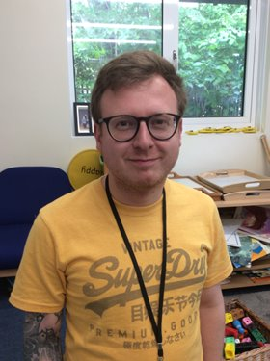
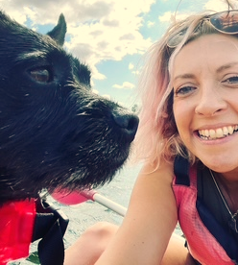

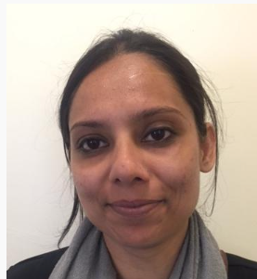
Hello everyone! My name is Mr Roche and I am the Teaching Assistant in Rainbow Fish! I love working down in our Early Years base, because we have SO much fun! I especially enjoy all the arts and crafts we do in our creative area and climbing on the apparatus in our outdoor provision. In my free time I enjoy playing badminton and going for long walks (apart from in the rain!). I’m looking forward to getting to know you all!
My name is Miss Bannister (but everyone calls me Miss B), and I will be your class teacher! Although I trained as a French teacher, Foundation is my happy place - especially getting messy in Forest School and scouting for wildlife! I love seeing the progression in EYFS, particularly with writing. In my spare time I go for long walks and kayaking with my dog Zizou! I can’t wait to meet you all, I’m sure we’ll have an awesome time next year!
I’m Mrs. Malik and I’ve worked in EYFS for 4 years. I love supporting the children in doing what they love. My favourite thing is to play in the outdoor provision, and to do crafts with the children. I can’t wait to meet everyone and have fun!

