Slide 1
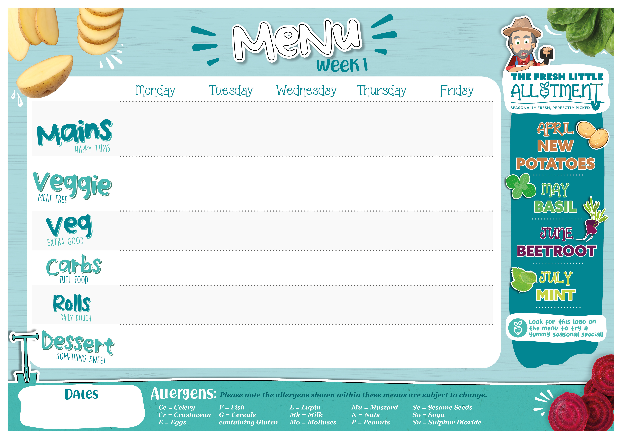

Butter Chicken Curry (Mk,So) | Tex-Mex Pizza (Ground Beef, Peppers and Sweetcorn) (G,Mk) | Pork Sausage with Gravy (G,Su) | Pasta Bar (G) Beef Bolognese Tomato sauce Nut free Basil Pesto (Mk) | Oven Baked Fish Fingers (G,F) Or Salmon Fishcake (G,F)
Vegetarian Butter Curry (Mk,So) | Margherita Pizza with Torn Basil (G,Mk) | Vegetable Sausage with Gravy (G,So) | Pasta Bar (G) Vegan Bolognese Tomato sauce Nut free Basil Pesto (Mk) | Oven Baked Vegetable Fingers (G)
Sweetcorn Spiced Cauliflower | Coleslaw | Braised Leek and Cabbage Roasted Honey Butternut Squash | Olives Cheese (Mk) | Peas Baked Beans
Rice | Potato Wedges | Roasted New Potatoes | Parsley, Mint and Olive Oil Focaccia (G) | Oven Baked Chips
Cheddar Cheese (G,So,Mk,E) or Tuna (G,So,Mk,E,F) | Ham (G,So,Mk,E) or Cheddar Cheese (G,So,Mk,E) | Cheddar Cheese (G,So,Mk,E) or Tuna (G,So,Mk,E,F) | Ham (G,So,Mk,E) or Cheddar Cheese (G,So,Mk,E) | Cheddar Cheese (G,So,Mk,E) or Tuna (G,So,Mk,E,F)
Fresh Fruit Platter | Beetroot Chocolate Cake (Low Sugar) (G,E,Mk,So) | Fruit Jelly | Honey Cake (G,E) | Peach Crumble (G)
Jacket Potatoes, salad bar, cold desserts and fresh fruit available daily.
13/4/26, 11/5/26, 8/6/26, 6/7/26

Slide 2

Beef Bolognaise Pasta (G) | Lamb Tacos with Grated Cheddar (Mk) | Moroccan Style Chicken (G) | Jacket Potato Bar: Baked Beans Pepperoni and Cheese (Mk,Mu,So) | Oven Baked Fish Fingers (G,F)
Macaroni Cheese (G,Mk) | Vegan Mince Tacos with Grated Cheddar (Mk) | Moroccan Style Vegan Plantballs (G,So) | Jacket Potato Bar: Baked Beans and Cheese (Mk) Margherita Topping (Mk) | Cheesy Beans and Sweetcorn Quesadilla (G,Mk)
Choose from our delicious Salad Bar | Broccoli Buffalo Beans | Roasted Butternut Squash Green Beans | Classic Coleslaw (E) Sweetcorn | Peas Baked beans
Beetroot Focaccia (G) | Basmati rice | Crushed New Potatoes |  | Oven Baked Chips
Cheddar Cheese (G,So,Mk,E) or Tuna (G,So,Mk,E,F) | Ham (G,So,Mk,E) or Cheddar Cheese (G,So,Mk,E) | Cheddar Cheese (G,So,Mk,E) or Tuna (G,So,Mk,E,F) | Ham (G,So,Mk,E) or Cheddar Cheese (G,So,Mk,E) | Cheddar Cheese (G,So,Mk,E) or Tuna (G,So,Mk,E,F)
Fresh Fruit Platter | Apricot Sponge Cake (G,E,Mk,Su,So) | Fruit Jelly | Vanilla Shortbread with Chocolate Sprinkles (G) | Sugar Free Pineapple and Carrot Cake (G,Mk)
Jacket Potatoes, salad bar, cold desserts and fresh fruit available daily.
20/4/26, 18/5/26, 15/6/26, 13/7/26

Slide 3

Chicken Meatballs Tossed in a Tomato and Basil Sauce | Lamb Keema Curry (G,Mk,So) | Classic Roast Chicken Served with Yorkshire Pudding and Gravy (G,E,Mk) | Beef Moussaka Topped with Fresh Mint (G,Mk) | Oven Baked Fish Fingers (G,F) or Salmon Fishcake (G,F)
Plant Balls Tossed in a Tomato and Basil Sauce (So) | Vegetable Curry (G,Mk,So) | Lentil And Vegetable Wellington with Gravy (G) | Green Lentil Moussaka Topped with Fresh Mint (G,Mk) | Oven Baked Vegetable Fingers (G)
Choose from our delicious salad bar | Tomato and Onion Salad (Su) Broccoli | Roasted Carrots Green Beans | Green Beans Carrots | Peas Baked Beans
Pasta (G) | Sweet Potato Roasties | Roast New Potato | Garlic Focaccia (G) | Oven Baked Chips
Cheddar Cheese (G,So,Mk,E) or Tuna (G,So,Mk,E,F) | Ham (G,So,Mk,E) or Cheddar Cheese (G,So,Mk,E) | Cheddar Cheese (G,So,Mk,E) or Tuna (G,So,Mk,E,F) | Ham (G,So,Mk,E) or Cheddar Cheese (G,So,Mk,E) | Cheddar Cheese (G,So,Mk,E) or Tuna (G,So,Mk,E,F)
Fresh Fruit Platter | Apple Cake (G,E) | Fruit Jelly | Oat and Orange Seed Bar (G,E) | Iced Sponge Cake with Rainbow Sprinkles (G,E,Mk)
Jacket Potatoes, salad bar, cold desserts and fresh fruit available daily.
27/4/26, 22/6/26

Slide 4

Jacket Potato Bar: Baked Beans Pepperoni and Cheese (Mk,Mu,So) | Classic Pizza with Ham and Sweetcorn Topping (G,Mk) | Chicken with Spinach and Roast Tomato Bake (G,Mk) | Pasta with Tomato Sauce and Lamb Mince (G) | Oven Baked Fish Fingers (G,F)
Jacket Potato Bar: Baked Beans and Cheese Margarita Topping (Mk) | Classic Margherita Pizza with Basil (G,Mk) | Vegetarian Bake with Spinach and Roast Tomato (G,Mk) | Vegetarian Pasta (G,So) | Vegetable Sausage Hot Dog (G,So,Se)
Classic Coleslaw (E) Sweetcorn | Mixed Vegetables | Thyme Roasted Beetroot Carrots | Choose from our delicious Salad Bar | Peas Baked Beans
Choose from our delicious Salad Bar | Potato Wedges | Rice | New Potato and Caramelised Onion Focaccia (G) | Waffle Fries
Cheddar Cheese (G,So,Mk,E) or Tuna (G,So,Mk,E,F) | Ham (G,So,Mk,E) or Cheddar Cheese (G,So,Mk,E) | Cheddar Cheese (G,So,Mk,E) or Tuna (G,So,Mk,E,F) | Ham (G,So,Mk,E) or Cheddar Cheese (G,So,Mk,E) | Cheddar Cheese (G,So,Mk,E) or Tuna (G,So,Mk,E,F)
Fruit Platter | Banana Flapjack (G) | Fruit Jelly | Basil, Lemon and Ginger Shortbread (G) | Pineapple and Raspberry Cake (G,E,Mk)
Jacket Potatoes, salad bar, cold desserts and fresh fruit available daily.
4/5/26, 1/6/26, 29/6/26

