Slide 1



Welcome to the Drama Department

Slide 2
At Holte School, pupils will ...

Slide 3

… learn to be confident communicators and develop their teamwork skills. This helps prepare all pupils for future careers and their life in general…

Slide 4

…learn to use many different types of theatre and performance techniques e.g. mime, improvisation and presenting. Pupils also practice different types of Drama such as comedy and story telling…

Slide 5

… and through Drama pupils explore issues relevant to themselves and the world they live in e.g. conflict, environmental issues and relationships.

Slide 6
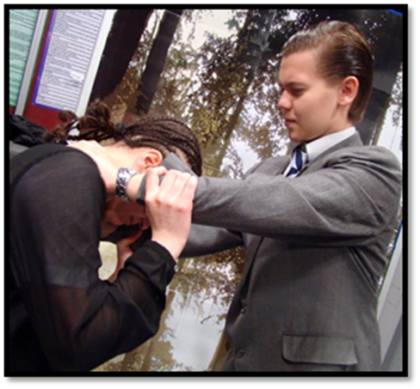
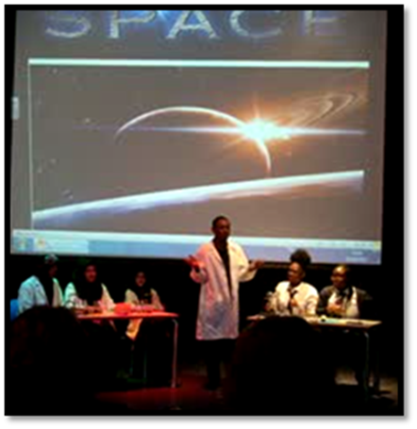
At Holte, Drama is an option subject at KS4 too…

Slide 7
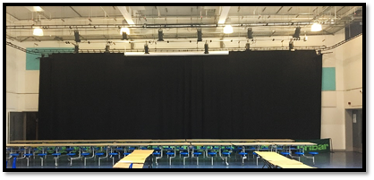

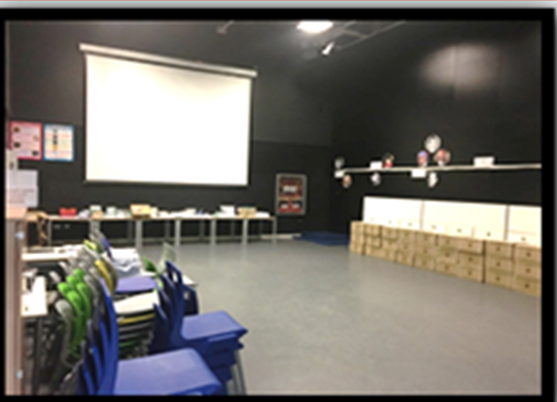
“We look forward to welcoming you in September!”
Holte Hall is a fantastic performance space where lessons and shows take place!
This is Drama room E003 (1 of 2 Drama studios at Holte).

