Slide 1



Maths Calculations Year 3
Methods for teaching the four calculations at St. David’s.

Slide 2
Year 3 National Curriculum objectives.
Addition, Subtraction, Multiplication and Division
Pupils should be taught to:
add and subtract numbers mentally, including:
  a three-digit number and 1s
  a three-digit number and 10s
  a three-digit number and 100s
add and subtract numbers with up to 3 digits, using formal written methods of columnar addition and subtraction
estimate the answer to a calculation and use inverse operations to check answers
solve problems, including missing number problems, using number facts, place value, and more complex addition and subtraction
recall and use multiplication and division facts for the 3, 4 and 8 multiplication tables
write and calculate mathematical statements for multiplication and division using the multiplication tables that they know, including for two-digit numbers times one-digit numbers, using mental and progressing to formal written methods
solve problems, including missing number problems, involving multiplication and division, including positive integer scaling problems and correspondence problems in which n objects are connected to m objects

Slide 3
Vocabulary related to the four calculations for Year EYFS – Year 6
EYFS/Year 1
more (than) less (than) total
fewer (than) equal (to) most
least
sum difference between total
first
plus add(ition) subtract(ion)
minus ones tens column(s) multiples
Year 2
multiple commutative
>as ‘greater than’
< as ‘less than’ partition
place holder
place value estimate
estimation
inverse
array
calculate
multiplication division
times tables
Year 3
multiple(s) inverse operations integer(s) decimal(s) remainder
Year 4
round rounding
negative
operation
Factor
factor pairs distributive associative derive remainder
odd even double halve pair
how much how many larger smaller estimate compare together
Year 5
power(s) prime complement
composite prime factor square(d)2 cube(d)3 equivalence
Year 6
long division Multi-step common factors common multiple

Slide 4
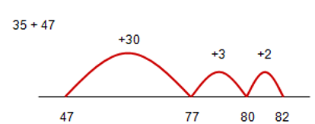
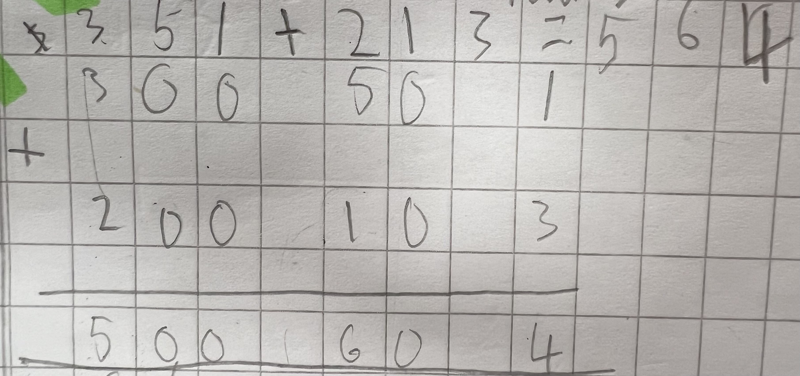
Addition
Using number lines:
Start with the greatest number and count forwards, partitioning into manageable chunks if necessary.
Children move onto the expanded method of addition. Paritioning each number into 100’s, 10’s and 1’s before adding from the ones and recombining the totals.

Slide 5
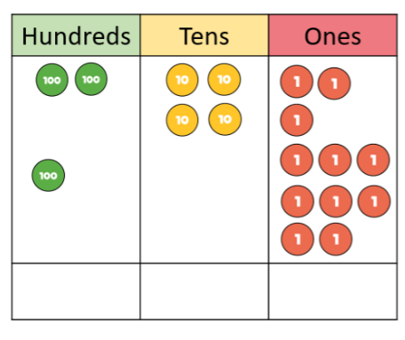
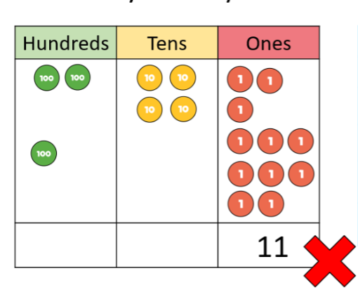
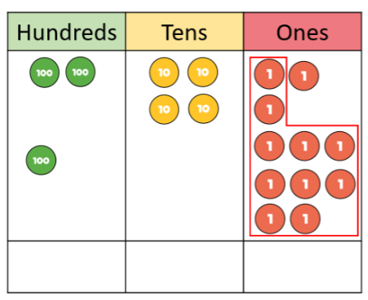
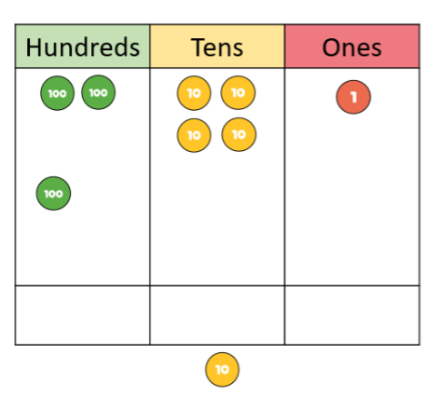
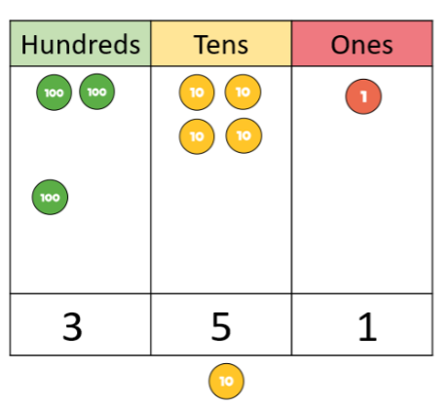
Addition with exchange and place value charts.
243 + 108 There are too many 1s in our 1s column. We need to exchange 10 1’s for a 10.
Need to be able to:
•Add in columns.
•Have place value awareness.
Knows to work right to left.
•Organisation (layout).
•Ability to estimate.
•Can check answers for reasonableness.

Slide 6
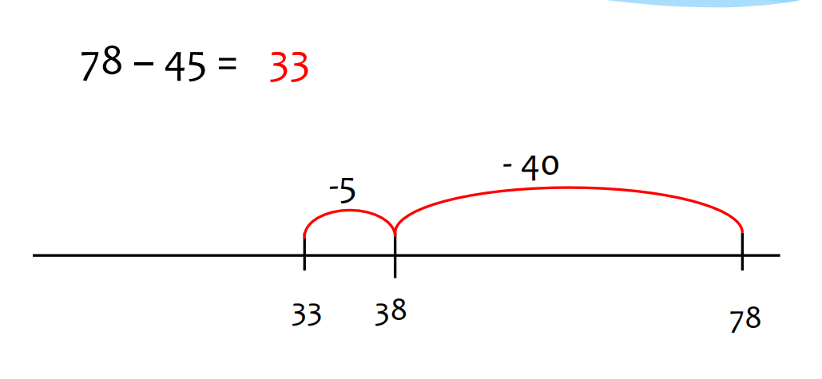
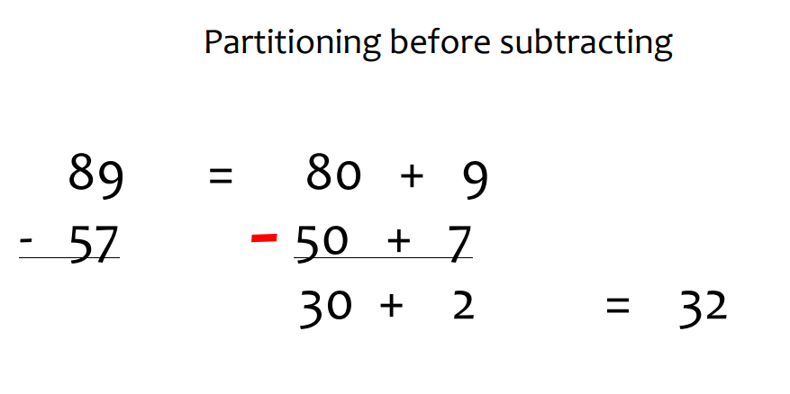
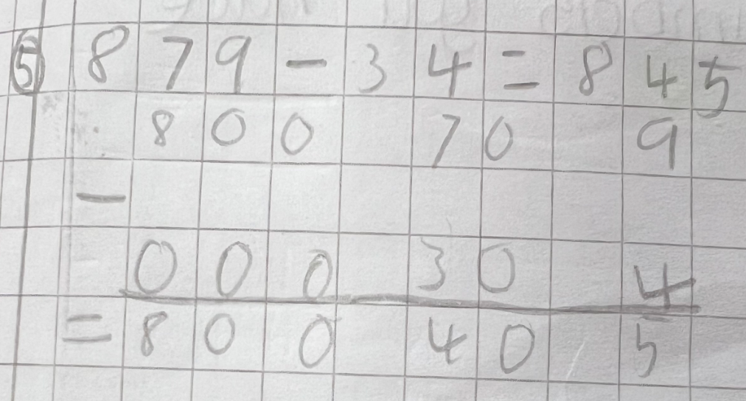
Subtraction
Using number lines.
Start with the greatest number and jump back in manageable chunks.

Slide 7
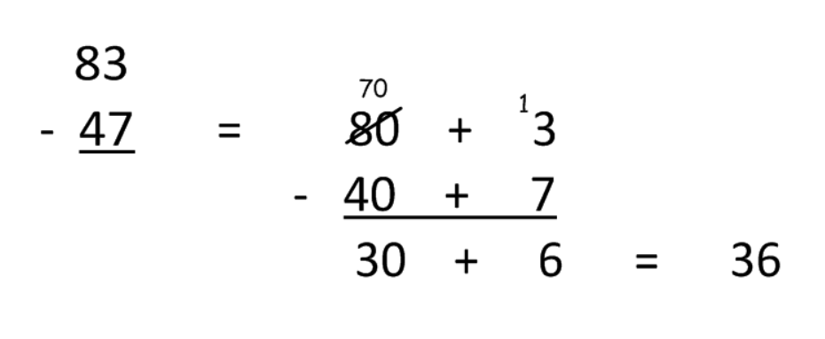
Partitioning with an exchange:
The children understand that they do not have the amount of 1s needed to subtract 7 from 3.
They exchange one 10 for ten 1s meaning they now have thirteen 1s.
Children remember to show they have exchanged by altering the 10s column accordingly.
Now they can subtract 7 1s from the newly formed 13, leaving 6. Moving to the 10s column they subtract 40 from 70, leaving 30.
They then add 30 + 6.
Need to be able to:
•Have place value awareness.
•Organisation (layout).
•Knows to work from right to left.
•Knows larger number goes “on top”.
•Knows you can only exchange one ten , hundred, etc.

Slide 8
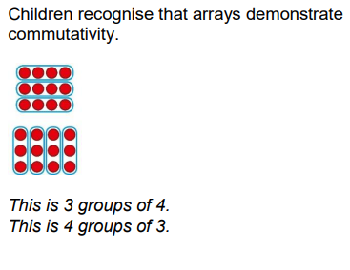
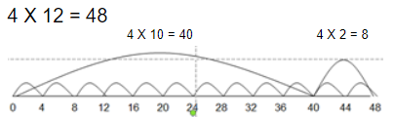
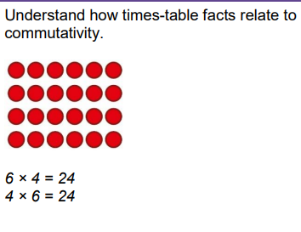
Multiplication
Children can use an empty number line to group efficiently:

Slide 9
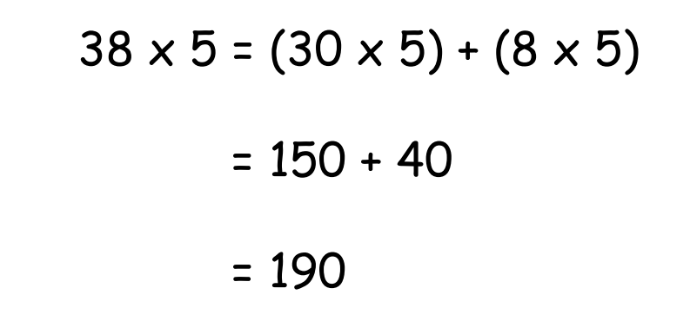
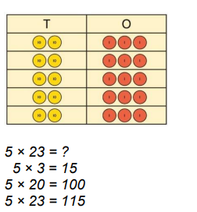
Next step:
Children to partition and place in grid format.
Multiply each column and then add totals together:
3x10=30
3x3=9
30+9=39
Children will then move onto being able to partition a 2-digit number, multiply the parts by the 1-digit number and then add the products together:
Need to be able to:
•Knows times tables.
•Have place value awareness.
•Procedural fluency.
•Organisation (layout).
•Ability to estimate.
•Can check for errors.

Slide 10
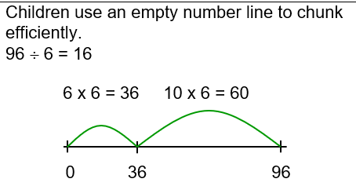
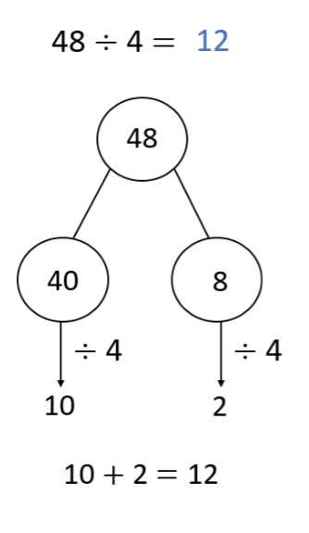
Division
Children use known multiplication facts
Subtract these amounts from the larger number.
Continue until you have reached zero.
Now count the number of chunks:
e.g. 6 + 10 = 16
Children use partitioning to divide a 2-digit number by a 1-digit number.

Slide 11
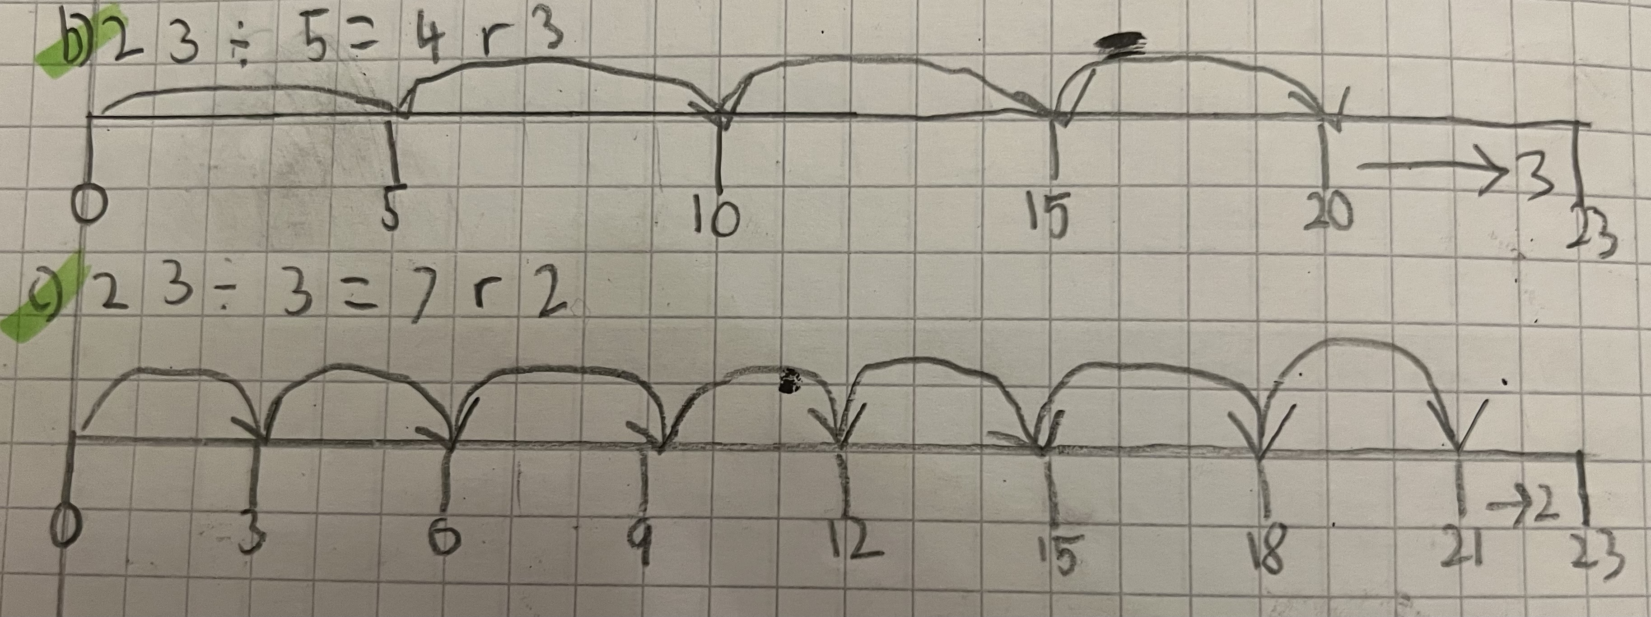
Dividing with remainders using a number line:
Start at 0 and count on in multiples of your divisor. Count how many complete groups you have and the remainder is the ‘bit left over’.
Need to be able to:
•Know times tables
•Have place value awareness.
•Can subtract HTO from HTO.
•Organisation (layout)
•Ability to estimate

