Slide 1
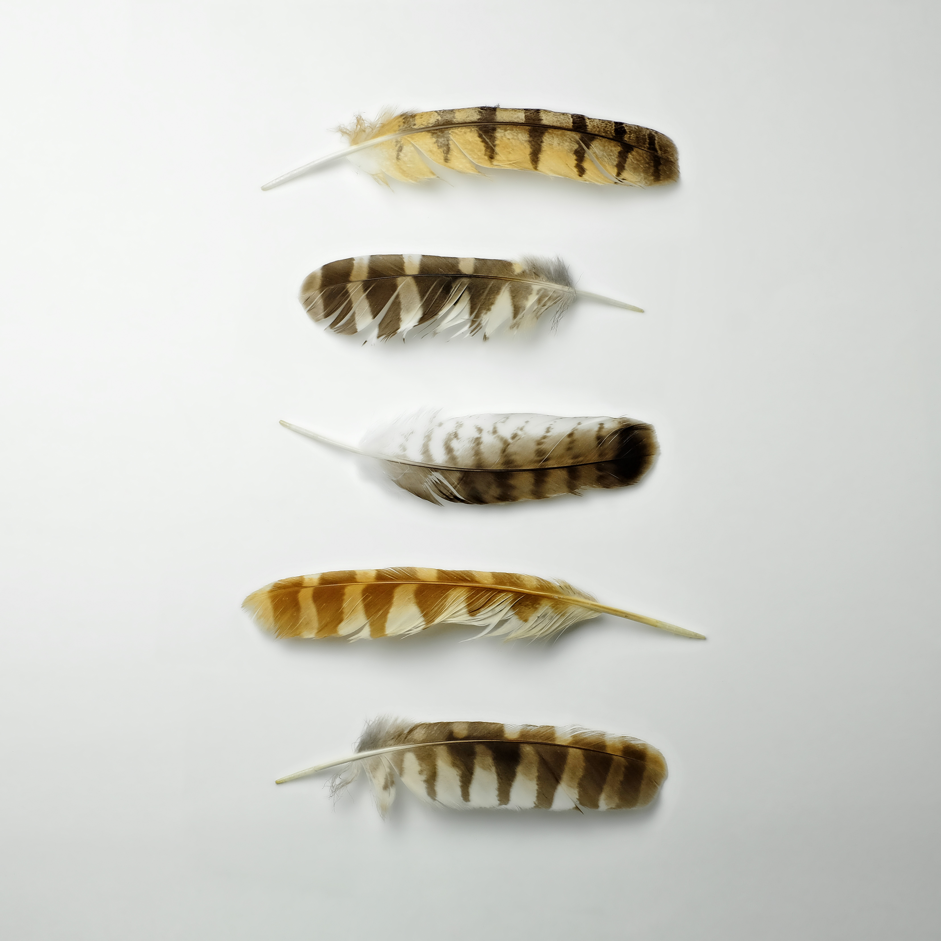

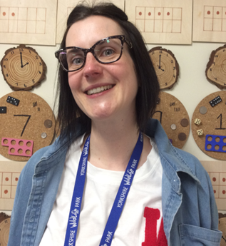
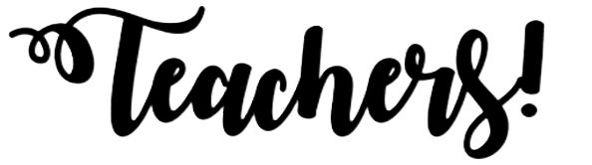

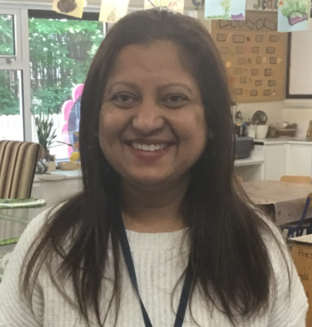
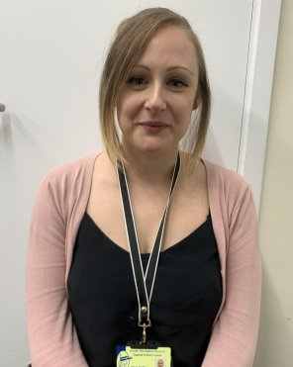
Miss Higgs
My name is Miss
Higgs and I will be
Your class teacher on
Mondays, Tuesdays
and Wednesdays! I
absolutely love
teaching in Reception
- especially when we get to play outside in the Secret Garden, get busy in the creative area and read magical stories together! In my spare time, I like baking and getting messy with my daughters, Florence and Eliza. I am so excited to meet you and I know we will have so much fun learning and playing together in Reception!
Ms Patel
My name is Ms Patel and I will be one of your teaching assistants, I will also teach the class on Wednesday afternoons when Miss Higgs and Miss McManus have their planning time. I am so excited to be in Reception! I love to paint and make beautiful artwork in our creative area. At home, I like to play with my two children Afiyah and Zain or curl up with a good book!
Miss McManus
My name is Miss McManus and I will be your class teacher on Thursdays and Fridays! I am so excited to meet you all so that we can play and share stories together – we are going to have so much fun! I love to play in the construction area and make models using the lego and big building blocks. I also love to explore nature in our fabulous outdoor area. When I'm not at school, you will find me playing with my baby daughter Jasmine – we love to sing nursery rhymes together!
Mrs Rego
My name is Mrs Rego and I am one of your teaching assistants. I am here to help look after you and make sure you are all happy at school! I love to sing and am looking forward to learning lots of new songs with you! I also love to read, and story time is my favourite part of the day! In my spare time, I enjoy badminton and spending time with my two sons!

