Slide 1


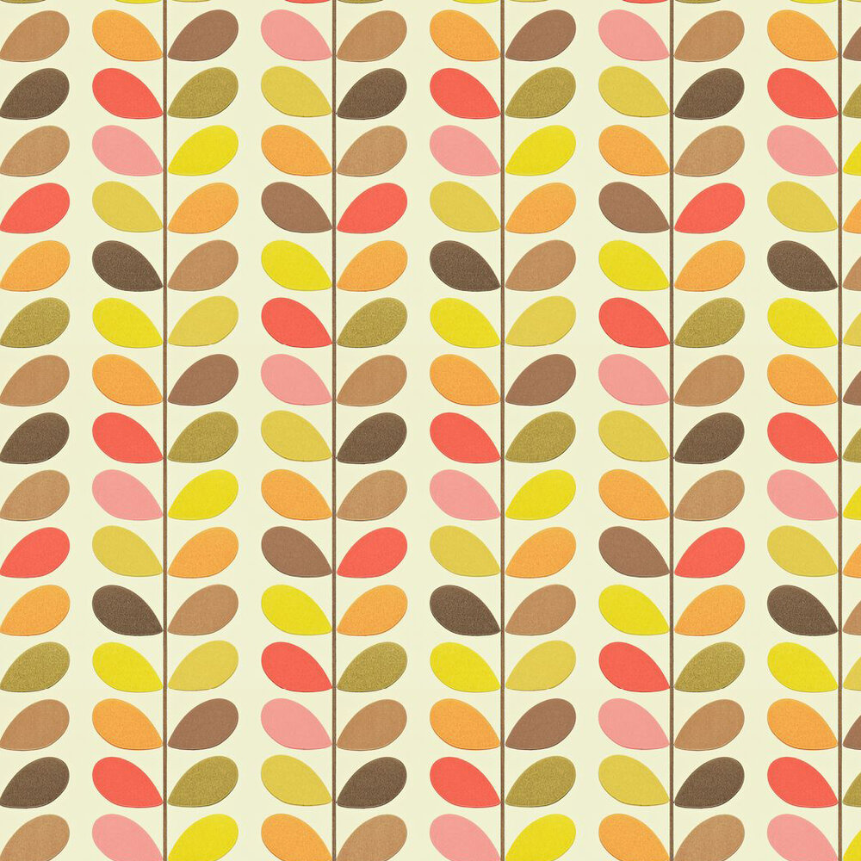
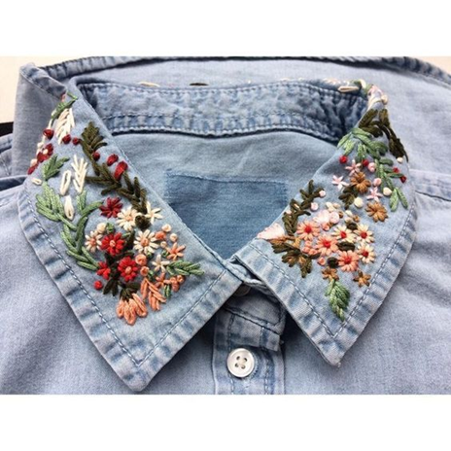
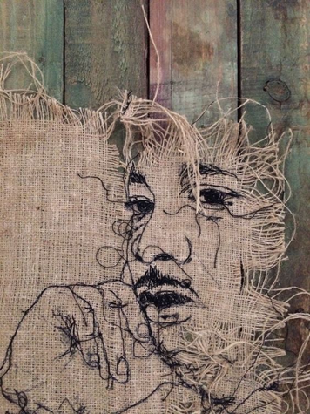
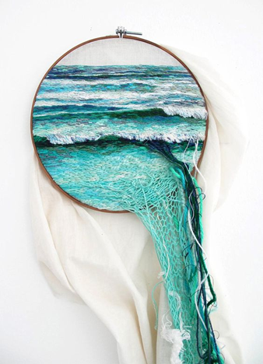


YR 11 TEXTILES
YR 12
AO4
EXTERNALLY SET EXAM
RESPONSE
CYCLE 3
Complete a 10 hour exam to create a final outcome.
EXPERIMENT
Texture and the Environment
Experiment with appropriate techniques and media. Refine along the way.
Skills & Inspiration Overview
A01
AO2
AO3
Learn how to apply and experiment with the Visual Elements through a variety of skills, techniques and processes
CYCLE 2
RESEARCH
RECORD
Collect images, research further artists/concepts. Record via drawing and other mediums
Make recordings by documenting ideas, completing observational drawing, photoshoots, techniques & processes
Developing how to talk and write about your own and other’s work
TRANSFORM
LANDSCAPES
Q1
Q2
Q3
Q4
CYCLE 1
Learning how to create original artwork inspired by the work of others
Learning how to evaluate your own and others work
MOCK EXAM
PATTERN
IDENTITY
Students respond to one of the following starting points; Landscapes, Identity, Transform, Pattern

