Slide 1





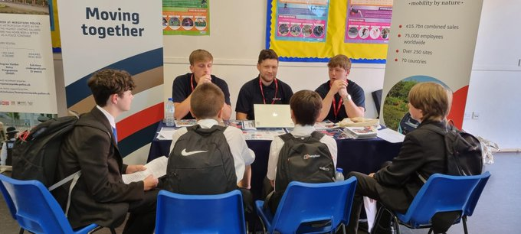








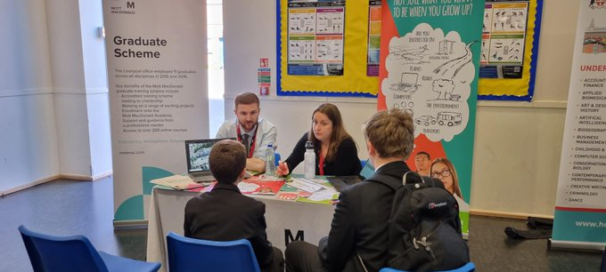





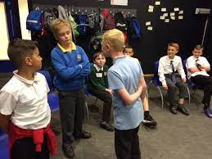

West Derby School
Year 7 to 13 CEIAG and Personal Growth Pathway
We want every student, no matter what their background is, to be able to build a rewarding career. We want to end the generational cycle of disadvantage. We want to break down the barriers facing students with Special Educational Needs or Disabilities, or those from disadvantaged groups. We want to challenge perceptions and raise aspirations so that people look beyond their immediate environment to new and exciting possibilities.
Ms C Jones
c.jones@westderbyschool.co.uk
01512351300
Shaping Futures presentation on UCAS applications
LJMU presentation on ‘Financing Your Studies’
National Apprenticeships talk on finding and applying for Level 3 apprenticeships
Speaker of the Month from a range of career fields and disciplines
PSHE: Writing a Personal Statement, Free Speech
Sept 2022-Jan 2023: Continuing Education Short Courses in partnership with Liverpool University
October 7th: Merseyside Police CSI workshop
October 13th: National Apprenticeship and University Fair in Manchester
March 31st: Making Student Finance applications with Shaping Futures
Transition to Sixth Form and thinking about Higher Education with LJMU / Unifrog
Speaker of the Month from a range of career fields and disciplines
Visit to LMA for Digital Media and TV production workshop / STEM day with Liverpool University
PSHE: Work Ethic and Motivation
Sept 2022-Jan 2023: Continuing Education Short Courses in partnership with Liverpool University
October 13th: National Apprenticeship and University Fair in Manchester
December: Advanced Pathways Research
March: Interview Skills with Shaping Futures
July 3rd to July 7th Work Experience
Social Engagement Opportunities with LFC
PSHE: Applying to College /Sixth Form with Unifrog. Job Interview Preparation.
Discover Your Potential with Shaping Futures
Careers Focused Assemblies, eg: M and Y Construction, Royal Navy
Sept 2022 to June 2023: Meeting with external Careers Advisor
October 12th: National Apprenticeship and University Fair in Manchester
20th Dec: PGD 1 Careers Carousel with a range of employers, apprenticeship, FE and HE providers.
March 31st: PGD 2: Revision and Exam Skills
Social Engagement Opportunities with LFC Foundation
PSHE: Employability Skills and CV Writing
Discover Your Potential with Shaping Futures
Access All Areas with LJMU
Pathways to apprenticeships, FE with Unifrog
Oxford / Cambridge Aspire
October: LMI with Shaping Futures
20th December: PGD 1 Elite Skills with the British Army, First Aid Session 2, Barclay’s Life Skills
March 31st: Interview Practice. National Careers Service. June 19th -30th: Work Experience
July 18th: PGD 3: Careers Carousel with employers and Sixth Form Taster Day
Social Engagement Opportunities with LFC
PSHE: Work Skills, Enterprise
Aim Higher with LJMU
Research your future options with Unifrog
Options Evening
Engage with STEM activities / Energy Quest
20th December: PGD 1 Sessions with Liverpool Uni Outreach, HSBC, First Aid, Royal Navy
February: Meet the Professionals: Elevate & Cadent
March 31st PGD 2 Careers Carousel / Speed Networking with a range of employers, apprenticeship, FE and HE providers and Sixth Form Taster Day
July 18th: PGD 3: Trip to a local cultural venue
Social Engagement Opportunities with LFC Foundation
PSHE: Personal target setting, self-confidence and goals, team-work and communication
Register with Unifrog
Engage with STEM activities / Energy Quest
20th December: PGD 1 Trip to a local cultural venue
February: Meet the Professionals: Elevate & Cadent
March 31st PGD 2 Careers Carousel with a range of employers, apprenticeship, FE and HE providers.
July 18th: PGD 3: Non-Core Subject Enterprise sessions
Transition from Primary Day
PSHE: Explore your Aspirations
Employer Encounters: Meet the Professionals
Engage with STEM activities / Energy Quest
Trip to a local cultural venue to learn from the professionals
Transition from Primary Day: meet our staff and experience a range of exciting secondary subjects
20th December: PGD 1: Non-Core Subject Enterprise sessions
31st March: PGD 2: Visit to Knowsley Safari Park
18th July: PGD 3: LFC Kick ‘Challenging Stereotypes’, HSBC ‘Savvy Shopping’, Introduction to First Aid, Liverpool University ‘Dragons’.

