Slide 1

Issue 9 September 2023
William Gilbert Endowed C of E Primary School and Nursery
www.williamgilbertend.derbyshire.sch.uk Safeguarding and Child Protection
at William Gilbert School
Welcome to our Safeguarding Newsletter
Coming up in this issue –changes to our safeguarding team, what is child abuse, sexual harassment/harmful sexual behaviour, domestic abuse, online Safety, keeping safe in the community – road safety.
Safeguarding & Child Protection is the most important issue for our children and young people. At William Gilbert School, we feel it is crucial to work with our parents and the high-quality agencies that support schools and young people, so that we can offer a safe environment allowing children to be aware of the risks they may face and how to respond to them safely.
Safeguarding and promoting the welfare of children is everyone's responsibility
The Safeguarding Team at William Gilbert Primary The William Gilbert safeguarding team has expanded and now has five Designated Safeguarding Leads or DSLs. These members of staff have enhanced safeguarding training and have a vital role in taking lead responsibility for child protection issues in school. The senior DSL is Mrs Britten. A DSL is always available during school hours for pupils, parents and staff to discuss any safeguarding concerns. Mrs Aston continues to support pupils and their families in her role as Pastoral and Wellbeing Mentor. Part of her role is to provide advice and access help as soon as a need emerges. Mrs Aston can support families with a wide range of issues, including but not limited to, mental health and wellbeing, attendance, persistent lateness, the impact of community safeguarding issues including bullying and online safety. Mrs Aston can be accessed at the school gate most mornings, via the school office or via pastorallead@williamgilbertend.derbyshire.sch.uk
Our Safeguarding Curriculum
‘Keeping Children Safe in Education 2023’(KCSIE) reminds us that safeguarding and promoting the welfare of children is everyone’s responsibility. Everyone who comes into contact with children and their families has a role to play. This means that they should always consider what is in the best interests of the child. At WGES we believe that it is vital for our children to have opportunities to learn how to stay safe both in and outside of school—learning which comes from parents and staff at WGES. Safeguarding awareness and understanding of issues including, but not limited to, children missing from education, child sexual exploitation, bullying, domestic abuse, discrimination, inequality, drugs & alcohol abuse, faith abuse, forced marriage, gender violence, radicalisation, mental health and trafficking - all start with the knowledge and skills we introduce at school.
Useful Acronyms & Vocabulary
DSL: Designated Safeguarding Lead
PREVENT: Part of the Governments Counter Terrorism Strategy to stop people being drawn into extremism
LADO: Local Authority Designated Officer - who deals with position of trust safeguarding issues
CEOP: Child Exploitation and Online Protection Centre
National Online Safety -Online training and support for families about all things online
KCSIE: Keeping Children Safe in Education (available on the school web pages)
Who’s Who at WGES
Mrs E H Britten - Senior DSL
Mrs Z Kibble - Deputy DSL
Mrs A Aston - DSL and pastoral wellbeing lead.
Mrs S Owen – DSL and mental health first aider
Mrs R Manners – DSL and SBM
Dr N Ruggins – Safeguarding Governor
Miss K Whiting –Mental Health First Aider
Mrs E Davies – SENCO
Designated Safeguarding Leads can be accessed via our safeguarding email
safeguarding@williamgilbertend.derbyshire.sch.uk
If you believe that a child or an adult is at immediate risk of harm and in need of protection then you should call the Police - 999, straight away.
Alternatively if you want advice from the Police and the child or adult is not in immediate need of protection, you can call the Police on the telephone number 101.
Here are some examples coming this term that you can discuss with your child
Weekly Safeguarding Awareness Assemblies covering the following topics this term –Who is a trusted adult at school and home; How to stay safe on the playground; NSPCC speak out to stay safe; Online safety; World mental health day, Child-on-child abuse
Religious Education lessons reinforce messages of tolerance and respect for others. Opportunities to learn about other faiths and visit places of worship.
RSHE lessons – see knowledge mats on the school website for year group information
Links with the NSPCC initiatives through workshops, assemblies and lessons
Balanceability and Bikeability training
Engagement with charities that broaden pupils' awareness, understanding and worldview
Behaviour policy and practice in school under the ‘Golden Rules’

Slide 2


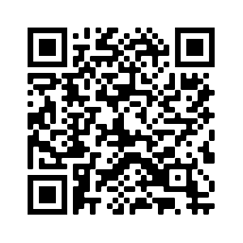
What are the signs of child abuse?
NSPCC
The signs of child abuse aren't always obvious, and a child might not feel able to tell anyone what's happening to them. Sometimes, children don't even realise that what is happening to them, is abuse.
There are different types of child abuse and the signs that a child is being abused may depend on the type. For example, the signs that a child is being neglected may be different from the signs that a child is being abused sexually.
Common Signs
Some common signs that there may be something concerning happening in a child’s life include:
unexplained changes in behaviour or personality
becoming withdrawn
seeming anxious
becoming uncharacteristically aggressive
lacks social skills and has few friends if any
poor bond or relationship with a parent
knowledge of adult issues inappropriate for their age
running away or going missing
always choosing to wear clothes which cover their body
These signs don’t necessarily mean that a child is being abused, there could be other things happening in their life which are affecting their behaviour – but we can help you to assess the situation.
You may also notice some concerning behaviour from adults who you know have children in their care, which makes you concerned for the child/ children’s safety and wellbeing.
https://www.nspcc.org.uk/what-is-child-abuse/
https://www.nspcc.org.uk/what-is-child-abuse/types-of-abuse/
Sexual Harassment in Schools
What is Sexual Harassment?
Sexual harassment in general is any unwanted sexual attention online and offline that can cause physical, emotional/mental, psychological or economic harm to the victim.
Can this happen in Primary School?
Research suggests that more than a third of sexual abuse reported by any age children is perpetrated by their peers (Child on Child Sexual Abuse) - with girls being the victim in the majority of cases. Sexual violence and sexual harassment can occur between two children of any sex. It can also occur through a group of children sexually assaulting or sexually harassing a single child or group of children. It is important that we teach all children (boys and girls), of all ages, what is acceptable interaction and what is not, and then what they must do if any unwanted sexual attention happens to them.
What can we do to teach children appropriate interaction?
Boys and girls mix together in every social environment, at every age and many children will never experience sexism, harassment or abuse based on gender. To ensure that our youngest children know how to keep themselves safe we must encourage an open honesty about their experiences so that they know it is always safe to disclose to a trusted adult. Parents and staff should make sure they model the best ways of showing respect between the genders and challenge any attempt by family members, friends, other parents and organisations to undermine that work.
Useful Acronyms & Vocabulary
Sexual Violence: Incidents such as rape, assault by penetration and sexual assault.
Sexual Harassment: sexual comments, remarks, jokes and online sexual harassment, which may be stand-alone or part of a broader pattern of abuse.
Sexting: also known as ‘youth-produced sexual imagery’
Sexual abuse: being persuaded or forced into undesired sexual activity
Misogyny: Feelings of hating women or the belief that men are better than woman.
Safeguarding Information at WGES
We have a wealth of information on our school website for parents to access, including important documents and contact details.
Please visit www.williamgilbertend.derbyshire.sch.uk
Scan the QR code below to take you to our safeguarding page

Slide 3
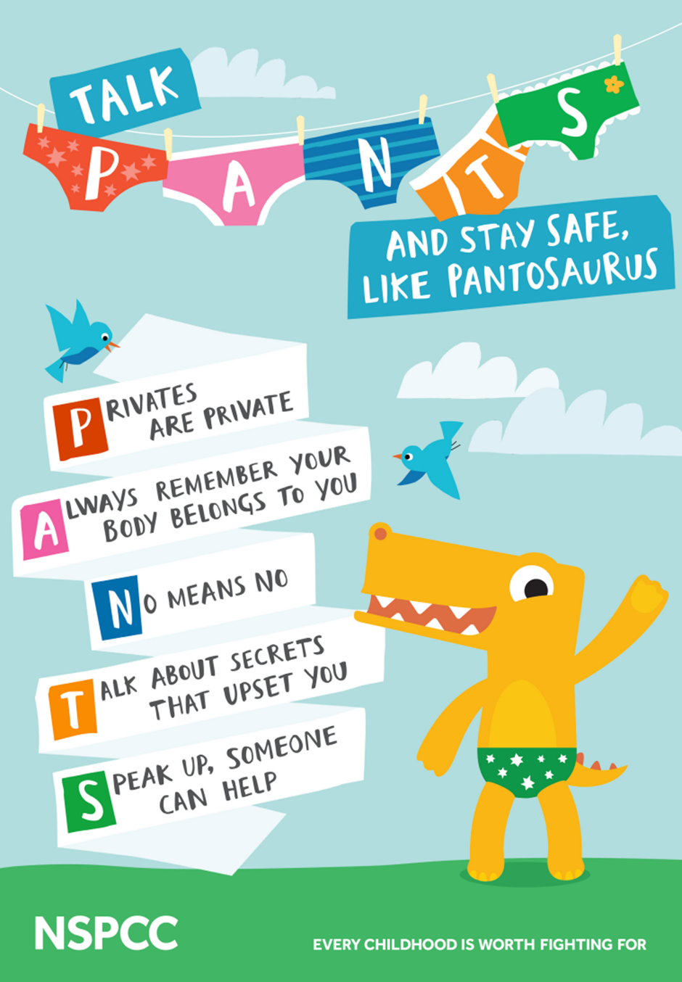
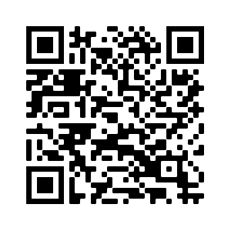
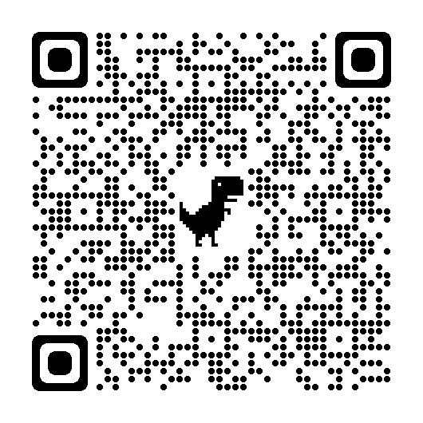
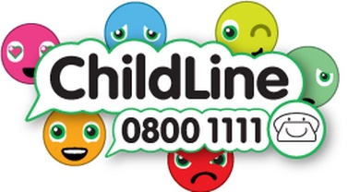
How to prevent Sexual Harassment in School and protect your child from sexual abuse
Useful Acronyms & Vocabulary
CAMHS: Child and Adolescent Mental Health Services
My Concern – Safeguarding record system (safeguarding and child protection software for schools used at WGES).
EHA: Early Help Assessment
SEND: Special Educational Needs & Disabilities
Safeguarding Information at WGES
We have a wealth of information on our school website for parents to access, including important documents and contact details.
Please visit www.williamgilbertend.derbyshire.sch.uk
If you believe that any child is in danger ring Call Derbyshire Tel: 01629 533190 choosing the option for urgent child protection calls at any time
At Primary School, we have to be very proactive in creating an environment that teaches boys and girls how to behave respectfully towards each other, and how to respect personal/physical boundaries set. We must make sure all of our young people (boys and girls) are prepared for the wider world of secondary school and employment.
Developing Awareness
We should not frighten children but should develop age-appropriate awareness and understanding of the dignity of the person and how to respect self, thereby giving skills to respect others. If children understand their own bodies, the terminology to use, why other words are not appropriate, they will speak more knowledgably and respectfully to each other.
Pupils who are the victim of any level of inappropriate sexual behaviour must tell (and adults must make it safe for them to do so)
Challenge your child if they are using stereotypical or sexist language and educate why it is wrong—the sooner we remove the normalisation of this language, the better.
Talk openly (in an age-appropriate way) about anatomy and the similarities and differences between people. We are all made in the image and likeness of God and so our form, no matter what form that takes, is always perfect to God (there is no superior gender)
Teach your child (and model) what healthy relationships look like—this is lifelong learning that will shape how your child views their future interactions with people and what they see as acceptable
Teach your child about consent
Make sure that your child knows they can say “No” if the behaviour of another person crosses a boundary making it unacceptable.
Teach your child to tell someone they trust about what has happened to them—we action and record all incidents
We use the NSPCC resources to teach pupils, in an age-appropriate manner about how to keep safe from sexual abuse.
Every family is different, and when and where you have these conversations may depend on your child's age, or how grown up they are - it's all about whatever feels natural for you and them.
Scan the QR code or follow the link below to take you to the NSPCC website to find lots of information for parents and fun songs to teach them these crucial messages.
https://www.nspcc.org.uk/keeping-children-safe/support-for-parents/pants-underwear-rule/

Slide 4


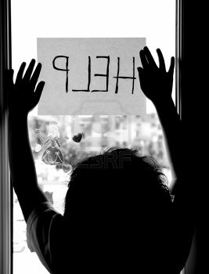
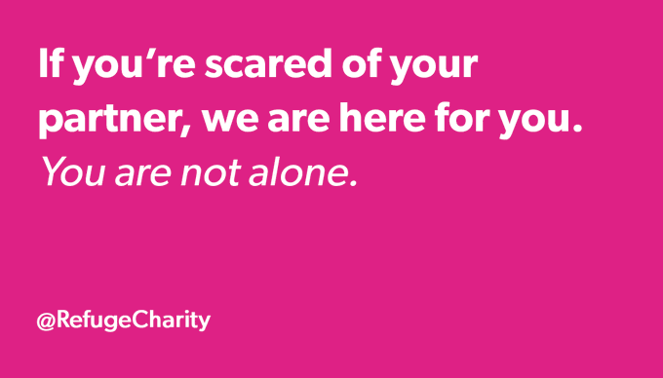
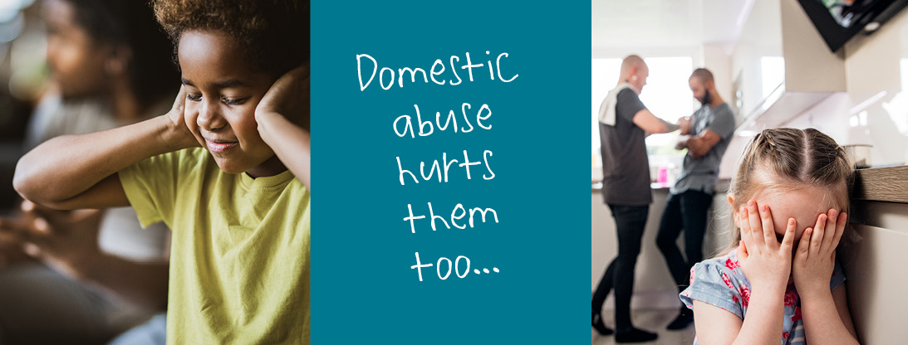
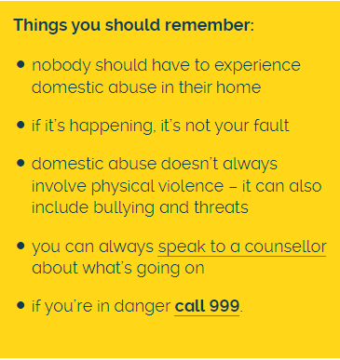

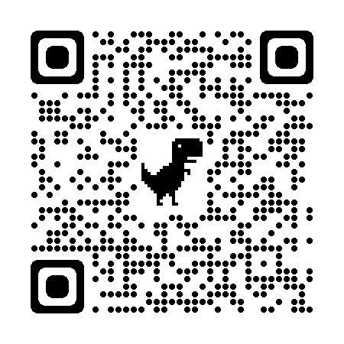
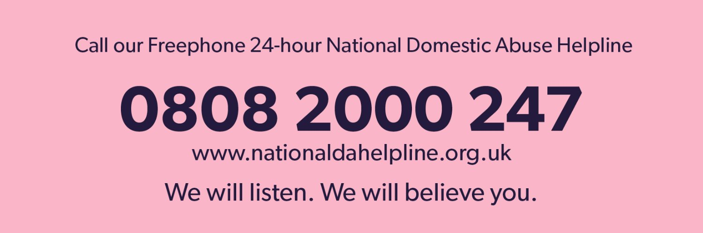

Domestic Abuse
What is Domestic Abuse
Domestic abuse is any type of controlling, bullying, threatening or violent behaviour between people in a relationship. It can seriously harm children and young people and witnessing domestic abuse is child abuse. It's important to remember domestic abuse:
can happen inside and outside the home
can happen over the phone, on the internet and on social networking sites
can happen in any relationship and can continue even after the relationship has ended
both men and women can be abused or abusers.
Types of Domestic Abuse
Domestic abuse can be emotional, physical, sexual, financial or psychological, such as:
kicking, hitting, punching or cutting
rape (including in a relationship
Controlling someone’s finances by withholding money or stopping someone earning
Controlling behaviour, like telling someone where they can go and what they can wear
Not letting someone leave the house
Reading emails, text messages or letters
Threatening to kill someone or harm them
Threatening to another family member or pet
Useful Acronyms & Vocabulary
Early Help – providing support as soon as needs emerge for a child or family.
Domestic Abuse (Domestic abuse is abusive, violent, controlling, coercive or threatening behaviour between people aged 16 or over who are, or have been, intimate partners or family members. It can happen to anyone.
Mrs Aston our Pastoral and Wellbeing Mentor is here to support you and your child if you are worried about Domestic Abuse and the impact on your child.
Contact Mrs Aston
On the school number 01332 840395 or via email at pastorallead@williamgilbertend.derbyshire.sch.uk
Or at the school gate each morning.
Domestic Abuse
Information at WGES
We have a further information on our parenting support page of the school website.
Scan the QR code below
Effects of Domestic Abuse
Living in a home where domestic abuse happens can have a serious impact on a child or young person's mental and physical wellbeing, as well as their behaviour.
Witnessing domestic abuse is child abuse. Domestic abuse can have a devastating impact on the victims and their families, with children and young people at risk of serious harm to both their emotional and physical health.
What's important is to make sure the abuse stops and that children have a safe and stable environment to grow up in
Support and Advice
If you're an adult experiencing domestic abuse or you know someone who needs help, there are organisations that can offer advice and support.
Relate
0300 003 0396
You can talk to Relate about your relationship, including issues around domestic abuse.
National Domestic Violence Helpline
0808 2000 247
A 24 hour free helpline run in partnership between Women's Aid and Refuge.
Men's Advice Line
0808 801 0327
Advice and support for men experiencing domestic violence and abuse.
National LGBT+ Domestic Abuse Helpline
0800 999 5428
Emotional and practical support for LGBT+ people experiencing domestic abuse.
Childline
We understand how difficult it is for children to talk about domestic abuse. Whether it's happening now or happened in the past, Childline can be contacted 24/7. Calls to 0800 1111 are free and confidential. Children can also contact Childline online.
Childline has information and advice for children and young people about domestic abuse, including why it happens and what they can do.
Help for Children and Young People
The NSPCC have a Domestic Abuse, Recovering Together (DART™) which is a therapeutic service for mothers and children who have experienced domestic abuse. This programme allows children and mothers to talk openly, learn to communicate about what’s happened and rebuild their relationship. There are local DART programmes available to families in our community – information can be found on the NSPCC website – follow the link https://www.nspcc.org.uk/keeping-children-safe/our-services/national-regional-hubs/

Slide 5



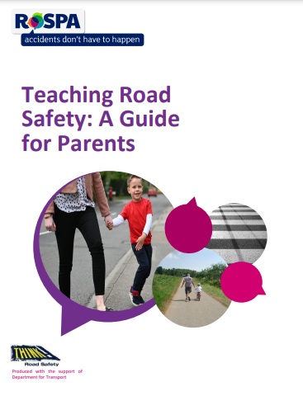
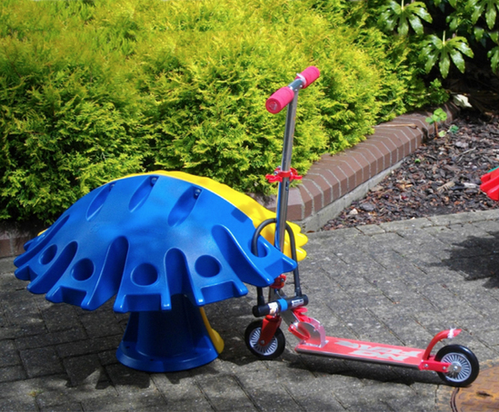
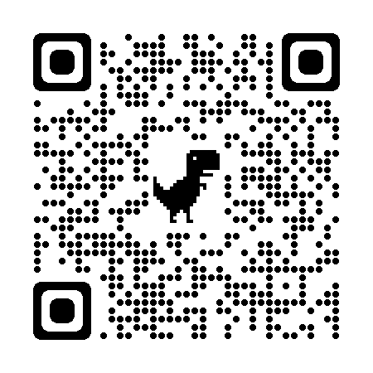

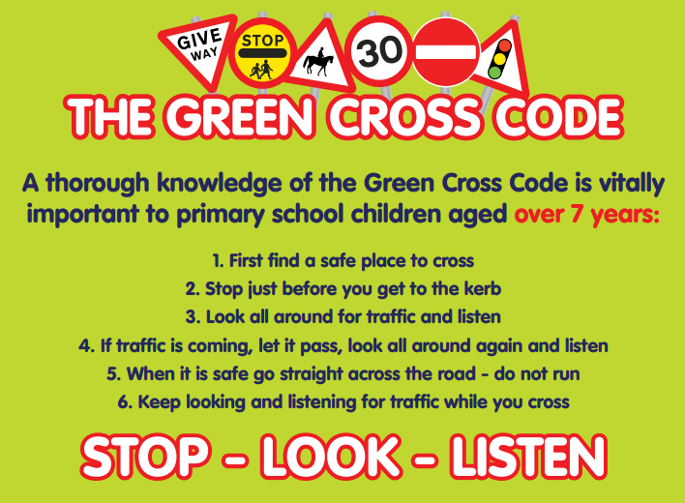
Keeping Safe in the Community
Useful Acronyms & Vocabulary
RoSPA: Royal Society for the Prevention of Accidents
My Concern – Safeguarding record system (safeguarding and child protection software for schools used at WGES).
EHA: Early Help Assessment
SEND: Special Educational Needs & Disabilities
Safeguarding Information at WGES
We have a wealth of information on our school website for parents to access, including important documents and contact details.
Please visit www.williamgilbertend.derbyshire.sch.uk
If you believe that any child is in danger ring Call Derbyshire Tel: 01629 533190 choosing the option for urgent child protection calls at any time
Road Safety As the daylight hours grow shorter and children are out and about around the local area and close to roads it is important to remind children of the road safety rules. During our weekly assemblies and bikeability sessions we will be discussing road safety. Our local Neighbourhood Safety Team from Derbyshire Constabulary will be visiting school in September to talk to children about road safety. We will be discussing the key roads close to school and where are the safest places to cross these roads safely. Ask your child what they can remember and use this as a starting point to remind them about keeping safe when crossing or playing near roads. Take a look at these useful resources and websites to remind children of the key safety messages.
https://www.think.gov.uk/education-resources/
https://www.rospa.com/media/documents/road-safety/teaching-road-safety-a-guide-for-parents.pdf
Plea to Parents/Carers – those of you who choose to
drive onto Vicarage Lane or St Alkmunds Close, please
do not park within 10 metres of the junction of St Alkmunds
Close, or mount the kerb. This is a busy junction which pupils use
to cross the road and need to do so without visual obstructions.
News! Scooter pods have arrived…
Following a successful bid to Duffield Parish Council, we have been able to purchase 2 Scooter pods for our playgrounds. These will allow pupils to travel to school by scooter and park them safely on our premises. There are holes to allow the scooters to be secured with a bike/scooter lock, should you wish to secure them. We hope this purchase will encourage more families to leave the car at home and travel to school in a healthier way.
Scooter Safety training
This term a team from Derbyshire County Council will be visiting school to deliver Scooter Safety training to help keep children road aware when using local pavements.

Slide 6




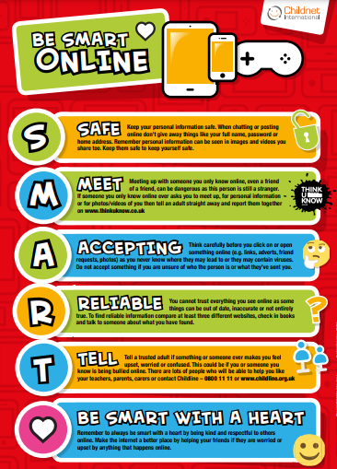
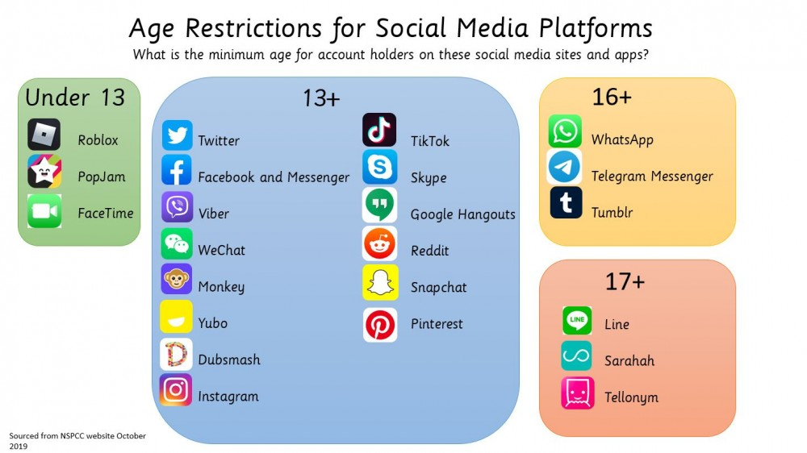
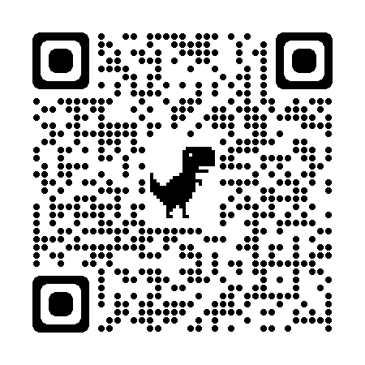
Keeping safe online
Useful Acronyms & Vocabulary
My Concern – Safeguarding record system (safeguarding and child protection software for schools used at WGES).
Cyberbullying is any form of bullying which takes place online or through smartphones and tablets – adults and children can be victims.
CEOP: Child Exploitation and On-line Protection Centre
https://www.thinkuknow.co.uk/parents/
Online Safety
Information at WGES
We have a wealth of information on our school website for parents to access.
Please visit https://www.williamgilbertend.derbyshire.sch.uk/staying-safe-on-the-internet/
Or scan the QR code below
-
Age Restrictions for Social Media Platforms
Do you know what your child is doing online? Are you routinely talking to your child and checking what internet sites they are accessing?
It is very important to monitor and teach your child some key internet safety rules.
Protect your personal information – don’t post any personal information online – like your address, email address or mobile phone number.
Think carefully before posting pictures or videos of yourself. Once you’ve put a picture of yourself online most people can see it – is it a photo you would want everyone to see?
Keep your privacy settings as high as possible
Never give out your passwords (except to your parents if they want to check your accounts to keep you safe.
Don’t befriend people you don’t know
Don’t meet up with people you’ve met online. Speak to your parent or carer about people suggesting you do.
Remember that not everyone online is who they say they are – adults sometimes pretend to be children to make friends with you online.
Think carefully about what you say before you post something online.
Respect other people’s views, even if you don’t agree with someone else’s views doesn’t mean you need to be rude.
Use parental safety software/apps to block inappropriate internet use and monitor your children’s online activity.
Ensure that the online games your child wants to play are appropriate to their age.
If you see something online that makes you feel uncomfortable, unsafe or worried: leave the computer and tell a trusted adult immediately.
Learn how to stay safe online through fun games
Visit Google’s Interland to play fun games as a family to be internet awesome
https://beinternetawesome.withgoogle.com/en_us/interland
Come and be internet awesome
Find further support about being smart online at:
https://www.childnet.com/parents-and-carers/

