Slide 1
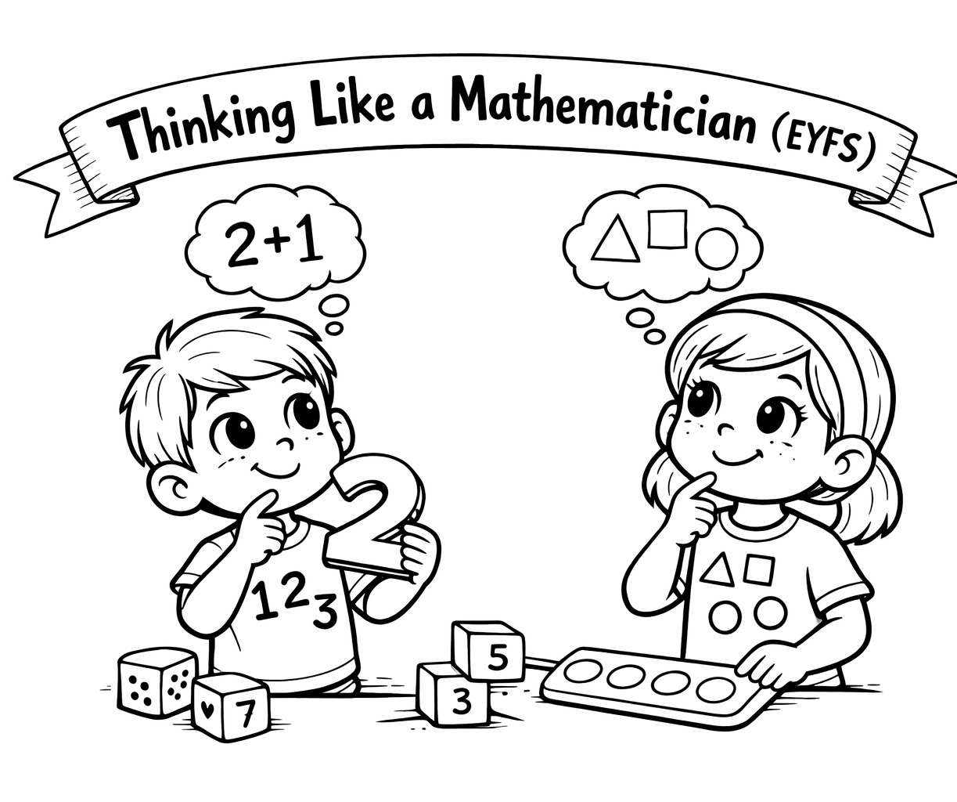
A Coppice Mathematician - EYFS
Number
Problem Solving
I am beginning to recognise numbers and count objects.
These are the skills I develop to help me to become a well-rounded Mathematician.
I try different ways to solve simple problems.
Calculation
Reasoning
I am beginning to add and take away using objects.
I can talk about my thinking.
Mathematical Language
Patterns
I notice patterns around me.
I use words like more, less, bigger and smaller.

