Slide 1
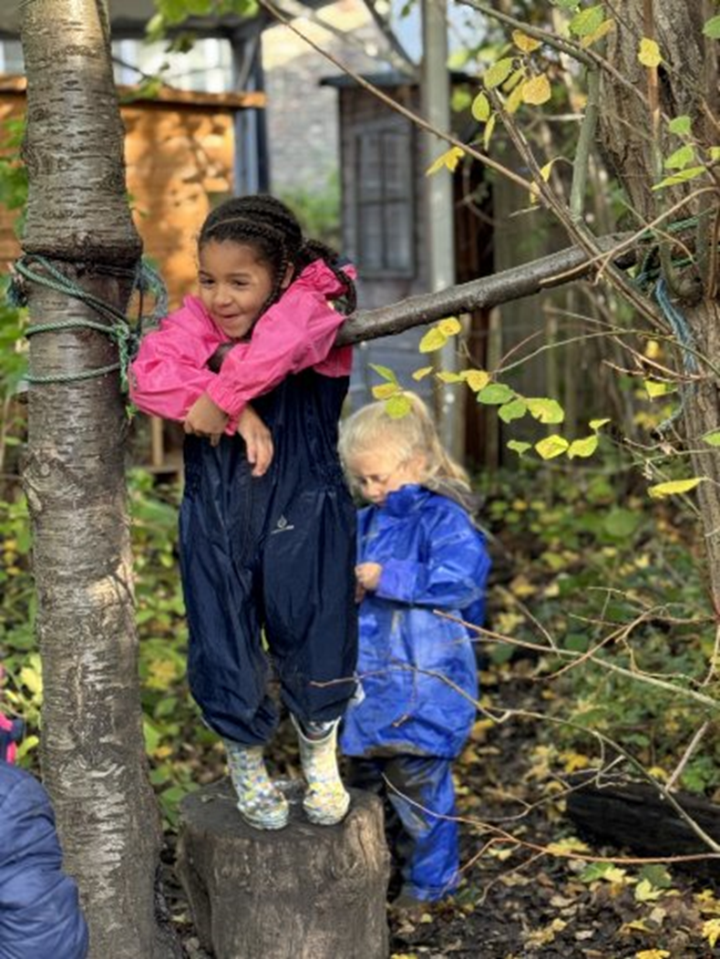


Slide 2
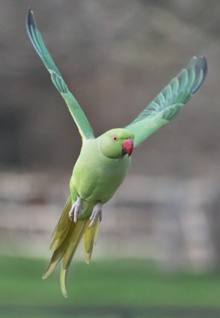
Our 5 new
Core Values
Empowerment
Empathy
Curiosity
Collaboration
Champion

Slide 3
Empathy: We encourage the children to understand and share the feelings of others, promoting kindness, respect, and compassion throughout our school community. This is reflected in our emphasis on mutual respect and teamwork, where children learn to appreciate different perspectives and work harmoniously.
Empowerment: We aim to empower the children by giving them the confidence and tools to take ownership of their learning and personal growth. Through democratic practices like Pupil Governors and encouraging student voice, we ensure the children feel valued and have the power to influence their educational journey.
Curiosity: Wyborne fosters a love of learning through a curriculum that stimulates curiosity and encourages the children to explore and question the world around them. This approach ensures that the children not only gain knowledge but also develop a deeper understanding across various subjects, preparing them for lifelong learning.

Slide 4

Collaboration: Collaboration is at the heart of how we operate as a school community. Whether in the classroom, during sports, or in extracurricular activities, we emphasise teamwork and cooperative learning. This strengthens the childrens’ ability to communicate effectively and work together towards shared goals.
Champion: We champion every child, ensuring that each one feels supported and celebrated for their unique abilities and contributions. This is reflected in our inclusive approach to education, where children of all abilities and backgrounds are encouraged to achieve their full potential, both academically and personally.

Slide 5

Sense of Community
Endless opportunities to try something new
The Kindness and Support of staff
Magical Experiences
Staff know the children individually
What is the best thing so far about your child's time at Wyborne?
Balanced Curriculum and a variety of ways to learn
A Diverse and Creative Curriculum
I love how the kids literally fight to get through the gates
A caring environment
Inclusivity

Slide 6
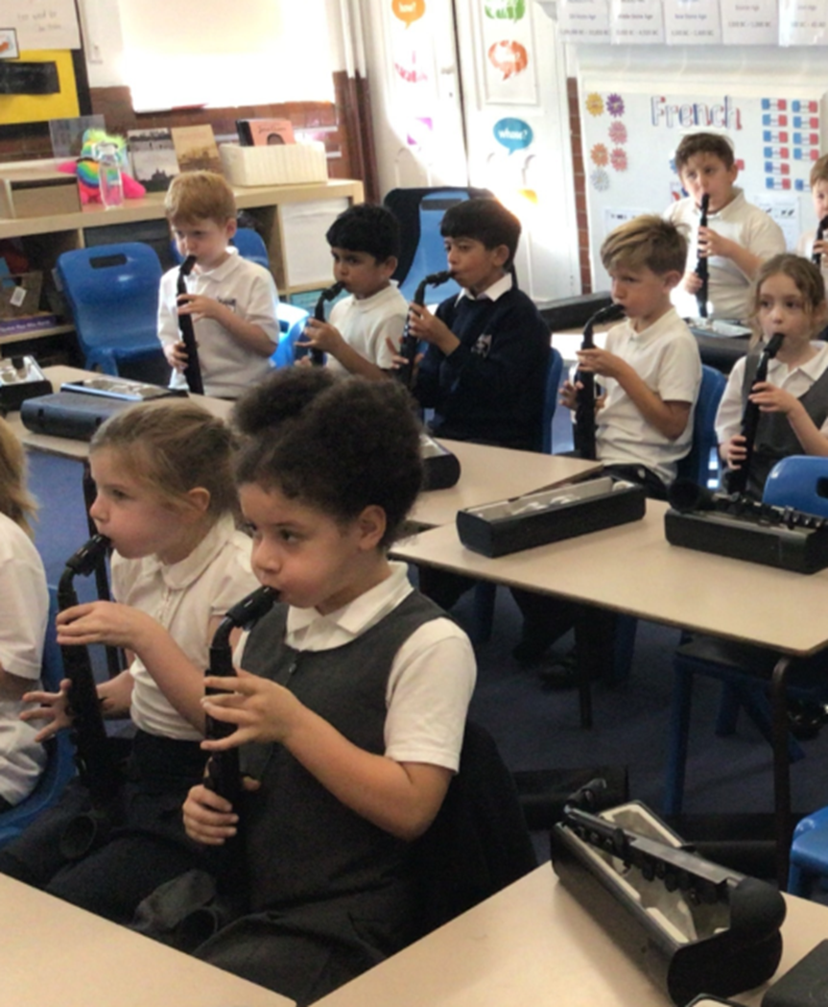
Why Wyborne?
Popular Choice within the community
Quality Teaching and Learning
Inclusive environment
Commitment to physical, mental and emotional well-being
Outstanding Pastoral Care
Safe and happy children
Commitment to spiritual, moral, social and cultural capital development
Commitment to recognising talents
Preparing pupils for their educational journey beyond
primary school and into employment.
A broad, balanced and relevant curriculum
Specialist Music and Dance teachers
Sense of community
‘Pupil Voice’ – Pupil Governors
Young Interpreters
Ambassadors
Trips, clubs and visitors
Inspiring awe and wonder

Slide 7

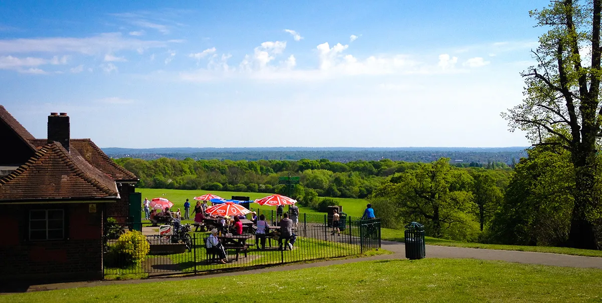
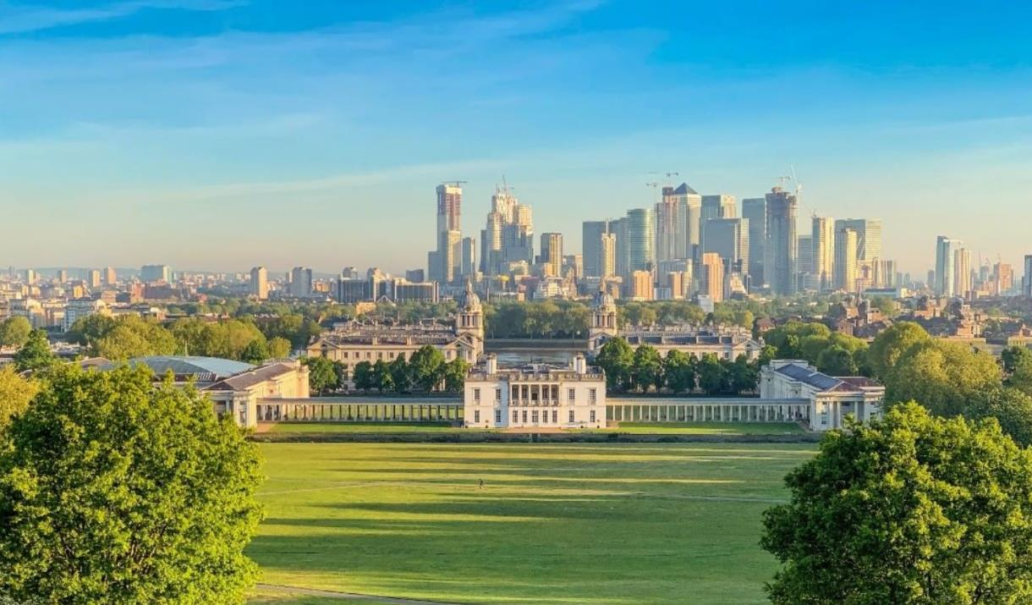
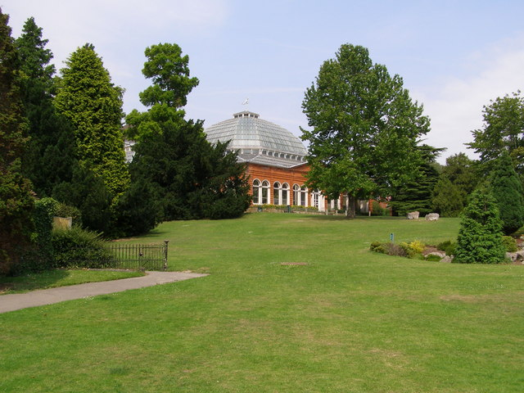
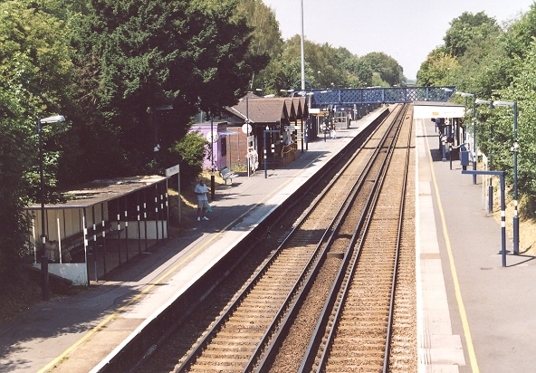

Slide 8
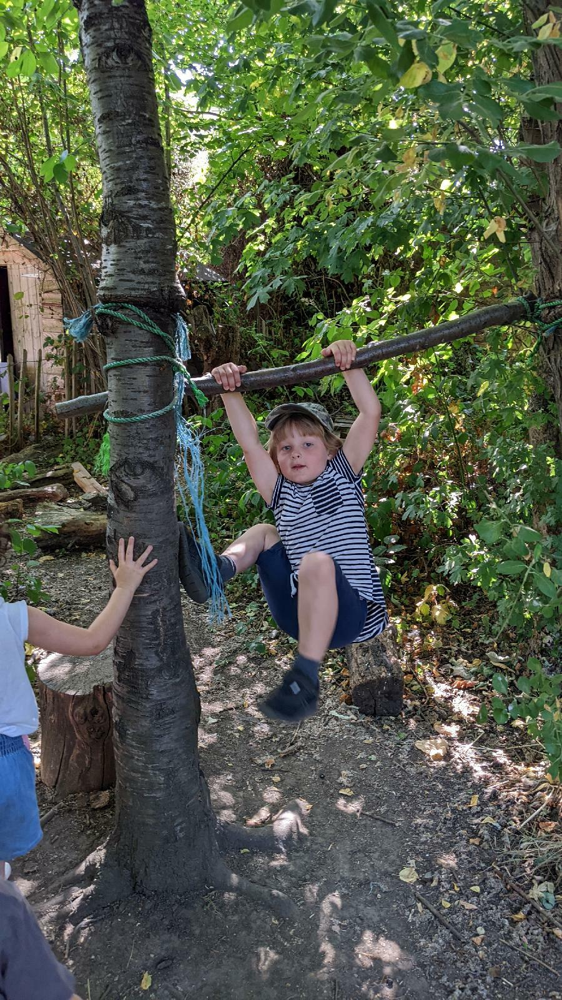
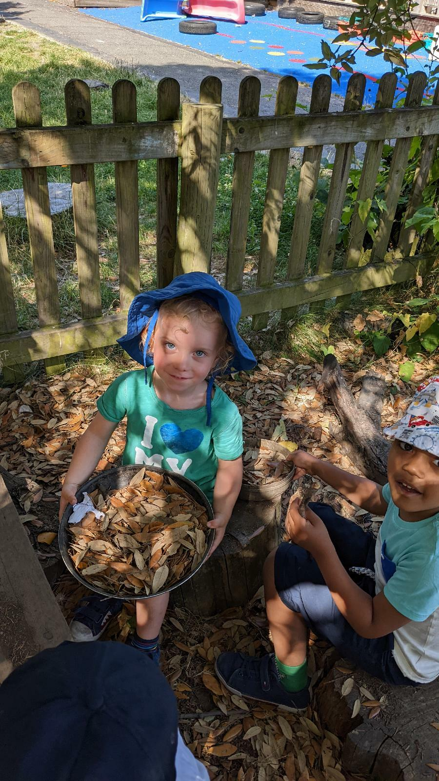
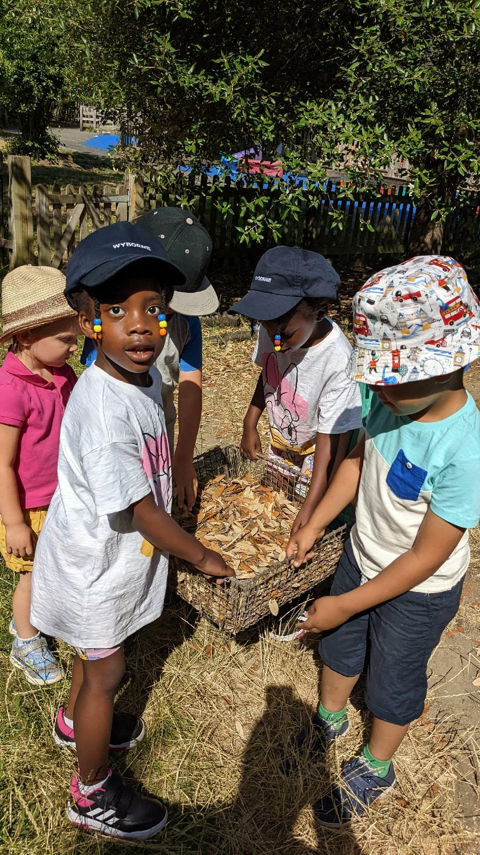
Outstanding
Forest School Provision

Slide 9
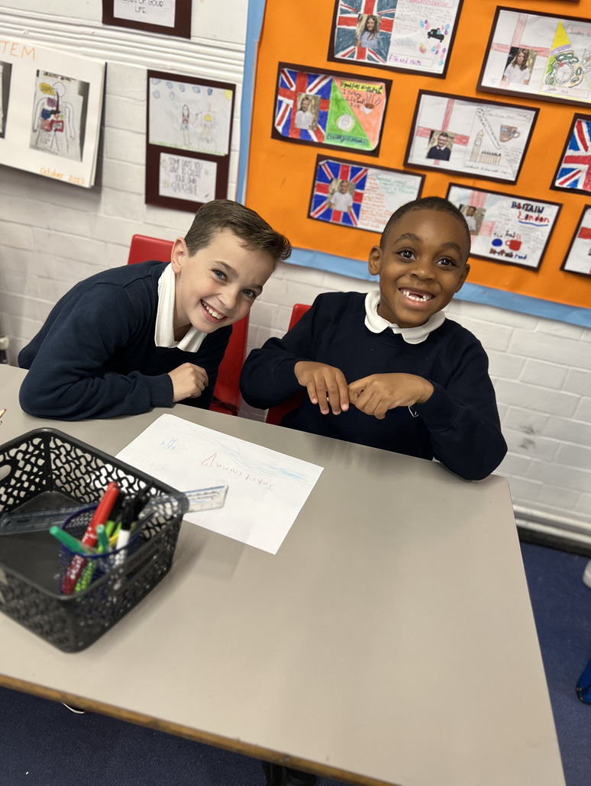
About Our School
2 form entry school with a nursery
Approx. 440 Pupils on Roll
Positive balance between academic and pastoral support
Over 30 different languages are spoken by our pupils
We celebrate diversity and equal opportunities for all
Consistently Good and Outstanding teaching staff
Quality team of Support Staff
Approachable Leadership Team and supportive/challenging Governors
Learning Mentors and Behaviour Support Officers
Efficient office and premises staff
Hardworking Parents and Friends Association
Excellent resources enhance teaching and learning, including laptops/ipads
‘Forest School’ provision, including trained teachers
A shared commitment to continuous improvement

Slide 10
Strategic School Improvement Plan 2024/27
5 Pillars
Teaching and Learning
Pupil Progress
Professional Development
Relationships
Equity (Inclusion and Diversity)

Slide 11

.
.

Slide 12


3 Year Strategic School Improvement Plan 2024/27
Teaching and Learning
Ensure the Wyborne Teaching and Learning Toolkit is fully embedded and systematically reviewed.
Further develop project based learning and continuous provision to ensure that learning is innovative, purposeful and fosters curiosity.
Enhance our English curriculum to ensure reading initiatives across all age groups foster the love of reading.
Increase access to high-quality oracy education, empowering children to use their voice.
Integrate technology across the curriculum to ensure future readiness and enhance educational experiences.

Slide 13

3 Year Strategic School Improvement Plan 2024/27
Pupil Progress
Prioritise personal and holistic development to ensure that all children experience success in their own areas of excellence.
Provide every pupil with the opportunity to achieve academic age related expectations.
Ensure more able pupils are appropriately challenged and supported.
Refine assessment practices to ensure they are consistently accurate and effective.
Evaluate reporting procedures to ensure they are purposeful for all stakeholders.

Slide 14

3 Year Strategic School Improvement Plan 2024/27
Professional Development
Continue to foster a culture of professional development and reflective practice to empower staff members and school governors.
Implement succession planning strategies to champion future leaders.
Draw on external experts and research to enhance our own practice and approaches.
Strengthen partnerships and actively share best practice.
Promote ethical leadership principles to guide decision making at all levels of the school.

Slide 15

3 Year Strategic School Improvement Plan 2024/27
Relationships
Continue to promote a culture of well-being to support the mental, emotional and physical health for all stakeholders.
Launch and embed our new school values to permeate through all aspects of school life.
Review and implement the relationships policy to foster positive interactions and a supportive school environment.
Strengthen community engagement and collaboration.
Develop our brand and identity to continue to be a first choice primary school.

Slide 16

3 Year Strategic School Improvement Plan 2024/27
Equity (Inclusion and Diversity)
Promote diversity by ensuring that the school workforce reflects the demographics of the local community.
Continue to provide targeted support for the most vulnerable pupils and groups within our school community.
Review and enhance provisions within the school to effectively support the increasing number of children with complex needs.
Address attendance and punctuality to ensure that all pupils have equal access to learning opportunities.
Continue to diversify the curriculum to ensure there is an accurate reflection of the diverse cultures and experiences of our school community.

Slide 17
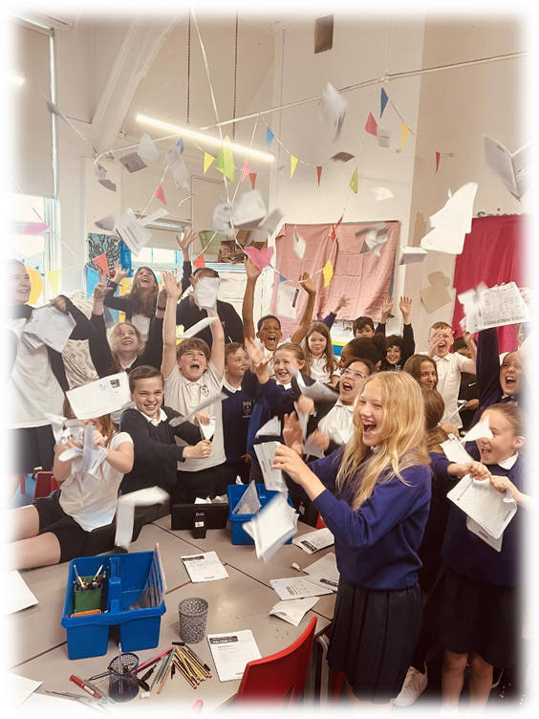
High Expectations at Wyborne
We expect:
All pupils to behave well – we accept mistakes
Zero tolerance to all forms of bullying
All pupils to do their best at all times
All pupils to wear school uniform
All pupils to attend school every day, on time
All pupils to read regularly at home
All pupils to be inclusive and respectful of each other

Slide 18
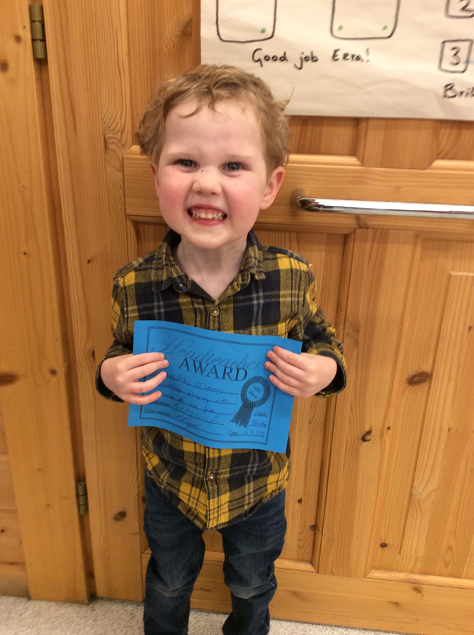
Behaviour Management
Positive behaviour management strategies
Rewards
Sanctions
Partnership with Parents/Carers
Restorative justice – (Respect, Responsibility, Repair and Reintegration)
Trauma informed approaches
Learning Mentors/Behaviour Support Officers

Slide 19
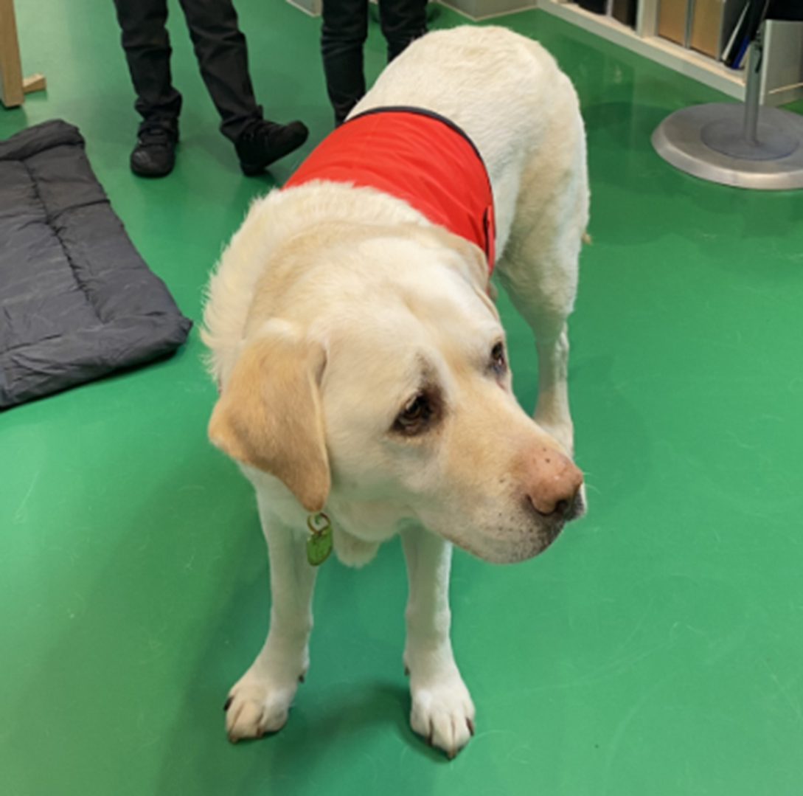
Parents/Carers
Parent/Carer coffee mornings
Parent/Carer Consultation Days
Parent/Carer Workshops (phonics/ reading)
Assemblies and performances
School trips
Parents and friends – social fund raisers
Breakfast/After school Club (7.30am – 6.30pm)
Home visits to all new entrants

Slide 20
PFA - Dates for the diary
Coffee morning 23rd September 2024
Uniform sale 24th and 25th September 2024
Bag2school 30th September 2024
Pyjama Day 4th October 2024
AGM 24th October 2024
GB10 fireworks display 27th October 2024
Winter Disco 14th November 2024
Bag Tombola 22nd November 2024
Christmas Fair 30th November 2024
Magic Show 6th February 2025
Mothers Day sale 27th March 2025
Disco 24th April 2025
Easter Creation Day 4th April 2025
Break the rules day 2nd May 2025
Cultural Celebration Day 23rd May 2025
Colour Run 7th June 2025
Fathers Day sale 13th June 2025
Family Fun Day 6th July 2025
Throughout the year, the PFA organise multiple events to support the school and raise money for the school. There will be a focus on raising money for playground equipment this year.
The PFA will communicate more details about each event in the run up to them.
All dates are subject to change.
The PFA are always looking for more helpers and volunteers. Please do get in contact if there is anything you can do to support!
Notes:
Ordinarily would not talk to staff for 15 minutes - but 15 minutes allocated

Slide 21
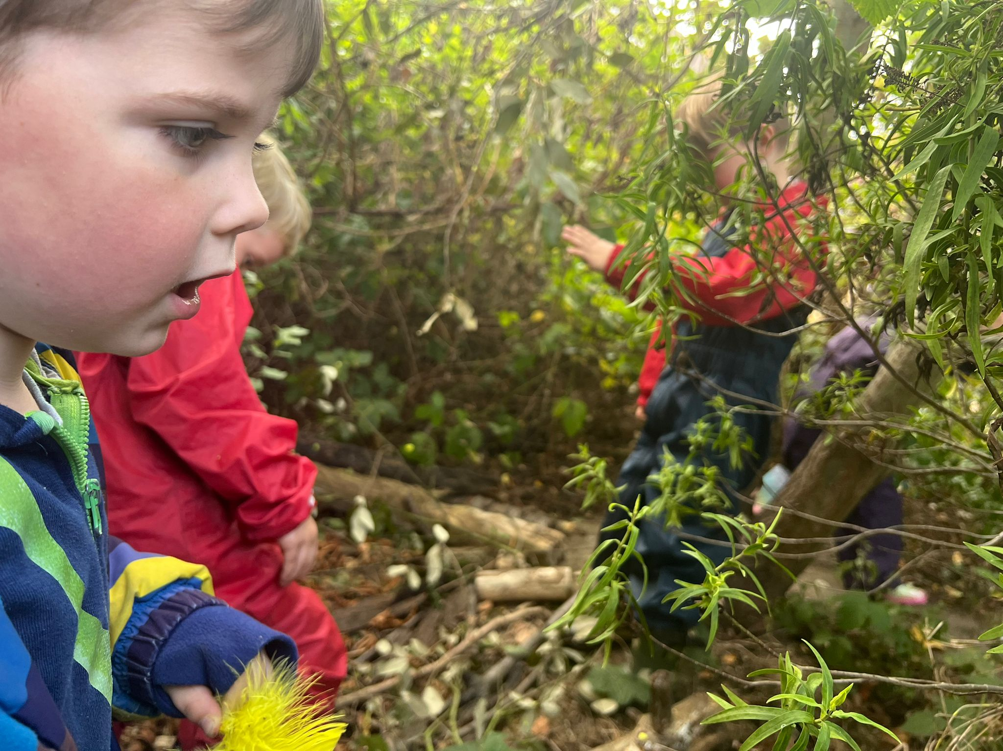
Our Nursery at Wyborne
We admit a mixture of part-time and full-time places – (15 or 30 hours)
The morning session is 8.45-11.45 am.
The afternoon session is 12.30-15.30 pm.
Full time places 8.45am-15.30pm
Excellent Provision and setting
Experienced and talented staff
Weekly Forest School Sessions

Slide 22
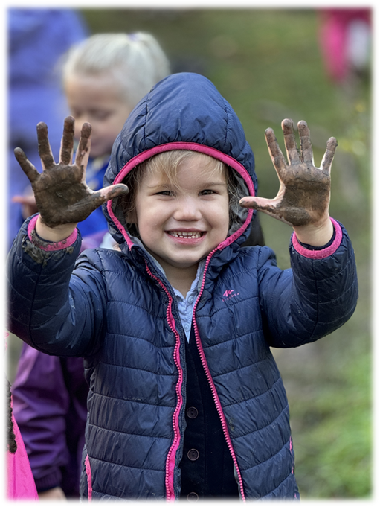
Our Reception at Wyborne
60 children - Reception Classes
Learning through play, whole class teaching and group work.
Indoors and outdoor learning plus Forest School.
Learning Areas include ;
- Communication and Language
- Physical Development
- Personal, Social, Emotional Development
- Literacy
- Mathematics
- Understanding the World
- Expressive Arts and Design
We encourage independence, cooperation and confidence
We develop a desire to learn
Strong focus on reading, phonics and number-work.

Slide 23
OFSTED December 2022
About Wyborne…
Pupils, staff and families are proud of their school.
Parents and carers are positive about the school, with many commenting that ‘the school has a feeling of community and coming together’.
Pupils work hard and enjoy their learning. Staff know them and care for them very well.
Pupils behave well and are respectful to each other and to adults. Wyborne is a safe and happy place to be.
Staff actively promote a love of reading.
Pupils are taught to respect and celebrate differences between them.
This is a respectful, harmonious community.
Leaders and staff know pupils well. They do everything they possibly can to keep pupils safe in school and protect them from harm when they are out of school.

Slide 24
Applying for a place in Reception September 2025
You must apply for a place at a primary school by
15th January 2025.
You must apply through the borough
in which you live. Applications should
be made online via
www.eadmissions.org.uk
**Please remember that you do not automatically gain you a place in Reception if your child attends the Nursery at Wyborne.**

Slide 25
Entrance Criteria
Diagnosed Special Need/existing EHC Plan – naming the school
Looked After Children – Children in care
Family needs (medical/social)
Siblings currently at Wyborne (apart from current Year 6)
Home to School distance – straight line from centre of home to centre of school site
Child Care arrangements ARE NOT taken into account

Slide 26
Tips on using your preferences wisely
Your preferences are up to you, but do be realistic. There's no guarantee you'll be offered a place at a preference school, but here are some recommendations:
Don't 'waste' a preference by naming a school where your child is unlikely to be offered a place.
Don't name a school that you'd not wish your child to attend - any preference may be offered.
Don't list the same school more than once as duplicates will be deleted.
Include schools nearest to your home address - otherwise, your child may end up being allocated to a school much further away.

Slide 27
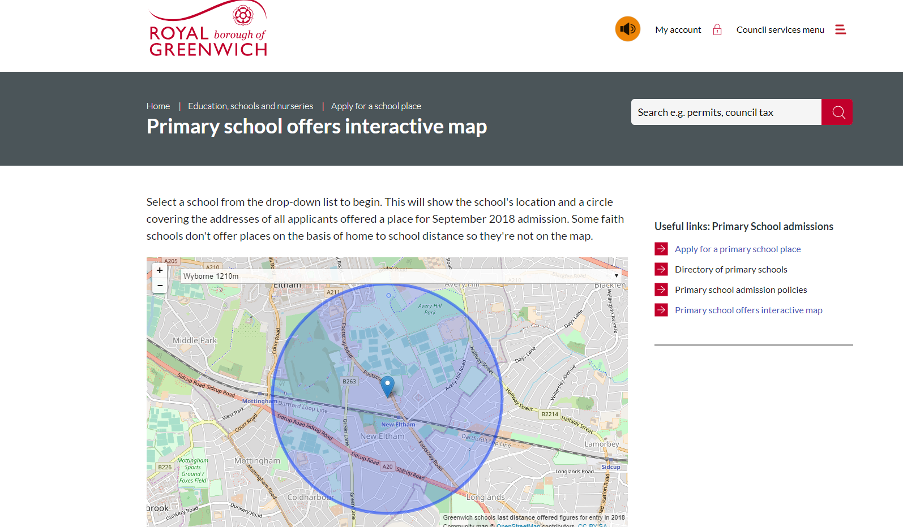
You can apply for up to six primary schools, listing them in order of preference.
Consider each school's admissions policies and previous years' application rates to see whether your child is likely to be offered a place.
For an indication of addresses offered by each school in the previous admission. Check out the Primary Schools Offer Map.

Slide 28
Applying for a place in Reception
Preferences- 6 Choices of Schools
-If you need any assistance speak to the school office
Allocation of School - April 2025
-Admissions will inform you of which school your child will be attending.
Wyborne Entrants
- Invited to a ‘new entrants’ meeting in the summer term
Home Visits for Families new to Wyborne
- This will be an opportunity for your child to meet the new teacher in your home setting and for you to discuss any settling in issues.
Applications Online
- you will receive confirmation of your application – notified earlier

Slide 29
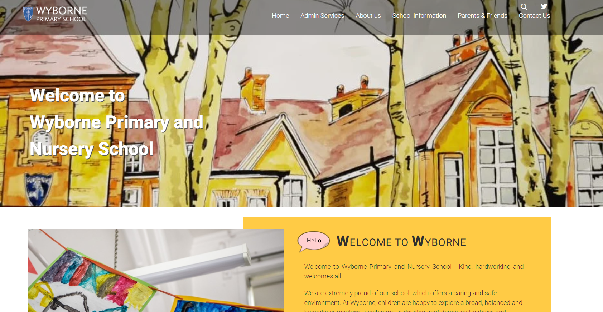
Website
http://www.wyborne.greenwich.sch.uk/

