Slide 1
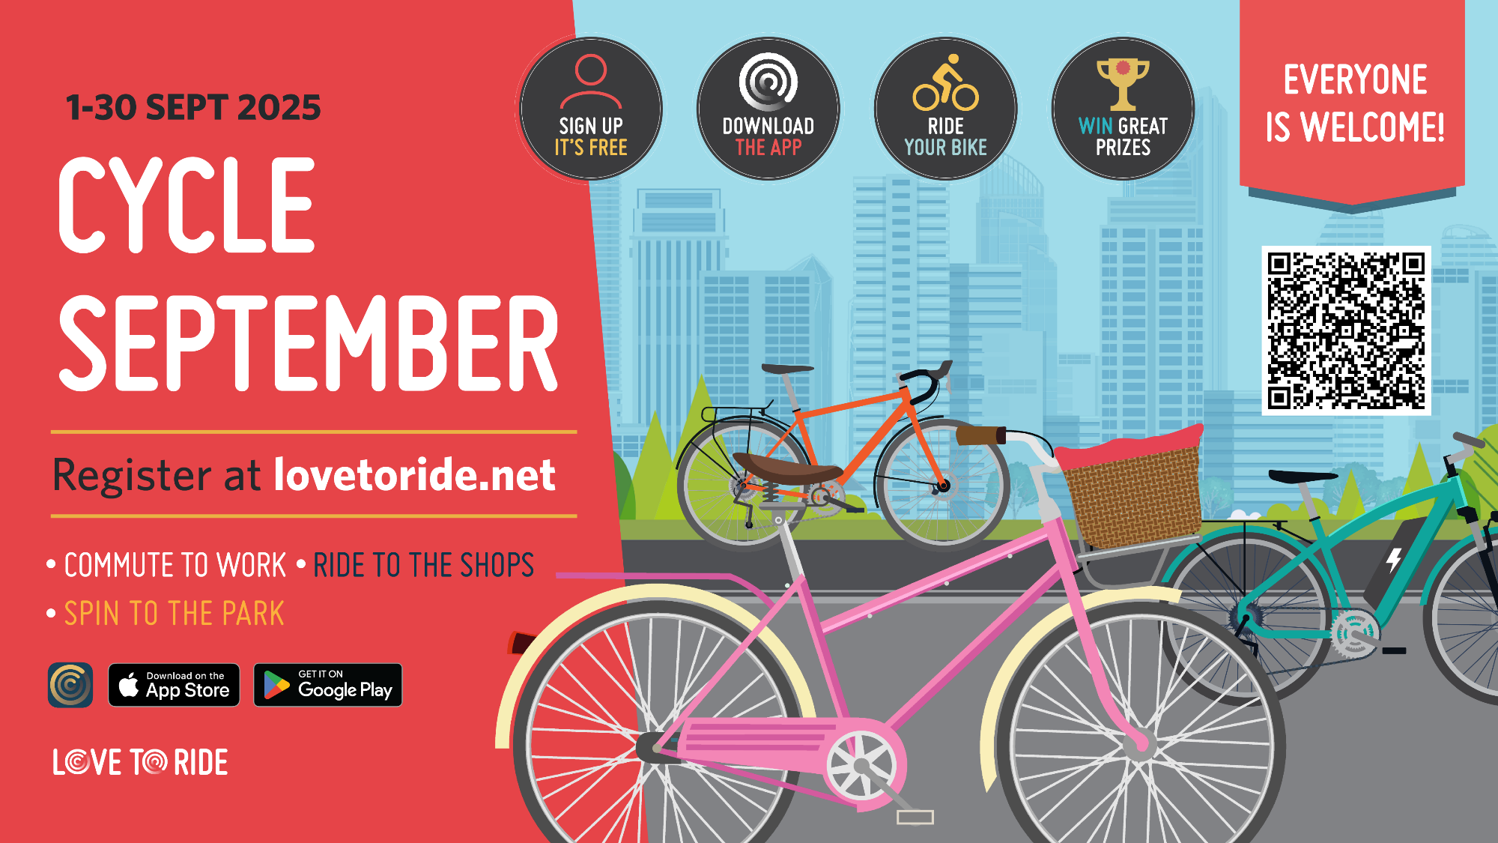
Cycle September -Love to Ride – Information for Parents

Slide 2

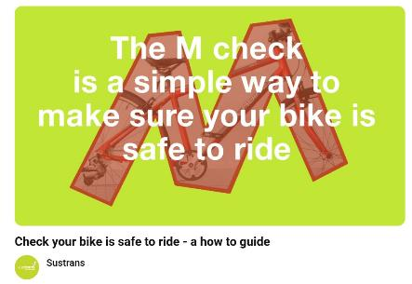




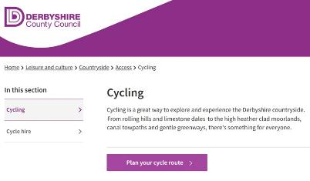




Here are our top tips for a great Cycle September
Make sure your bike is ready to ride.
Remember the rules of the road.
Plan your route.
Enjoy the journey and share your travels with us!

Slide 3
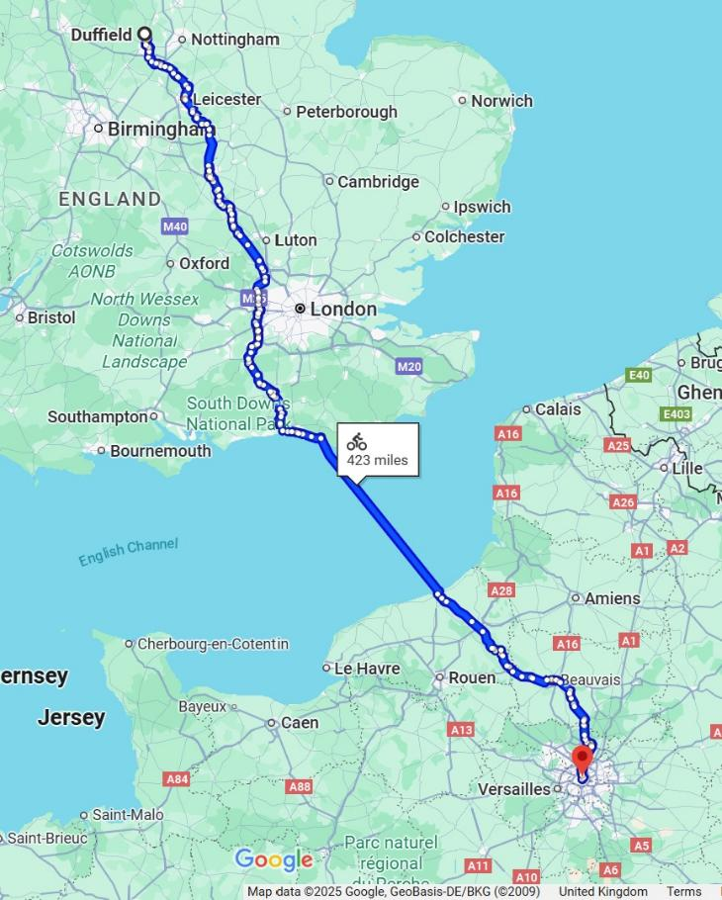
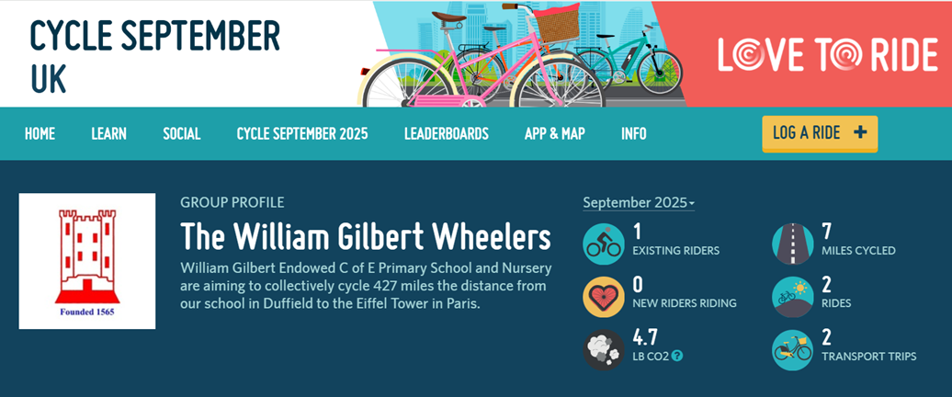



Join the William Gilbert Wheelers Duffield to Paris Cycle Challenge
Sign up and create a family profile on Love to Ride.
Join the William Gilbert Wheelers group.
Go for a cycle ride and record your miles – either automatically in the app or manually on the website.
You can even share a photo there too if you want.
Remember every mile counts – it can be a cycle to work or school, a quick pedal to the shops or a ride to the park!

Slide 4
Hey! You're invited to join The William Gilbert Wheelers on Love to Ride. Check it out and join here: https://www.lovetoride.net/england/groups/6213?group_invite=true&ic=f0c62f77&locale=en-GB

Slide 5
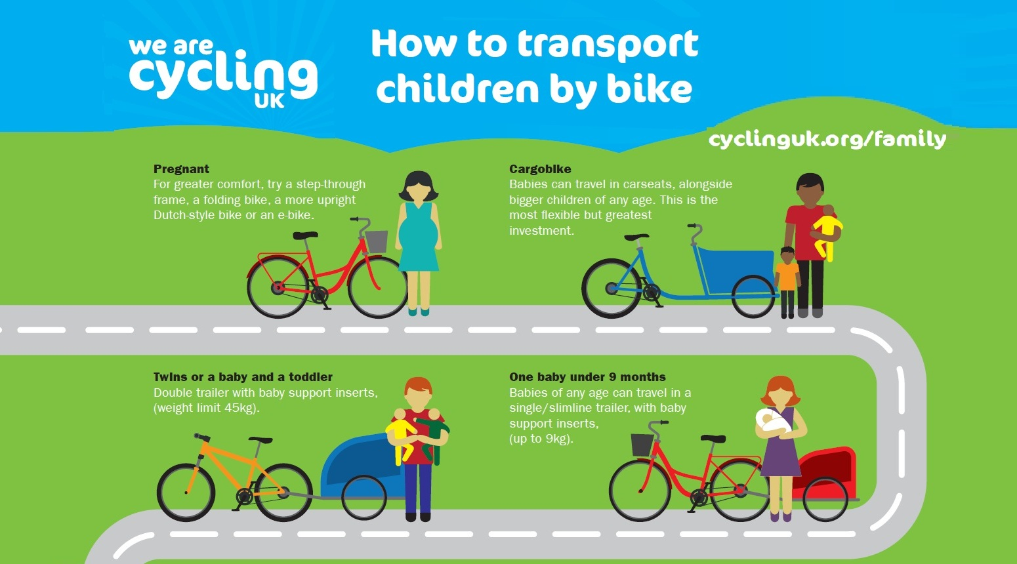

Slide 6
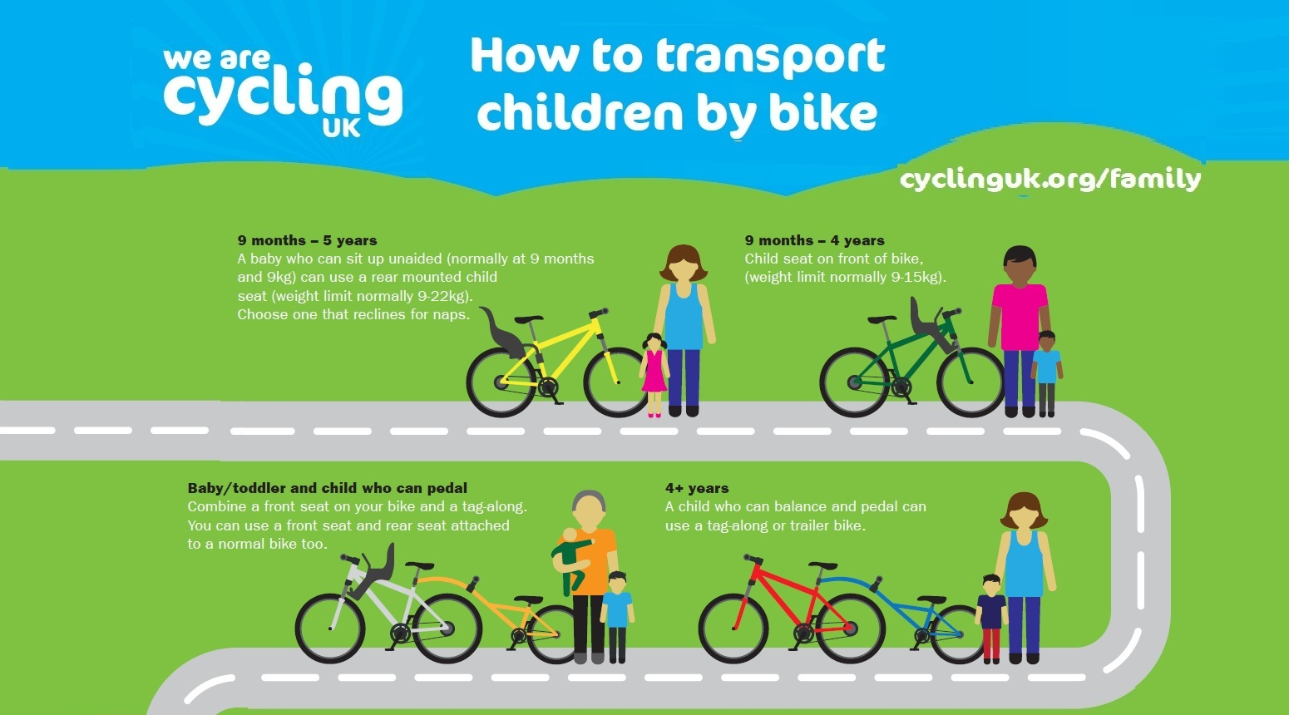

Slide 7
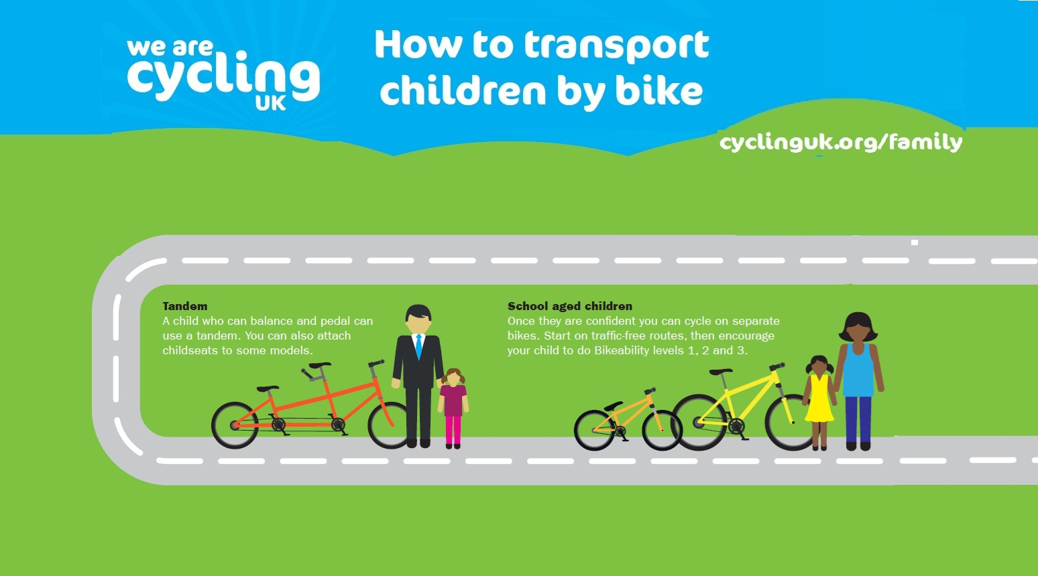

Slide 8

You could even pedal through Cycle September to get ready for

