Slide 1



Slide 2

Aims of the morning
Welcome and introduction.
Meet new teachers.
Sharing information about the new year– there will be lots! (This PowerPoint will be available on Weduc and the website).
There will be a chance to ask any questions at the end.
Notes:
James

Slide 3
Meet new teachers

Slide 4

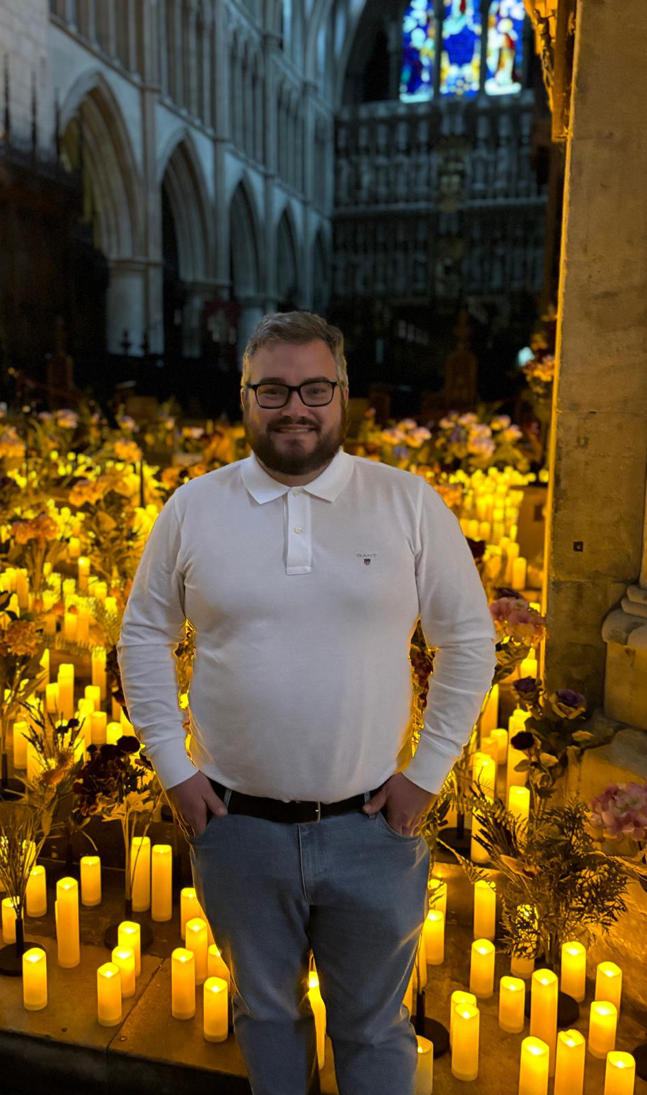
Sharks – F2S
Class Teacher: Mr Cook
Support Staff:
Mrs Sullivan
Miss Kaley McCarthy
Ms Boyle
Mrs Hassan
Ms Beaney
Notes:
James

Slide 5

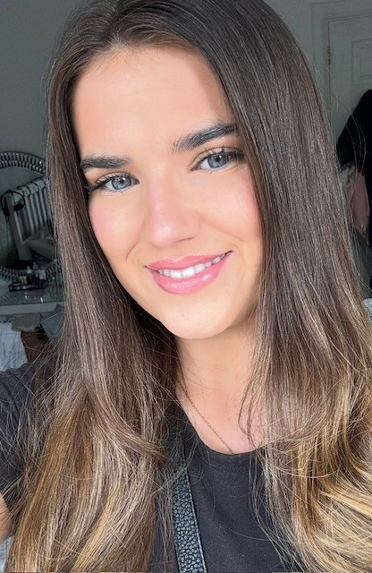
Turtles – F2T
Class Teacher: Miss McCarthy
Support Staff:
Ms Gumeni
Ms Boyle
Mrs Hassan
Notes:
James

Slide 6

Start Dates
Whole School (not Reception) First day of academic year – Wednesday 3rd September 2025
– Week beginning:
Monday 1st September – Home Visits by Class Teacher and another member of staff – by Friday 18th July by email
Reception Start School Monday 8th September - Morning session (09:00- 1pm)*
Monday 15th September - ALL DAY (08:50 - 3:20)
*Nursery children who were full-time last year at Wyborne can start Reception (if they choose) full time from the week beginning Monday 8th September.
**Hot meals will begin from Monday 8th September. A hot meal is free for all Reception children. It's a good idea to let all children try a hot meal for the first week and they are shorter days and then make a decision between packed lunch and school dinner after that time.
Notes:
Marcel

Slide 7
Uniform
White Polo and Wyborne Jumper/cardigan (or black jumper/cardigan)
Black tracksuit bottoms or leggings (shorts in the summer) – best for Reception children – both girls and boys (outdoor learning/climbing, dresses not suitable!).
Day to day footwear – Black Shoes should be velcro fastening (no laces) and no open toed sandals.
Everything named - including water bottles, bags and packed lunch boxes.
Hair tied back.
No jewellery please.
P.E. Kit –Black shorts or jogging bottoms – coloured house T-shirt -PE times will be shared
Trainers are not needed until the summer term.
Notes:
Marcel

Slide 8

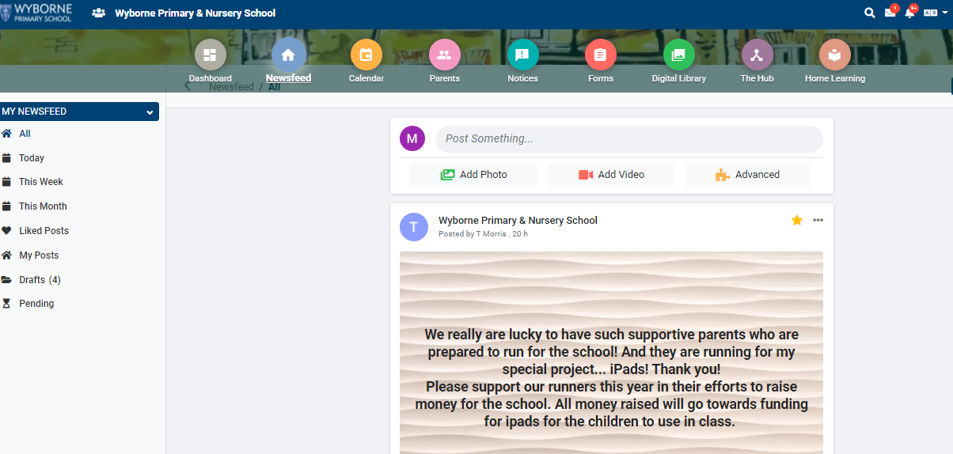
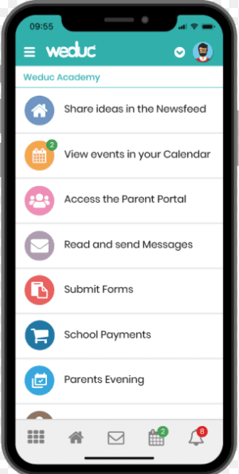
Parent/Carer and School Communication - Weduc

Slide 9

Weduc
Once your child has started with us in September you will receive an invitation via email giving instructions on how to sign up for Weduc
(this will include an enrolment code - you will also receive a text).
IT IS VERY IMPORTANT as it is the Parent/School Communication system where all details of any events, etc. will be immediately notified.
It is also a chance to see photos of what your child and their class are doing that day/week. Star of the Week photos are normally posted on Weduc.

Slide 10
Curriculum
It is a continuation of the Early Years Foundation Stage (started in Nursery) following the EYFS Curriculum
Working towards Early Learning Goals and a Good Level of Development
Continued Learning through play and inquiry and direct teaching(Maths, English, phonics and topics)
Lots of outdoor learning and Forest School.

Slide 11


Phonics and Reading
We follow a scheme call Little Wandle.
Each term we will share what new learning will happen via WEDUC.
In the first term children learn initial sounds and letter formation.
Each letter and sound has a rhyme and mnemonic
At the end of each half term children are assessed and this informs what book children will read during guided reading sessions.
Children will read with a school adult a number of times a week.
Children will then have the Opportunity to practice the skills learnt at home.

Slide 12
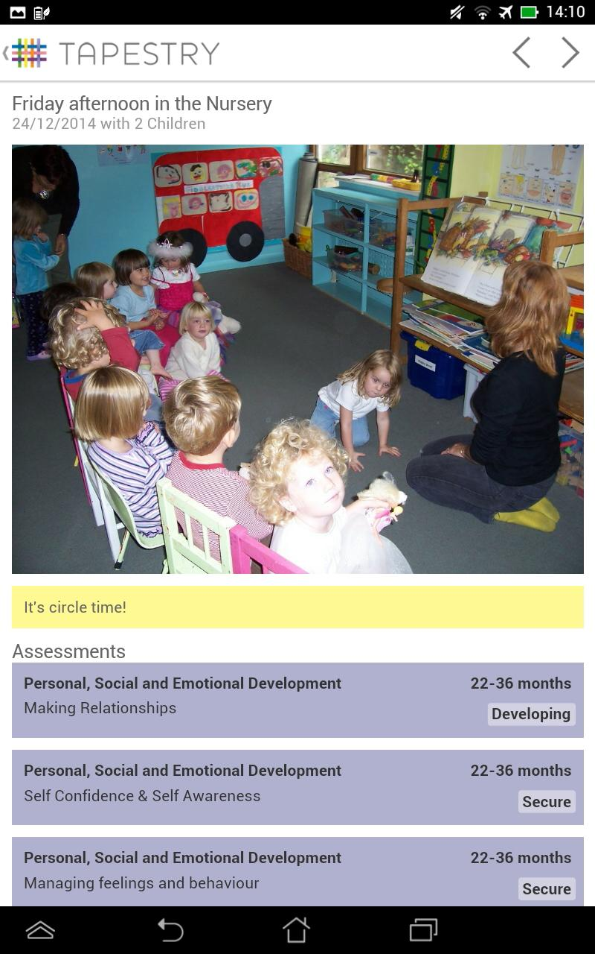

Tapestry
Tapestry is our Online Learning Journey
A communication tool to strengthen home/school relationships
It is a tool to share and evidence work and experiences at school and at home
In ‘app’ style, you can access from you mobile device or the Tapestry website, you’re given log in details, there’s only access for your child. You will be sent a joining email through the email you have supplied on your contact details so please make sure these are up to date
Opportunities to view photographs, videos, examples of work
Opportunities to make comments, share feedback about school and special occasions at home etc.
Tapestry is used to inform our assessments of your children through the observations we make.

Slide 13

Forest School
Forest School will start after the October half term.
We have Forest School trained teachers and it is based at school.
Forest School is an opportunity for the children to holistically learn outside within a safe environment, learning to take risks e.g. climbing trees, playing with mud, problem solving, using tools and much more.
Teachers will notify you of the day Forest School is during your home visit. Children must wear (waterproof trousers and a waterproof jacket) in the new academic year and have arms and legs covered in all weathers.
Forest School will take place in ALL weathers, unless in the case of high winds for example, when branches can fall from the trees, your children's safety is paramount and they will stay in class.
Notes:
Marcel

Slide 14
High Expectations at Wyborne
We expect:
All pupils to behave well – we accept mistakes
Zero tolerance to all forms of bullying
All pupils to do their best at all times
All pupils to wear school uniform
All pupils to attend school every day, on time
All pupils to read regularly at home
All pupils to be inclusive and respectful of each other

Slide 15

Alpha Club
External Provider
Separate admissions
Before and after school provision
Notes:
James

Slide 16

Child Protection
Safeguarding – duty of care
DSL (Designated Safeguarding Leads) – Mr Searjeant, Ms Heath, Ms Tanner, Jane Davey, Mr Cook
Who is responsible? Everyone.
Social Services – reporting incidents
Collecting your child – forms and communicating with the office
Permission for children to be photographed – written exemption to be provided.
Notes:
James

Slide 17

Health and Safety
Minor accidents – logged/verbally communicated
Minor bump to head – phone call or text message and slip (please don’t be alarmed)
More serious injury – parent/carer telephoned
Even more serious injury – ambulance
Only prescribed medication can be administered with permission form completed.
Please ensure emergency contact details are up to date and you notify the school office when this changes.
Notes:
James

Slide 18

Attendance
Automated service – answer phone
Letters
Office staff will ring
Absenteeism monitored - 95% threshold
Holidays in school time – UNAUTHORISED – will have to arrange pre appointment with the headteacher – Roiyal Greenwich now fine
Avoid being late
Notes:
James

Slide 19

Lunchtime
Timings – routines established at the very beginning – Dining Centre
Reception lunch time is at 11:30 and the children also have a fruit snack in the afternoon in class.
School dinner -Choice of food menus
Allergies and specific dietry requirements communicated at the very beginning
Trays – cups
Toilets
Notes:
Marcel

Slide 20
And other bits…
Parents and Friends – we need new recruits.
Please don't send children in with toys.
Headlice – hair tied back. When there is a case in your class you will be notified via WEDUC
Book Bags – brought in and taken home daily .
Named water bottle – brought in and taken home daily.
Regular contact with teacher or reception staff
Formal parent/carer conferences x2 per year.
Voluntary £1 weekly fund or donations biscuits, playdough ingredients, wet wipes etc.

Slide 21

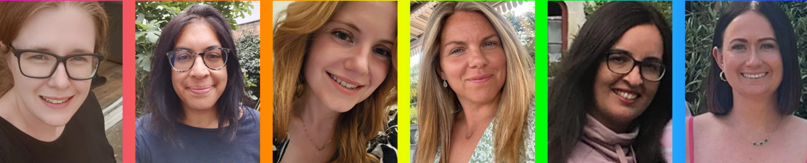
Wyborne Parents & Friends
WHAT WE DO
We organise fun events throughout each school year to build connections, and raise money to give Wyborne pupils the best possible school experience.
HOW WE FUNDRAISE
From fairs and discos, to raffles and bake sales – we raise funds through fun, inclusive events for all!
HOW WE SPEND THE MONEY
Every penny we raise goes straight back into the school – funding additional resources, experiences, equipment and any extras that the standard budget can’t cover.
GET INVOLVED
You can volunteer at our events big or small – no pressure, just join in when you can and be a part of something great.
Come along to our coffee mornings to find out more.
You can contact us directly at wybornepfa@gmail.com or via your class reps
MEET THE COMMITTEE
Wyborne PFA is a team of parents working together to support and celebrate our school community.
Cindy | Jill | Cathleen | Claire | Hayley | Lizzie
Secretary | Committee Member | Chair | Committee Member | Treasurer | Committee Member

Slide 22
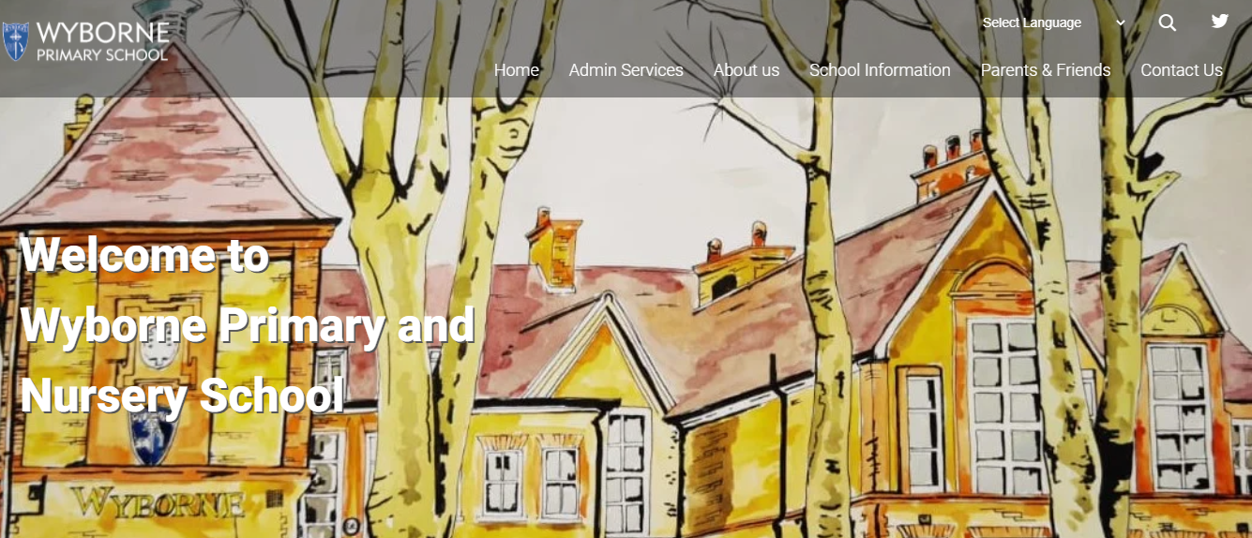
Thank you
Any questions?
This Presentation PowerPoint will be available on the website.

