Slide 1


Welcome to
Belvoirdale Primary School
2025 - 2026

Slide 2
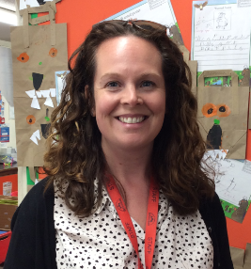
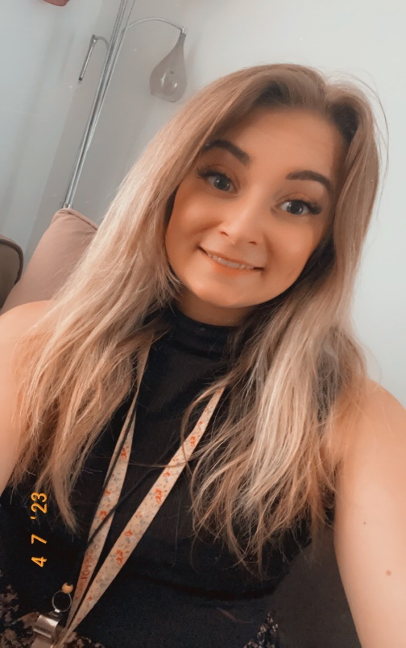
Class Teacher
Ladybirds
Bumblebees

Slide 3
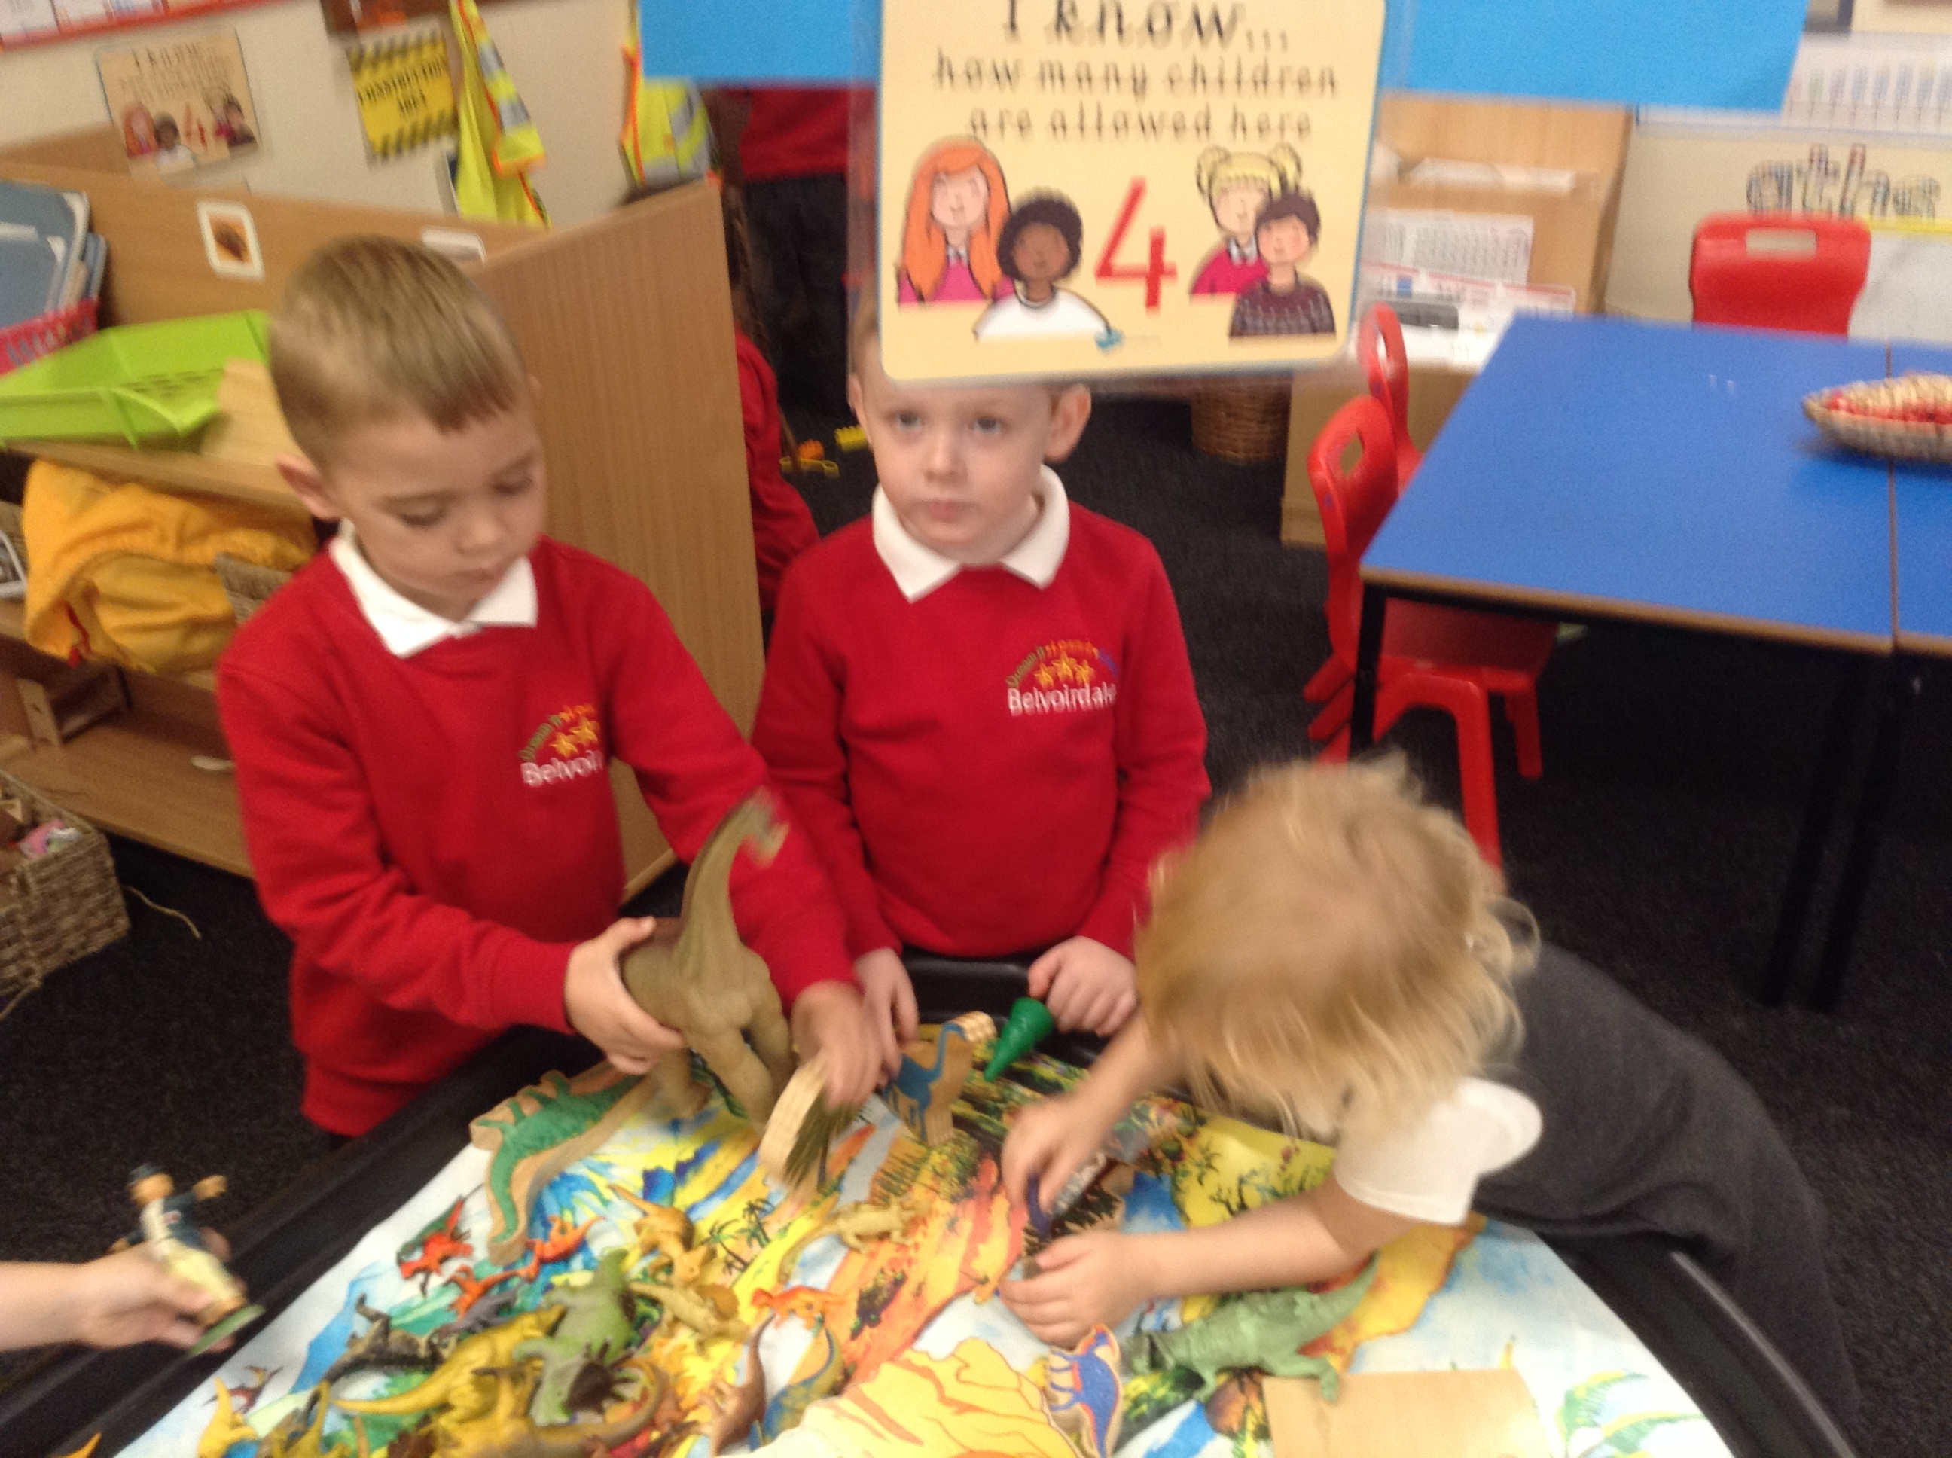
Pre-school Visits
EYFS staff will visit your child in their current setting.
If this cannot be arranged, we will speak to your child’s Keyworker instead.
These visits/calls will take place between now and the end of term.

Slide 4
2 Induction sessions in the classroom
Thursday 3rd July – morning session – 9:30-11:30am (Group A)
Friday 4th July – morning session – 9:30-11:30am (Group B)

Slide 5
Enhanced transition
We will be offering extra sessions for certain children to come in and get to know the environment and staff with their parents / grandparents.
This is for children who need that extra support to feel settled in school.
We have been liaising with nurseries to find out which children would benefit, and you will have a letter in your induction pack.
Please come and see us at the end of this talk if you think your child would benefit from extra transition time.
    Thursday 12th June 1:30 – 2:30
    Thursday 19th June 1:30 – 2:30
    Thursday 26th June 1:30 – 2:30

Slide 6
Being school ready
Between now and your child starting school in September here is a list of things you could practise with your child to help them be ‘school ready’ (Please see Leicestershire – Ready for school leaflet in your pack).

Slide 7

I can get my shoes on.
I can get dressed/undressed by myself.
I can take off my coat and put it on and fasten it.
I can ask to go to the toilet.
I can independently clean myself after visiting the toilet and wash my hands.
I can listen when someone else is talking.
I can sit and listen to a story.
I can share and take turns.
I can ask for help if I need it.
I can use a knife and fork.

Slide 8
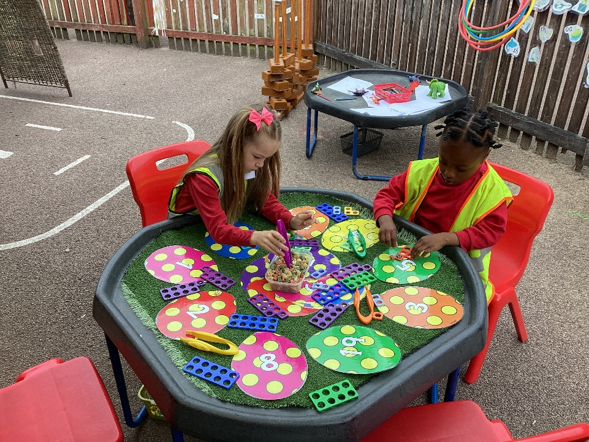
Autumn Term 2024)
Belvoirdale offers a gradual introduction to the school day.
Start on Tuesday 26th August 2025
4 days of part time attendance with the 4th day staying for dinner.
All children start full days on Monday 1st September

Slide 9
Drop in Sessions
We are offering drop in sessions on the week beginning Tuesday 26th August and these will last about 15 minutes.
This is an opportunity for you and your child to meet one of the teachers on a 1:1 basis in the classroom. These sessions will replace home visits.
Please sign up to the relevant group’s sheet at the end of this session.
  Pink sheet with Mrs Tatam – Group A
  Yellow sheet with Miss Bunn – Group B

Slide 10
Groups
The reception intake has been split in half and put into either Group A or Group B sessions.
You will have received a letter that lets you know which session your child needs to attend.

Slide 11
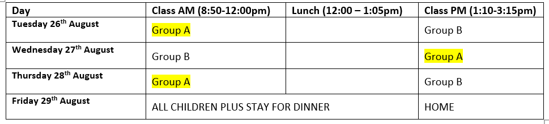
Group A
Your child is in Group A
The group that your child will be in, will be confirmed on Friday 29th August ready for when the children start school full time from Monday 1st September.

Slide 12
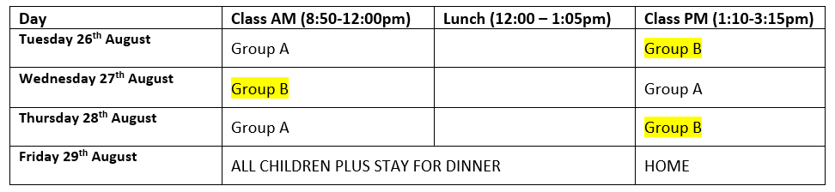
Group B
Your child is in Group B
The group that your child will be in, will be confirmed on Friday 29th August ready for when the children start school full time from Monday 1st September.

Slide 13


Which class will my child be in?
The children will then find out whether they are a Ladybird or Bumblebee at the end of the first half term.
We have a settling in period over the first half term where children may be moved between groups

Slide 14
Contacting parents during the school day
We will inform you if your child has had any bump to the head or face via WEDUC message.
We will make contact with you if your child has a more serious accident.
If your child is poorly and we feel that they are too ill to be in school, then we will contact you.
Please ensure that contact details are up-to-date and correct
Please ensure that we have several contacts just in-case we are unable to contact you on the first instance
Notes:
Contact forms
Importance of contact numbers
Weduc / SEESAW

Slide 15
What will the children be doing at school?
Early Years Foundation Stage curriculum is from birth to five so we continue their learning from home and pre-school.
Seven areas of learning split into three prime areas and four specific areas.
The three prime areas are –
- Personal, Social and Emotional Development
- Physical Development
- Communication and Language.
The four specific areas are –
- Literacy
- Mathematics
- Understanding the World
- Expressive Arts and Design

Slide 16
Baseline assessment
Over the first 6 weeks of school your child will be assessed using the Government Baseline Assessment Tool.
The scores are just used by the National Pupil Database to give evidence towards the progress children within that cohort make from EYFS to the end of Key Stage 2.
Before your child begins reception, we work closely with nurseries and yourselves to identify your child’s interests, likes and dislikes.
Then over the first half term we begin to form a picture of your child’s current level of development and begin to develop an idea of what your child’s nest steps would be.
After this period there maybe changes to your child’s original class, based on educational and emotional needs as well as staffing changes to support individuals.
Any class changes will always be done with the full consultation of parents/carers.

Slide 17
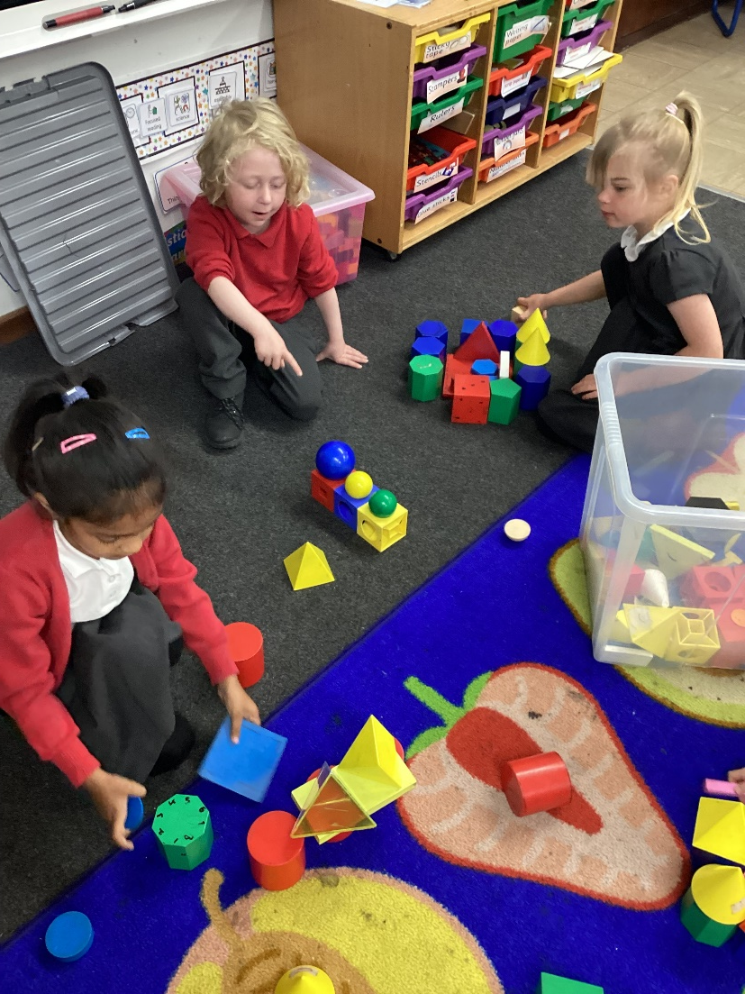
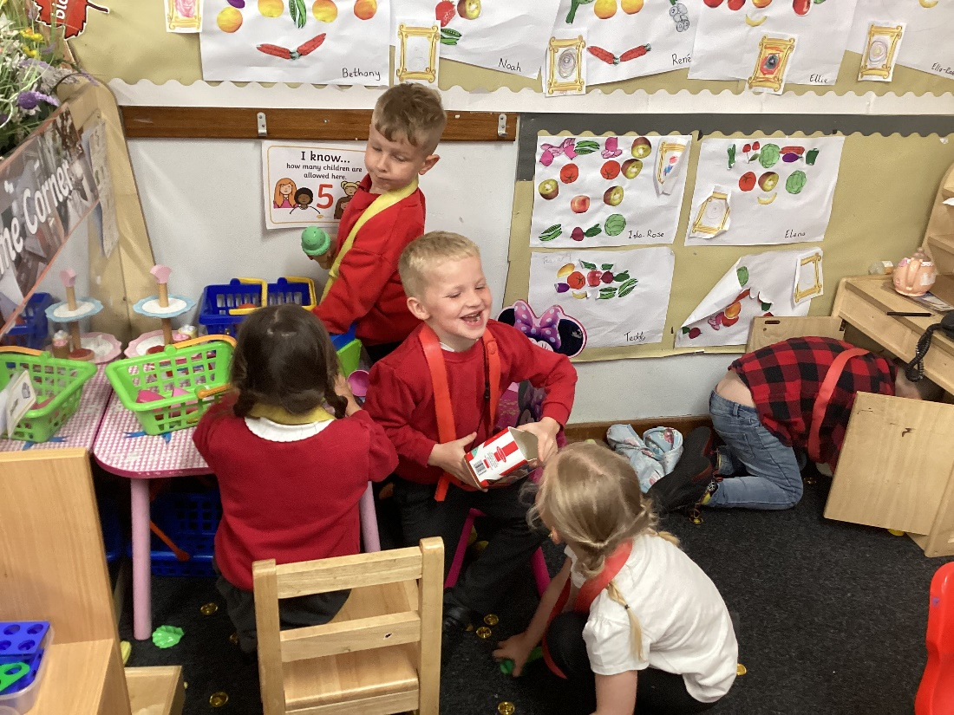
The curriculum is active and play based. The children will have a balance of adult led and self-initiated learning.

Slide 18
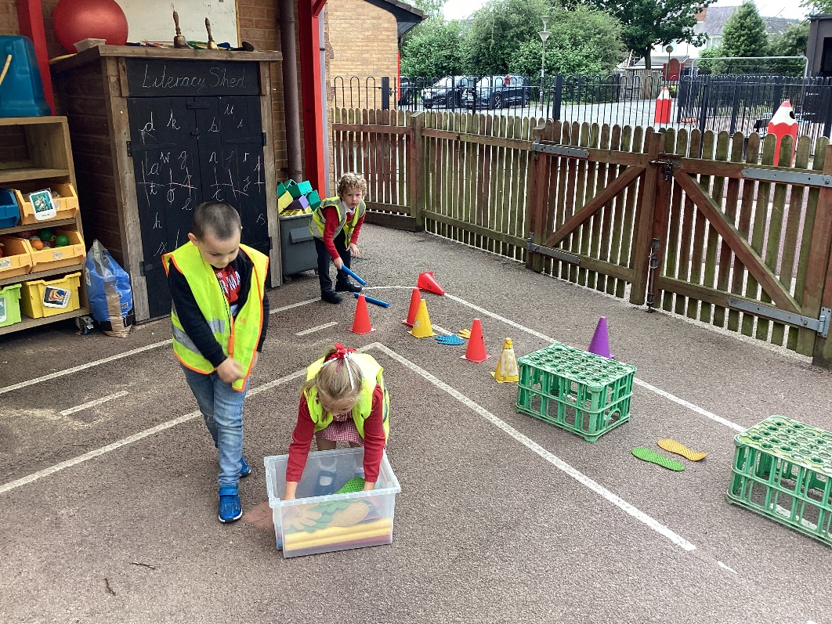
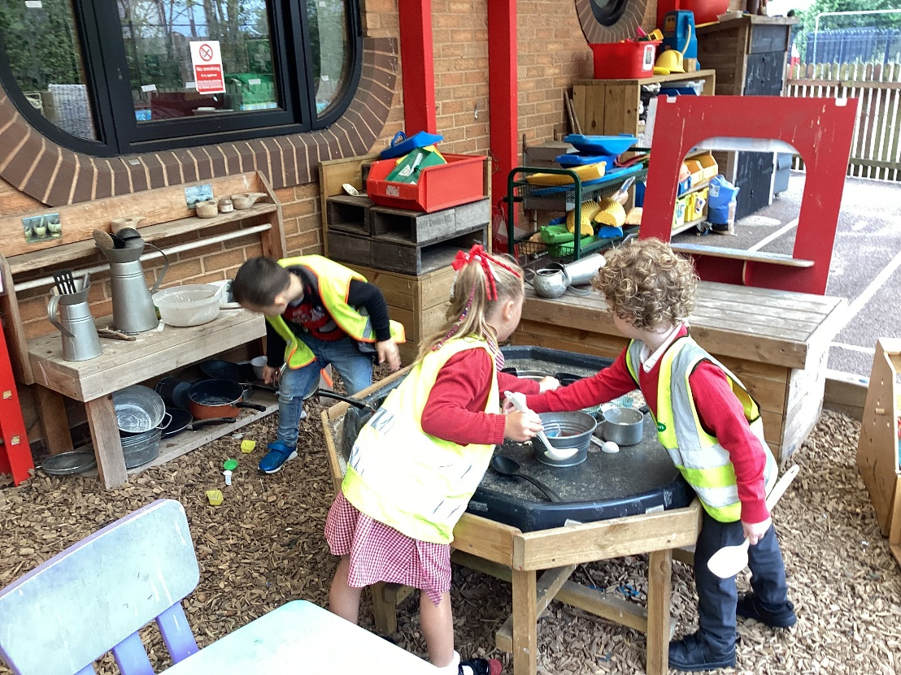
The learning will not all be classroom based – the children will have daily access to the outdoor environment.

Slide 19
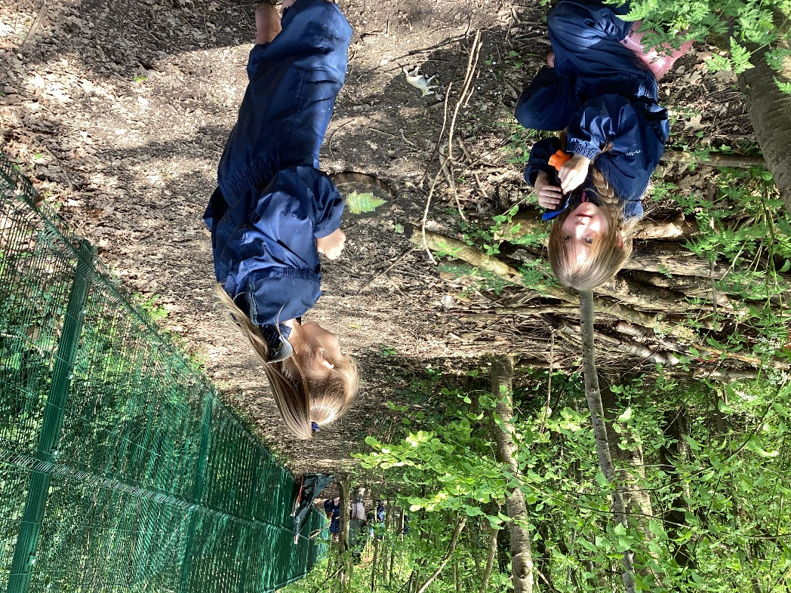
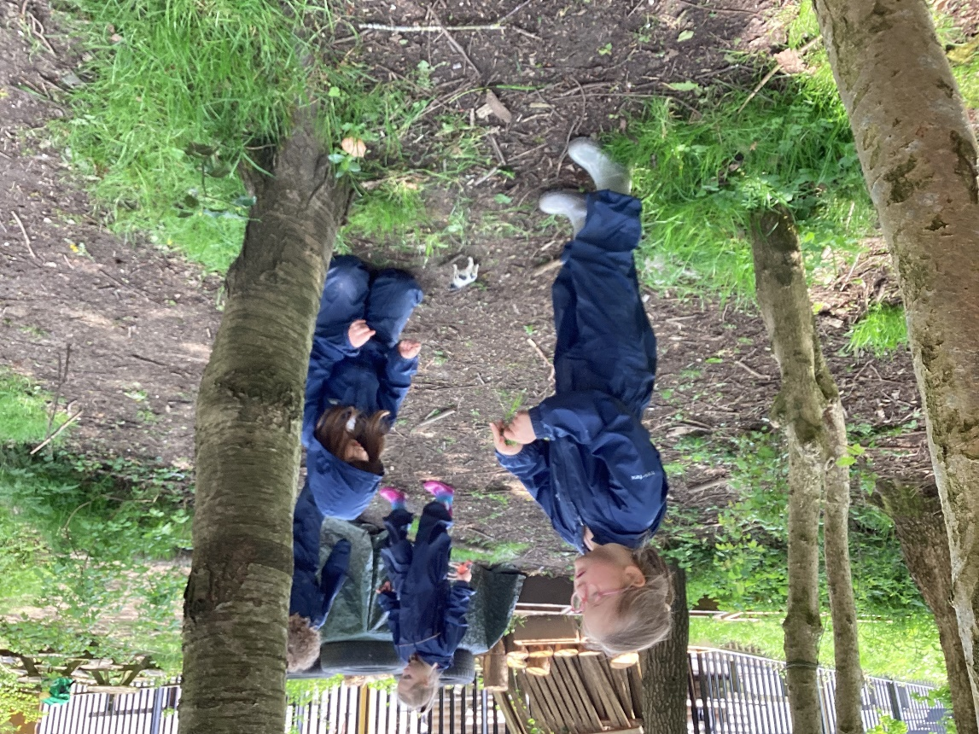
Forest School

Slide 20
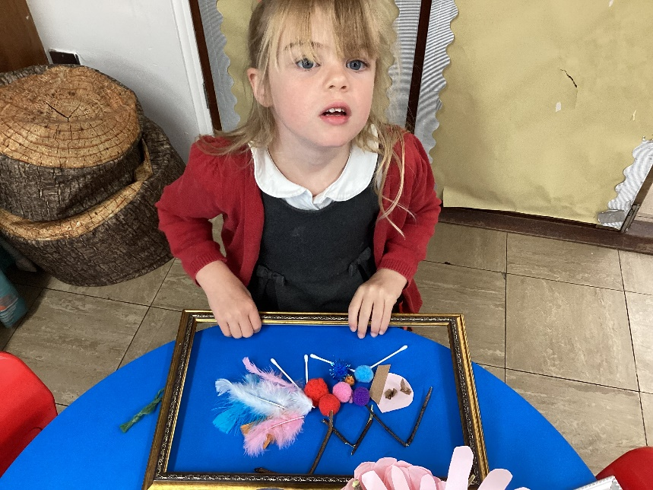
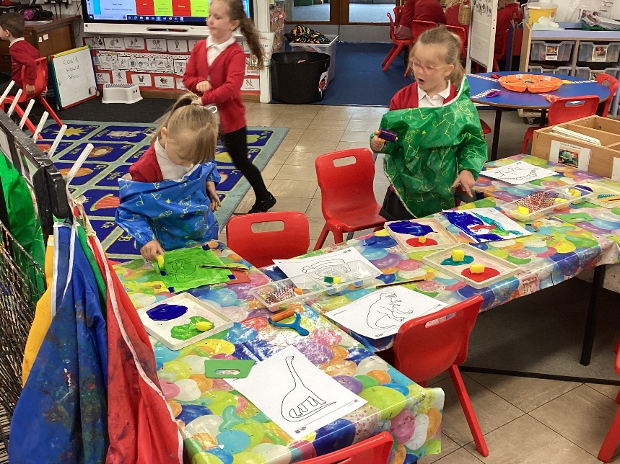
School Routines
Your child will arrive to welcoming activities, songs and self-registration for 8:50.
Classroom time will be a mixture of teaching time, adult supported activities and learning through play.
Assembly time will be introduced gradually after the first half term at 2:55.
P.E weekly. Kit will be kept at school and sent home half termly.
Forest School weekly.
A short breaktime in the morning at 10:50 – 11:05
Lunchtime sitting with their own classes 11:45 – 1:00.
A short breaktime in the afternoon at 2:00 – 2:15
Story time followed by home-time at 3:15 (getting ready at 3:10).
Notes:
come in – daily songs etc, self registration
assembly – not joining yet
Activities
Playtimes
lunchtimes – staff in
P.E

Slide 21

Daily Phonics Lesson
Right from when your child starts full-time school, they will have a ‘Daily phonics lesson’
At Belvoirdale, we follow a phonics scheme called ‘Song of Sounds’ which is a creative and engaging phonics scheme to help your child to learn their letter sounds and names. For each sound your child will learn the shape of the letter and a song with actions to help your child remember it.
As your children learns new letter sounds there will be opportunities for them to apply these new sounds in a range of activities that involve using the sounds to read and write in a fun and engaging manner.
As your child learns the sounds in school, they will take home a phonics ‘Song of Sounds’ book to help then say and recognise these sounds – as practice is key.
More information about the phonics scheme will be given in a Phonics Workshop for parents during your child’s first term in school.

Slide 22

Belvoirdale is a Healthy School
*Only water in your child’s water bottle in class, they can have juice, etc in their lunchbox, but no fizzy drinks)
* Your child can bring a snack in for morning snack time (Only a piece of fruit / some dried fruit or a snack (e.g. crackers / unsalted popcorn / Breakfast biscuits)
* In your child’s lunchboxes we ask that you only give your child 1 packet of crisps and 1 treat sized chocolate bar or biscuit bar (club / kit kat)
Our school is a No nut school so please don’t send your child in with nuts or food containing nuts - e.g. chocolate spread / chocolate croissants / cereal bars

Slide 23
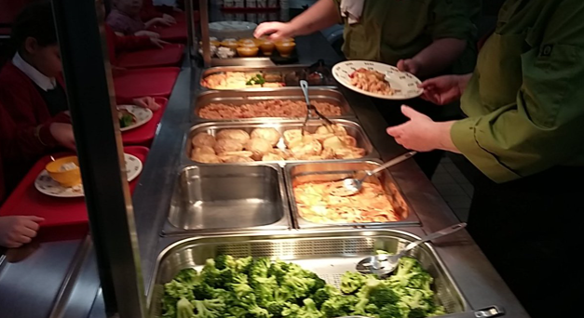


Healthy Eating at Belvoirdale
Home made school dinners!
Free Fruit for all children in school
Free milk for children under 5
Your child’s meals can be ordered in advanced on the school grid, and you will receive an email to sign in once your child is admitted onto the school system.
Children in reception to year 2 are entitled to a free school meal
If your child has a special dietary requirement then parents can fill in ‘A medical Dietary Request Form’ and a special menu will be organised.
Notes:
Talk about universal free school meals

Slide 24
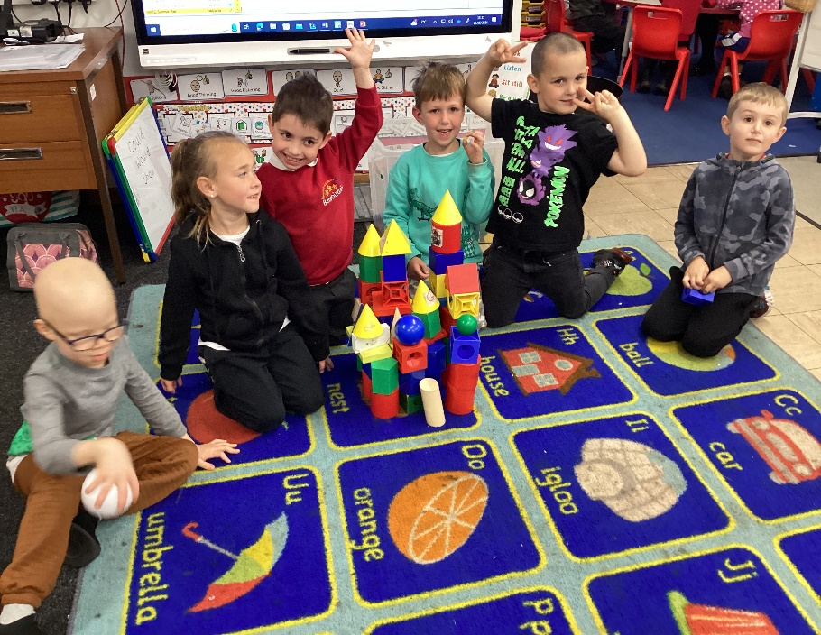
We develop characteristics of effective learning- through play-based activities
Playing and exploring – engagement
Finding out and exploring
Playing with what they know
Being willing to ‘have a go’
Active learning – motivation
Being involved and concentrating
Keeping trying
Enjoying achieving what they set out to do
Creating and thinking critically – thinking
Having their own ideas
Making links
Choosing ways to do things

Slide 25
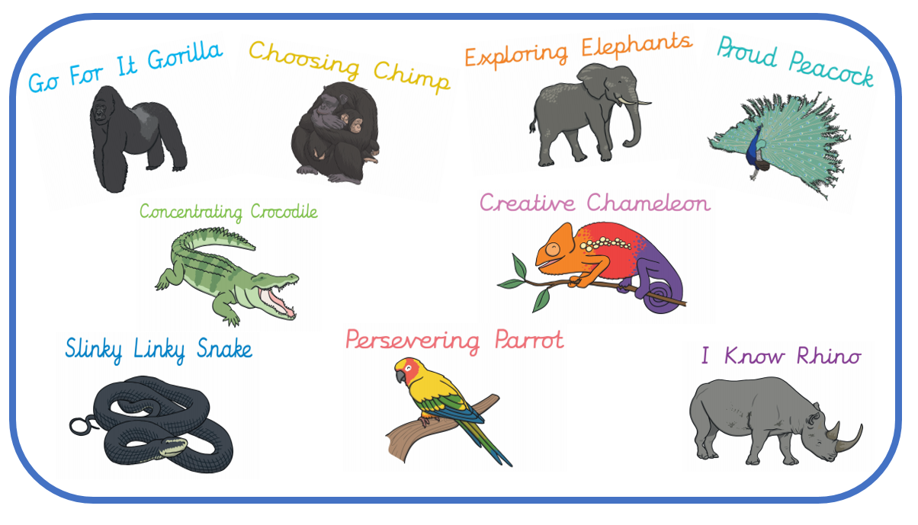
Character in EYFS at Belvoirdale

Slide 26

Dojo’s
The children are awarded Dojo’s for positive behaviour
    Dojos is an on-line reward system
    Each child has a Dojo character
    They earn Dojo points
Dojo points are added up at the end of each half term and turned into a treat afternoon to celebrate their Dojo success (Dojo Celebration)

Slide 27
Celebrating your child’s achievements
Celebration assembly every Friday
      Celebrates the ‘learner of the week’ - the children who have shown those characteristics in order to achieve in their learning
      Along with any personal achievements that are met by individual children inside or outside of school – swimming etc.

Slide 28
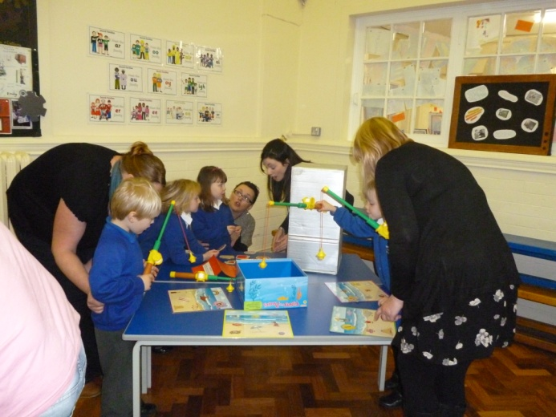
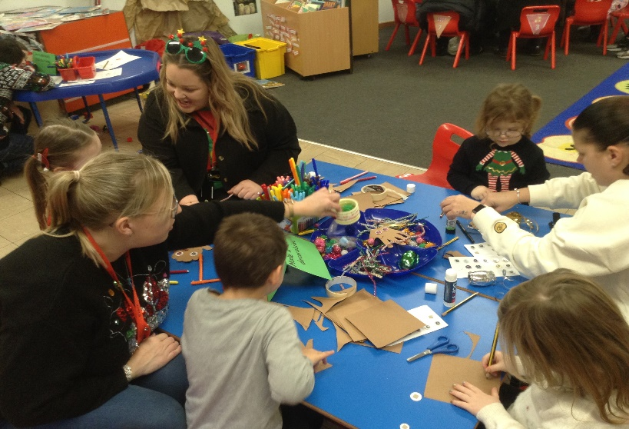
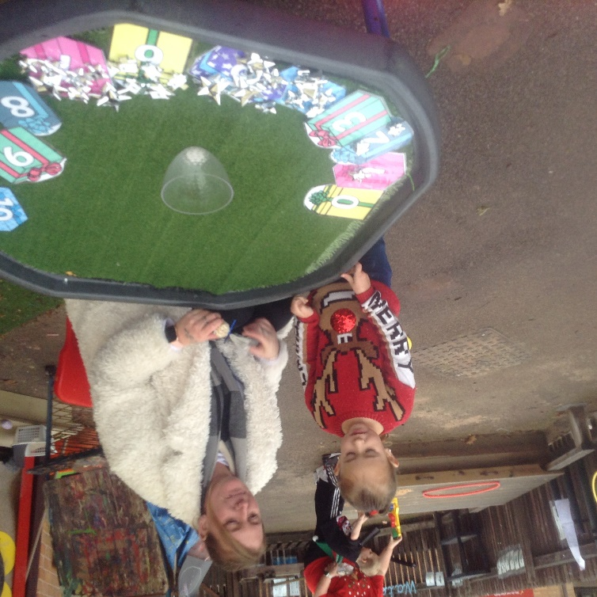
We value the partnership between home and school.
At the beginning of most new topics we invite parents into our Knowledge Harvests to share what they know about our new topics
At the end of most topics we invite parents in for our FAB finishes so that the children can share what they have learnt.
We invite parents in for workshops on how we teach phonics / writing / numeracy, throughout the year.

Slide 29
Time away from school
Please ring in and let the school office know by 9:00 am if your child is poorly.
If you child has sickness or diarrhea then please keep your child off for 48 hours from the last episode
Any absences that are not related to sickness need to be requested on the appropriate form and authorised by Mr Dax (Headteacher) and this will only be agreed in exceptional circumstances at Mr Dax’s discretion.
Notes:
keep at home if ill- ring in
Medicines – policy – we can not give calpol, but can give prescription meds but a form needs to be filled in
*SCHOOL NURSE?*
holidays in term time

Slide 30
Illness in school
Please can you add a slide (29/30) in about attendance to school is very important, illness will be taken seriously but we will closely monitor pupils in school.....just in a supportive way to help their child reach their potential...
Attendance in school is very important to enable your child to reach their full potential.
However, if your child does full poorly while in school we take this seriously and closely monitoring your child throughout their time in school.
If we feel it necessary, we will contact you to get permission to give your child liquid paracetamol
Please be assured that if we feel your child is too poorly to be in school, we will contact you and arrange for them to go home.

Slide 31
Practicalities
Uniform – order form in the pack – Grey or black trousers or knee length shorts / skirt, red chequered summer dress / red or white polo t-shirt or shirt / red jumper or cardigan / black shoes
Please label all your child’s clothes and possessions. We do have a lost property system, but it does rely on things being named.
PE kit within a bag to be kept in school – Black shorts, jogging bottoms or leggings, white t-shirt and black plimsoles or un-branded trainers
WEDUC Pay to make any payments to school.
Cool Milk registration in the pack for children 5 and over
Toys from home
Every child will get a school bookbag

Slide 32

Pupil Premium
Leaflet in packs
PP is extra government money paid to school to support children’s learning and development
If your child received EYPP at pre-school, it does not automatically transfer to school, so you need to reapply
Notes:
What do we currently use PP money for?

Slide 33
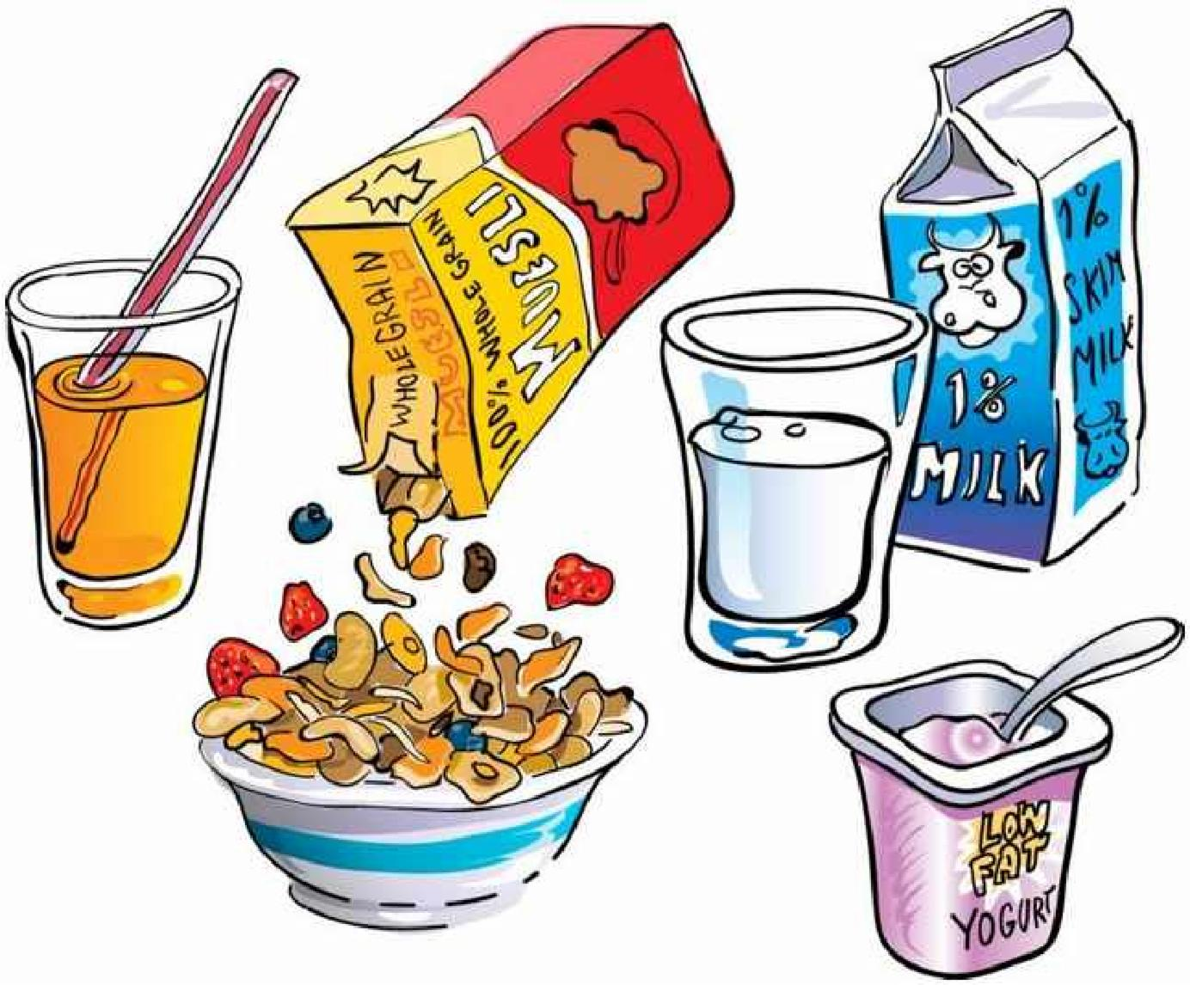
Breakfast Club
Breakfast club is for all pupils, and we ask children to be there from 8am to allow time for breakfast, it is £2 a day and this is payable via Weduc pay, the same system is used for all payments.

Slide 34
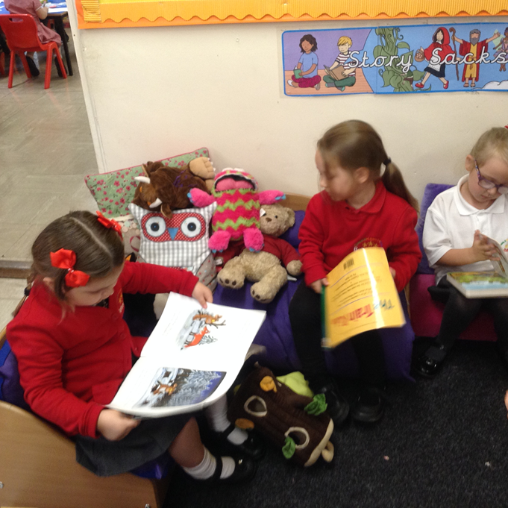
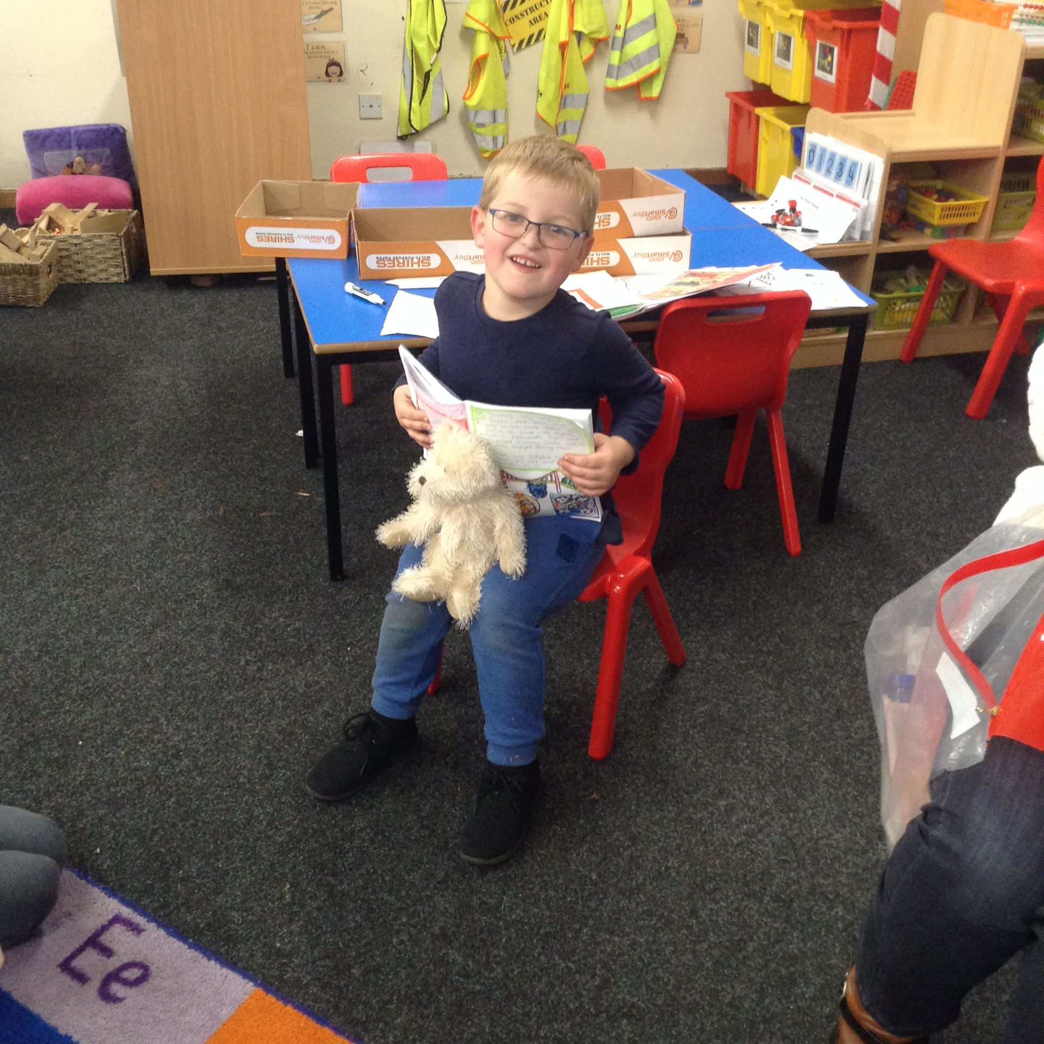
Helping your child and the school
Reading books and phonics ‘song of sound’ books will come home in your child’s book bag. Please make sure your child brings their bookbag in daily.
Children need to bring in a water bottle in daily filled with fresh water.
Making us aware of your child’s achievements at home so that we can celebrate them in school.
Notes:
language – talking
reading books – change at least once, we try to change twice
home readers, library – enjoyment
read each night – consolidate and reinforce
Books may not have words to begin with
write in passport
Phonics passport
Leaflets
how parents can help – Friend and Family → recent purchases.
Mention about nursery consultation – what do parent think? Pick up a leaflet

Slide 35
Communication with parents
Letters home (please check book bags!)
Weduc is used for all communication including messaging and all payment.
Seesaw (Information sent from teaching staff / you can also message staff and share information)
The school website: www.belvoirdale.org
School facebook (2) Belvoirdale Primary School | Facebook
School email enquiries@belvoirdale.leics.sch.uk

Slide 36

Reading system
We have moved onto an electronic system to track reading both in school and at home.
You and your child can add book reviews
Your child can collect virtual rewards for their reading at home
We will send you some log-in details within the first few weeks

Slide 37
Things sent home in the first few weeks
During the first few weeks you will get the following:
  A letter about how to log onto WEDUC
  QR code registration for Seesaw
  Log-in information for Boomreaders
  A pack with your child’s reading book, phonics ‘Song of sounds’ book and homework book inside. This pack is to be kept inside your child’s book bag.

Slide 38
School Nursing Service
https://vimeo.com/manage/videos/463343675

Slide 39

Any Questions

