Slide 1



Slide 2

Aims of the morning
Welcome and introduction.
Meet new teachers.
Sharing information about the new year– there will be lots! (This PowerPoint will be available on Weduc and the website).
There will be a chance to ask any questions at the end.
Notes:
James

Slide 3
Meet new teachers

Slide 4

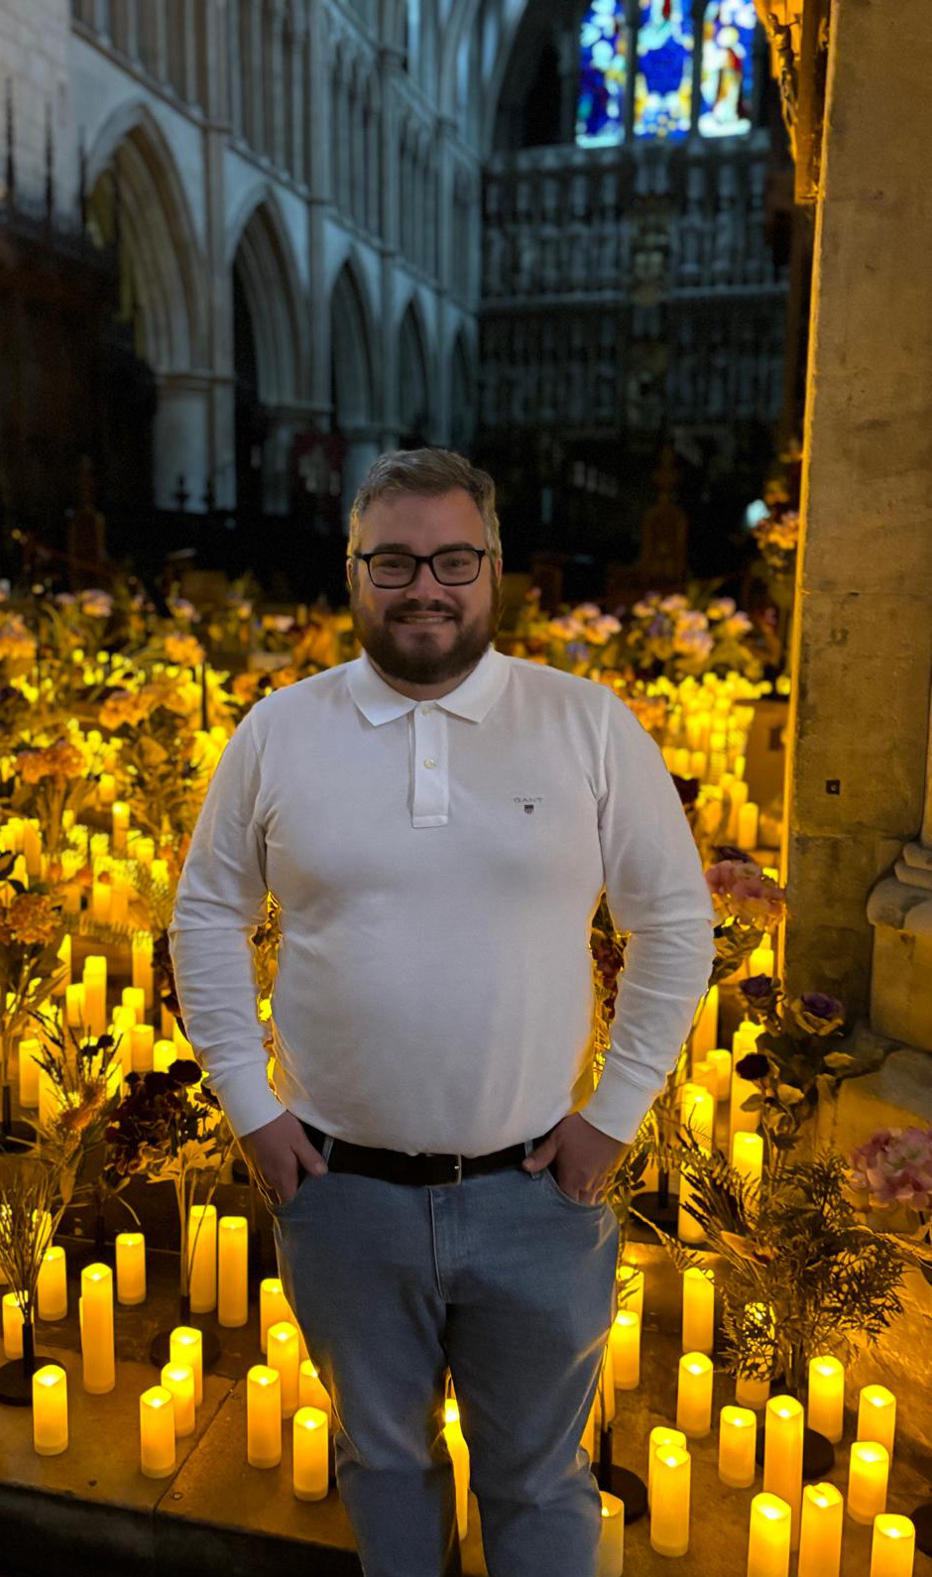
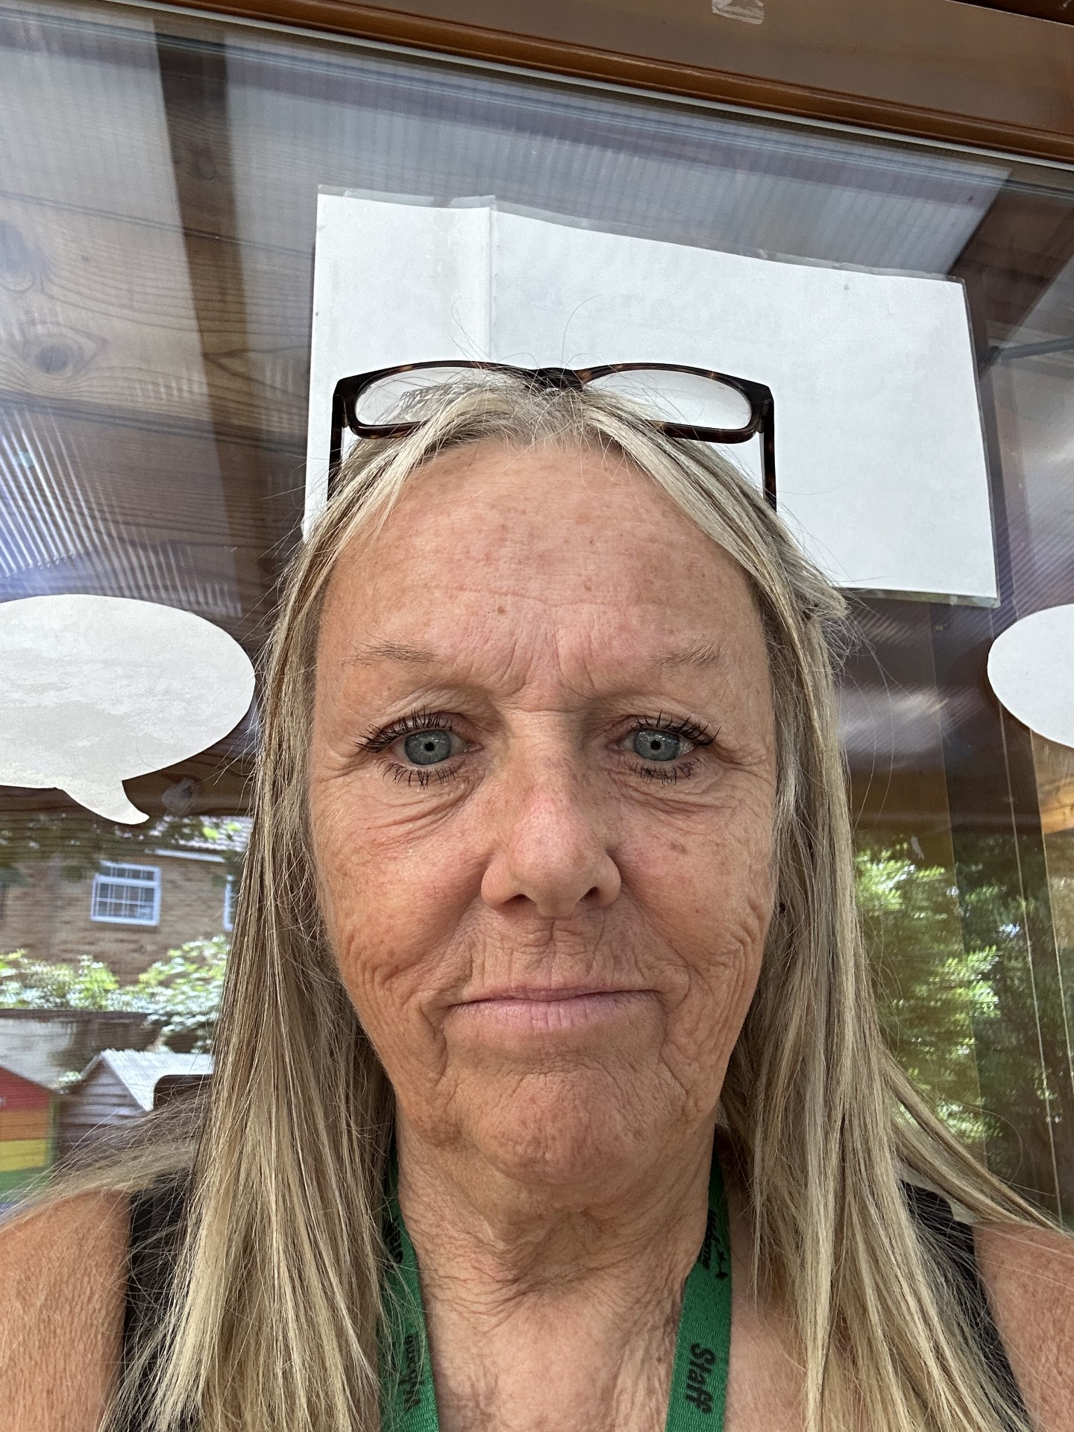
Sharks – F2S
Class Teacher: Mr Cook
Cover Supervisor:
Mrs Marshall
Notes:
James

Slide 5

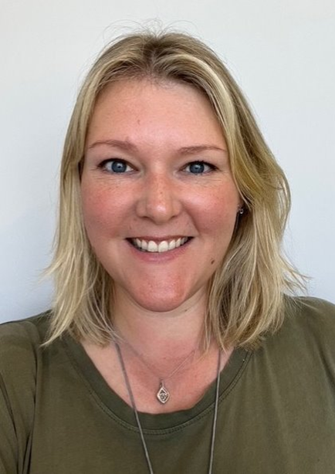
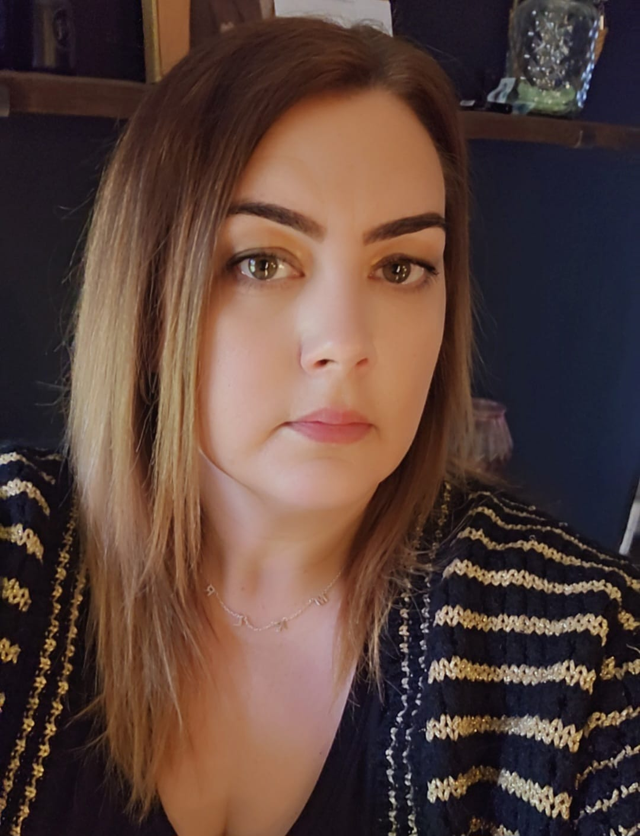
Turtles – F2T
Class Teacher: Mrs Smith
Cover Supervisor:
Miss Sullivan
Notes:
James

Slide 6

Start Dates
Whole School (not Reception) First day of academic year – Monday 7th September 2026
Week beginning Monday 7th September 2026
Home Visits by Class Teacher and another member of staff –
Parents notified by Thursday 16th July by email
Monday 14th, Tuesday 15th and Wednesday 16th September 2026
Reception will attend school 9.00 a.m.– 12.30 p.m.
(this will include staying for lunch in the Dining Centre)*
Thursday 17th September 2026 onwards:
All Reception children will attend school full time – ALL DAY (8.50 am – 3.20 pm)
*Nursery children who were full-time last year at Wyborne can start Reception (if they choose) full time from the week beginning Monday 14th September.
**Hot meals will begin from Monday 14th September. A hot meal is free for all Reception children. It's a good idea to let all children try a hot meal for the first week and they are shorter days and then decide between packed lunch and school dinner after that time.
Notes:
Marcel

Slide 7
Uniform
White Polo and Wyborne Jumper/cardigan (or black jumper/cardigan)
Black tracksuit bottoms or leggings (shorts in the summer) – best for Reception children – both girls and boys (outdoor learning/climbing, dresses not suitable!).
Day to day footwear – Black Shoes should be velcro fastening (no laces) and no open toed sandals.
Everything named - including water bottles, bags and packed lunch boxes.
Hair tied back.
No jewellery please.
P.E. Kit –Black shorts or jogging bottoms – coloured house T-shirt -PE times will be shared
Trainers are not needed until the summer term.
Notes:
Marcel

Slide 8

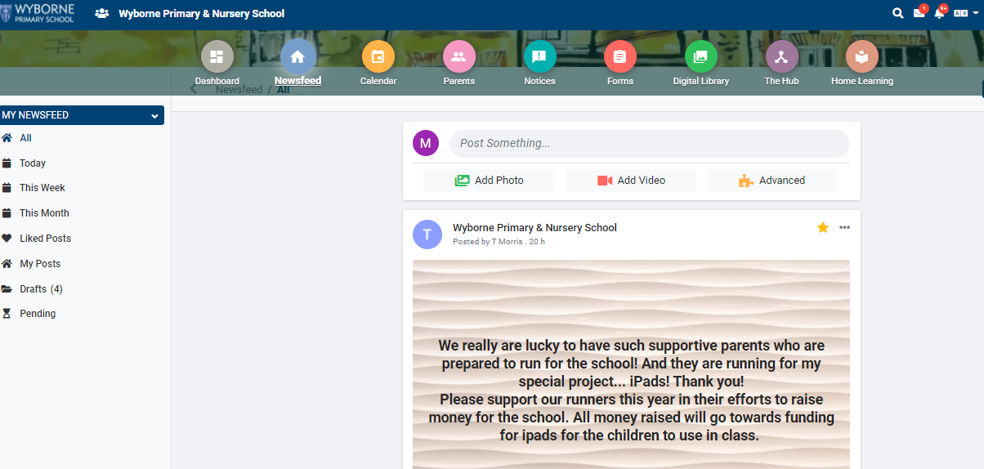
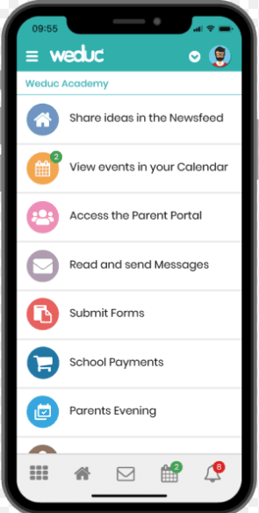
Parent/Carer and School Communication - Weduc

Slide 9

Weduc
Once your child has started with us in September you will receive an invitation via email giving instructions on how to sign up for Weduc
(this will include an enrolment code - you will also receive a text).
IT IS VERY IMPORTANT as it is the Parent/School Communication system where all details of any events, etc. will be immediately notified.
It is also a chance to see photos of what your child and their class are doing that day/week. Star of the Week photos are normally posted on Weduc.

Slide 10
The Early Years Foundation Stage (EYFS)
Reception is a continuation of your child's Early Years Foundation Stage journey, building on the foundations established at home and in Nursery.
The EYFS curriculum is designed to support children's development across seven areas of learning, helping them become confident, independent and enthusiastic learners. Throughout the year, children work towards the Early Learning Goals, which are the national expectations for the end of Reception.
Learning takes place through a balance of:
High-quality play and exploration
Child-led enquiry and discovery
Adult-guided learning experiences
Direct teaching of key skills, including phonics, reading, writing and mathematics
Our curriculum is carefully planned to nurture children's curiosity, creativity, communication skills and emotional wellbeing, while developing the knowledge and understanding they need for future learning.
Children benefit from rich indoor and outdoor learning opportunities every day, including Forest School experiences, which encourage resilience, independence, problem-solving and a love of the natural world.
Our aim is for every child to feel happy, safe and valued, developing the confidence and skills they need to thrive as they move into Key Stage 1.

Slide 11
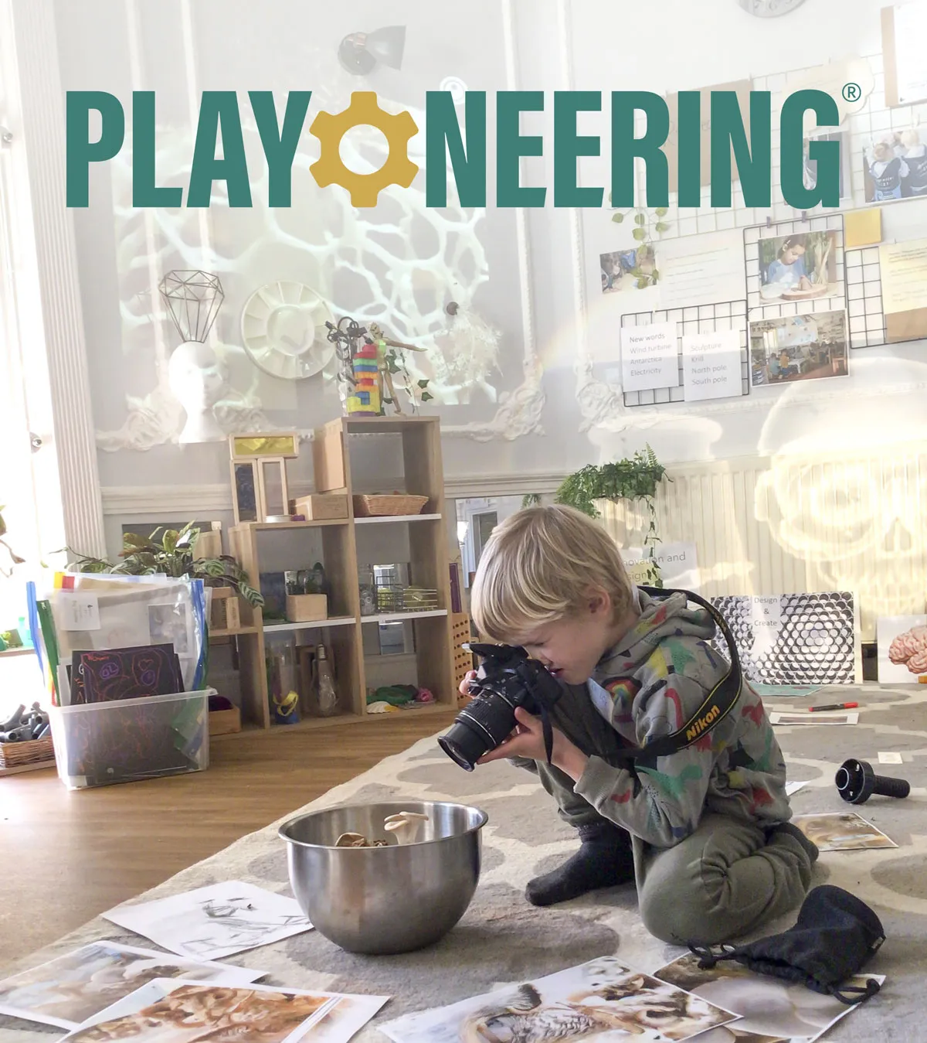
Playoneering Approach
At Wyborne, play is at the heart of everything we do. We use the Playoneering approach, which combines purposeful play, enquiry and high-quality teaching to create meaningful learning experiences for children.
Through carefully planned indoor and outdoor environments, children are encouraged to explore, investigate, create, collaborate and solve problems. We believe that children learn best when they are actively engaged, following their interests and making connections through first-hand experiences.
Our adults play a vital role as facilitators of learning. They observe, question, challenge and support children, helping them to deepen their thinking, develop language and build confidence. Alongside child-initiated learning, there are focused teaching sessions in phonics, reading, writing, mathematics and other areas of the curriculum.

Slide 12
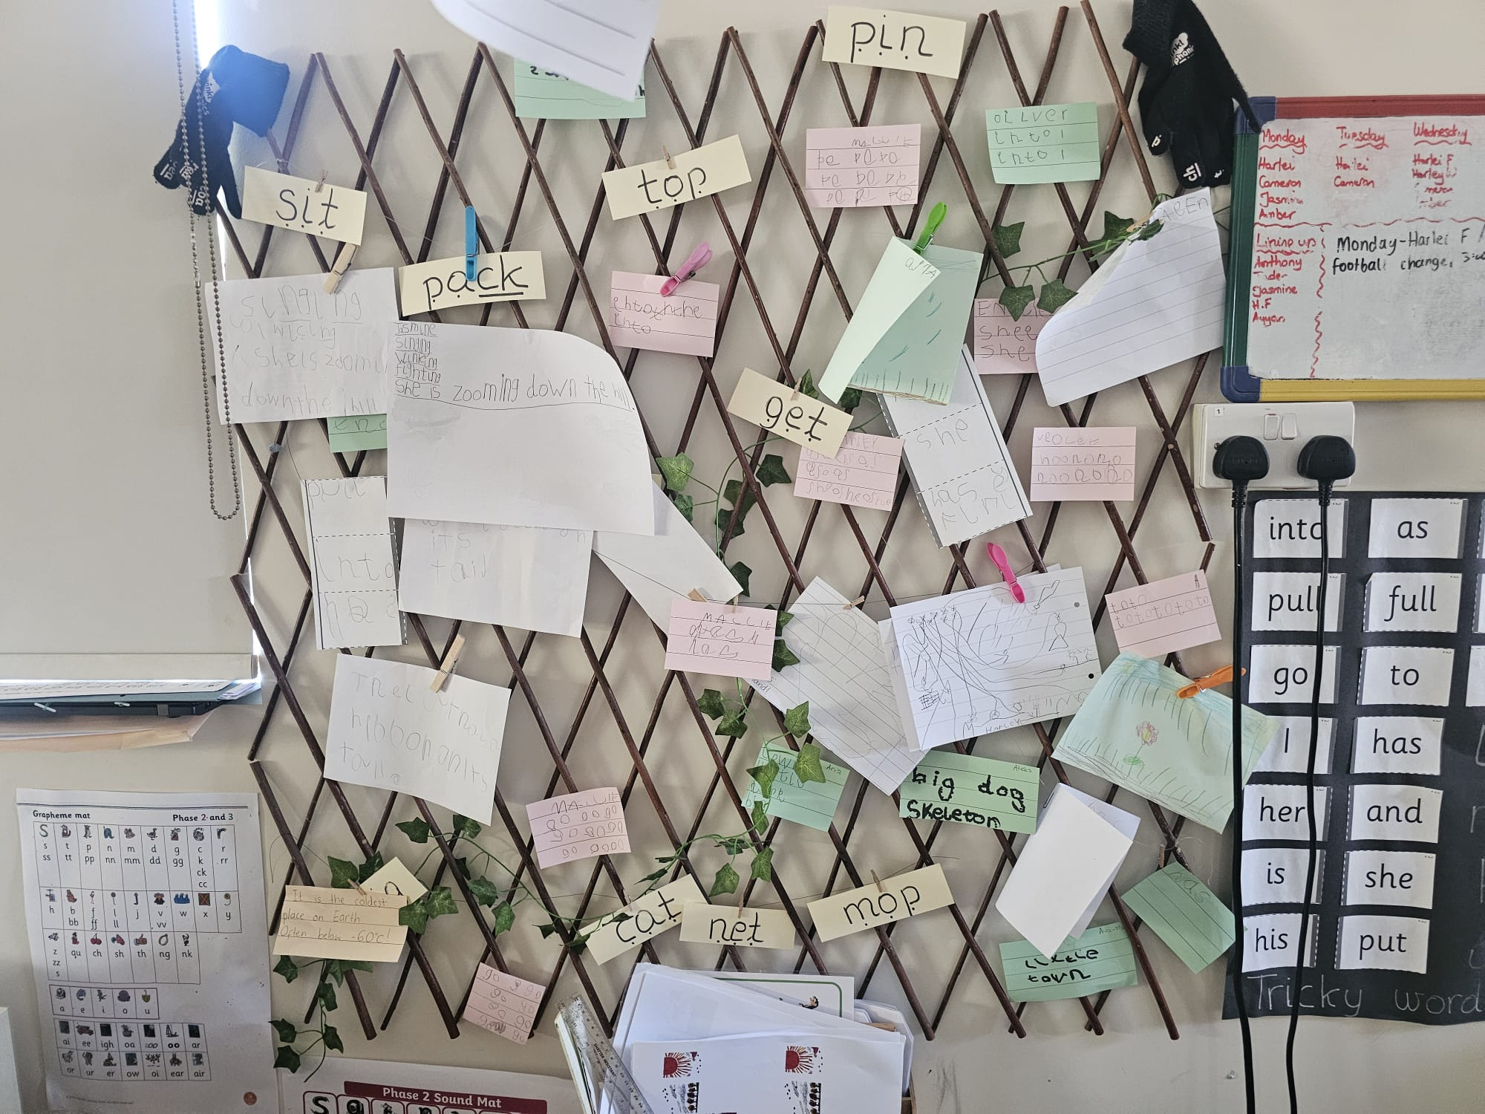
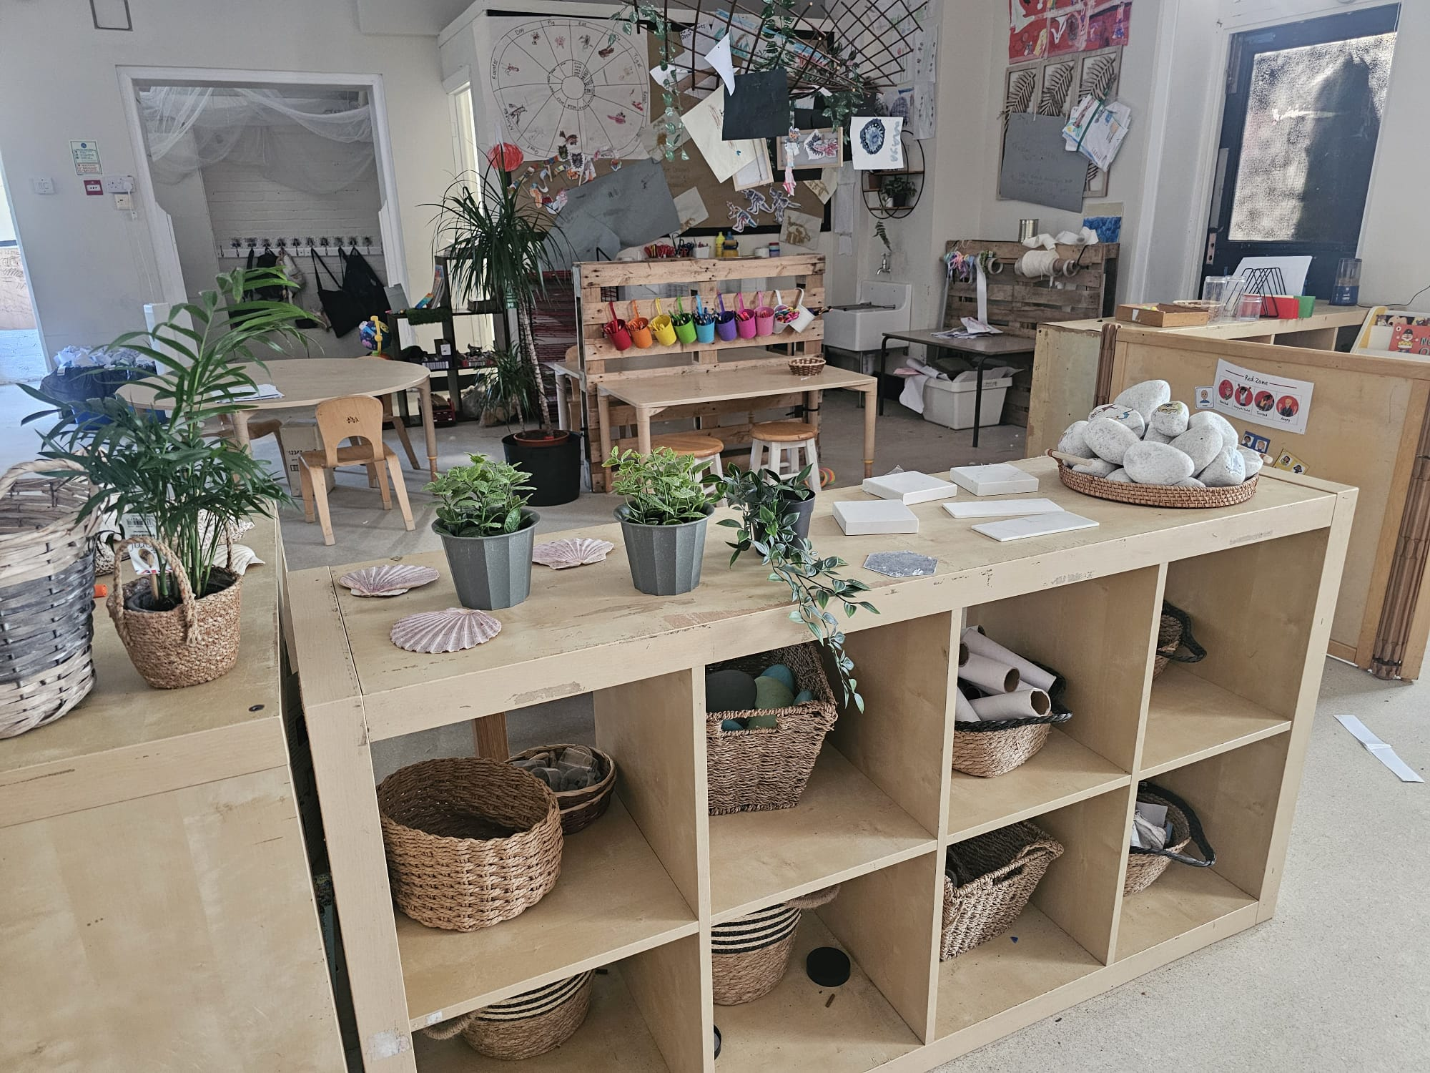
Playoneering Continued
The Playoneering approach helps children develop the skills they need to thrive both now and in the future, including:
• Curiosity and creativity
• Communication and language
• Independence and resilience
• Problem-solving and critical thinking
• Collaboration and teamwork
• Confidence and self-belief
At Wyborne, this approach does not stop at the end of Reception. Playoneering continues throughout Years 1 and 2, supporting a smooth transition from the Early Years Foundation Stage into the National Curriculum. Children continue to benefit from enquiry-led learning, purposeful play and rich learning environments, alongside increasingly structured teaching. Elements of the Playoneering approach remain evident in Year 3 and beyond, ensuring that creativity, curiosity and independence continue to be nurtured as children progress through school.
By valuing play as a powerful vehicle for learning, we nurture happy, engaged and motivated learners who are excited to discover the world around them.

Slide 13


Phonics and Reading
We follow a scheme call Little Wandle
Each term we will share what new learning will happen via WEDUC.
In the first term children learn initial sounds and letter formation.
Each letter and sound has a rhyme and mnemonic
At the end of each half term children are assessed and this informs what book children will read during guided reading sessions.
Children will read with a school adult a number of times a week.
Children will then have the Opportunity to practice the skills learnt at home.

Slide 14
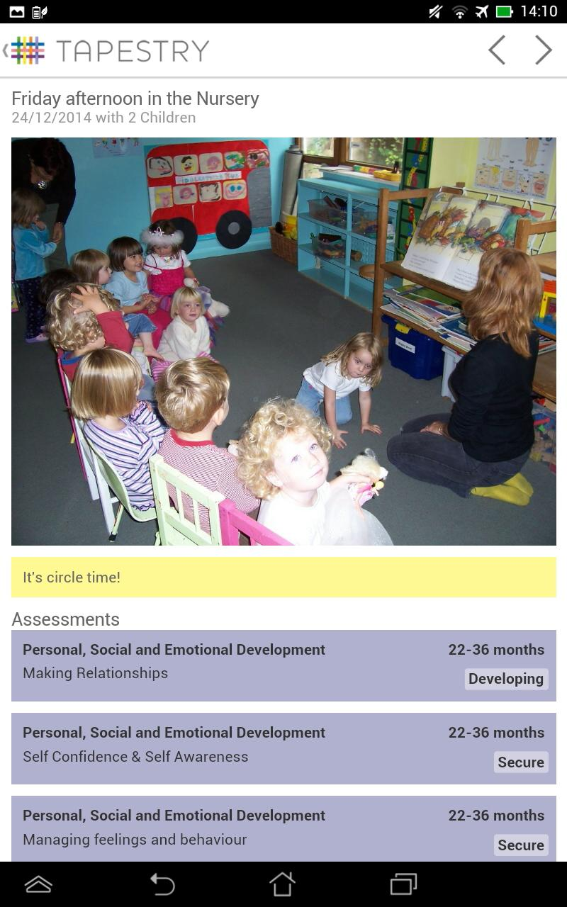

Tapestry
Tapestry is our Online Learning Journey
A communication tool to strengthen home/school relationships
It is a tool to share and evidence work and experiences at school and at home
In ‘app’ style, you can access from you mobile device or the Tapestry website, you’re given log in details, there’s only access for your child. You will be sent a joining email through the email you have supplied on your contact details so please make sure these are up to date
Opportunities to view photographs, videos, examples of work
Opportunities to make comments, share feedback about school and special occasions at home etc.
Tapestry is used to inform our assessments of your children through the observations we make.

Slide 15
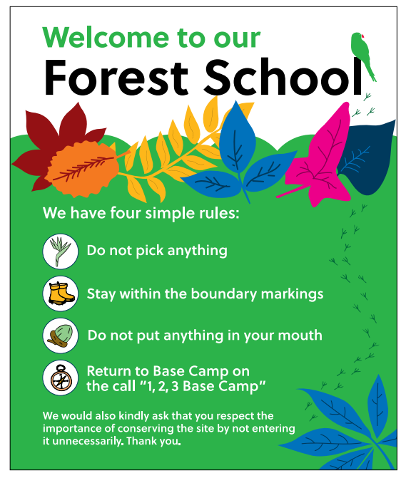
Forest School
Forest School will start after the October half term.
We have Forest School trained teachers and it is based at school.
Forest School is an opportunity for the children to holistically learn outside within a safe environment, learning to take risks e.g. climbing trees, playing with mud, problem solving, using tools and much more.
Teachers will notify you of the day Forest School is during your home visit. Children must wear (waterproof trousers and a waterproof jacket) in the new academic year and have arms and legs covered in all weathers.
Forest School will take place in ALL weathers, unless in the case of high winds for example, when branches can fall from the trees, your children's safety is paramount and they will stay in class.
Notes:
Marcel

Slide 16
High Expectations at Wyborne
We expect:
All pupils to behave well – we accept mistakes
Zero tolerance to all forms of bullying
All pupils to do their best at all times
All pupils to wear school uniform
All pupils to attend school every day, on time
All pupils to read regularly at home
All pupils to be inclusive and respectful of each other

Slide 17

Alpha Club
External Provider
Separate admissions
Before and after school provision
Notes:
James

Slide 18

Child Protection
Safeguarding – duty of care
DSL (Designated Safeguarding Leads) – Mr Searjeant, Ms Heath, Ms Tanner, Jane Davey, Mr Cook
Who is responsible? Everyone.
Social Services – reporting incidents
Collecting your child – forms and communicating with the office
Permission for children to be photographed – written exemption to be provided.
Notes:
James

Slide 19

Health and Safety
Minor accidents – logged/verbally communicated
Minor bump to head – phone call or text message and slip (please don’t be alarmed)
More serious injury – parent/carer telephoned
Even more serious injury – ambulance
Only prescribed medication can be administered with permission form completed.
Please ensure emergency contact details are up to date and you notify the school office when this changes.
Notes:
James

Slide 20

Attendance
Automated service – answer phone
Letters
Office staff will ring
Absenteeism monitored - 95% threshold
Holidays in school time – UNAUTHORISED – will have to arrange pre appointment with the headteacher – Royal Greenwich now fine
Avoid being late
Notes:
James

Slide 21

Lunchtime
Timings – routines established at the very beginning – Dining Centre
Reception lunch time is at 11:30 and the children also have a fruit snack in the afternoon in class.
School dinner -Choice of food menus
Allergies and specific dietry requirements communicated at the very beginning
Trays – cups
Toilets
Notes:
Marcel

Slide 22


Slide 23
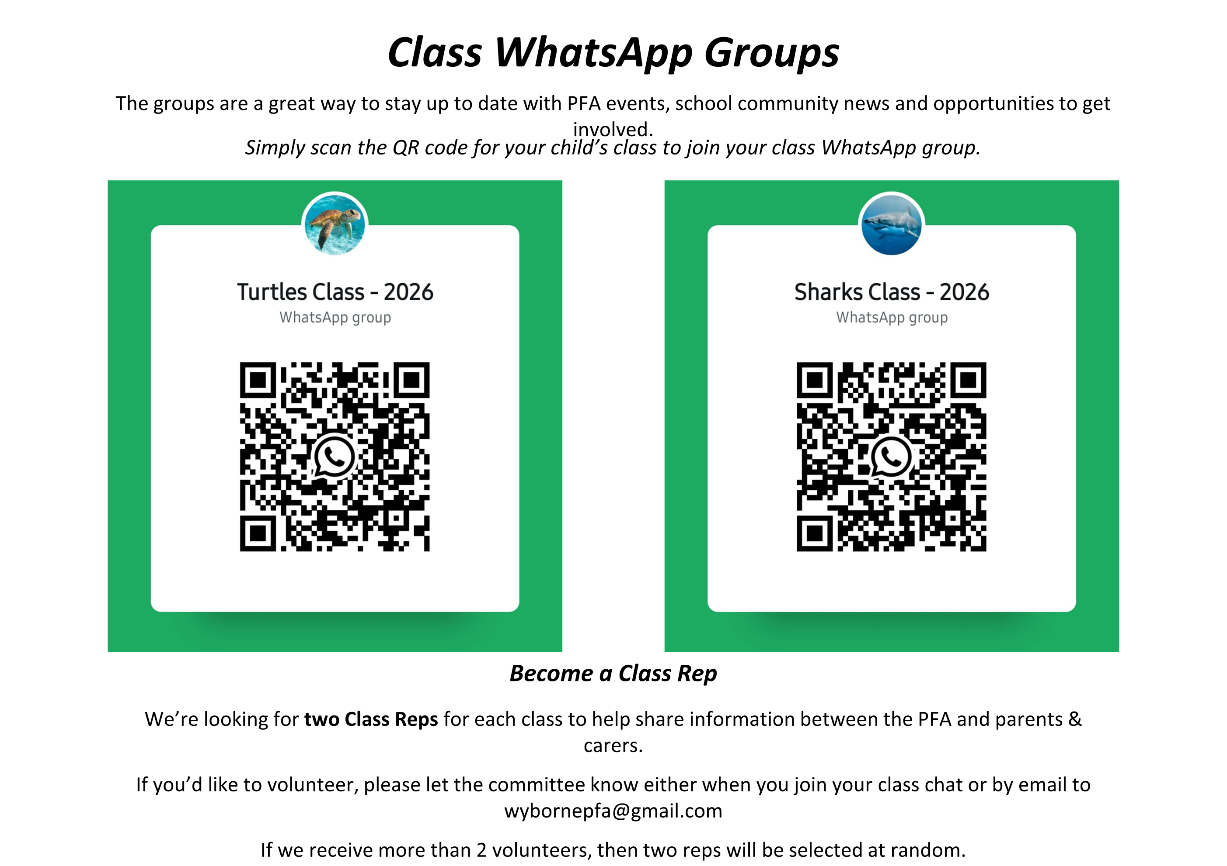

Slide 24
And other bits…
Parents and Friends – we need new recruits.
Please don't send children in with toys.
Headlice – hair tied back. When there is a case in your class you will be notified via WEDUC
Book Bags – brought in and taken home daily .
Named water bottle – brought in and taken home daily.
Regular contact with teacher or reception staff
Formal parent/carer conferences x2 per year.
Voluntary £1 weekly fund or donations biscuits, playdough ingredients, wet wipes etc.

Slide 25
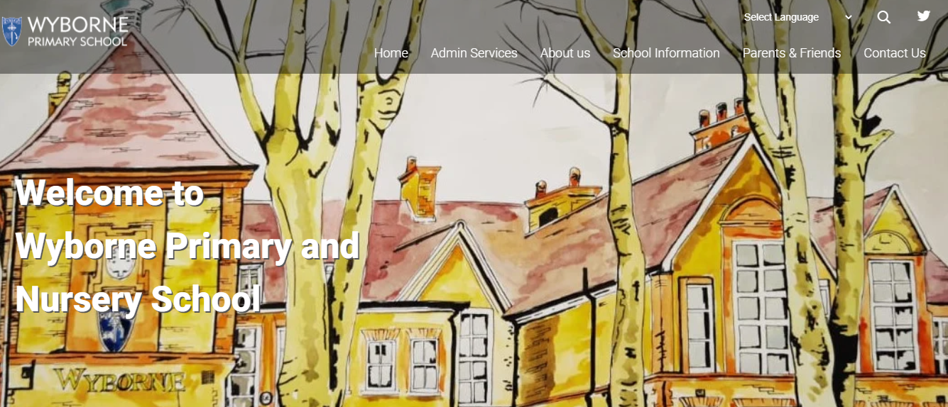
Thank you
Any questions?
This Presentation PowerPoint will be available on the website.

