Slide 1

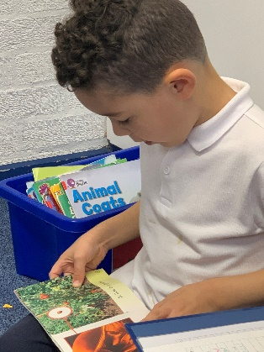
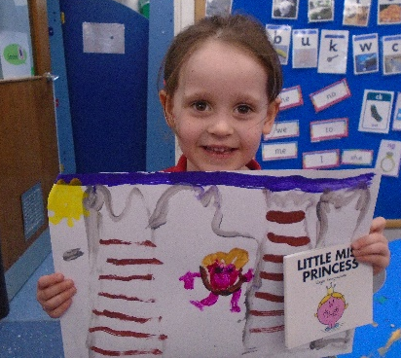
Reading
What?
Impact
Intent
We have consistent and robust teaching of early reading and synthetic phonics in Foundation Stage and KS1 so that pupils are able to read with increased speed and fluency and access the wider curriculum. Children are provided with books that match their current phonics development and reading ability. All pupils have opportunities to develop their reading skills daily and are encouraged to read at home with an adult. We provide a text rich environment in order to develop skills and competence. We aim for children to:
Read accurately fluently and with understanding across a range of subjects.
Read with expression, clarity and confidence
Develop a good linguistic knowledge of vocabulary and grammar
Read and respond to a wide range of text types
Develop a deeper level of emotional intelligence and empathy
Children are taught explicit synthetic phonics lesson daily in EYFS and KS1.
Our consistently high results in the year 1 phonics screen reflect this successful approach. Our results have been above the national standard for several years. In 2019 and 2020, 93.3% of our children achieved the expected standard.
Children are supported to choose books to take home. In KS1 And EYFS, these are consistent with their phonics ability
This provides children with the opportunity to consolidate prior learning, practice new learning and build independence. Our children enjoy reading
Children are explicity taught VIPERS. (vocabulary, inference, prediction,explanation, retrieval and sequencing) to enhance comprehension
Our children have good comprehension skills and can identify and talk about the key skills for comprehension. In 2019 80.9% of our children achieved the expected standard or above in Reading (38.5% above the expected standard)
Queniborough CE Primary School

